Slide 1
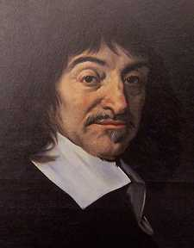
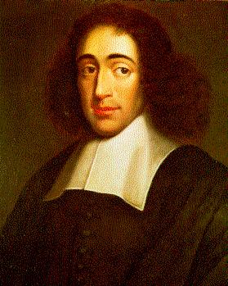
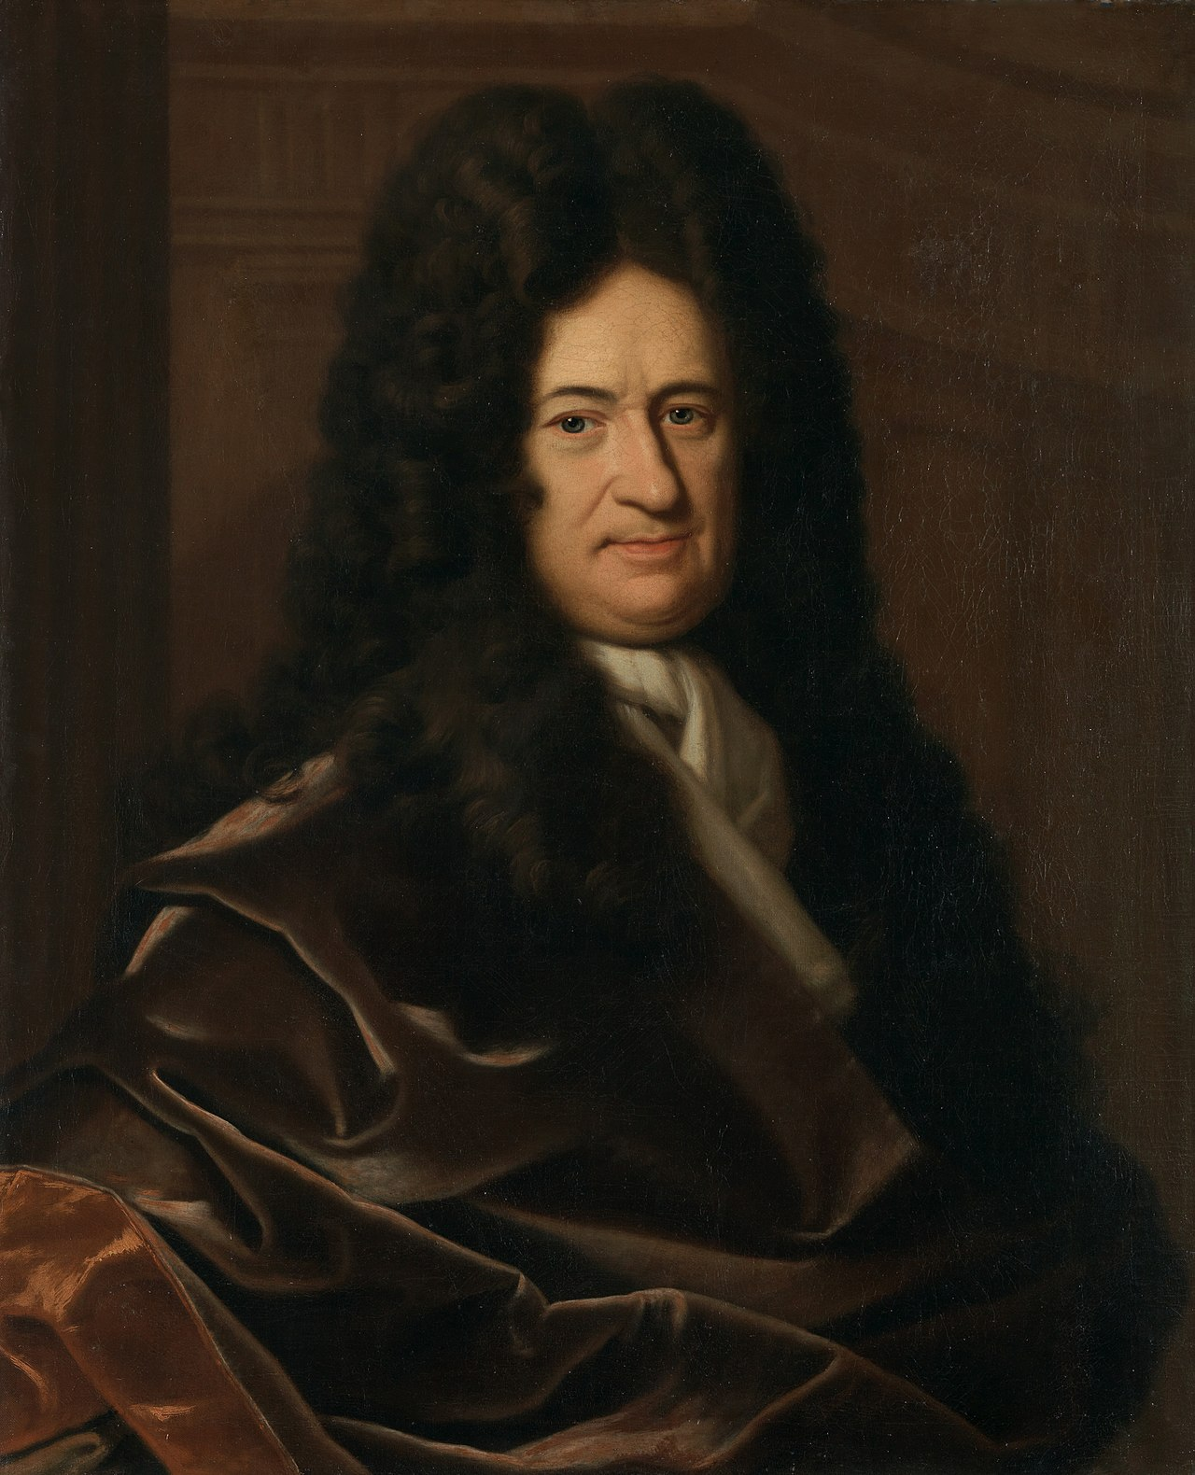
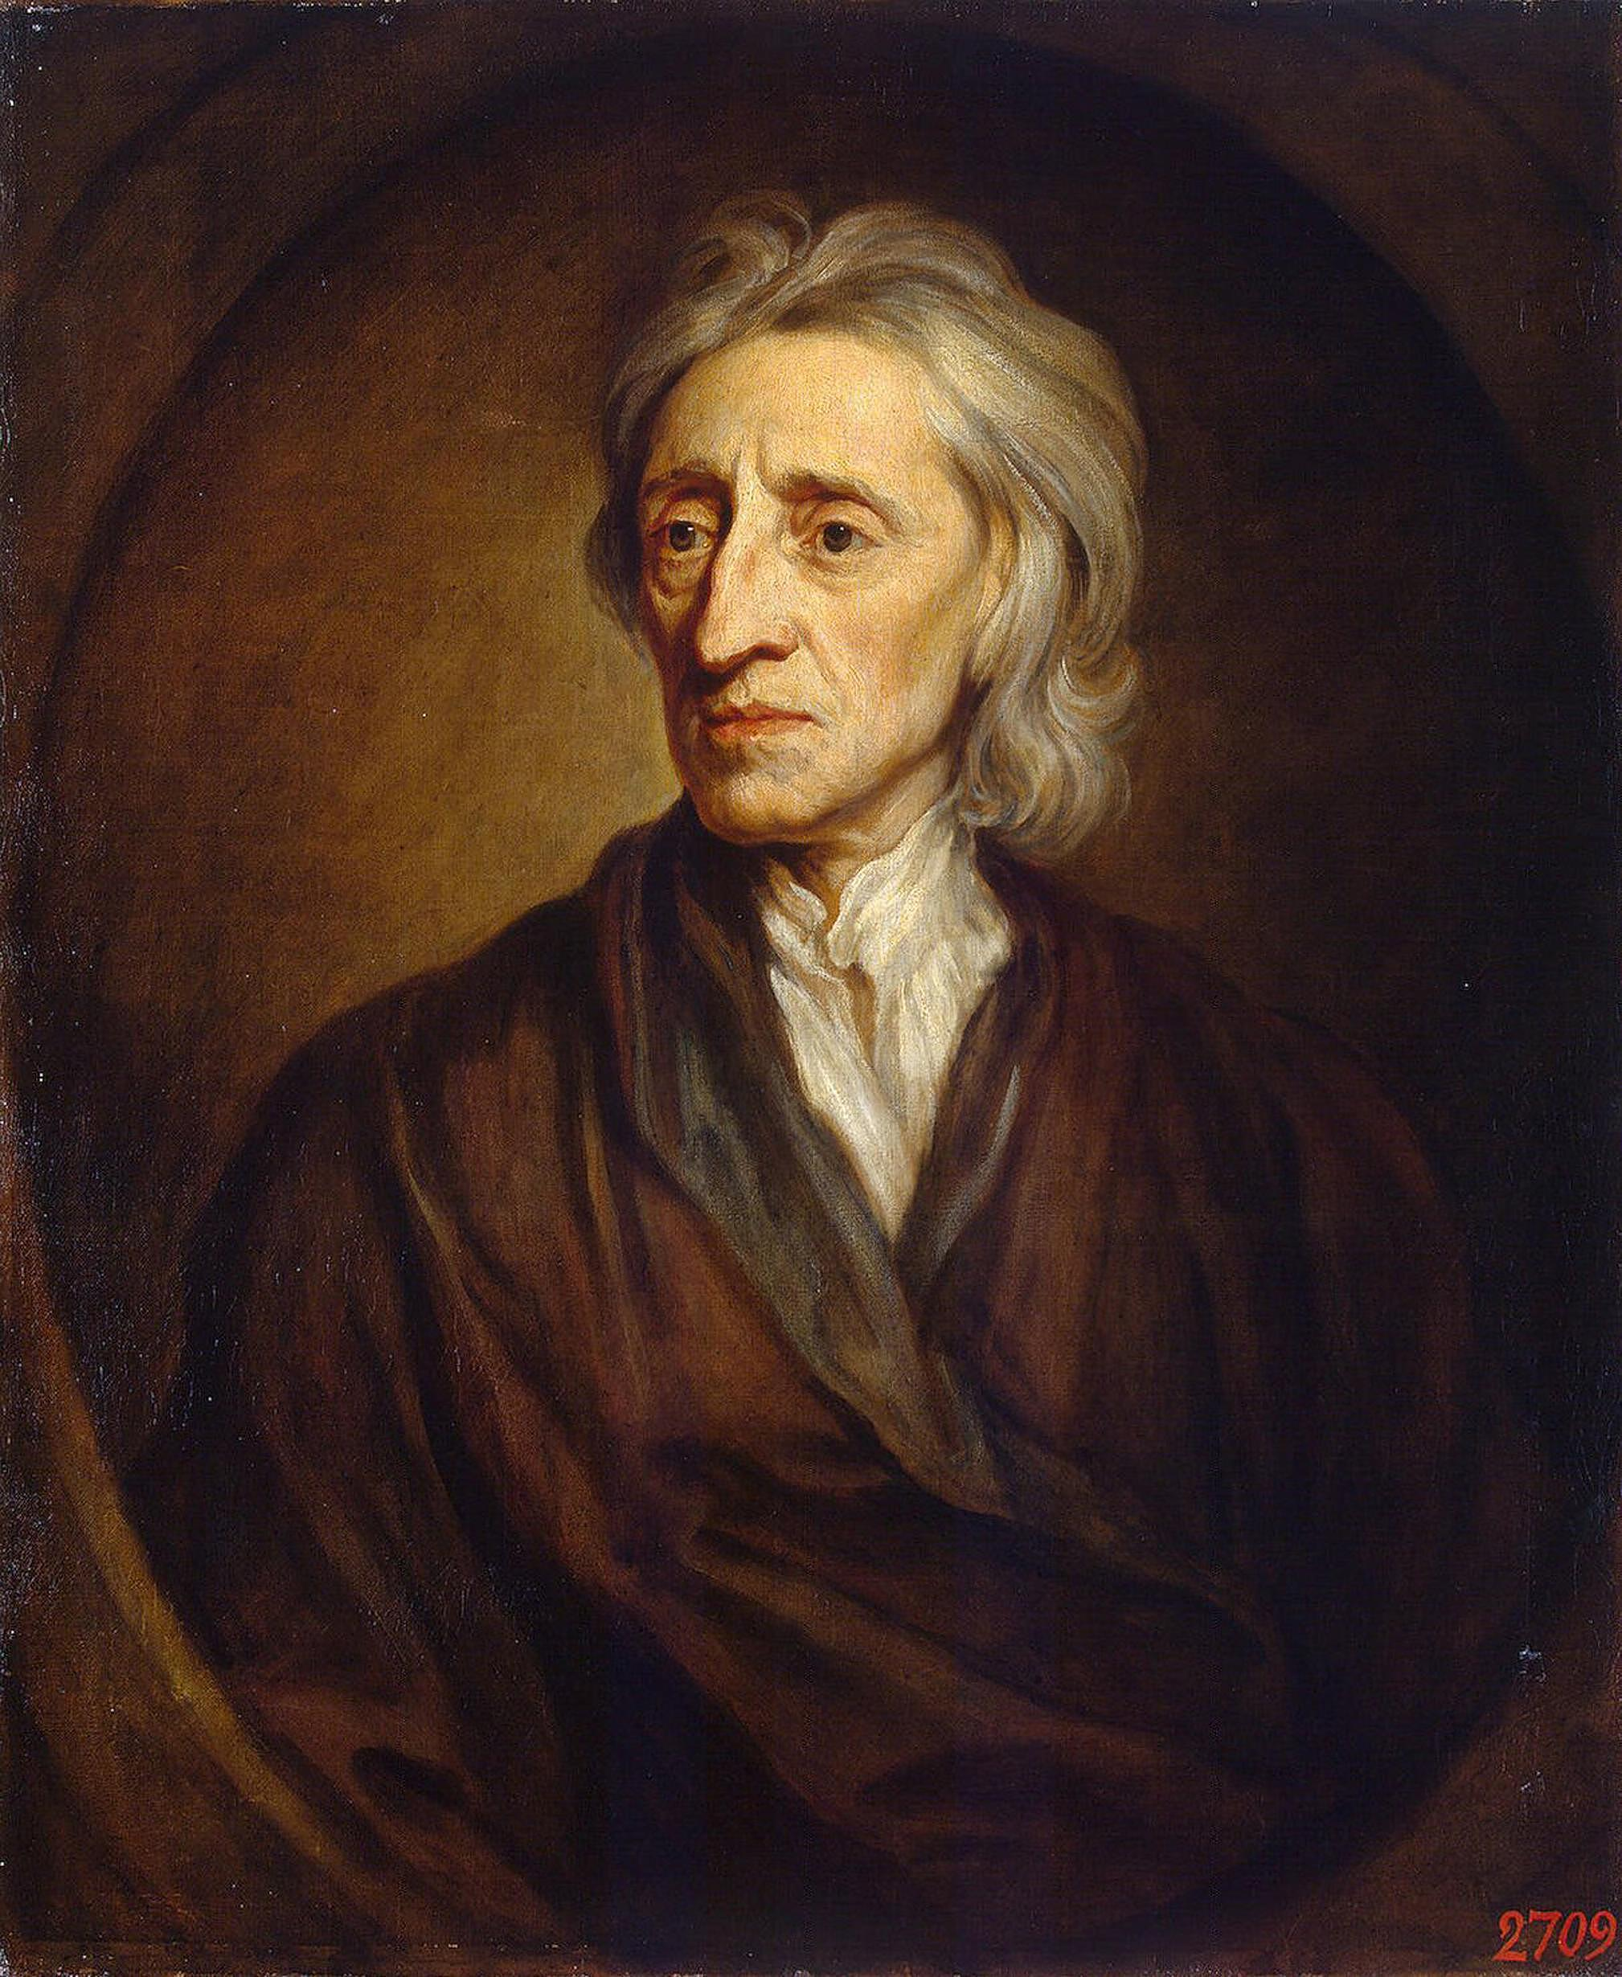
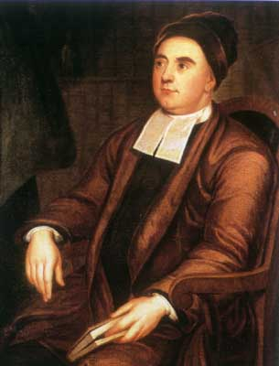
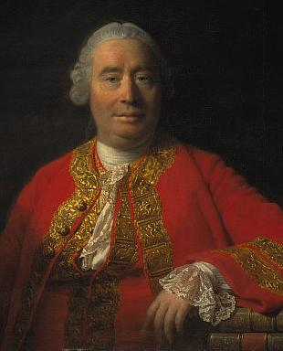
Modern Philosophy
Rationalism
Knowledge comes from Pure Reason
Empiricism
Knowledge comes from the Senses
René
Descartes (1596–1650)
France
Baruch
Spinoza
(1632–1677)
The Netherlands
Gottfried Leibniz (1646–1716)
Germany
John
Locke
(1632-1704)
England
George
Berkeley
(1685-1753)
Ireland
David
Hume
(1711-1776)
Scotland

Slide 2
The Epistemological Problem
How do I know anything else exists outside my mind?
Solipsism:
only one’s own mind exists
Am I alone in the Universe?
Is the Universe just my mind?

Slide 3
Am I imprisoned
in my mind?

Slide 4
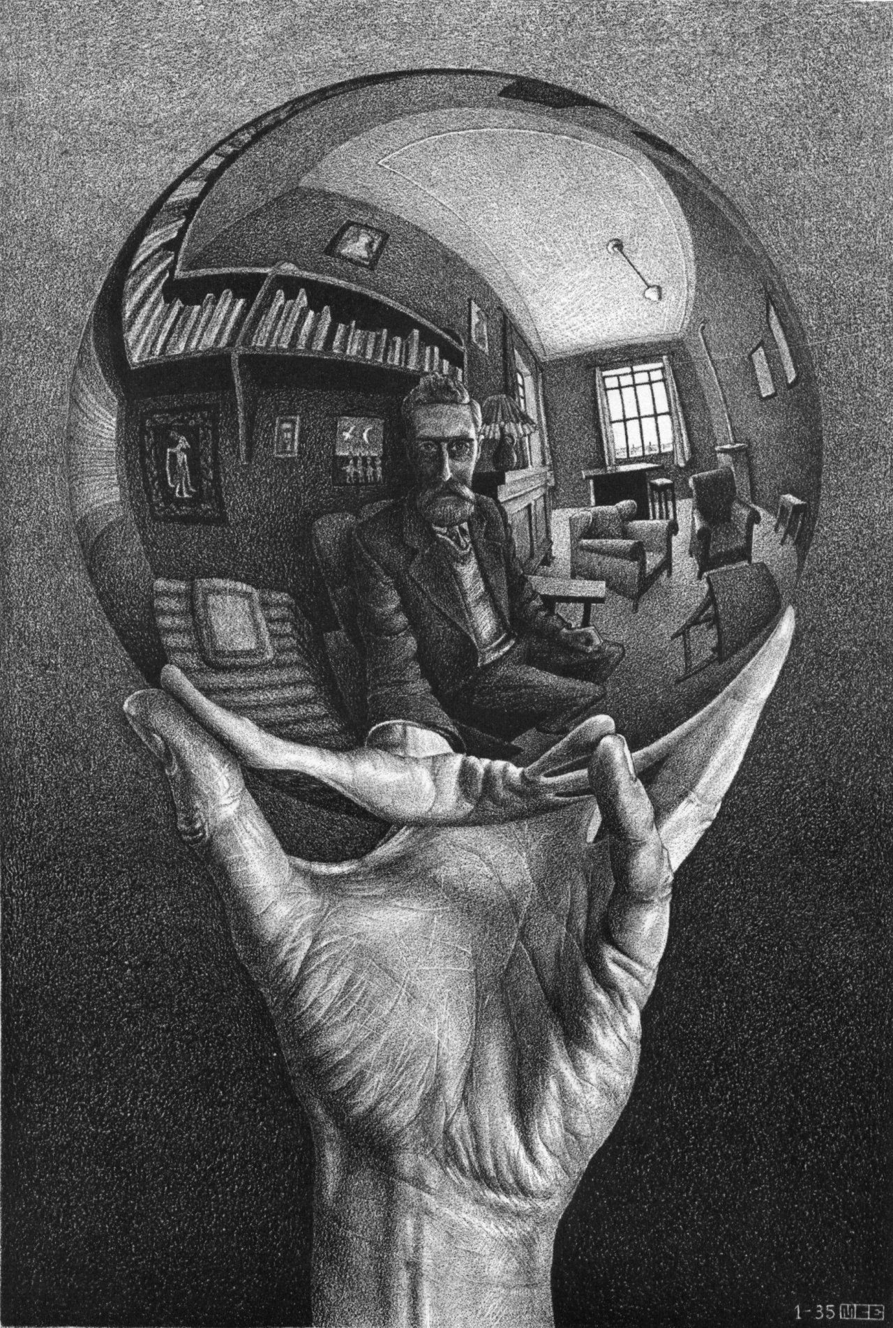
Mind as a Mirror of Nature
Mind
Thinking Substance
Ideas in Mind Reflect Reality
Nature/Reality as it is in-itself
Extended Substance

Slide 5
God
myself
Rationalism:
Trust only reason, not the senses.
Tried to solve epistemological problem by examining the ideas already in the mind from birth—innate ideas.
Descartes examines the idea of God.
If God is not a deceiver, I should be able to trust the clear and distinct ideas.
other people
my hands
red

Slide 6
Empiricism
Begins with Locke’s assertion that there are no innate ideas.
The mind at birth is a tabula rasa—a blank slate.
All ideas get into the mind through sensation.
All ideas come from sensation or reflection on the ideas we get from sensation.

Slide 7
Locke’s Empiricism
Qualities in Bodies
Ideas in the Mind
Simple ideas: red
Primary Qualities:
solidity, extension, figure, and mobility
Secondary Qualities
colours, sounds, tastes, &c.
Complex ideas: Red Apple

Slide 8
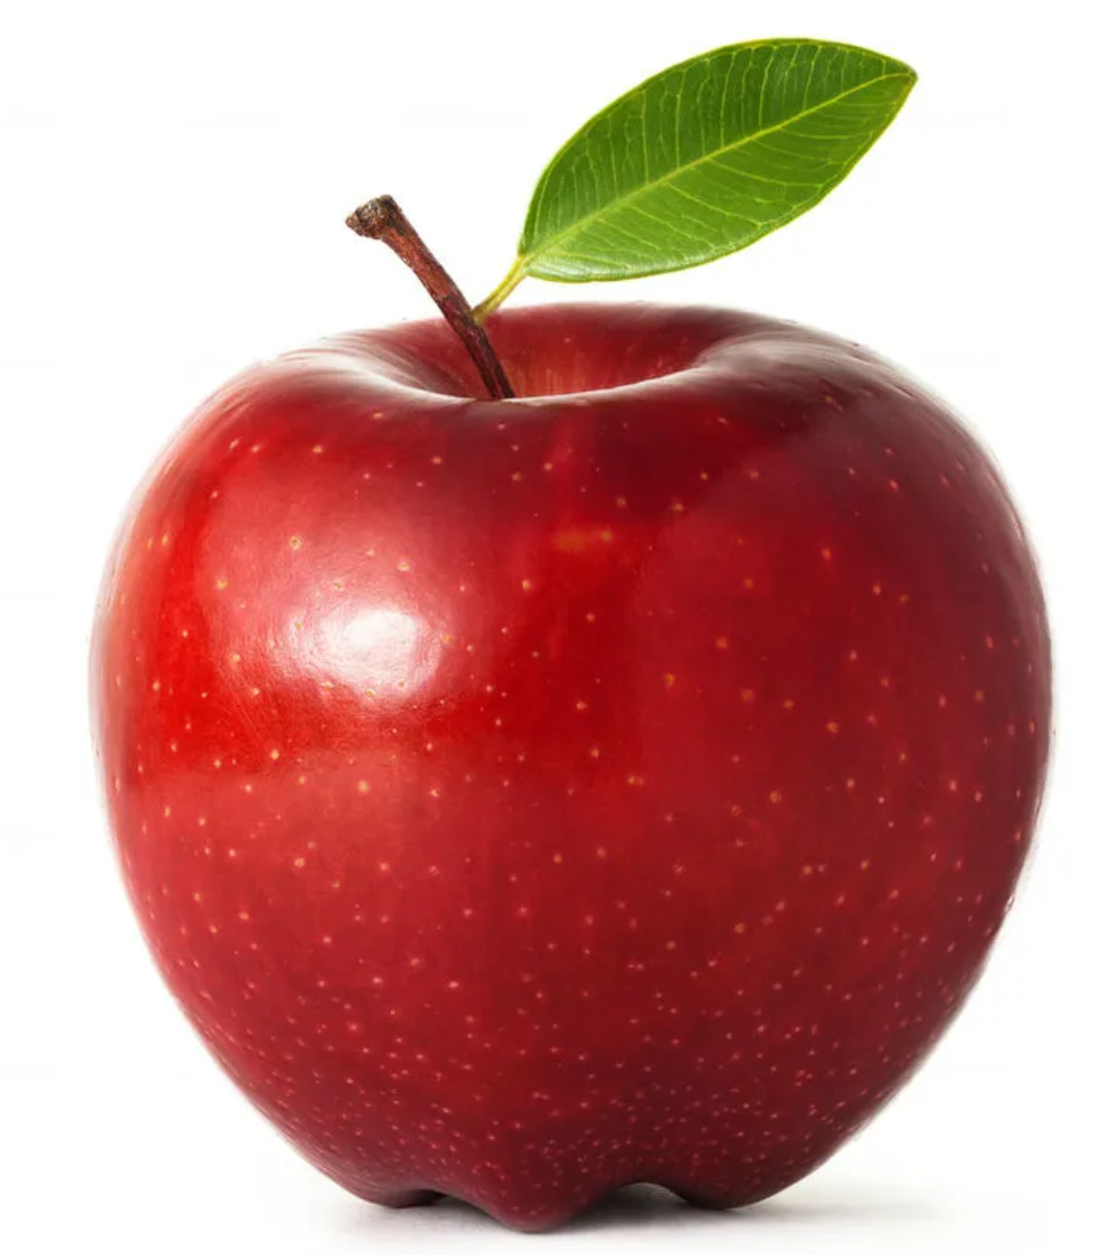
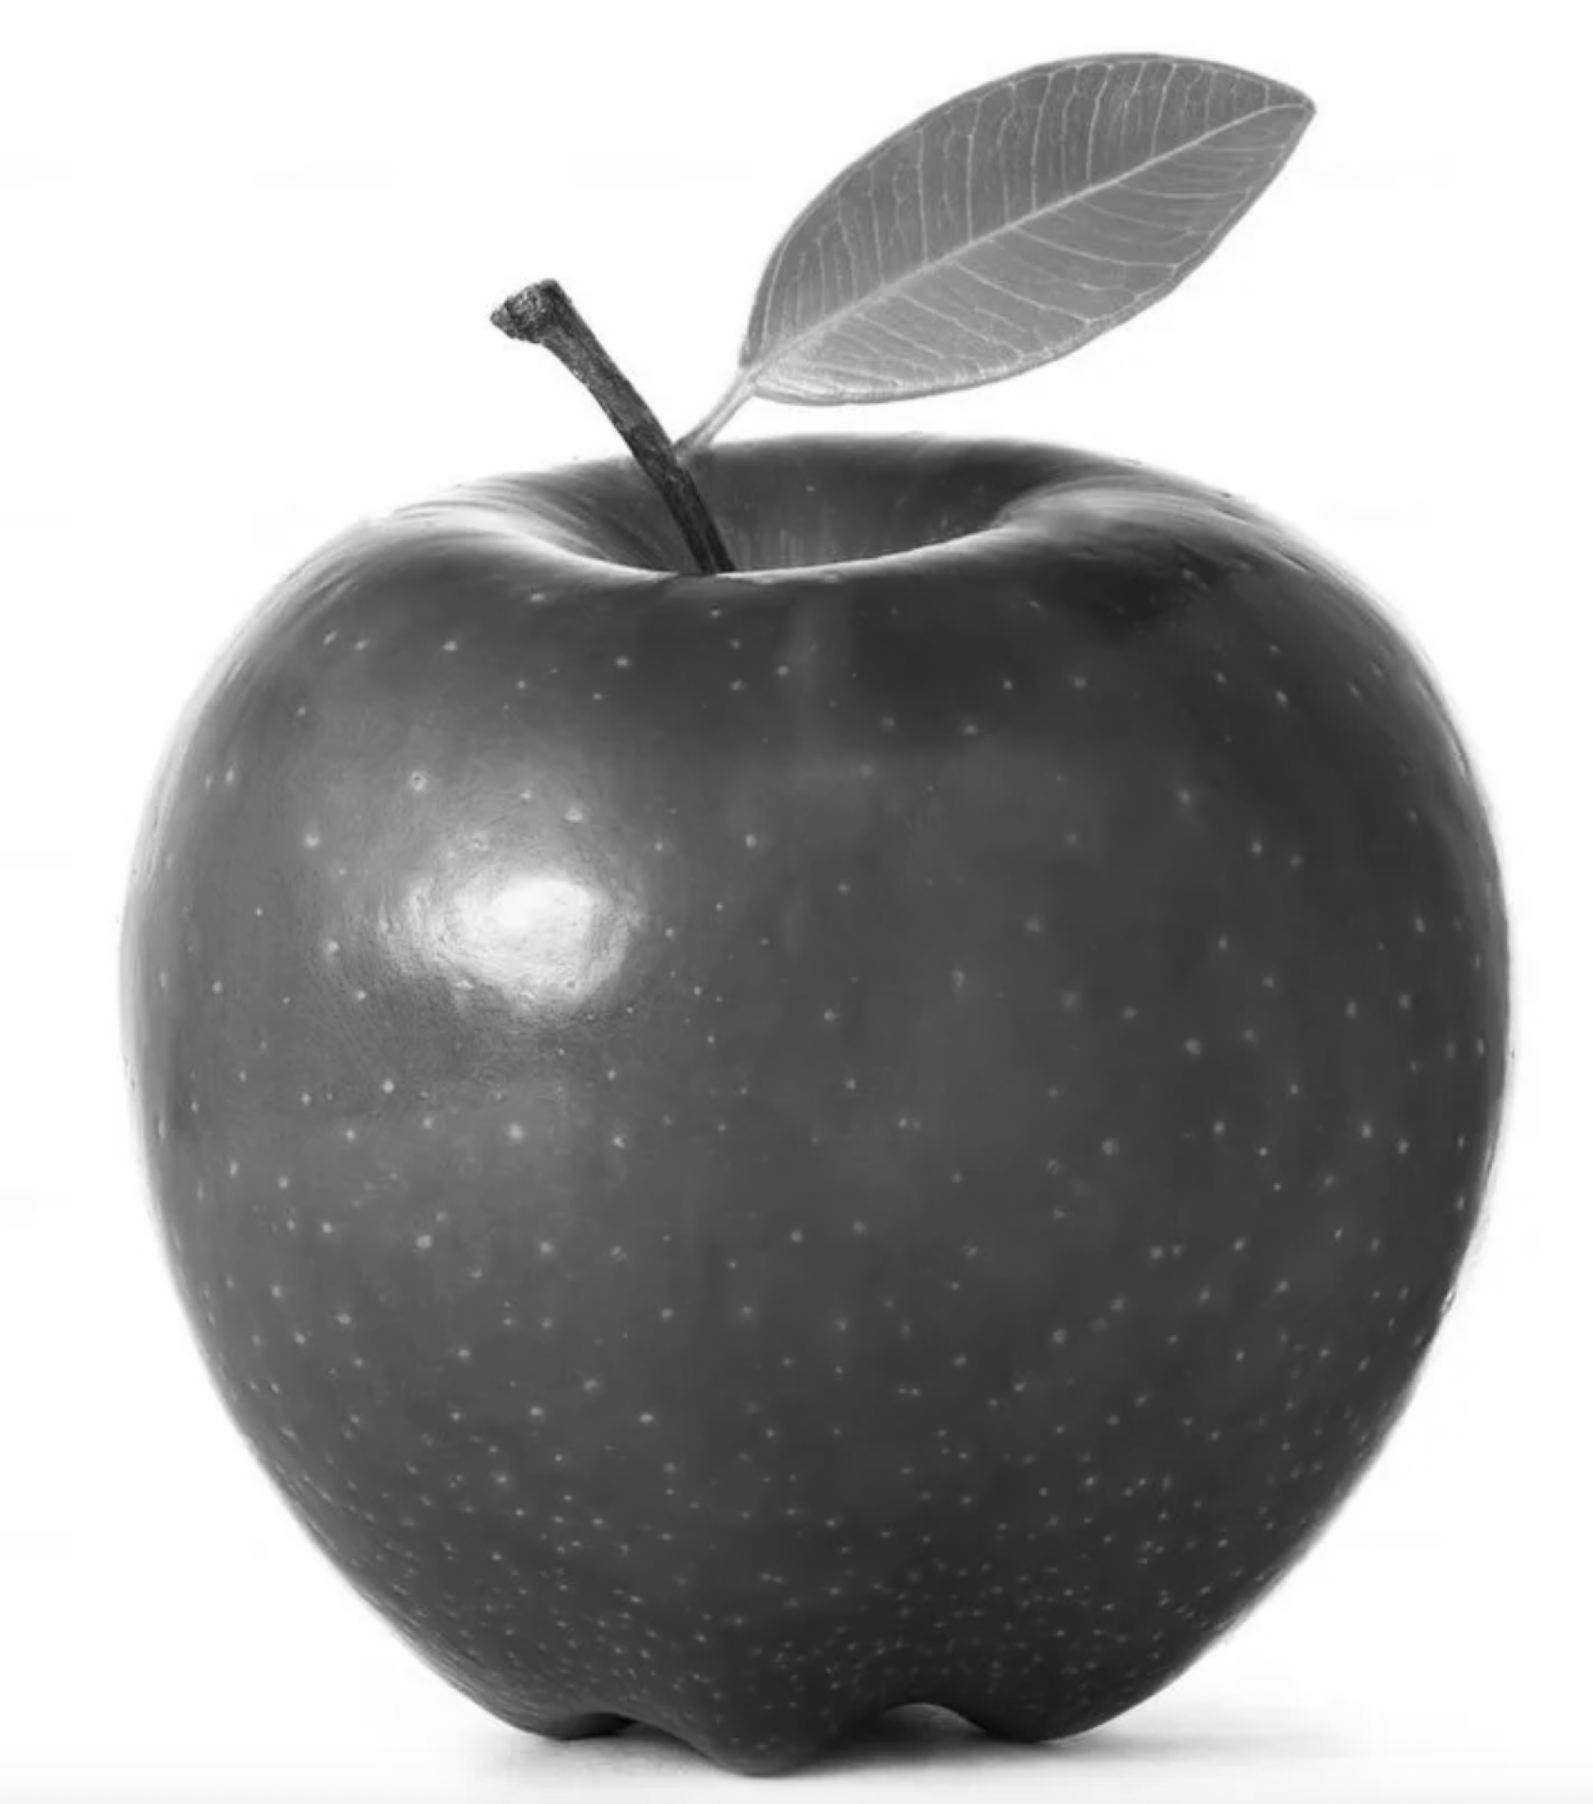
Locke’s Empiricism
Qualities in Bodies
Ideas in the Mind
Primary Qualities:
solidity, extension, figure, and mobility
Secondary Qualities
colours, sounds, tastes, &c.
Ideas of primary Qualities are Resemblances; of secondary, not. —From whence I think it easy to draw this observation,—that the ideas of primary qualities of bodies are resemblances of them, and their patterns do really exist in the bodies themselves, but the ideas produced in us by these secondary qualities have no resemblance of them at all.

Slide 9
Hume’s Fork All knowledge statements are of two kinds:
Relations of Ideas
True by definition
Certain truths
A priori truths
(No sense evidence needed)
All bachelors are unmarried men.
Matters of Fact
Not true by definition
Contingent (probable) truths
A posteriori truths
(require sense evidence)
All Swans are white

Slide 10
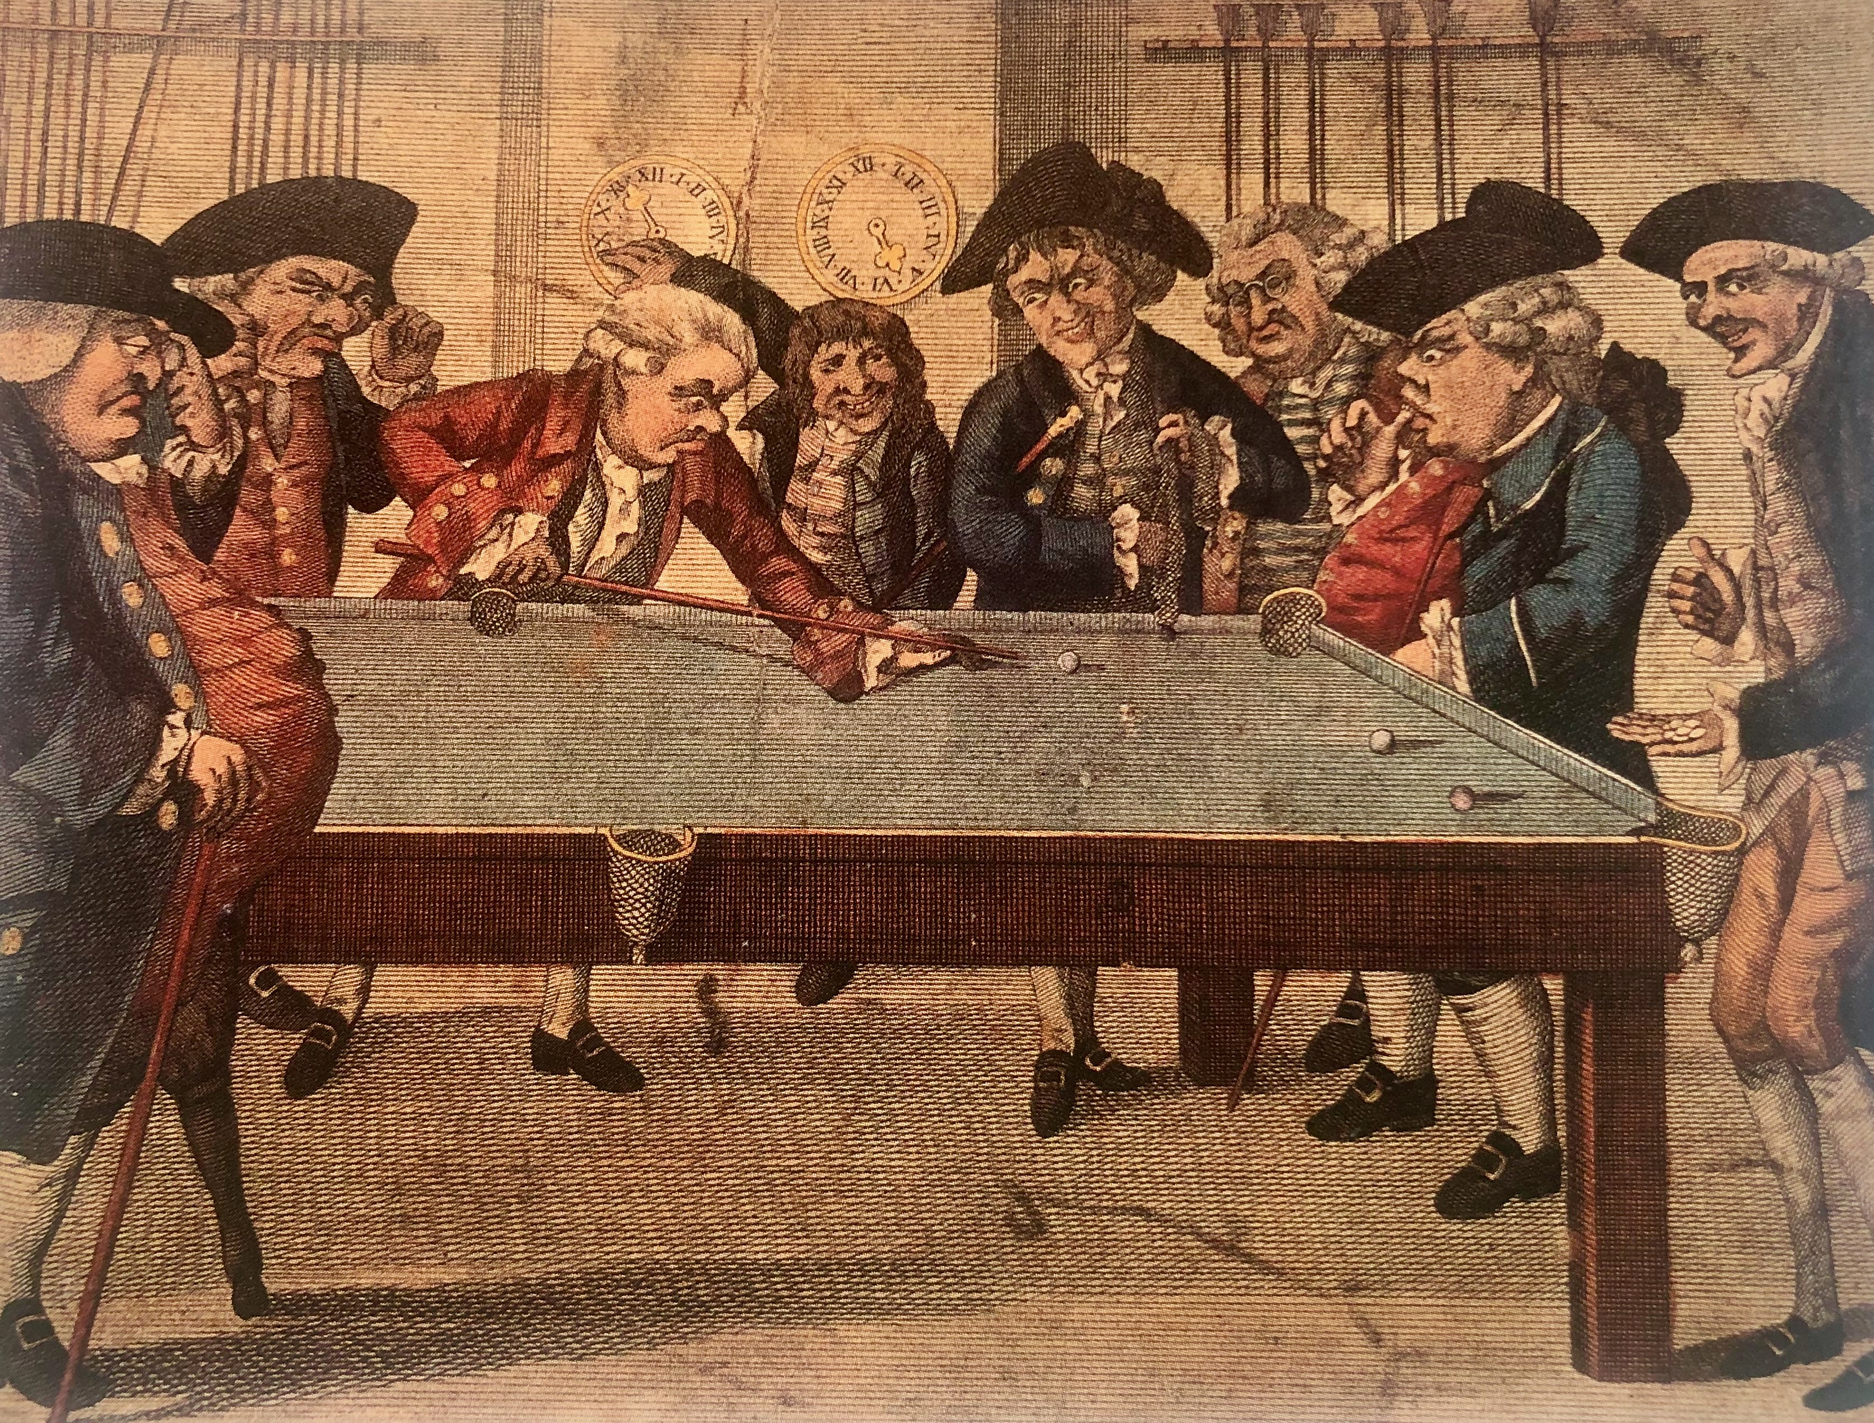
Hume’s Analysis of Causality All cause and effect statements are matter of fact statements thus require sense evidence What four things would you need sense evidence for in order to prove that event A was the cause of event B?

Slide 11
Hume’s Analysis of Causality All cause and effect statements are matter of fact statements thus require sense evidence What four things would you need sense evidence for in order to prove that event A was the cause of event B? 1. Temporal Priority (A happens then B happens)

Slide 12
Hume’s Analysis of Causality All cause and effect statements are matter of fact statements thus require sense evidence What four things would you need sense evidence for in order to prove that event A was the cause of event B? 1. Temporal Priority (A happens then B happens) 2. Spatial contiguity (There is a spatial connection between event A and event B)

Slide 13
Hume’s Analysis of Causality All cause and effect statements are matter of fact statements thus require sense evidence What four things would you need sense evidence for in order to prove that event A was the cause of event B? 1. Temporal Priority (A happens then B happens) 2. Spatial contiguity (There is a spatial connection between event A and event B) 3. Constant Conjunction (would have to see it many times)

Slide 14
Hume’s Analysis of Causality All cause and effect statements are matter of fact statements thus require sense evidence What four things would you need sense evidence for in order to prove that event A was the cause of event B? 1. Temporal Priority (A happens then B happens) 2. Spatial contiguity (There is a spatial connection between event A and event B) 3. Constant Conjunction (would have to see it many times) 4. Necessary connection (the next time that A happens, B will happen)

