Slide 1
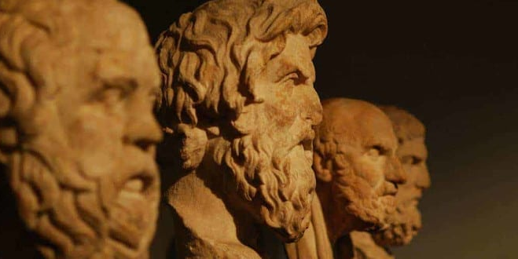
Early Greek Philosophy
The Pre-Socratics and the Sophists

Slide 2
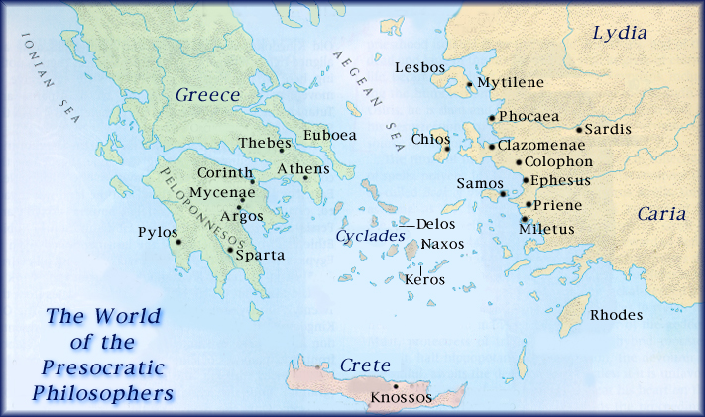

Slide 3
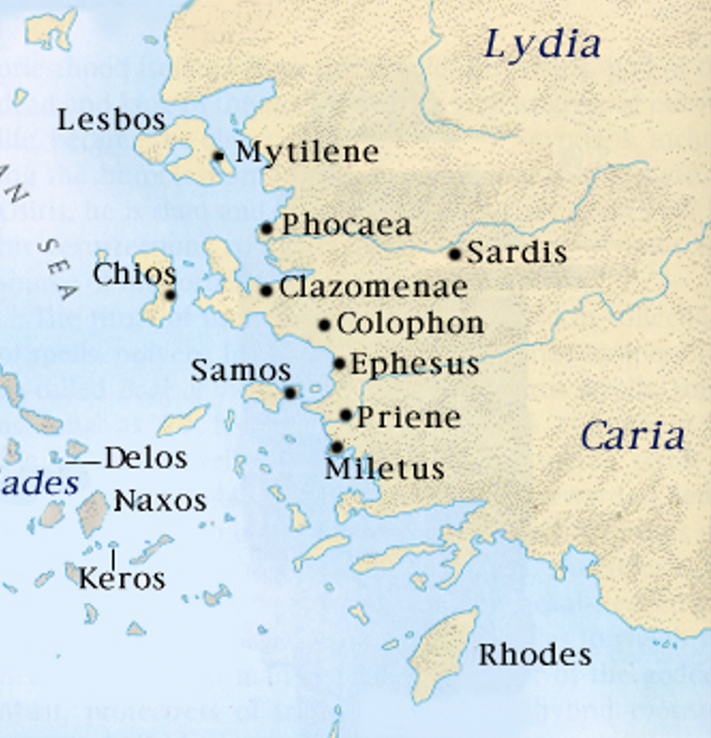
The Milesians
These philosophers are so named because they lived in the Ionian city of Miletus, situated in the eastern part of the Greek world on the coast of Asia Minor. These thinkers rejected the mythological and religious tradition of their ancestors and sought a naturalistic and universal explanation of existence. They shared a tendency to look for a single substance as the source of everything.

Slide 4
Arché (ἀρχή): The One behind the Many
The term "Presocratic" is commonly used to refer to those early Greek thinkers who lived before the time of Socrates from approximately 600 to 400 B.C. These thinkers attempted to find the arché (ἀρχή), the origin, or ultimate source of the whole of everything. The assumption they all shared is that there must be one origin of the universe. Thus, the first philosophical problem can perhaps be stated as the question, “What is the One behind the Many?” When we look upon the world and observe things with our senses, we see a multitude of different kinds of things. These early thinkers began to think that there must be some one thing, one substance, or perhaps one process, that underlies all the changing, multifarious things we see with the senses. Each of these early philosophers came up with a different answer to this fundamental first question. Is this question still asked today, do people still seek a One behind the Many?

Slide 5
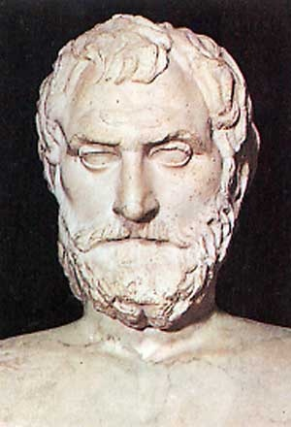
Thales (c. 640-546 B.C.)
Often considered the "first" philosopher. He is known for this famous statement, which affirms both a single unifying primary substance as well as a divine omnipresence: "All is water, and the world is full of gods." He is perhaps the first philosopher because we see in this single fragment attributed to him by ancient writers a transition from mythos to logos, from an earlier mythic mode of thought to the beginnings of an attempt to provide a naturalistic explanation for the world based on sense observation. He is also said to have said that “the earth is a disc floating on water.” What possible observations could have led Thales to the view that the One behind the Many is water, and that the earth is a disc floating on water?

Slide 6
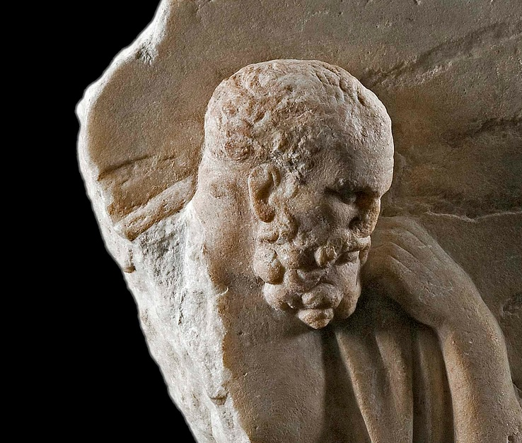
Anaximander (c. 611-547 B.C.)
Anaximander saw the world as a struggle of opposites, hot and cold, wet and dry. Since water puts out fire, he reasoned it could not be the source of fire, and thus not the primary source. Anaximander is notable for being the first to consider the primary substance as imperceptible. He called the primary substance or ultimate reality the apeiron, the "infinite" or "indefinite."

Slide 7
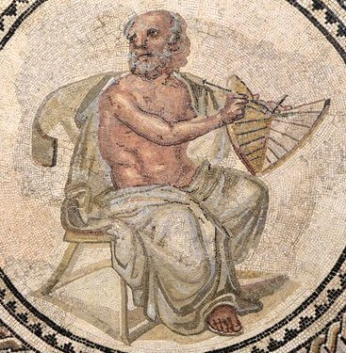
Anaximenes (c. 585-528 B.C.)
Anaximenes thought of the basic substance as "air." Through completely natural processes of condensation and rarefaction everything separated out into its form from Air."Just as our soul, which is air, integrates us, so breath and air surround the whole cosmos."

Slide 8
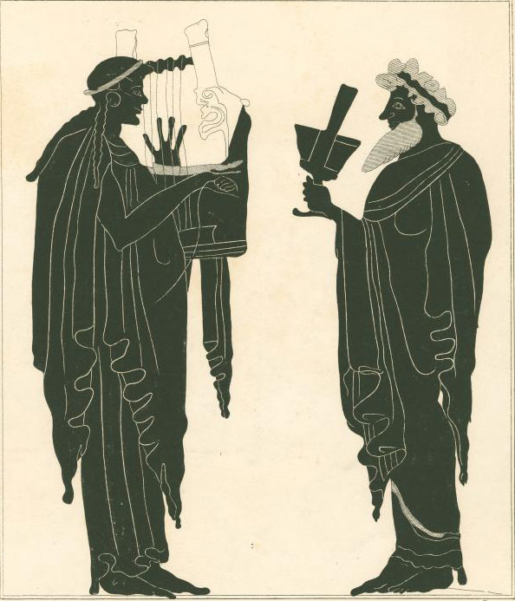
Mythos to Logos
Much like Homer these earliest philosophers perceived nature and divinity as yet intertwined. They also maintained something of the old Homeric sense of a moral order governing the cosmos, an impersonal fate that preserved the world's equilibrium amidst all its changes.
But the decisive step had been taken. The Greek mind now strove to discover a natural explanation for the cosmos by means of observation and reasoning, and these explanations soon began to shed their residual mythological components. Ultimate, universal questions were being asked, and answers were being sought from a new quarter—the human mind's critical analysis of material phenomenon. Nature was to be explained in terms of nature itself, not of something fundamentally beyond nature, and in impersonal terms rather than by means of personal gods and goddesses. The primitive universe ruled by anthropomorphic deities began to give way to a world whose source and substance was a primary natural element such as water, air, or fire. In time, these primary substances would cease to be endowed with divinity or intelligence and would instead be understood as purely material entities mechanically moved by chance or blind necessity. But already a rudimentary intelligence grew stronger, the sovereign power of the old gods grew weak.

Slide 9
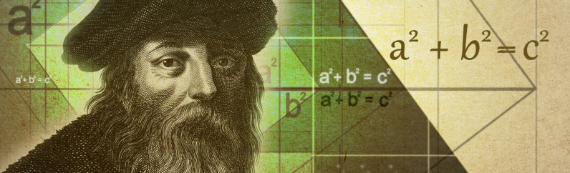
Pythagoras (c. 582-c.507 B.C.)
Established a school of philosophy which lasted 400 years that was dedicated to a kind of mathematical contemplation of the universe. Pythagoras held that “all things are numbers.” this might seem absurd at first, but what Pythagoras meant is that the universe could be understood in terms of numbers. A correct description of reality could then be given in terms of mathematical formulas. Pythagoras was also the leader of a religious cult that practiced asceticism, numerology, and vegetarianism. Pythagoras also is important because of his belief in the immortality of the soul. For both his belief in the importance of mathematics and for his belief in the immortality of the soul Pythagoras had a profound impact upon Plato.

Slide 10
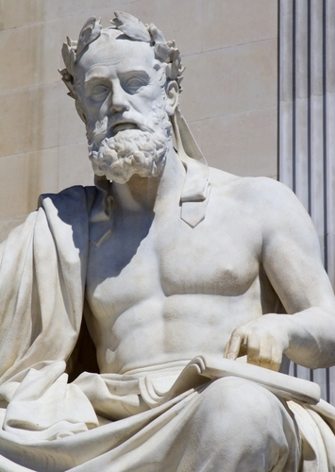
Xenophanes
“One of the more attractive of the pre-Socratic philosophers is Xenophanes, who flourished in the latter part of the 6th century BC. […] He seems to have understood in a rather deep way that human views of things are human creations, including what we take to be our knowledge. By learning more and more, and changing our ideas in the light of what we learn, we may get nearer and nearer to the truth, but our ideas remain always ours, and there is always an element of guesswork involved. […] Xenophanes was shrewd, indeed witty, on the subject of the gods:
The Ethiops say that their gods are flat-nosed and black.
While the Thracians say that theirs have blue eyes and red hair:
Yet if cattle or horses or lions had hands and could draw
And could sculpture like men, the the horses would draw their gods
Like horses, and cattle like cattle, and each would then shape
Bodies of their gods in the likeness, each kind, of its own.
(Magee 2001, 16)

Slide 11
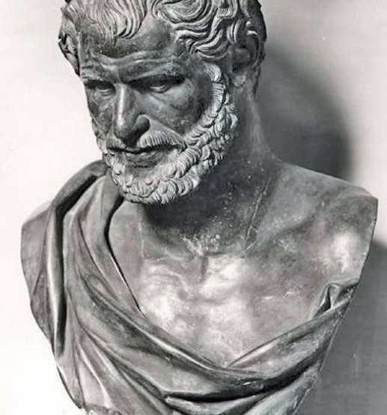
Heraclitus (c. 535-475 B.C.)
A Greek nobleman from Ephesus who proposed another candidate as the basic element: fire. Heraclitus was not simply proposing an alternative to Thales’ water and Anaximenes's air. He wished to call attention to what he thought was the essential feature of reality, namely, that it is ceaselessly changing. He is known for the epigramic sayings "You can't step in the same river twice" and "Everything changes but change itself." There is no reality, he maintained, save the reality of change; permanence is an illusion. Thus fire, whose nature it is to ceaselessly change, is the root substance of the universe.
Heraclitus, however, did not believe that the process of change is random or haphazard. Instead, he saw all change as determined by a cosmic order that he called the logos, which is Greek for "word." This logos he thought of as an unobservable order or "logic" which governed change, made the process of change a rational phenomenon.

Slide 12
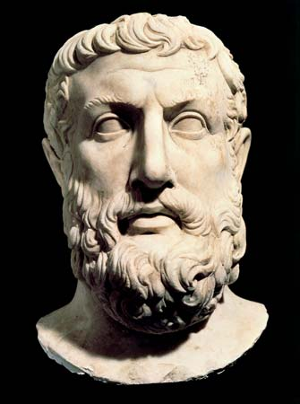
Parmenides (fifth century B.C.)
Parmenides takes the next step in this philosophical revolution. Unlike the Milesians, Heraclitus, and Pythagoras, who probably reached their conclusions by observation of the world around them, Parmenides approached the problem of the real by means of a purely abstract rational logic. As with the early Ionians, Parmenides' thought possessed a peculiar combination of traditional religious and novel secular elements. From what he described as a divine revelation emerged his achievement of an unprecedentedly rigorous deductive logic. In their search for simplicity in explaining nature, the Ionian philosophers had stated that the world was one thing, but had become many. But in Parmenides' early struggle with language and logic, "to be" something made it impossible for it to change into something it is not, for what “is not” cannot be said to exist at all. Similarly, he argued that "what is" can never have come into being or pass away, since something cannot come from nothing or turn into nothing if nothing cannot exist at all. Things cannot be as they appear to the senses: the familiar world of change, motion, and multiplicity must be mere opinion, for the true reality by logical necessity is changeless and unitary.

Slide 13
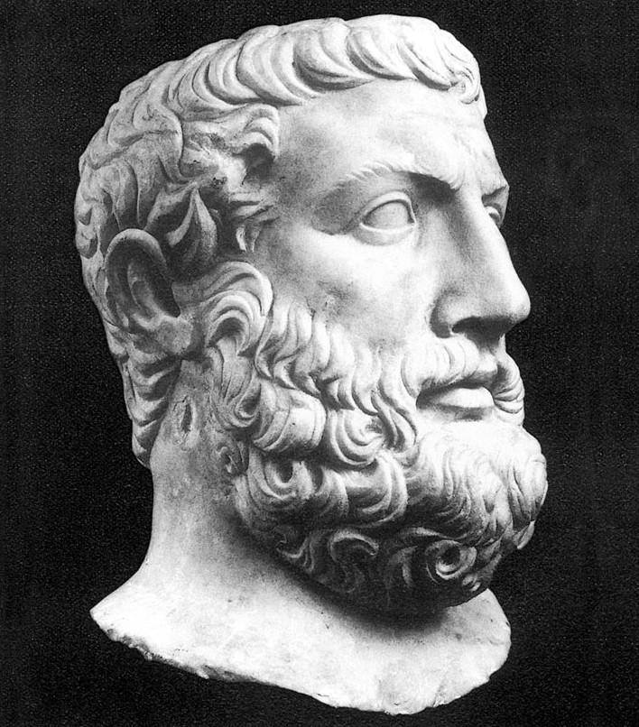
Parmenides Rationalism: Knowledge comes from Reason and not the Senses
Parmenides is an example of a rationalist. Rather than relying on the testimony of his senses, he assumed some very basic principles and attempted to deduce from these what he thought must be the true nature of being. These "principles of reason" or a priori principles, are known "prior" to experience, that is, our knowledge of them does not depend on our senses.
“Parmenides considered it self-contradictory to say of nothing that it exists. There can never, he thought, have been nothing, and therefore it cannot be true to say that everything—or indeed, anything—came out of nothing. Everything must already have existed. For a similar reason it is not possible for anything to pass into nothing. Therefore not only must everything be beginningless and uncreated, it must also be eternal and imperishable. For similar reasons, too, there cannot be any gaps in reality, parts of reality where nothing is: reality must be continuous with itself at all points; all of space must be full, a plenum. This gives rise to a view of the universe being really a single unchanging entity. All is one.” (Magee 2001, 17)

Slide 14
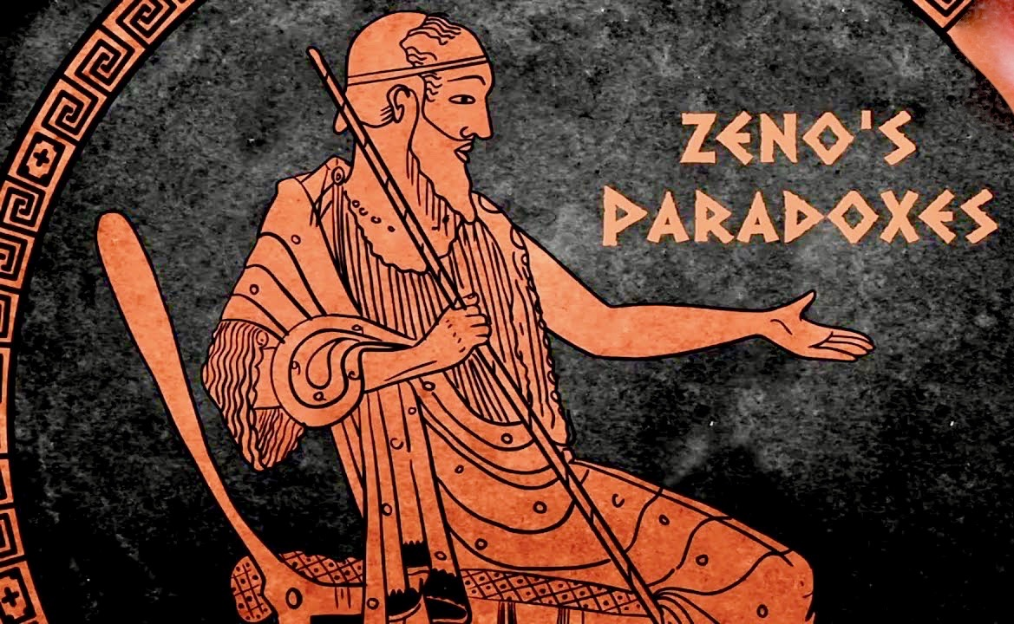
Zeno (c. 489-430 B.C.)
Zeno was Parmenides’ most famous disciple. He came up with a series of arguments, known as “Zeno’s Paradoxes,” to support Parmenides’ theory that reality was one and unchanging. “Almost everything that we know about Zeno of Elea is to be found in the opening pages of Plato’s Parmenides. There we learn that Zeno was nearly 40 years old when Socrates was a young man, say 20. Since Socrates was born in 469 BC we can estimate a birth date for Zeno around 490 BC. Beyond this, really all we know is that he was close to Parmenides (Plato reports the gossip that they were lovers when Zeno was young), and that he wrote a book of paradoxes defending Parmenides’ philosophy” (Stanford Encyclopedia of Philosophy).

Slide 15
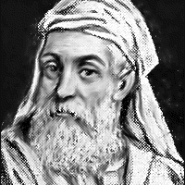
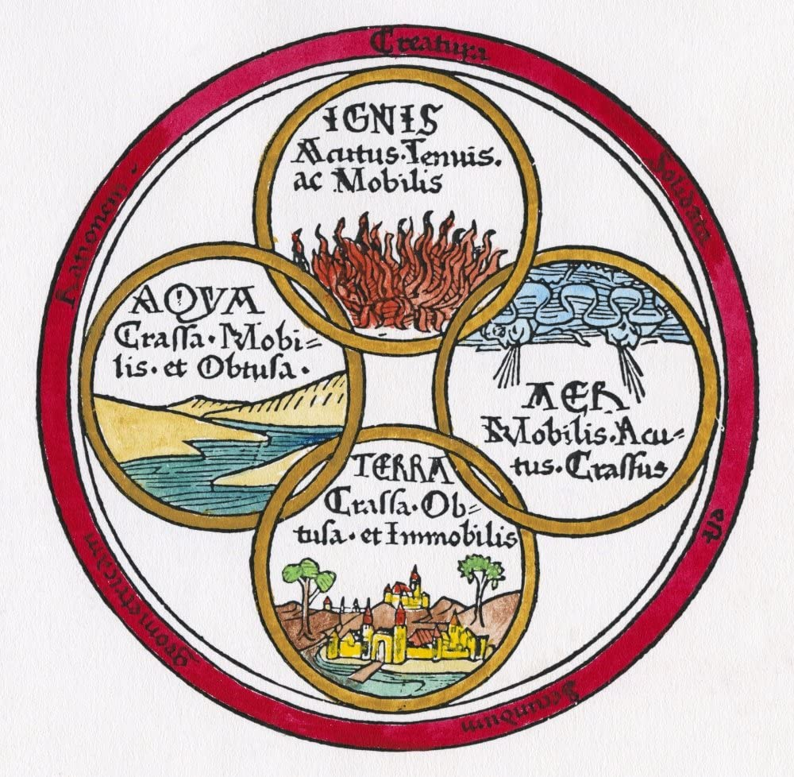
Empedocles (c. 495-c. 435 B.C.)
Empedocles also thought that reality is permanent and unchanging; nevertheless, he thought there should be a better account of why things seem to change. According to Empedocles the objects of experience do change, but these objects are composed of more basic elements which do not change. He held that there were four basic unchanging elements of which all things are made. These four elements are constantly being pulled together and apart by contrasting forces of love and strife to produce the ever- changing world. Legend has it that Empedocles died by hurling himself into a volcano.

Slide 16
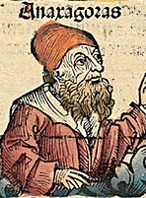
Anaxagoras (c. 500-c. 528 B.C.)
Anaxagoras introduced distinction between matter and mind. He thought that the source of all motion is something called nous, which can be translated as “reason” or “mind.”

Slide 17
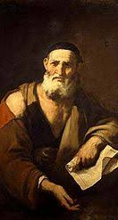
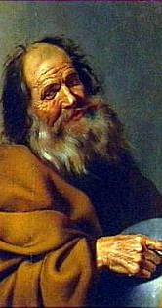
Leucippus (c. 430 B.C.) Democritus (460-370 B.C.)
These two philosophers are known as the “Atomists” since they held that all things are composed of physical atoms—tiny, imperceptible, indestructible, indivisible, eternal, and uncreated particles. They held that the experience of change can be accounted for by the constant movement of these unchanging atoms.

Slide 18
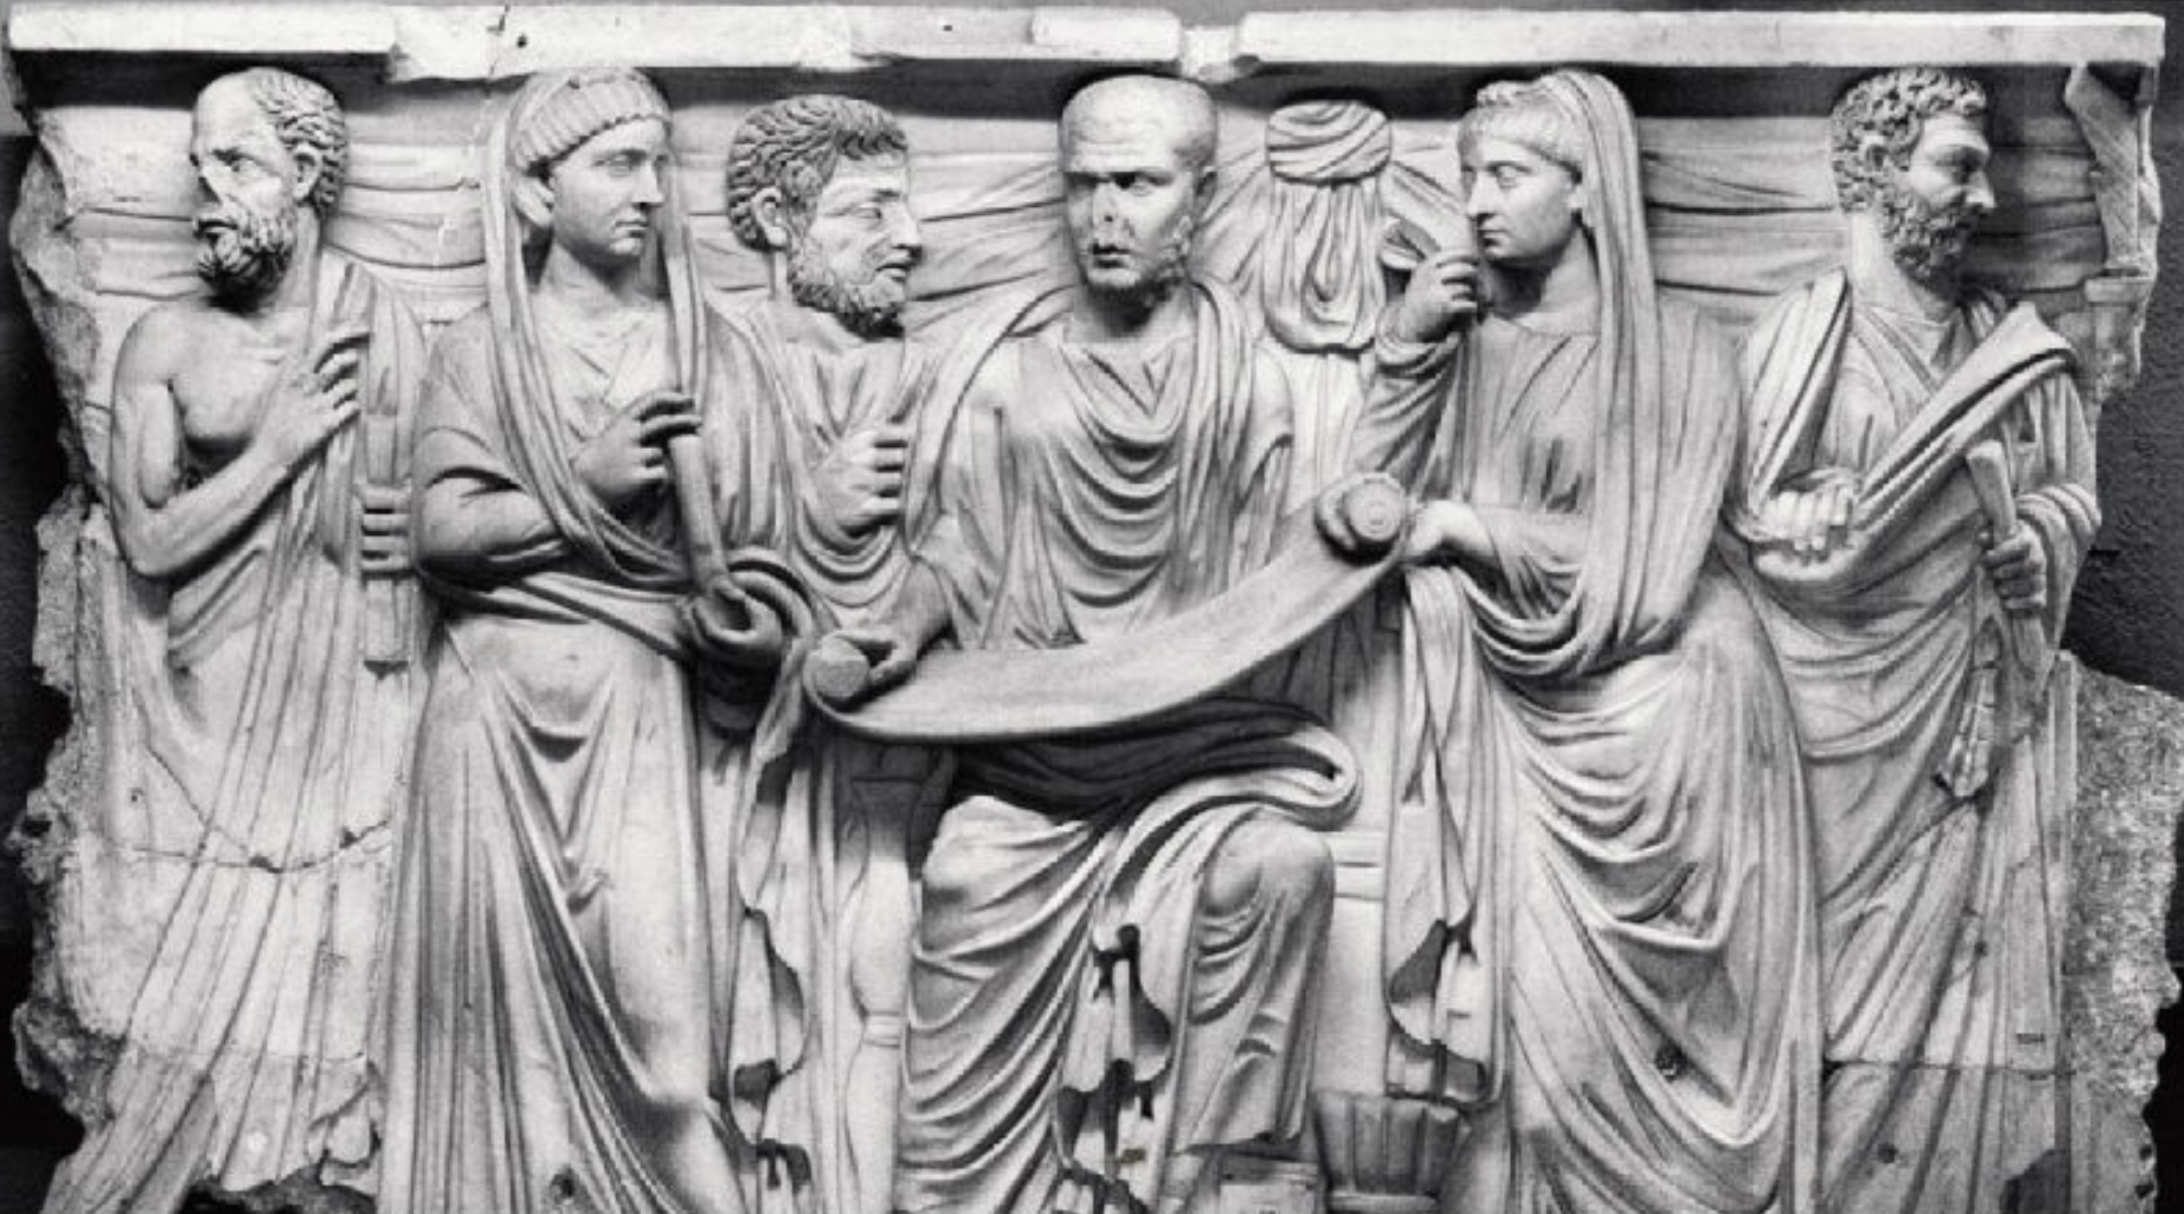
The Sophists
Greek culture reached its climax in Athens with the convergence of various streams of art and thought during the fifth century B.C. The age of Pericles and the building of the Parthenon saw Athens at the peak of its cultural creativity and political influence in Greece. Athens had become the first Greek metropolis. The development of democratic self-government and technical advances in agriculture and navigation encouraged a new humanistic spirit. The most acute stage of this evolution was reached in the latter half of the fifth century with the emergence of the Sophists.
As the fifth century developed, the Sophists were the leading intellectuals of the day. They were professional teachers or "wise men" who traveled about Greece offering their services in intellectual instruction and practical affairs. Most importantly, they taught rhetoric—the art of persuasive speech. The services of the Sophists were in high demand, for with the development of democracy the art of speaking well could lead to political success and power. Their thought was marked by the same rationalism and naturalism that had characterized the development of the philosophers before them. With the Sophists, however, a new element of pragmatism entered Greek thought, signaling a turn away from the metaphysical speculations of their predecessors. Socrates shared the sophists concern with the more practical human questions as opposed to the abstract metaphysical speculations of the earlier philosophers. Yet Socrates' thought and then Plato's philosophy developed in opposition to the sophists. To understand the development of Plato’s philosophy it is therefore crucial to understand the opposition between Socrates and the sophists. The philosophical view of the Sophists can be described in terms of relativism or subjectivism, skepticism, and nihilism.

Slide 19
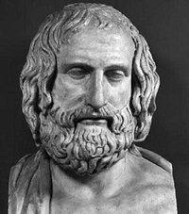
Protagoras
"Man is the measure of all things."
The relativism of the Sophists stands out in the famous phrase from the most well known of the Sophists, who is reported to have said that "Man is the measure of all things." One can also recognize the skepticism of the Sophists in Protagoras' statement: "Concerning the gods, I have no means of knowing whether they exist or not, nor of what form they are; for there are many obstacles to such knowledge, including the obscurity of the subject and the shortness of human life."
Protagoras (c. 490-c.422 B.C.)

Slide 20
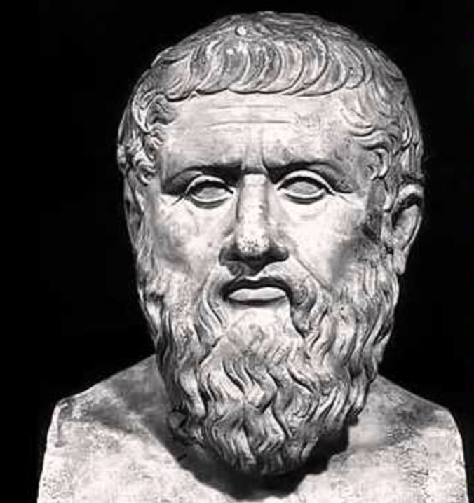
Gorgias
“Nothing is true.”
Gorgias, another skeptic, used arguments like the following to "prove" skepticism:
(1) There is nothing.
(2) If there were anything, no one could know it.
( 3) If anyone did know it, no one could communicate it.
The first assumption displays Gorgias' nihilistic view, for nihilism, coming from the Greek nihil ("nothing") is the view that "nothing exists" or "nothing is true."
Gorgias (c. 483-c.375 B.C.)

Slide 21
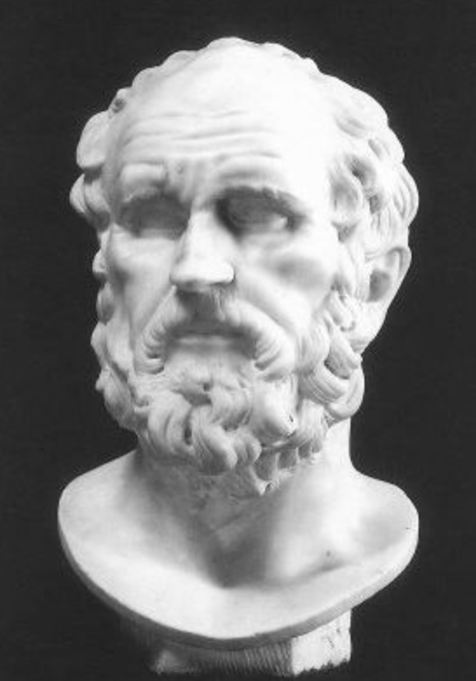
Thrasymachus
"Might makes right!"
Portrayed by Plato in the Republic as Socrates’ main opponent, Thrasymachus is reported to have drawn the consequence that since there is no truth then all disputation about morality is pointless. He is famous, or rather infamous, for having come to the conclusion that "might makes right" and "justice is in the interest of the stronger."
Thrasymachus (c. 459—400 B.C.)

Slide 22
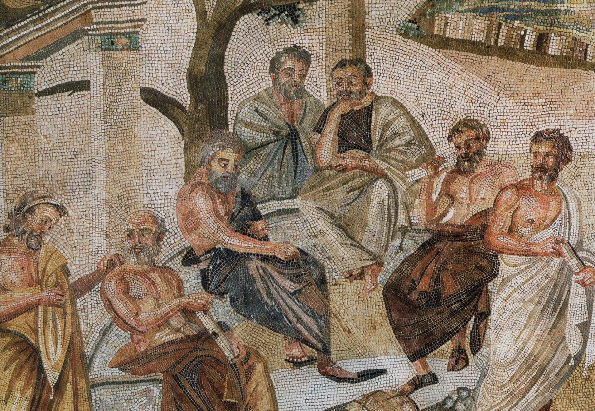
Callicles
Callicles was one of Gorgias’ students. He is depicted in Plato’s dialogue the Gorgias as holding the view that “might makes right” and that traditional morality is only a means for the weak to gain power, and thus, what matters most is not justice but power.
Socrates and Plato were convinced that the views of the Sophists had grave consequences for society and thus their philosophy can be seen as a reaction against the sophists.
The contributions of the sophists was not all negative, however, they turned the attention of philosophers toward the areas of ethics and politics which had previously been for the most part ignored, and which would henceforth become a central concern for Socrates and Plato.
Roman mosaic of the 1st century BCE from Pompeii.
The image may represent Plato’s Academy.

