Slide 1
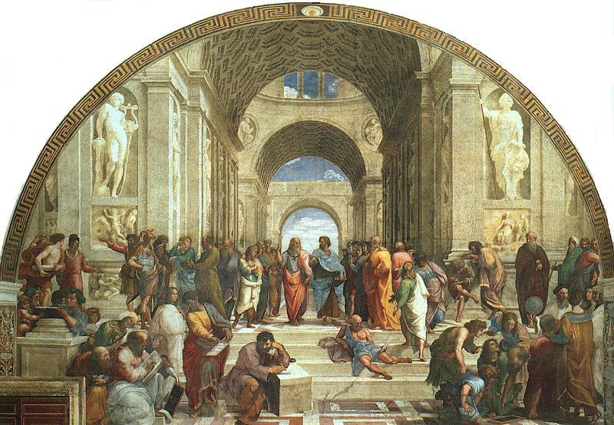
The School of Athens, Raphael 1509-1511

Slide 2
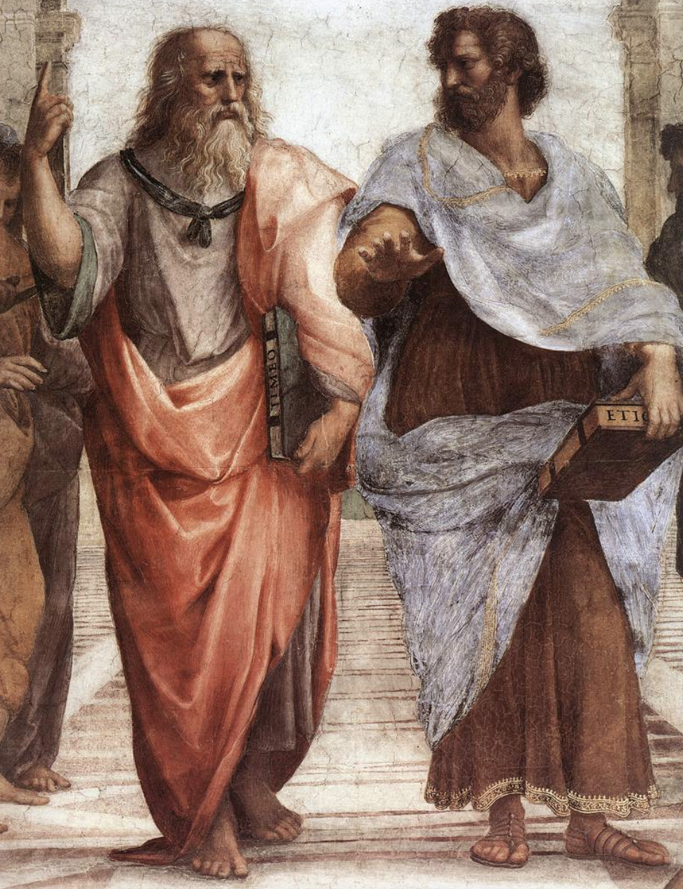
Plato and Aristotle

Slide 3
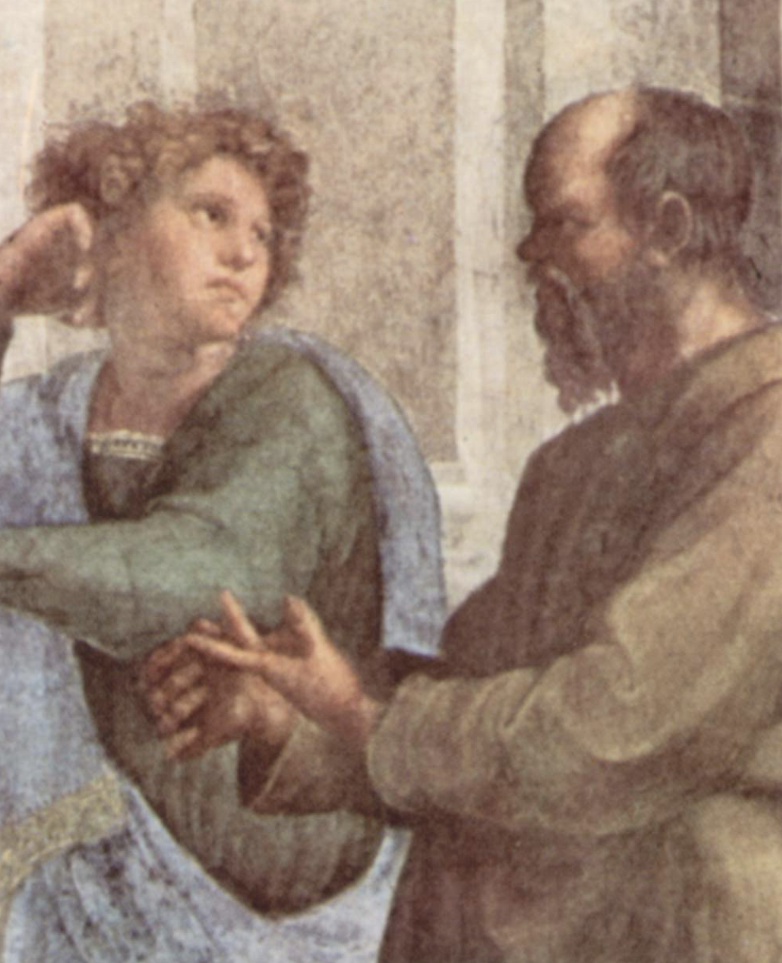
Aeschines and Socrates

Slide 4
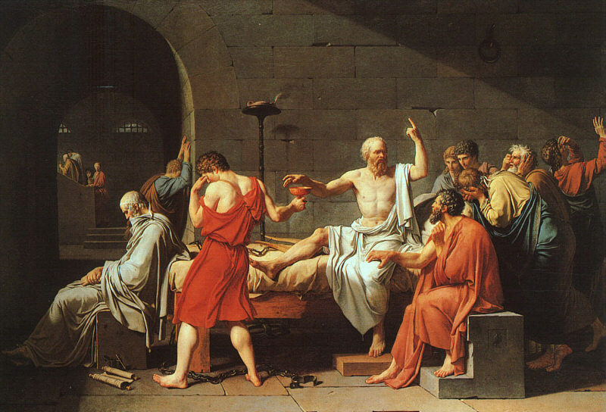
The Death of Socrates, Jacques-Louis David, 1787

Slide 7
Plato’s Philosophy
Appearance
(The Visible World)
The Dreamworld
Particular things
Changing
Senses
The body
Lies, illusion, fiction
Art
Writing
Painting
Woman
Reality
(The Intelligible World)
Waking Reality
Universal Forms or Ideas
Unchanging
Pure Reason
The soul
Truth
Philosophy
Speech
Logos
Man

Slide 8
