Slide 1
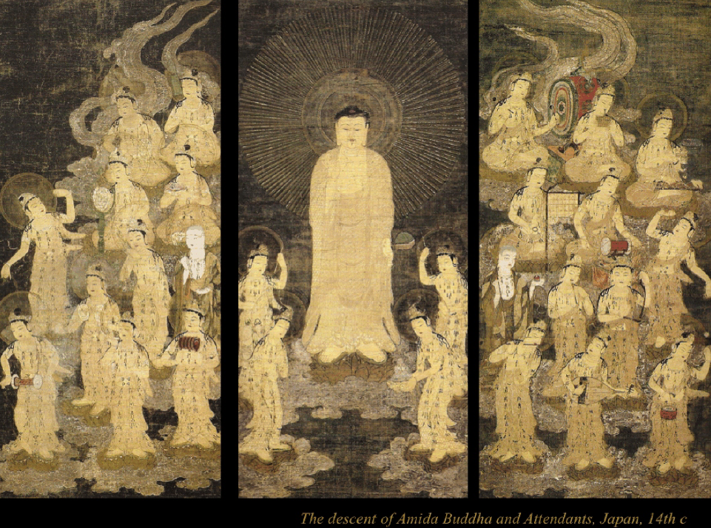
Celelestial Buddhas and Bodhisattvas of Mahāyāna Buddhism

Slide 2
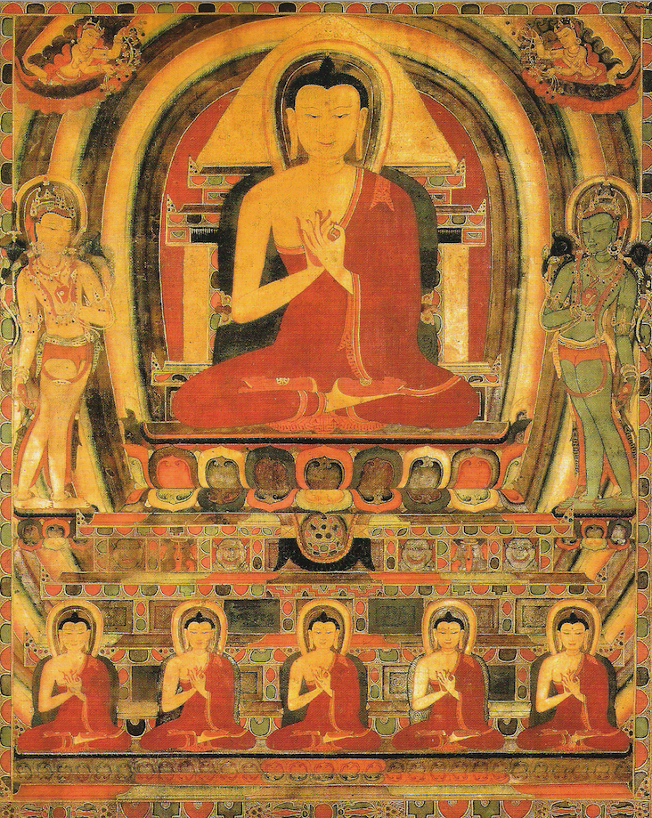
Buddha with the Five Tathāgatas
Tibet, 13th c.

Slide 3
Akṣobhya Buddha
Akṣobhya Buddha is one of the most famous of the celestial Buddhas. When he took up the practice of the Bodhisattva Path, he made a vow never to be angry or have thoughts of malice or hatred toward any living being until he attained Buddhahood. Thus, he was named Akṣobhya, meaning "Unperturbed."
Akṣobhya Buddha is perhaps the first of the celestial Buddhas during this eon to be mentioned in the early Mahāyāna sūtras. In one of the early Perfection of Wisdom Sūtras, Gautama Buddha is said to have enabled his hearers to see Akṣobhya Buddha.
In the Vimalakīrti Sūtra, it is said that Vimalakīrti revealed Akṣobhya’s Buddha realm called Abhirati, “Joyous,” that is populated mainly by arhats and a few bodhisattvas. It is said that with the assistance of Akṣobhya, a person can easily attain Arhatship in his Buddha realm. Scholars see this fact as indicating that Akṣobhya Buddha represents a transitional stage between the goals of Arhatship and Buddhahood. (Mitchell & Jacoby, 144)

Slide 4
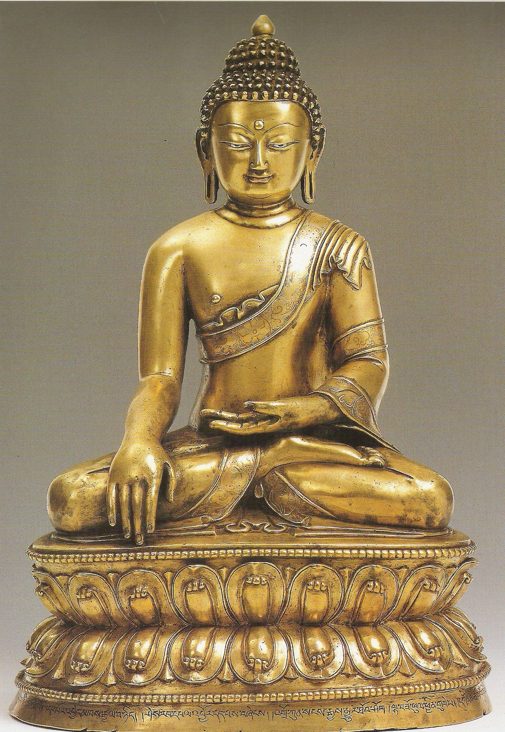
Akṣobhya Buddha
Tibet, 15th-16th c.

Slide 5
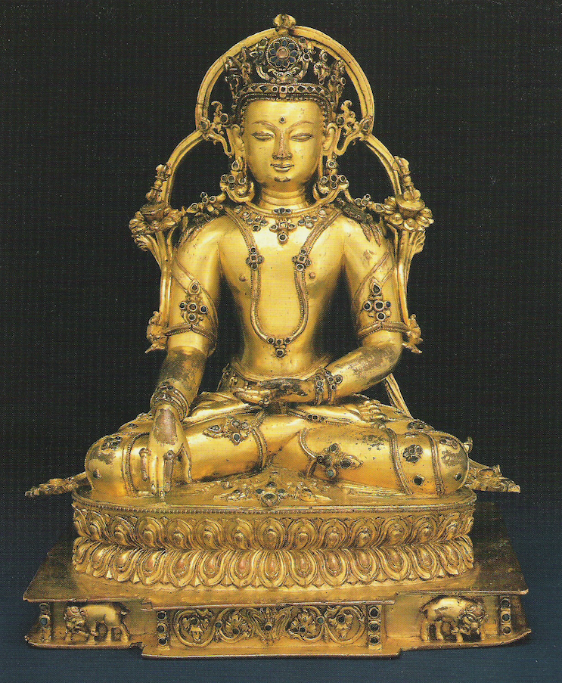
Akṣobhya Buddha
Tibet, 15th-16th c.

Slide 6
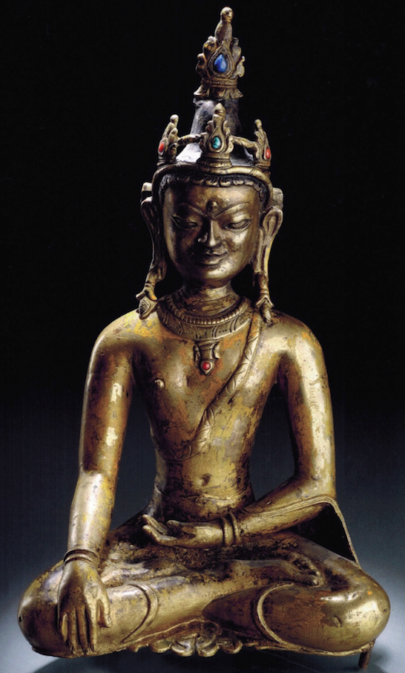
Akṣobhya Buddha
Tibet, 15th-16th c.

Slide 7
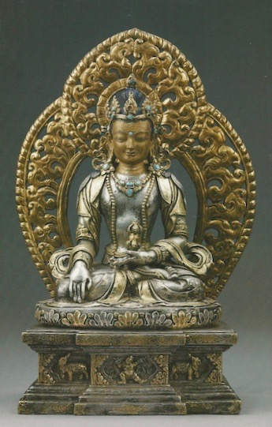
Akṣobhya Buddha
Bhutan, 18th c.

Slide 8
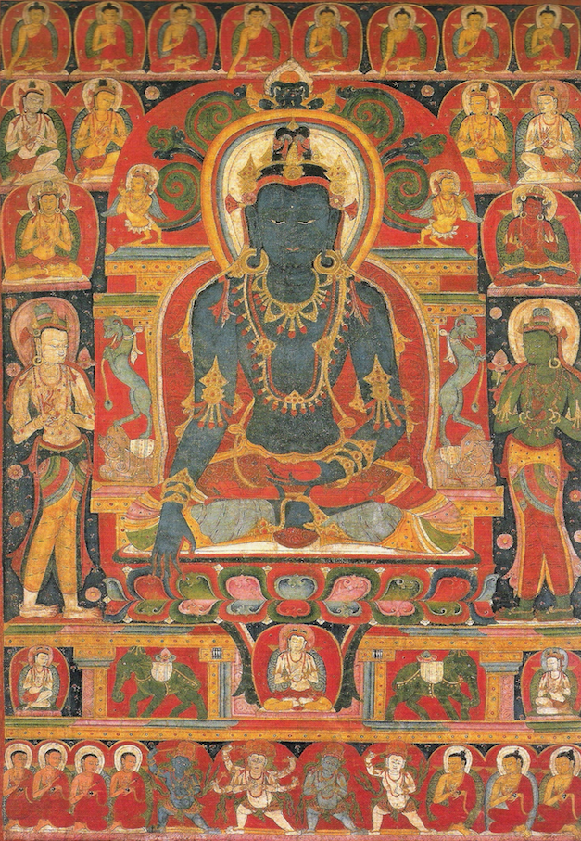
Akṣobhya Buddha
Tibet, 12th c.

Slide 9
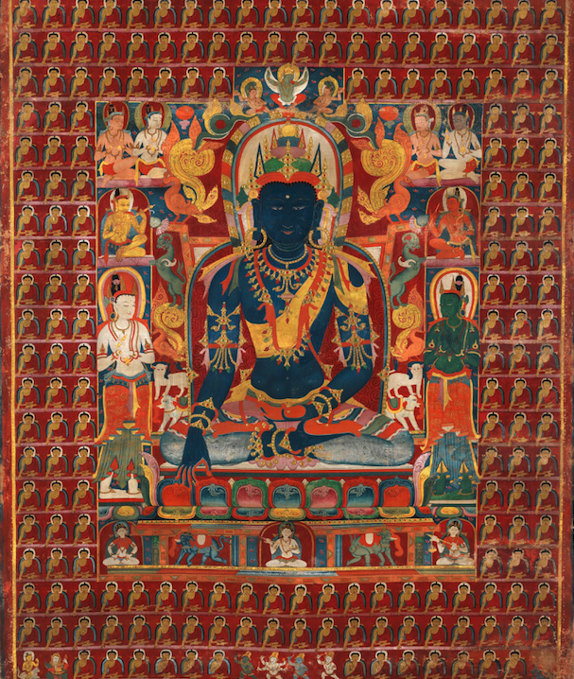
Akṣobhya Buddha
Tibet, 14th c.

Slide 10
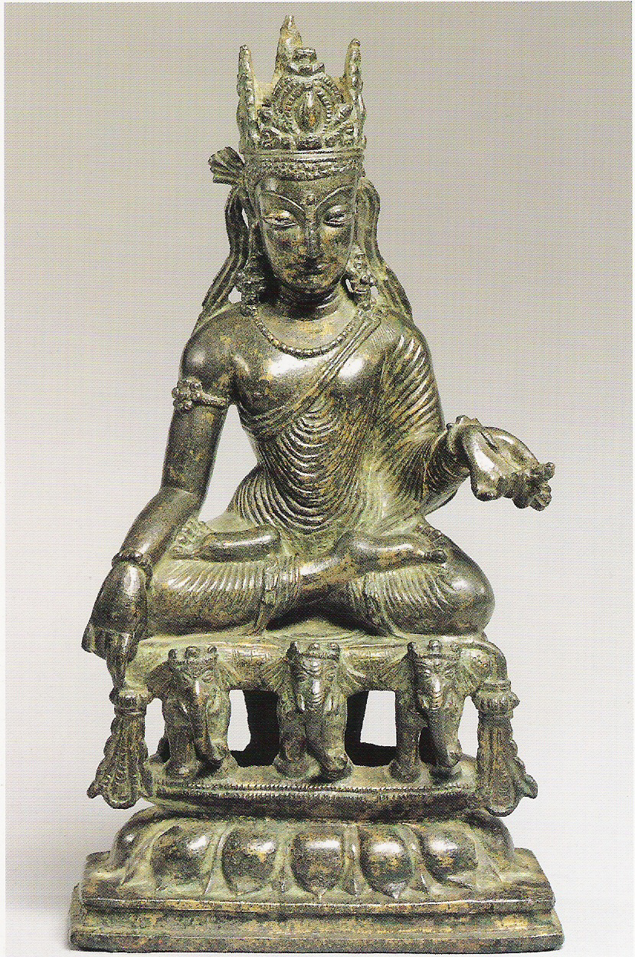
Akṣobhya Buddha
Pakistan, 9th c.

Slide 11
Amitābha Buddha The Buddha of Infinite Light also known as Amitāyus Buddha The Buddha of Infinite Life
Sanskrit Amitābha, Amitāyus
Chinese 阿彌陀佛 (Traditional)
阿弥陀佛 (Simplified)
Pinyin: Ēmítuófó/Āmítuófó
Wade-Giles: A-mi-t’uo Fo
Japanese 阿弥陀仏 Amida Butsu
阿弥陀如来 Amida Nyorai
Tibetan འོད་དཔག་མེད་
'od dpag med
Ö-pa-me
Vietnamese A-di-đà Phật

Slide 12
Amitābha Buddha
Certainly the most widely known celestial Buddha is Amitābha, or the Buddha of "Unlimited Light." He is also known as Amitāyus, the Buddha of "Unlimited Life."
The story of Amitābha Buddha is presented in the Land of Bliss Sūtras. This Land of Bliss (Sukhtāvati), also called the "Pure Land," is Amitābha's Buddha-realm. Amitābha Buddha will bring good Buddhists to the Pure Land at death if they arouse the thought of Awakening, meditate with a faithful mind on Amitābha, and desire to be reborn in his Pure Land. Amitābha has the power to bring even an evil person to his Pure Land if that person hears the name of Amitābha Buddha, repents, and seeks to be reborn in the Pure Land. There is a mixture of inhabitants in the Pure Land, including mainly bodhisattvas and some arhats. However, the sole practice in this Pure Land is the Bodhisattva Path leading to Buddhahood. (Mitchell & Jacoby, 145)

Slide 13
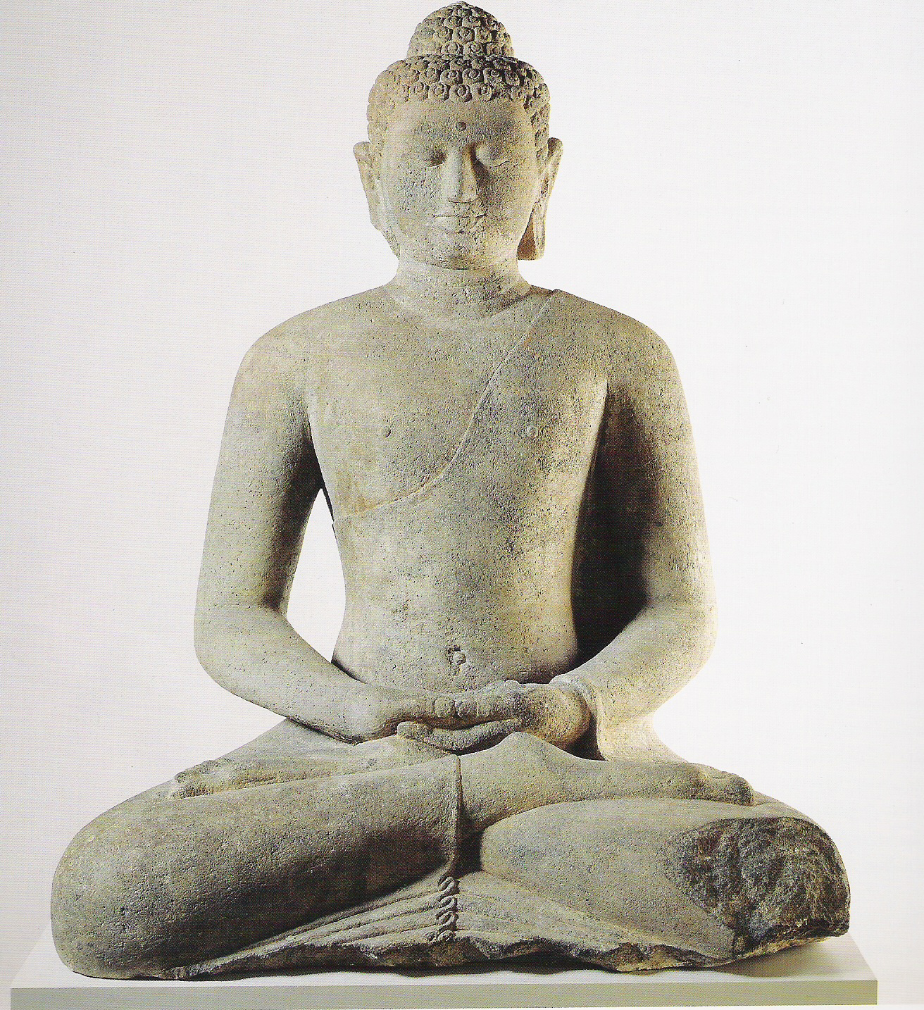
Amitābha Buddha
Indonesia, 8th– 9th c.

Slide 14
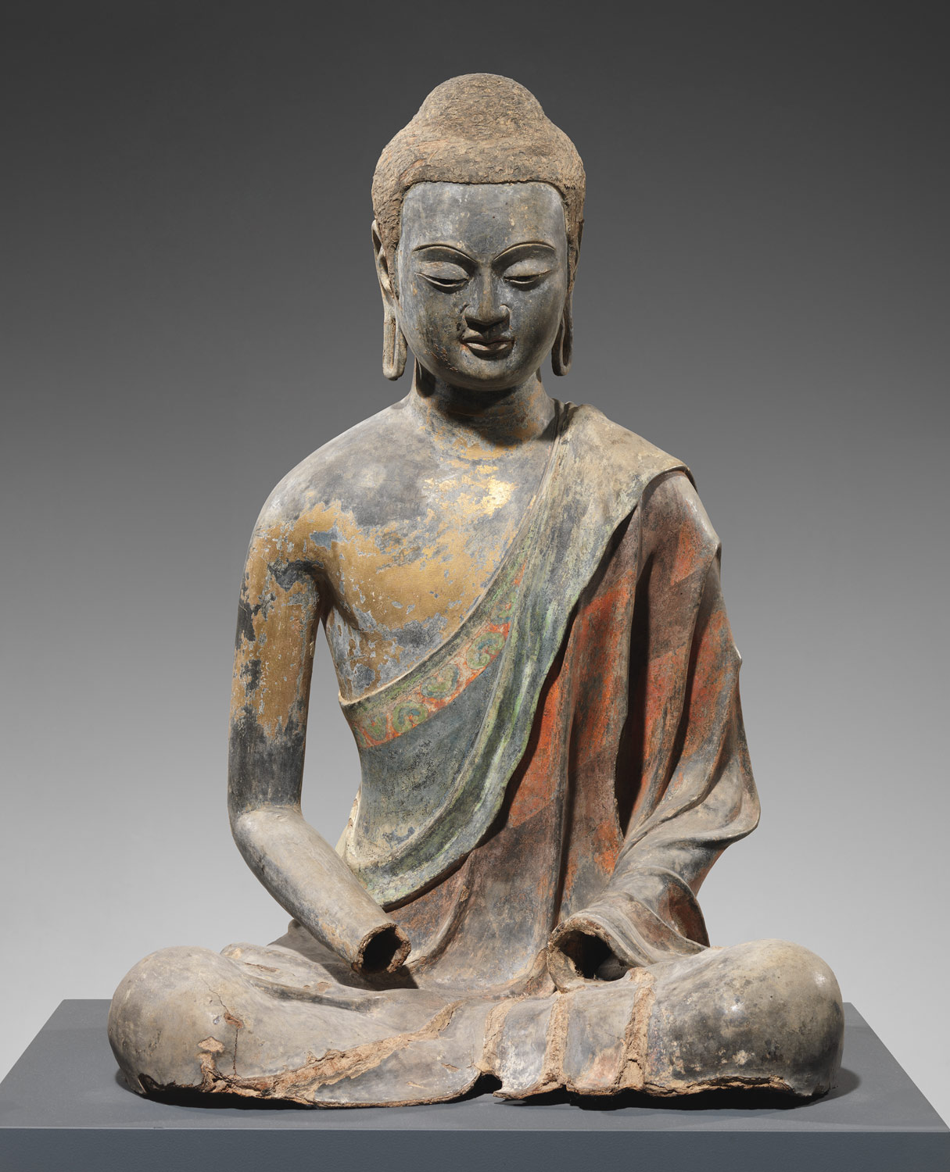
Amitābha Buddha
China, Tang Dynasty, early 7th c.

Slide 15
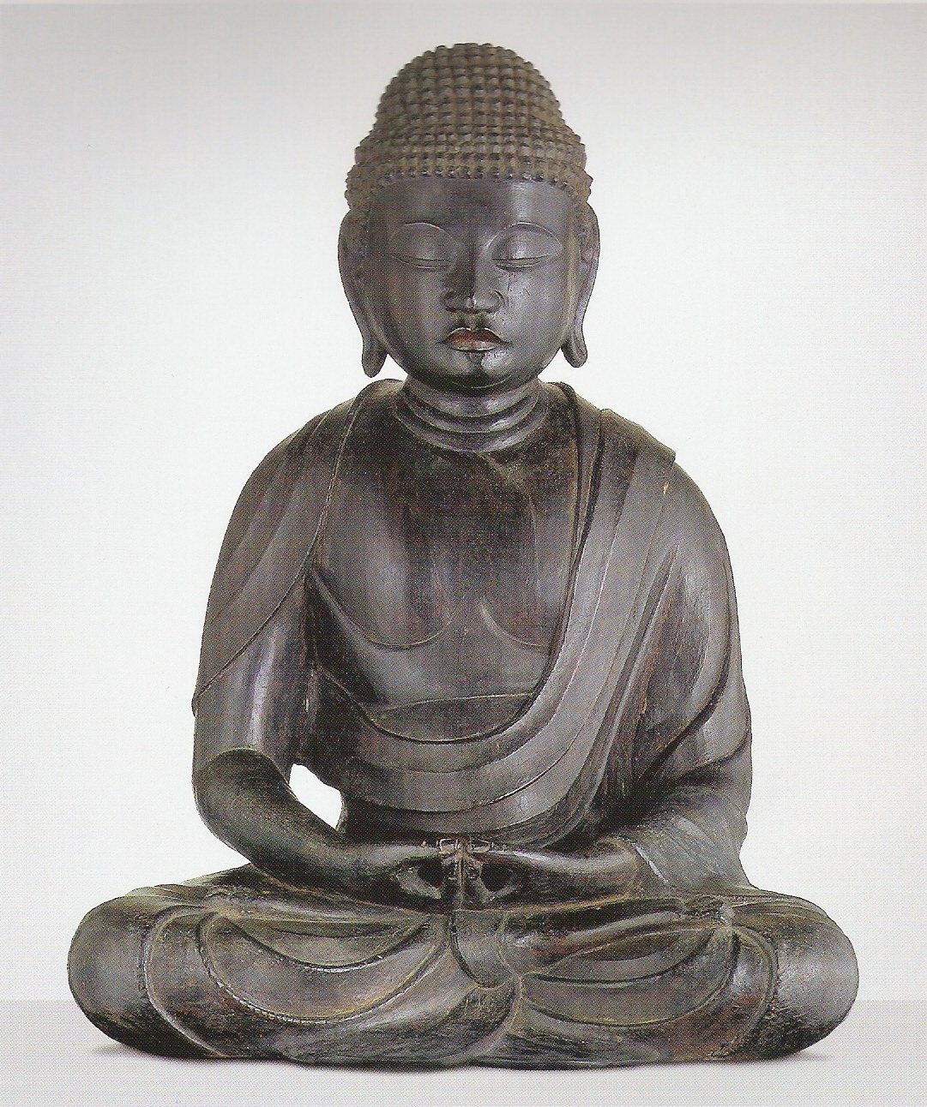
Amida Buddha
Japan, Heian period, 11th– 12th c.

Slide 16
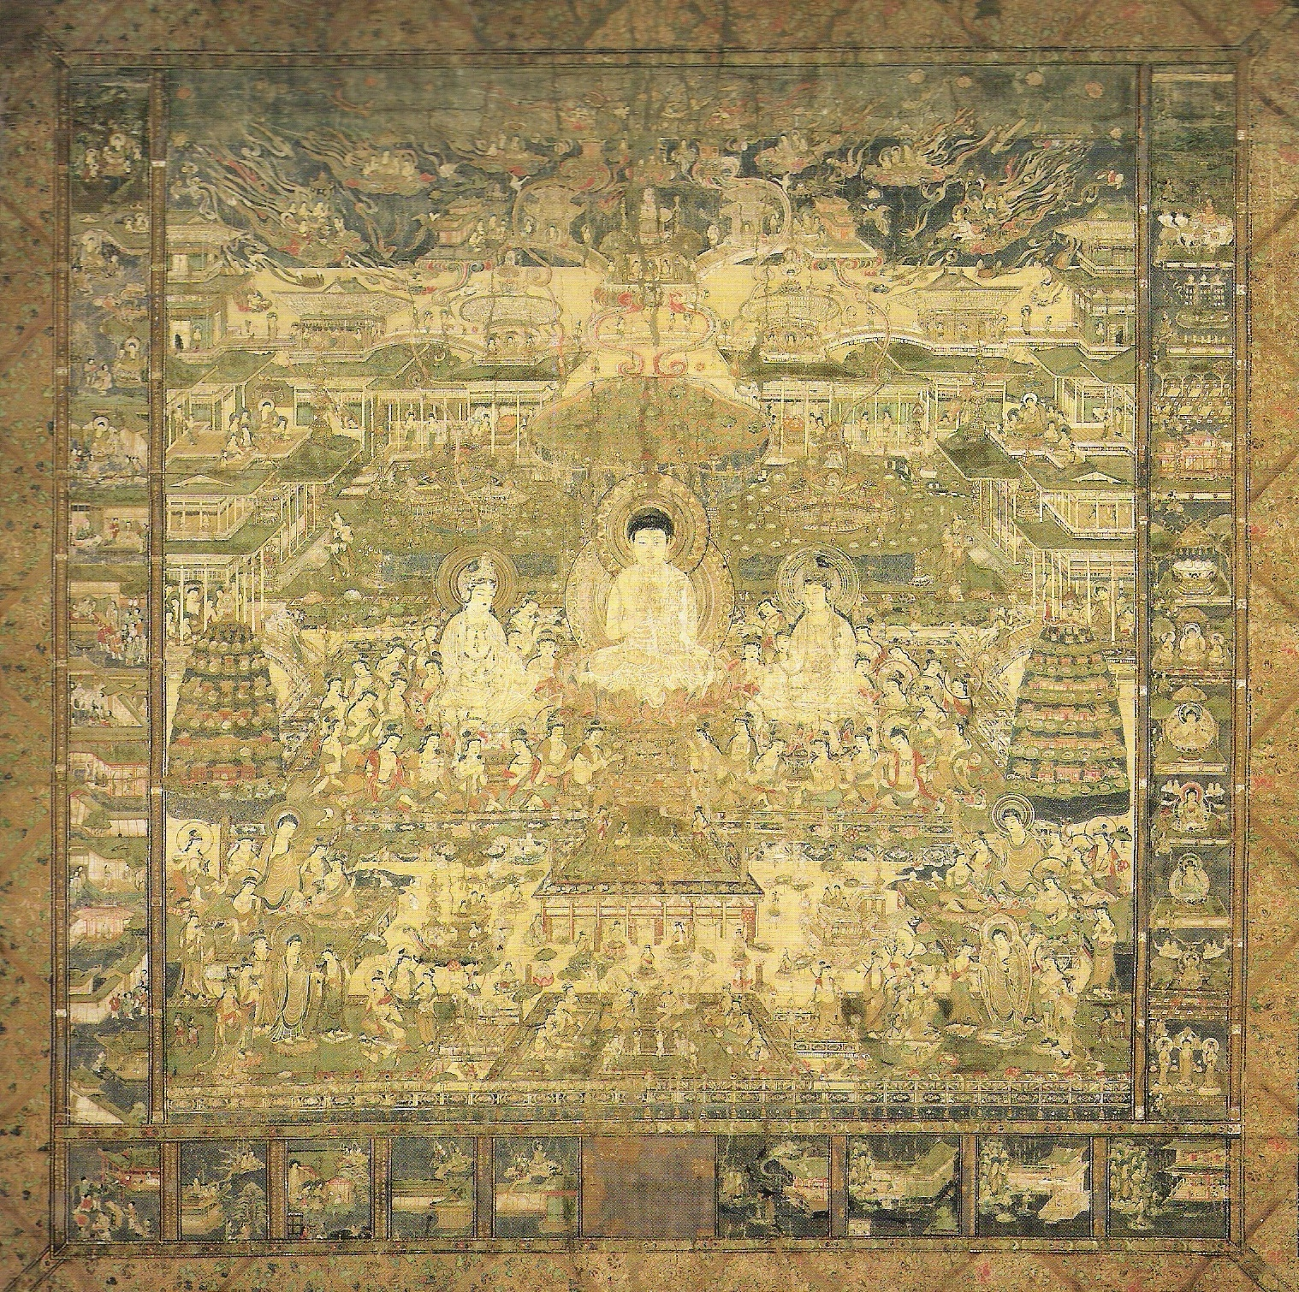
Amida Buddha
Japan, Kamakura period, 14th c.

Slide 17
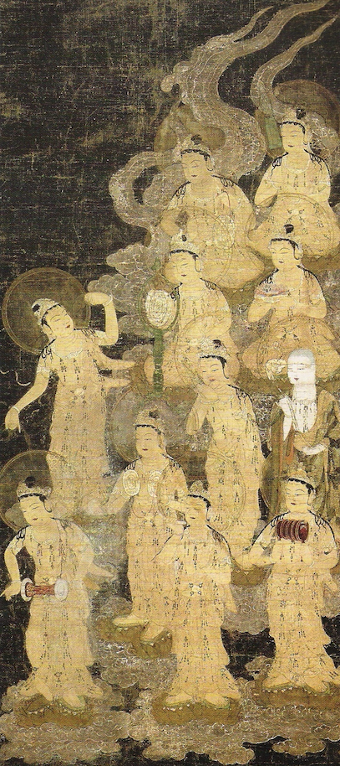
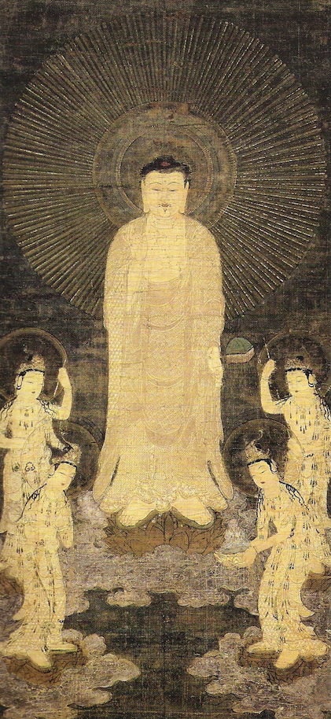
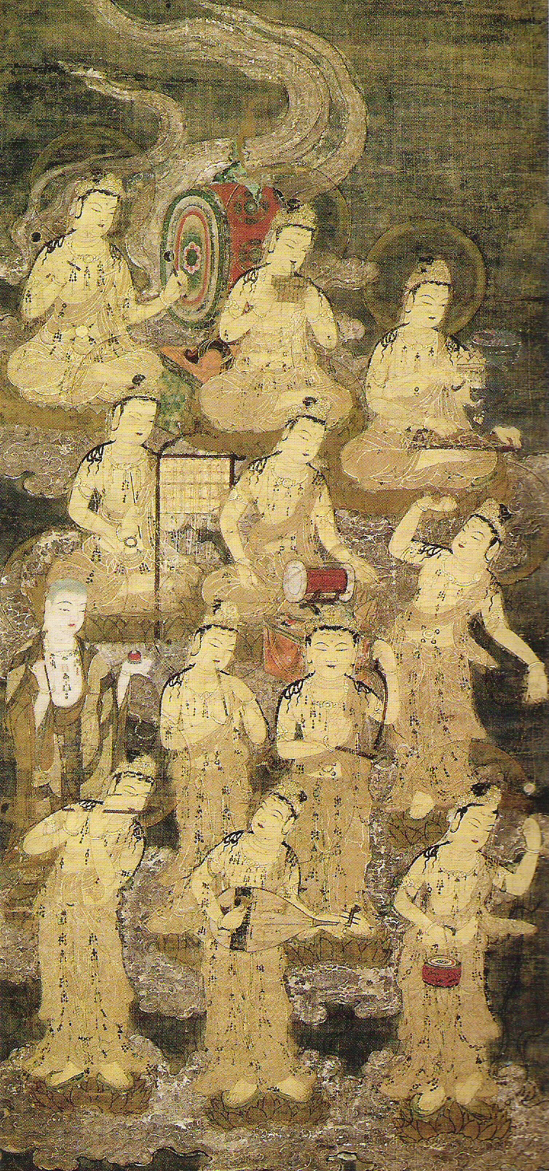
The Descent of Amida Buddha and Attendants
Japan, Kamakura period, 14th c.

Slide 18
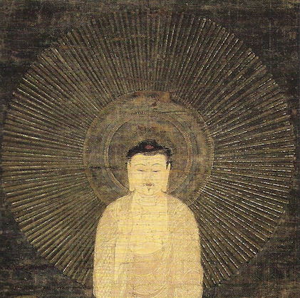
The Descent of Amida Buddha and Attendants (detail)
Japan, Kamakura period, 14th c.

Slide 19
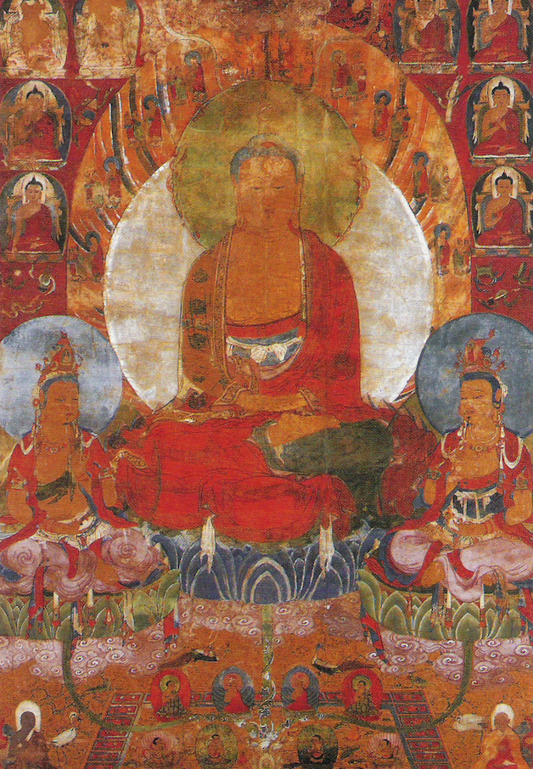
Amitābha Buddha
Central Asia, 12th c.

Slide 20
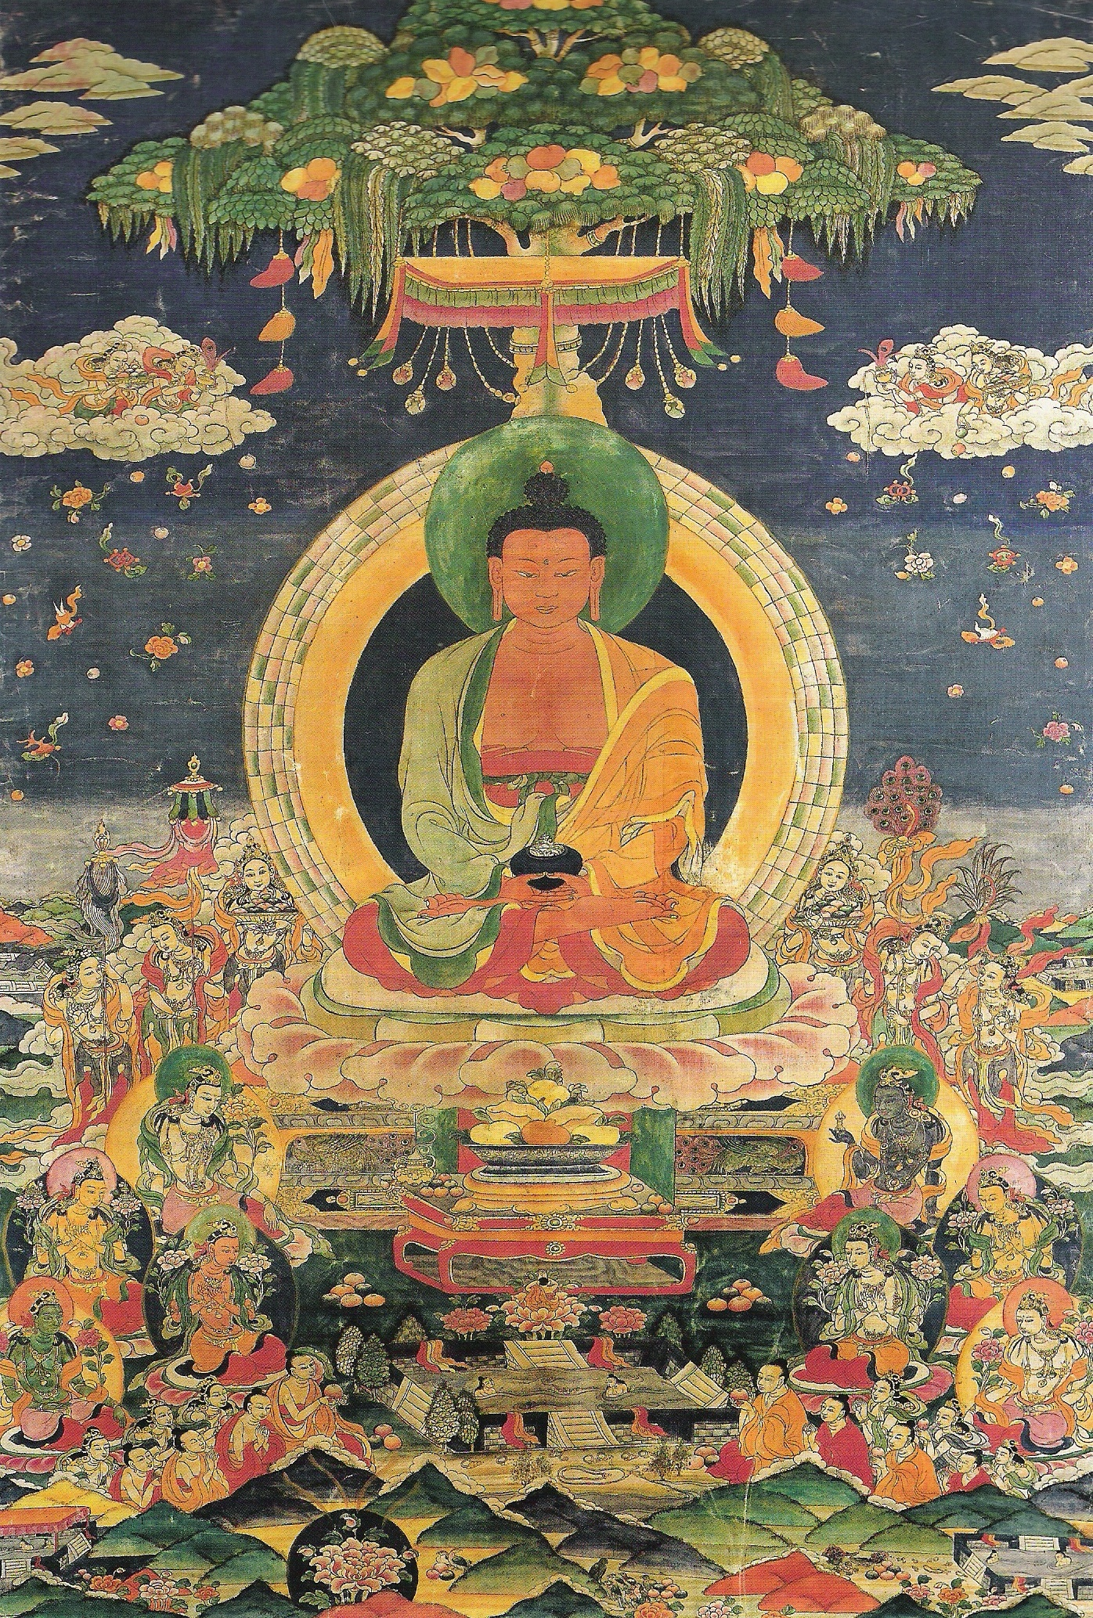
Amitābha Buddha
Tibet, 19th c.

Slide 21
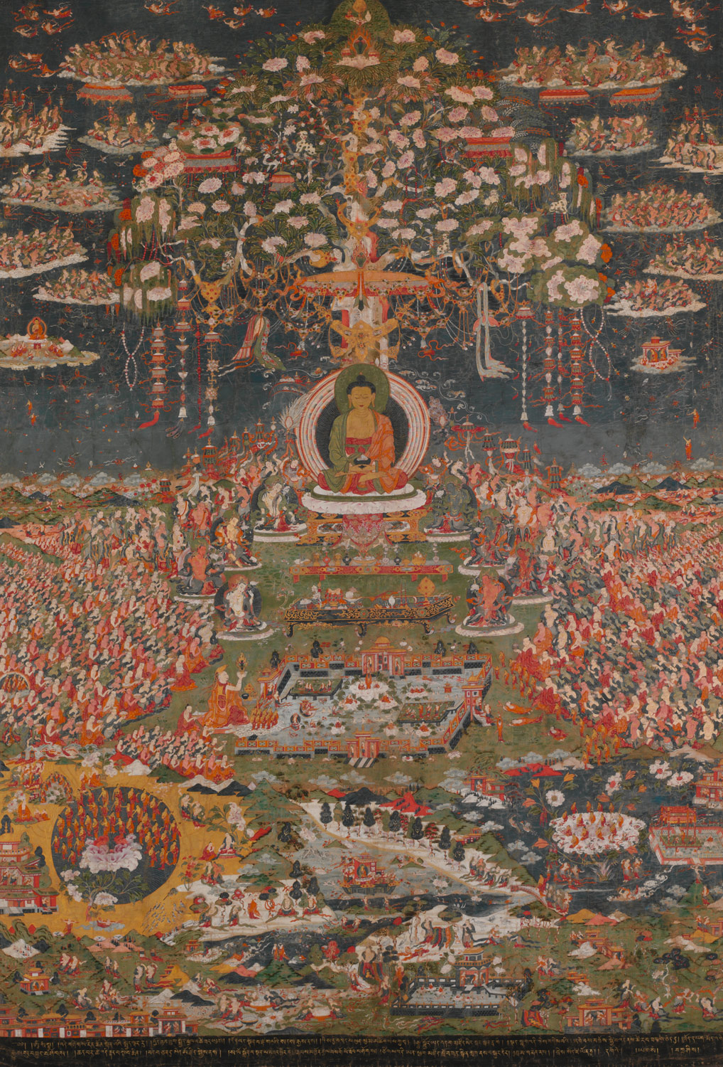
Amitābha Buddha
Tibet, 17th – 18th c.

Slide 22
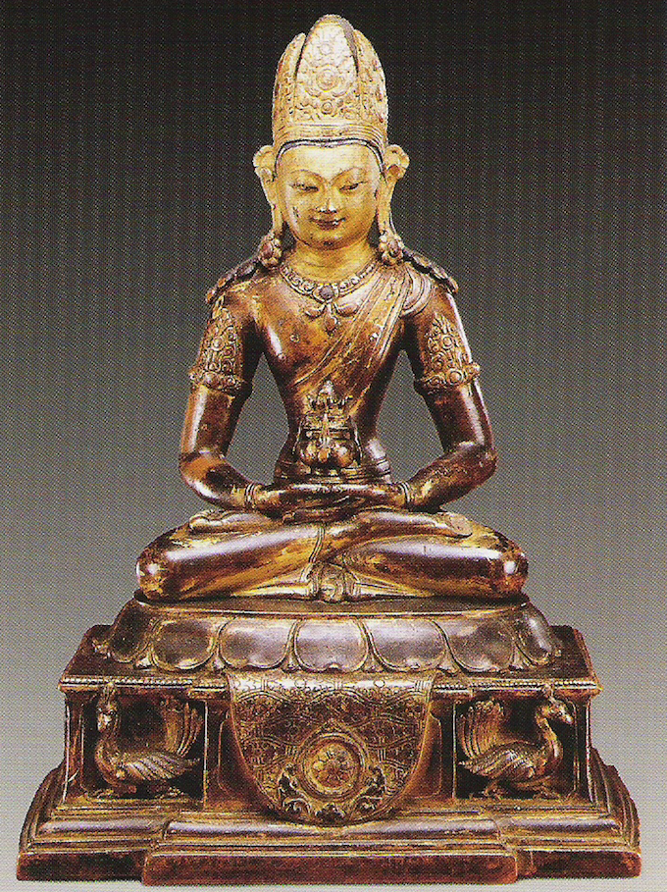
Amitāyus Buddha
Nepal 11th c.

Slide 23
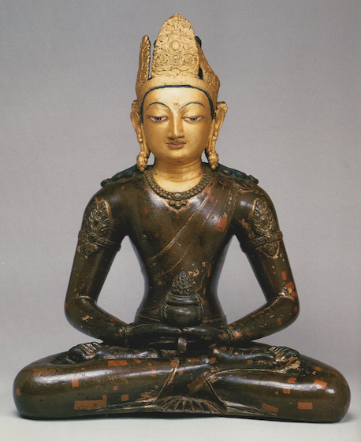
Amitāyus Buddha
Bhutan 11th c.

Slide 24
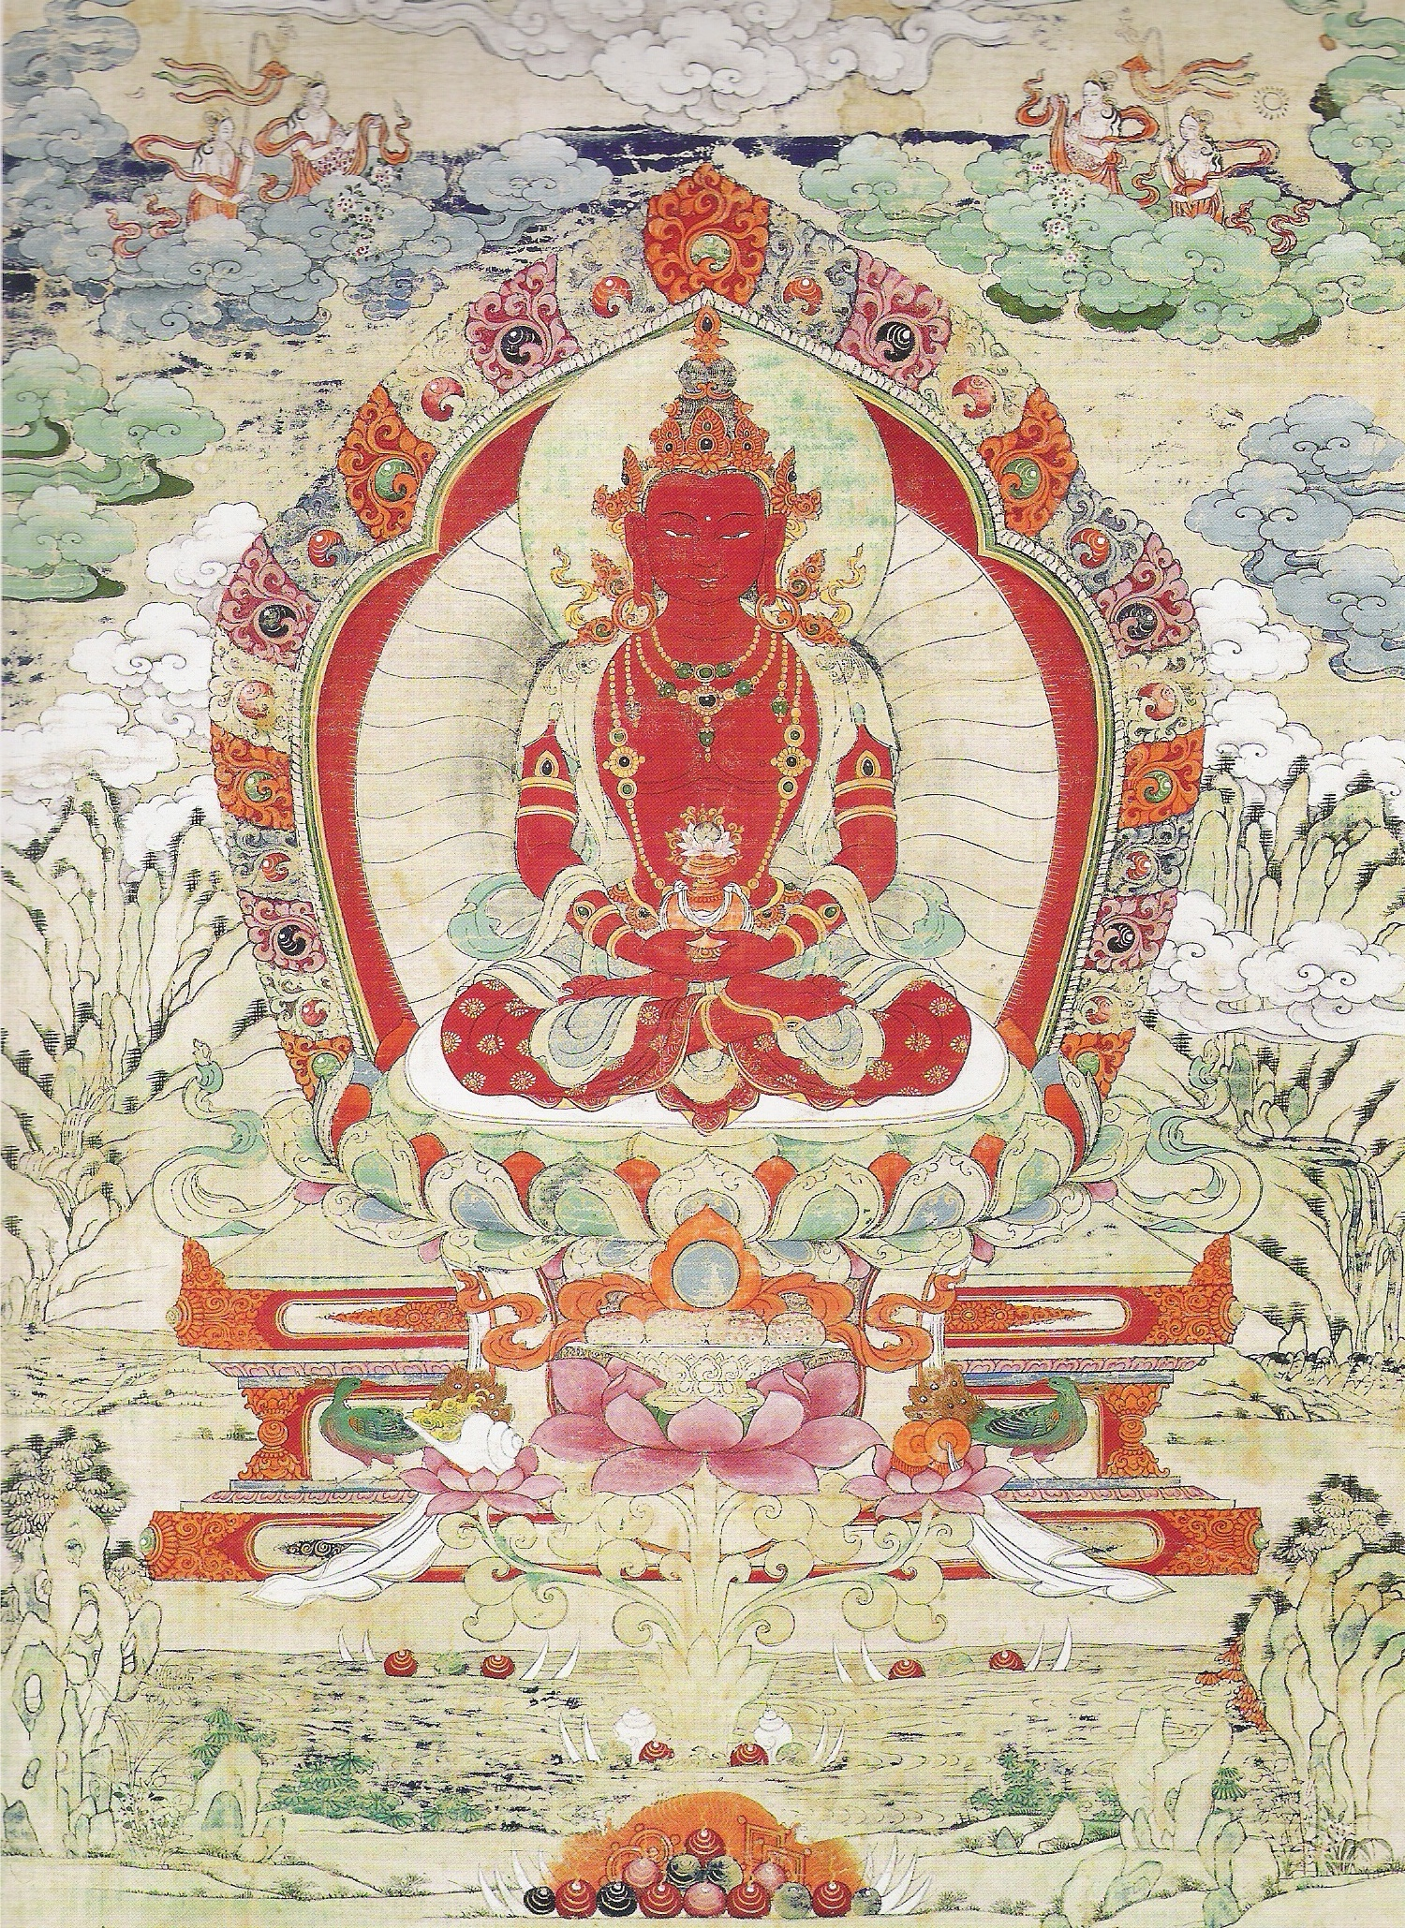
Amitāyus Buddha
China, Qing Dynasty,18th c.

Slide 25
Vairocana Buddha
Vairocana Buddha is another of the great celestial Buddhas. His name means "Shining Out" like the sun.
The first mention of Vairocana is perhaps in the Avataṃsaka Sūtra. There, he is described as being at the center of the cosmos like a cosmic sun radiating the light of the Dharma to all worlds. The luminous rays of his light dispel the darkness of ignorance releasing sentient beings from all obstructions to Awakening. These rays are often represented in Buddhist art.
His Buddha-realm was born from the lotus and was purified by Vairocana for eons. Unlike the Buddha-realms of Akṣobhya and Amitābha, the Lotus Land of Vairocana is not inhabited by arhats, but only by bodhisattvas. Here we see a Mahāyāna development from the Buddha-realm of Akṣobhya where there are mainly arhats and a few bodhisattvas, to the Buddha-realm of Amitābha where there are mostly bodhisattvas and a few arhats, to the Buddha-realm of Vairocana where there are only bodhisattvas.
The Avataṃsaka Sūtra also considers Vairocana to be the same as Gautama Buddha, but just different bodies. In later sūtras, this relationship is described as Gautama Buddha being the nirmāṇakāya of Vairocana. (Mitchell & Jacoby, 145)

Slide 26
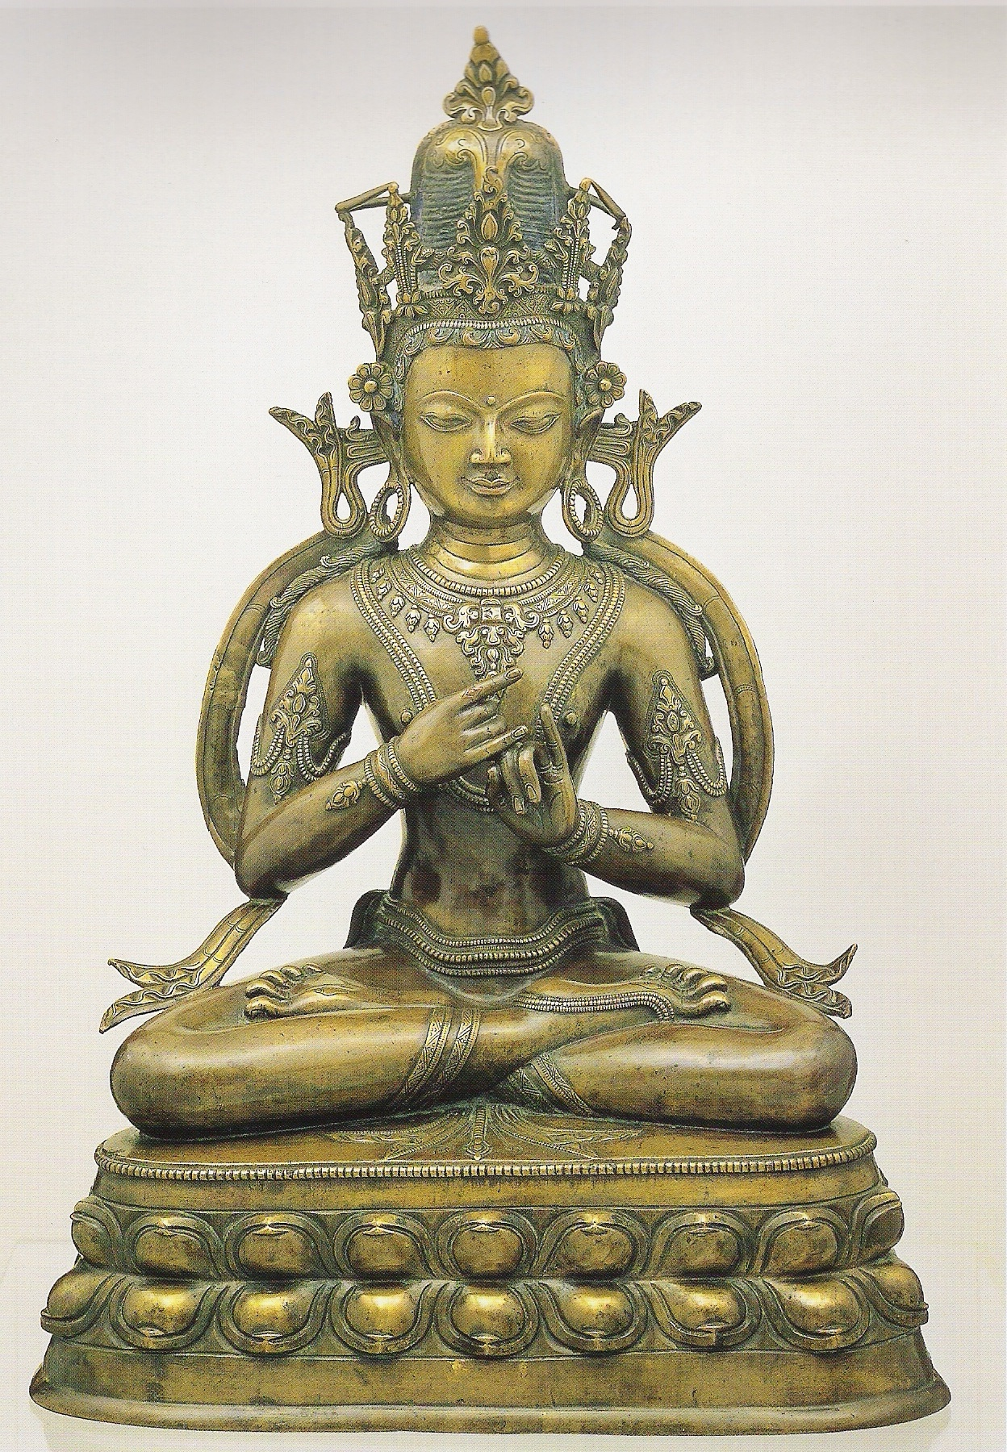
Vairocana Buddha
Tibet, 14th c.

Slide 27
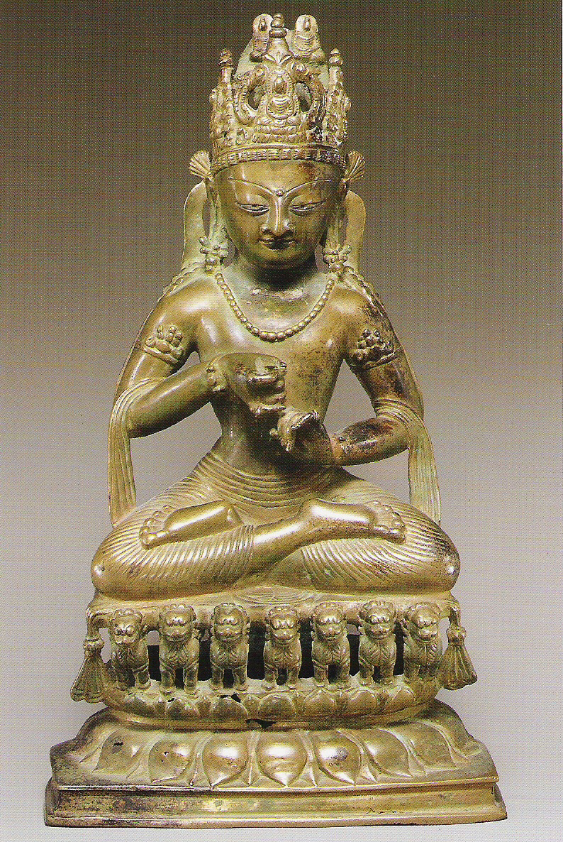
Vairocana Buddha
Pakistan,9th- 10th c.

Slide 28
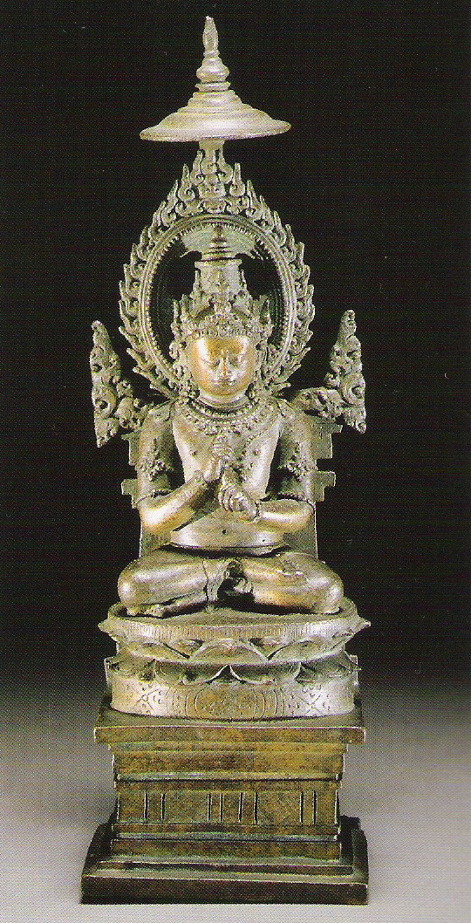
Vairocana Buddha
Indonesia, 10th c.

Slide 29
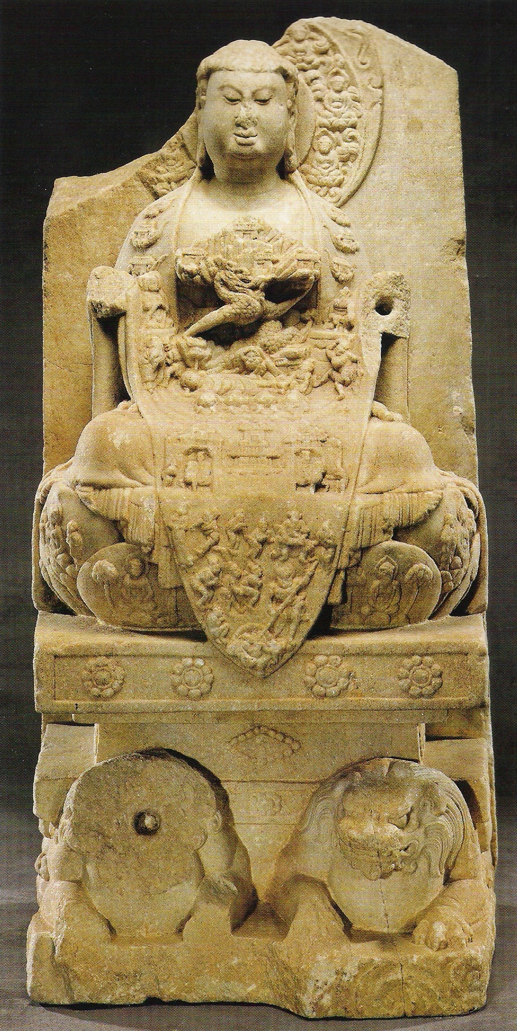
Vairocana Buddha
China, Tang Dynasty, 8th c.

Slide 30
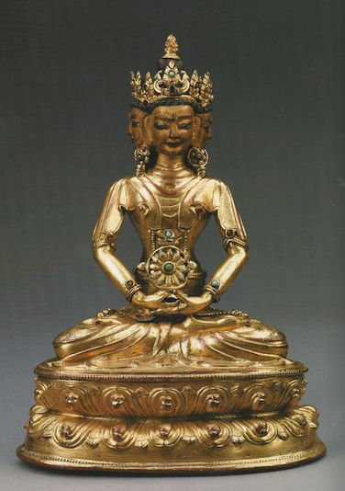
Vairocana Buddha
Bhutan, 18th c.

Slide 31
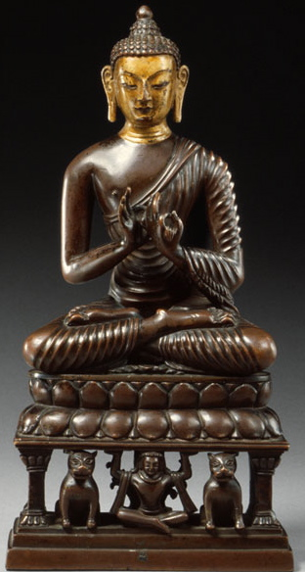
Vairocana Buddha
Tibet,16th- 17th c.

Slide 32
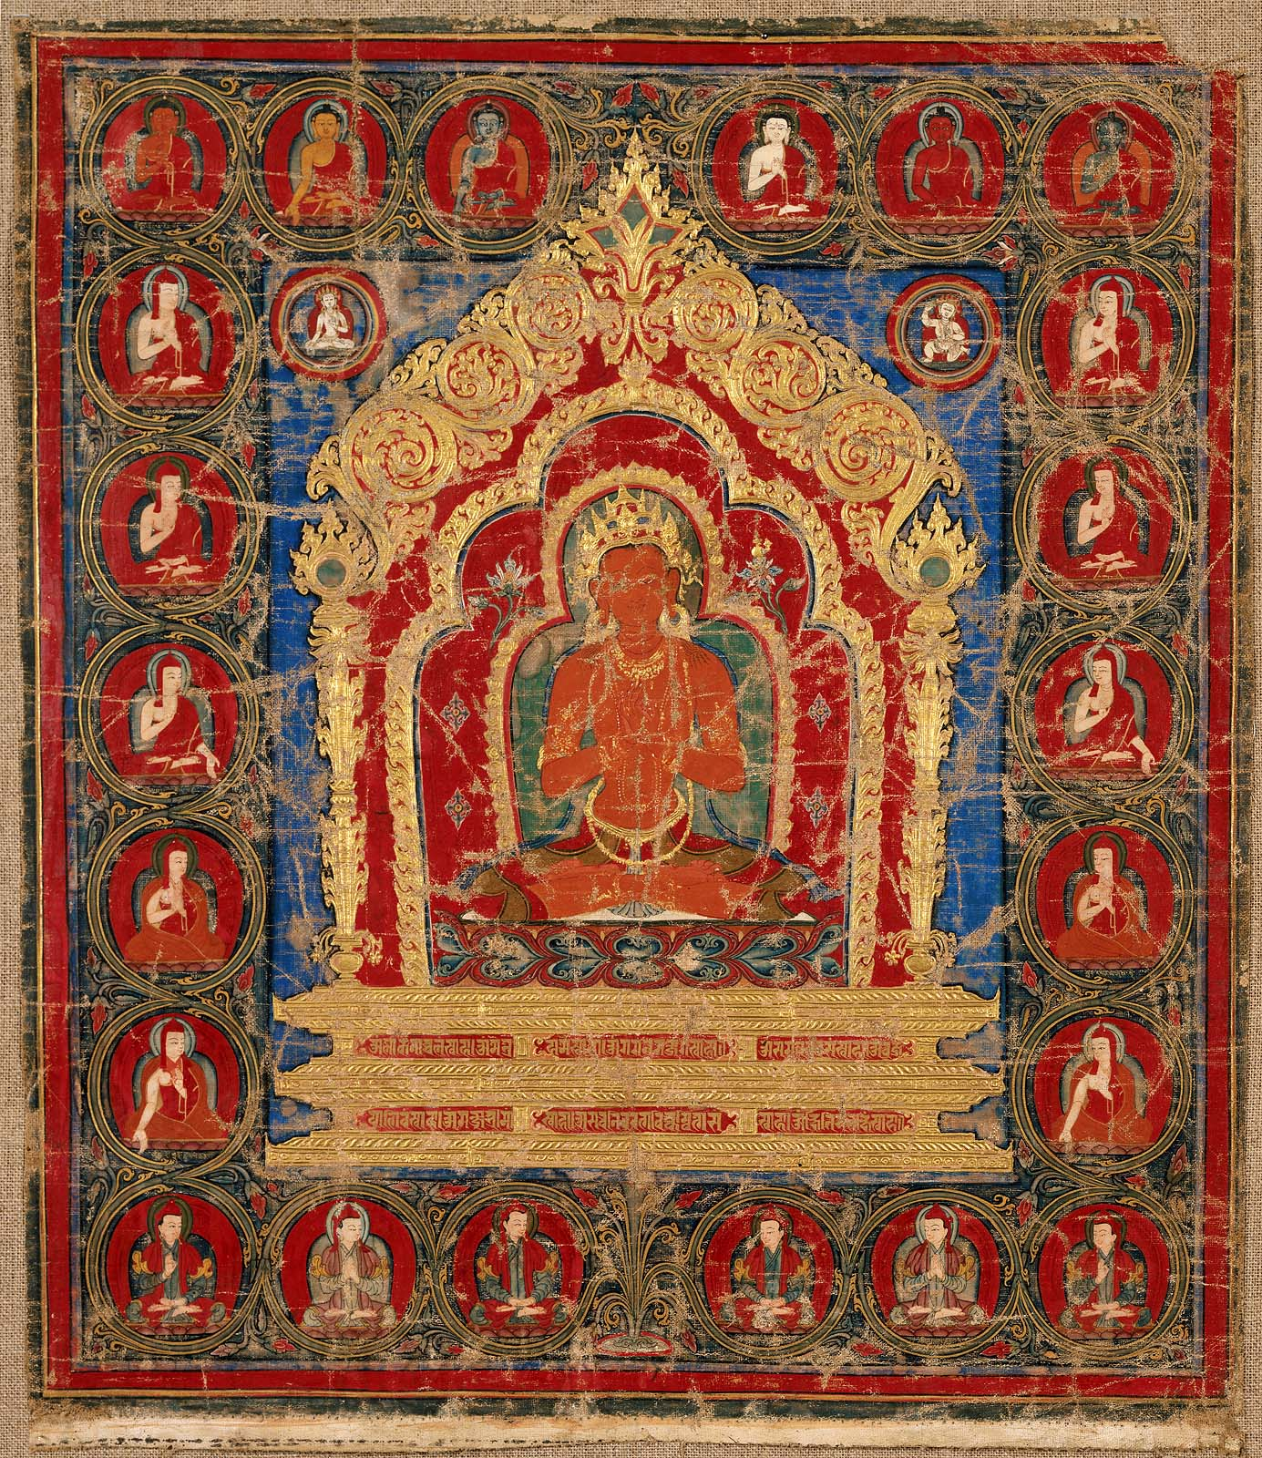
Vairocana Buddha
Tibet,15th c.

Slide 33
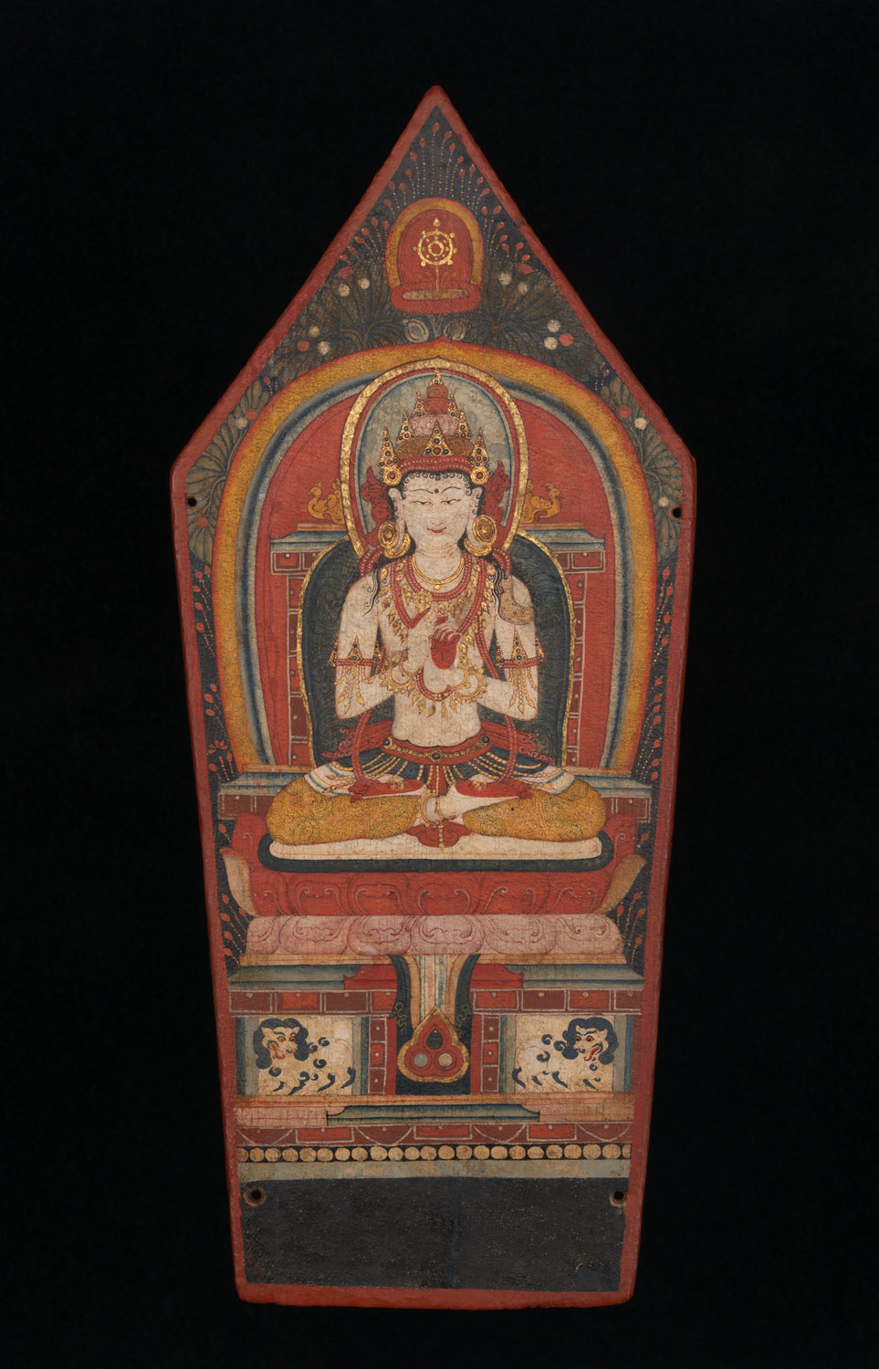
Vairocana Buddha
Tibet, 13th – 14th c.

Slide 34
Vairocana Buddha
China, Qing Dynasty,18th c.

Slide 35
Ratnasambhava Buddha The Jewel-Born Buddha
The name Ratnasambhava means “the Jewel-born One” or “Origin of Jewels.” The Three Jewels are the Buddha, the Dharma and the Sangha. The Buddha is the Enlightened One, the Guru, the hub of the wheel of the Law. The Dharma is the Teaching, or the Law, and the Sangha is the Community.
Ratnasambhava transmutes the poison of spiritual, intellectual and human pride into the Wisdom of Equality.
Tibetan Buddhists teach that with the Wisdom of Equality one sees all things with divine impartiality and recognizes the divine equality of all beings. One sees all beings and the Buddha as having the same nature. This is a condition we need, says author Giuseppe Tucci, “to spur our spiritual ascension and to acquire the trust to realize in ourselves the status of a Buddha.”1
Ratnasambhava is the Dhyani Buddha of the south. His color is yellow, the color of the sun in its zenith. He rules over the element of earth and embodies the skandha of feeling or sensation.

Slide 36
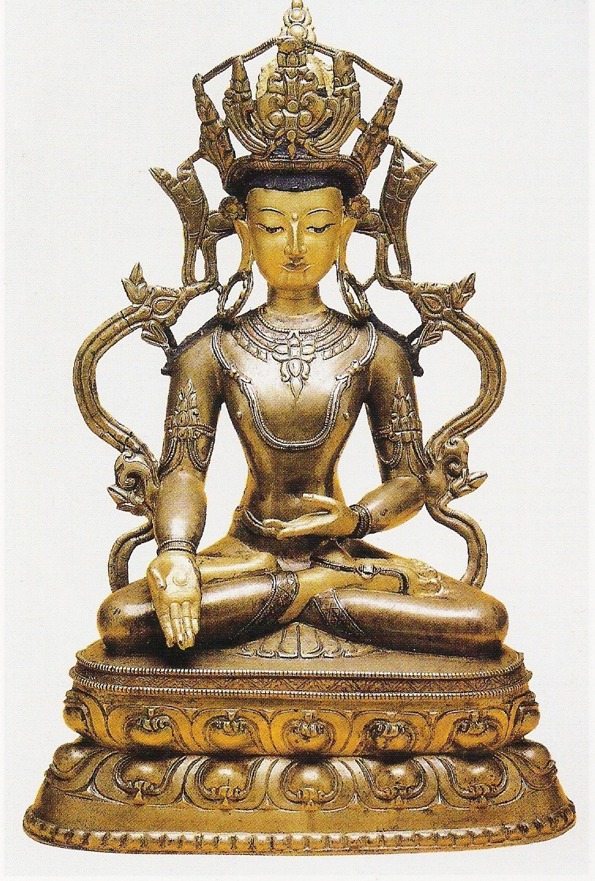
Ratnasambhava Buddha
Tibet, 14th – 15th c.

Slide 37
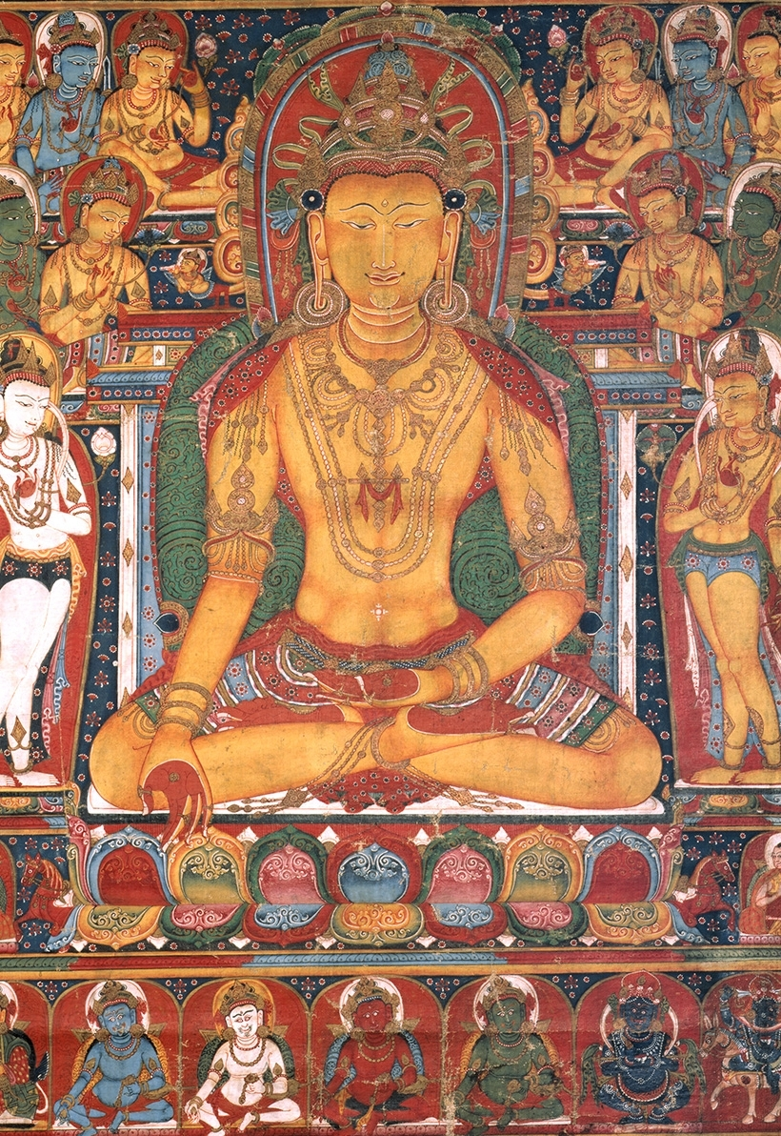
Ratnasambhava Buddha
Tibet, 14th c.

Slide 38
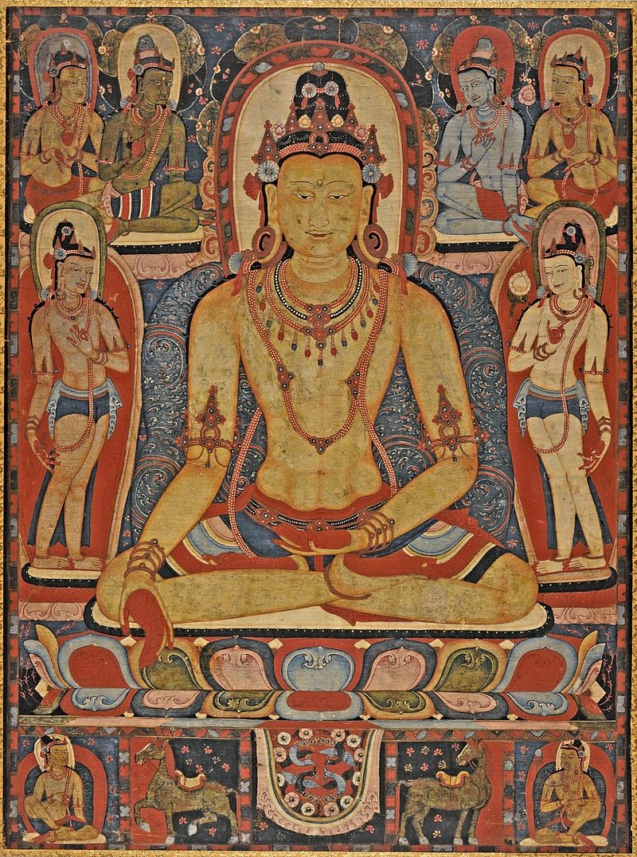
Ratnasambhava Buddha
Tibet, 12th c.

Slide 39
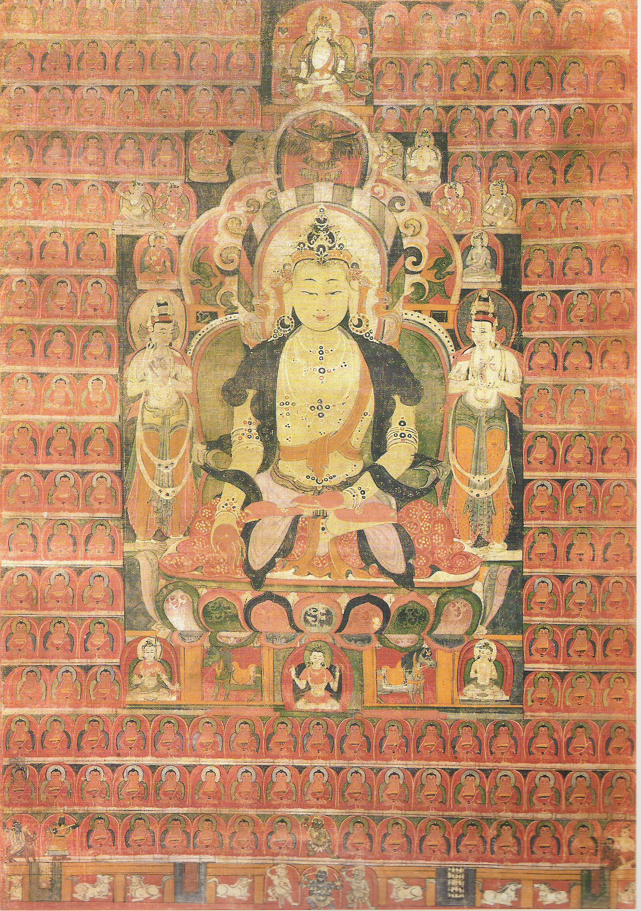
Ratnasambhava Buddha
Tibet, 15th c.

Slide 40
Amoghasiddhi Buddha Buddha of Fearlessness
Amoghasiddhi is the last of the Five Dhyani or Five Wisdom Tathagatas. They are believed to have originated from Vajrasattva, the Buddha of purification. Of these five, Amoghasiddhi is the buddha of the north. He is associated with energy and known as the Lord of Karma and the Buddha of unfailing accomplishment. His name literally means infallible (amogha) success (siddhi). He holds his hands in the Abhaya, fearlessness mudra. Amoghasiddhi is the Buddha of all accomplishing wisdom. He is venerated not only for his wisdom of success but he is also known to defeat envy. As it says in Buddhist tradition, Devadatta, a very envious cousin of Amoghasiddhi once attempted to murder the Buddha by releasing a rampaging elephant into the Buddha's path to which Amoghasiddhi simply raised his mudra calming the beast, embodying both fearlessness and defeating envy.

Slide 41
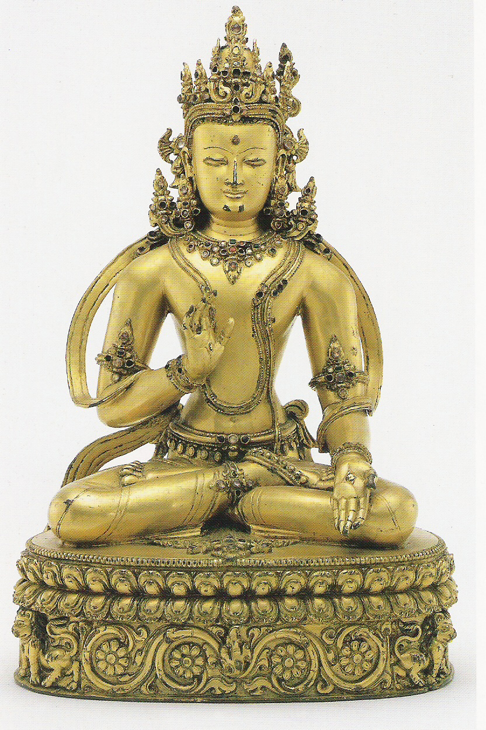
Amoghasiddhi Buddha
Tibet, 14th c.

Slide 42
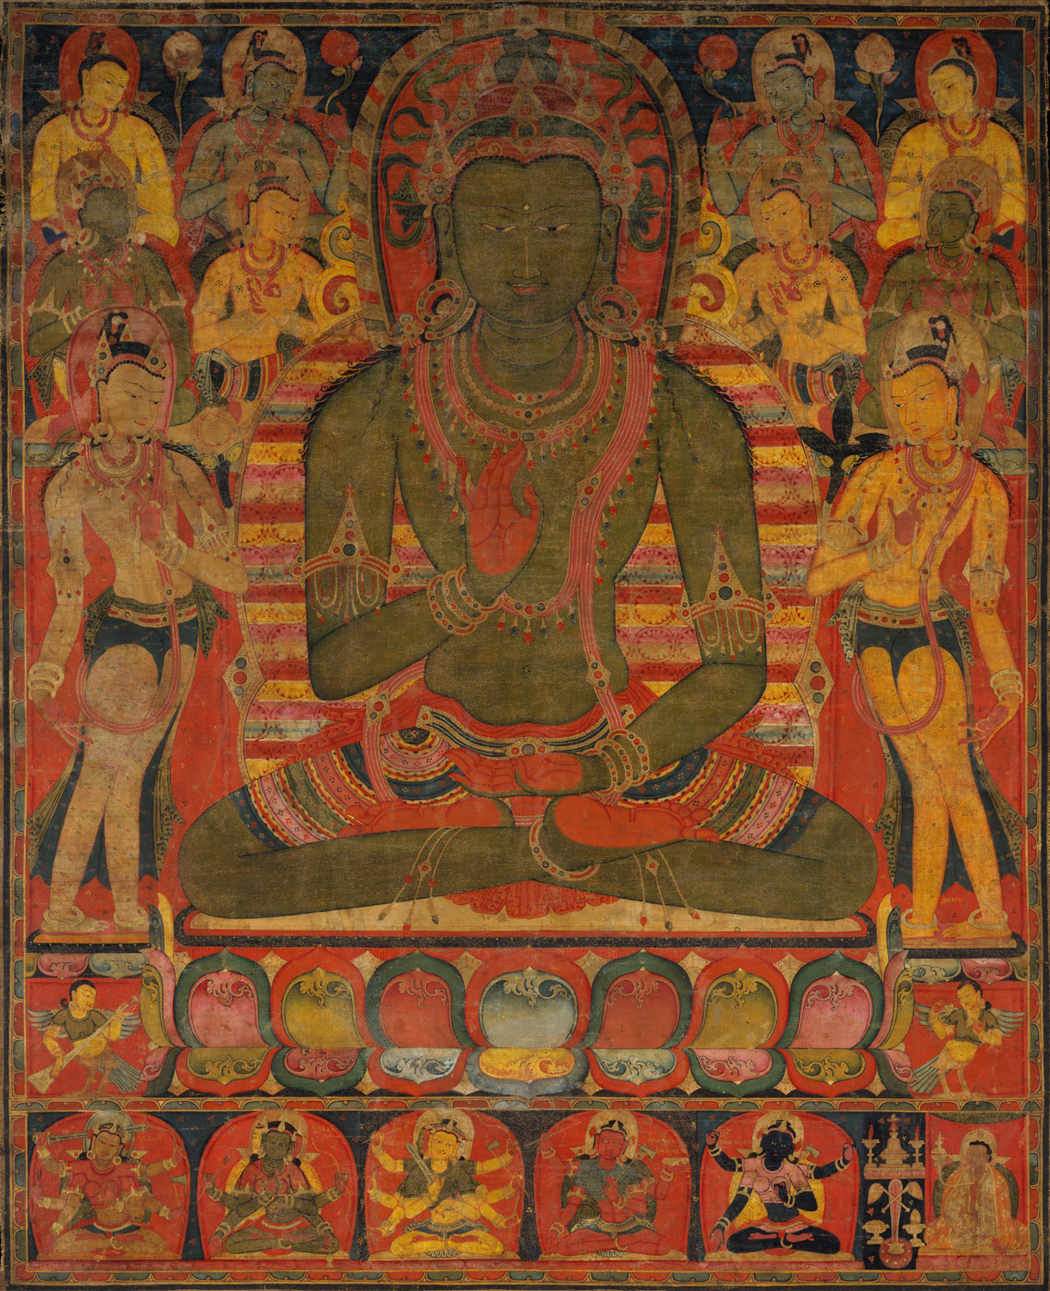
Amoghasiddhi Buddha
Tibet, 13th c.

Slide 43
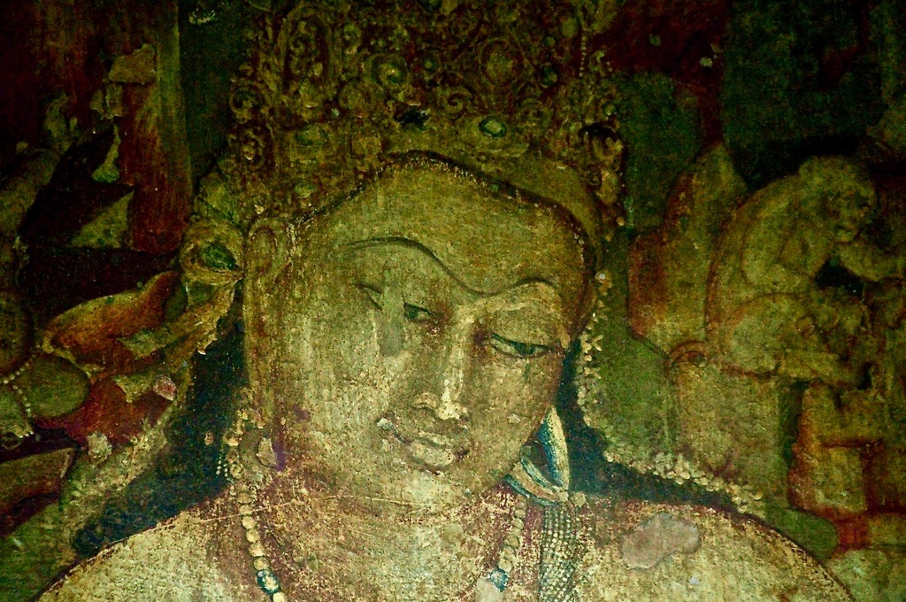
Celestial Bodhisattvas
Certain tenth-stage bodhisattvas also became celestial persons to be worshiped and venerated. Given their powers gained in the Bodhisattva Path, they too are considered sources of help for Buddhists on the Great Journey. These bodhisattvas are called "Great Beings" (mahāsattvas). Different sūtras identify these Great Beings in longer or shorter lists. Three of the most important are Maitreya, Mañjuśrī, and Avalokiteśvara. (Mitchell & Jacoby, 145)

Slide 44
Avalokiteśvara
Avalokiteśvara resides in the Buddha realm of Amitābha Buddha. His name means "the Lord Who Looks Down," indicating that Avalokiteśvara looks down from Amitābha's realm with love and compassion, ready to respond to the needs of living beings. So, while he possesses all virtues, he is especially known for his love and compassion, which he expresses in his limitless forms of skillful means. He often takes on an emanation body to appear compassionately in this world. In Tibet, His Holiness the Dalai Lama is believed to be an emanation of Avalokiteśvara, Later Buddhist art portrays Avalokiteśvara as having many heads and arms, representing his ability to notice and respond to the needs of many beings at the same time. In East Asia, Avalokiteśvara is represented as a female bodhisattva who is widely worshiped. In China she is known as Guanyin, and in Japan as Kannon. (Mitchell & Jacoby, 146)

Slide 45
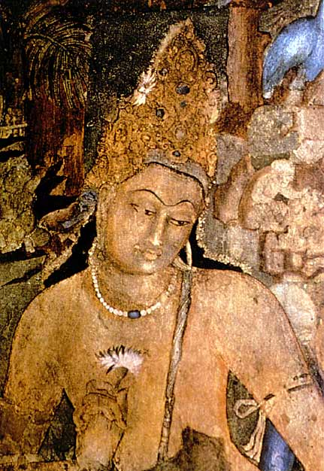
Avalokiteśvara Bodhisattva Padmapani Bodhisattva with Lotus
India, Ajanta Caves, 5th c.

Slide 46
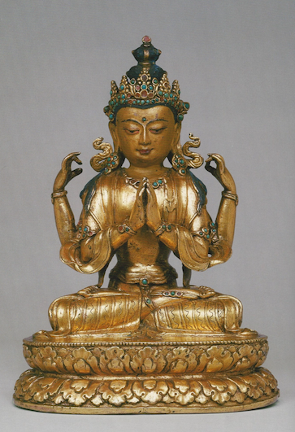
Seated Four-Armed Avalokiteśvara
Bhutan, 18th c.

Slide 47
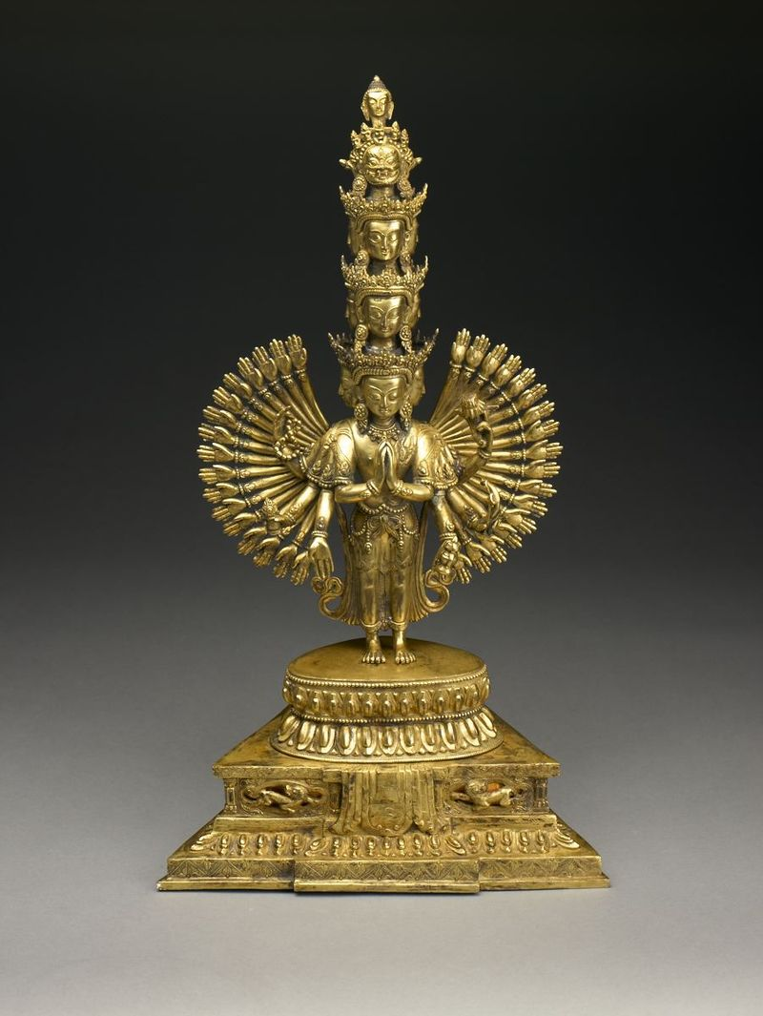
Thousand-Armed Avalokiteśvara
Tibet, 18th c.

Slide 48
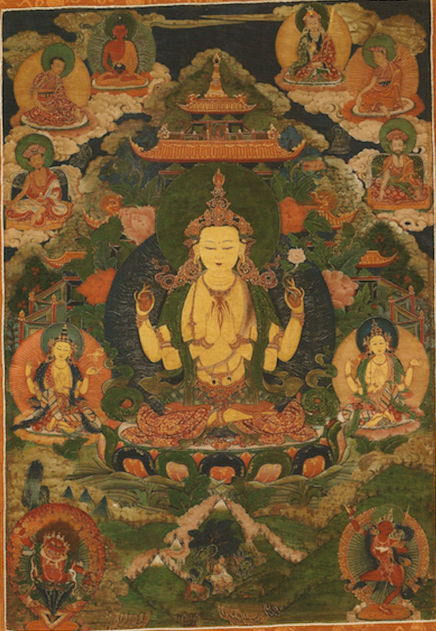
Four-Armed Avalokiteśvara
Bhutan, 17th -18th c.

Slide 49
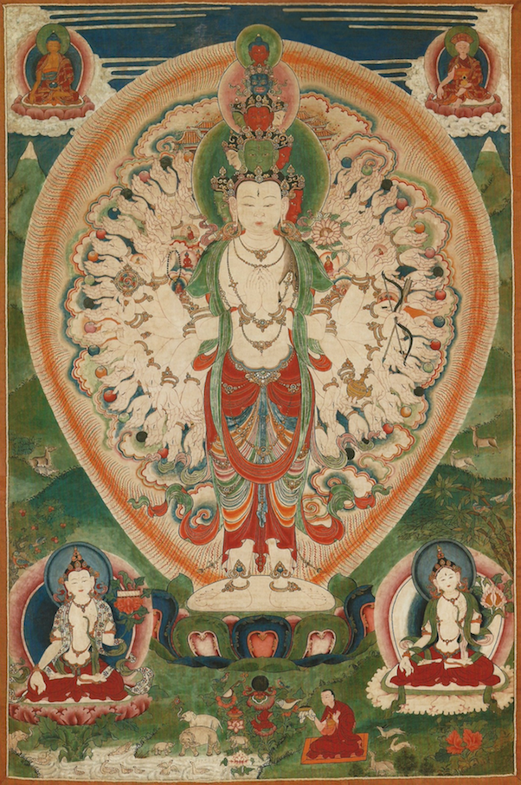
Thousand-Armed Avalokiteśvara
Bhutan, 19th c.

Slide 50
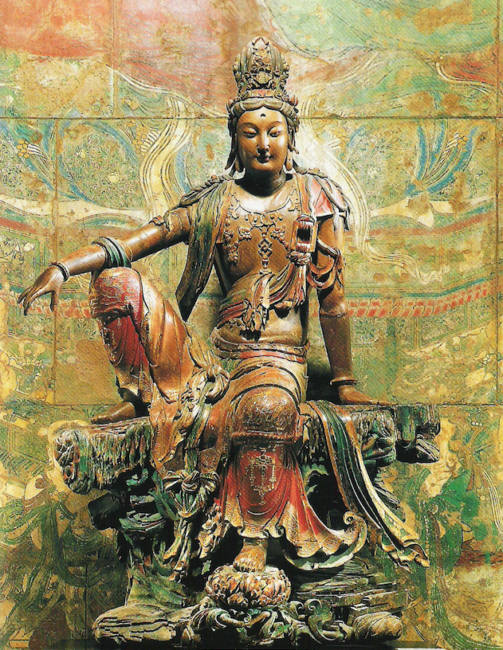
Guanyin
China, 12th-13th c.

Slide 51
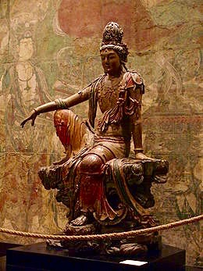
Guanyin
China, 12th-13th c.

Slide 52
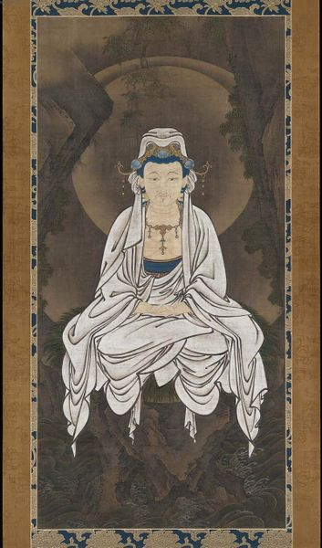
White Robed Kannon
Japan, 16 ^{th} c.

Slide 53
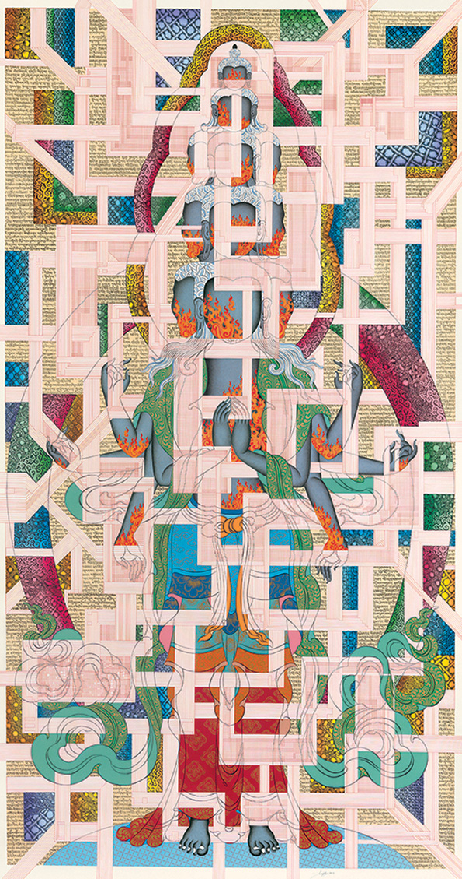
Pin-Drop Silence: Eleven-Headed Avalokiteśvara
Tenzin Rigdol, Nepal, 2013.

Slide 54
Mañjuśrī Bodhisattva of Wisdom
Mañjuśrī, or "Sweet Glory," is a celestial bodhisattva who resides in many worlds and is so revered for his great wisdom that he is called the "prince of the Dharma." He often appears in dreams and visions and protects Buddhists in times of need with his great powers. Mañjuśrī is known especially for using his great wisdom to destroy ignorance and awaken knowledge. (Mitchell & Jacoby, 145)

Slide 55
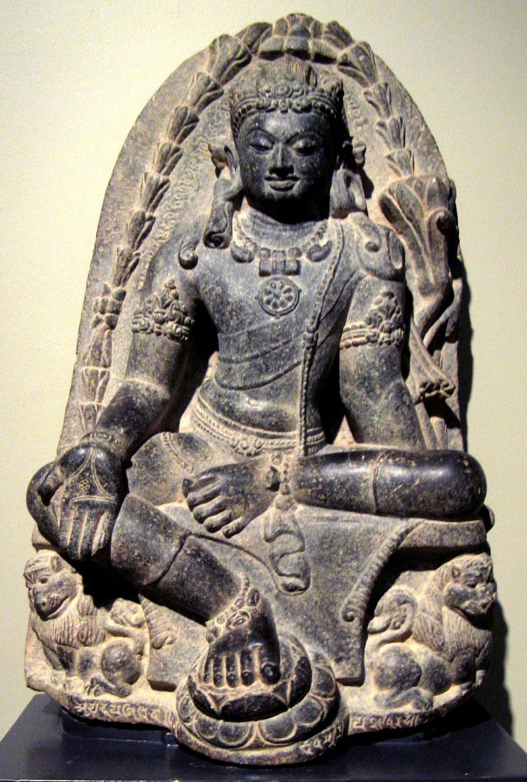
Mañjuśrī
India, 9th c.

Slide 56
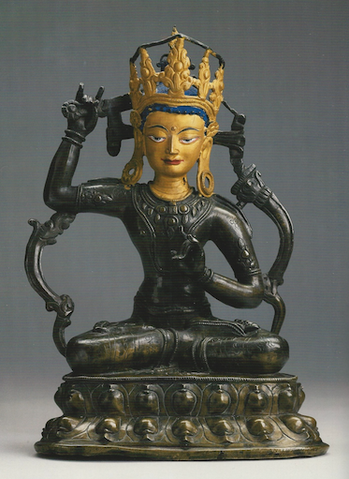
Mañjuśrī
Tibet, 13th – 14th c.

Slide 57
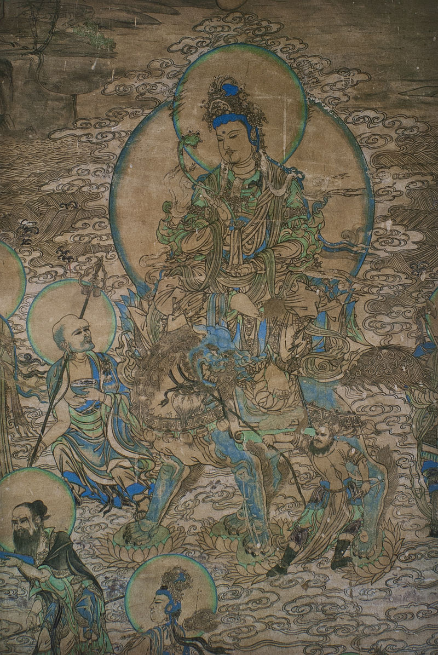
Mañjuśrī
China, Western Xia Dynaasty, 11th – 13th c.

Slide 58
Mañjuśrī
Bhutan, 18th c.

Slide 59
Mañjuśrī
Tibet, 18th c.

Slide 60
White Mañjuśrī
Bhutan, 18th – 19th c.

Slide 61
Mañjuśrī
Central Asia, 19th c.

Slide 62
Maitreya The Future Buddha
Maitreya, or "Kindly One," is mentioned in the early Pali texts as the bodhisattva who in the distant future will become a Buddha in this world. At the present time, Maitreya is living in the Tuṣita Heaven waiting to be born as the next Buddha after Gautama. In the meantime, he uses his powers and skillful means to respond to the needs of all living beings, especially to those expressed in prayers by worshipers. In tenth-century China, there was a Chan (Zen) monk named Budai. Budai was a happy and rather portly monk who gave presents to children from a bag he carried with him. After his death, a legend developed in China that he was, in reality, an emanation body of Maitreya. In the West, his image is sometimes called “the Laughing Buddha.” (Mitchell & Jacoby, 146)

Slide 63
Maitreya
India, 10th – 11th c.

Slide 64
Maitreya
Korea, 7th c.

Slide 65
Maitreya
China, Yuan Dynasty, 14th c.

Slide 66
Maitreya
Bhutan, 17th c.

Slide 67
Maitreya The Future Buddha
Bhutan, 18th -19th c.

Slide 68
Miroku Bosatsu (Maitreya Buddha)
Japan, 7th c.

Slide 69
Miroku Bosatsu (Maitreya Buddha)
Japan, 7th c.

Slide 70
Maitreya
Tibet, 13th c.

Slide 71
Maitreya
Tibet, 19th c.

Slide 72
Maitreya
Tibet, 17th c.

