Slide 1
In his book Art and Experience, which came out in 1934, philosopher John Dewey explains that in painting "the medium becomes color alone, and since color alone must now carry the qualities of movement, touch, sound, etc., that are present physically on their own account in ordinary vision, the expressiveness and energy of color are enhanced" (Dewey 1994, 214-15). This view seems to anticipate the work of painter Mark Rothko, who was at that time just beginning to experiment in his color field paintings.
Art as Experience
Yellow Over Purple
Oil on canvas, Mark Rothko, 1956.
Private collection of Kate Rothko Prizel and Christopher Rothko

Slide 2
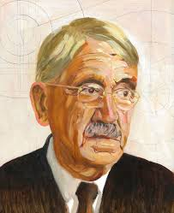
John Dewey (1859-1952) was an American philosopher who was instrumental in the development of that distinctive American philosophical movement or tradition of thought known as Pragmatism. Modern Western philosophy developed in two main traditions, the Anglo Analytic tradition with roots going back to British empiricism (Locke, Berkeley, Hume), and the Continental tradition with roots going back to the Continental Rationalists (Descartes, Spinoza, Leibniz) . In the late 19th century a third tradition, known as Pragmatism, developed in the United States with the work Charles Sanders Pierce (1839-1914), William James (1842-1910) and Dewey.
Art as Experience
John Dewey
Portrait by Darren McAndrew, 2019.

Slide 3
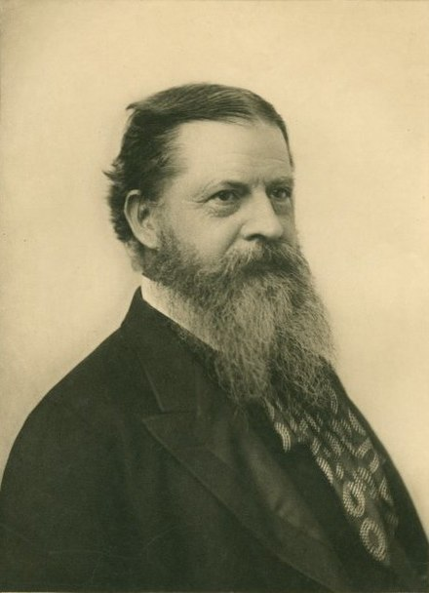
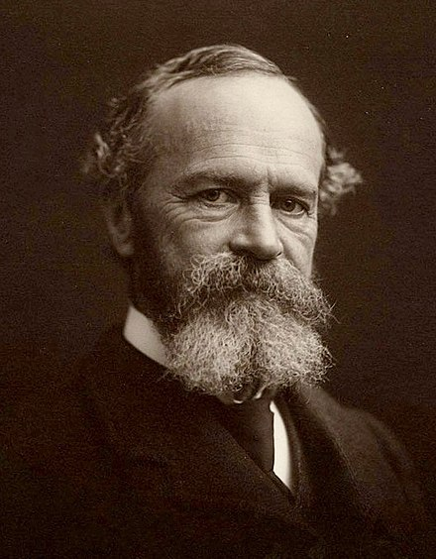
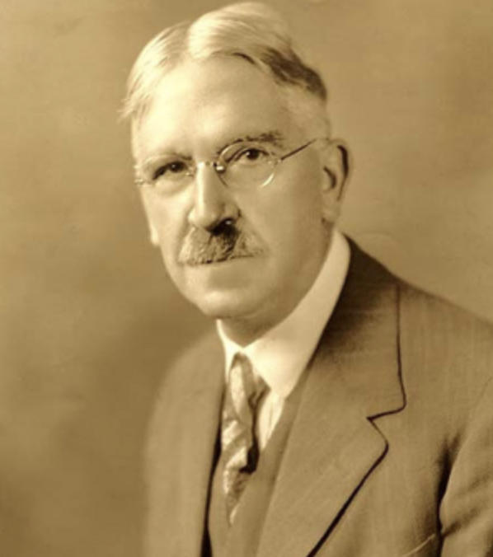
The distinctive characteristic of Pragmatism is a focus on the pragmatic, what works, what is most practical in human use. The origin of the term pragmatism is traced to what Peirce called the pragmatic maxim: "Consider the practical effects of the objects of your conception. Then, your conception of those effects is the whole of your conception of the object" (Peirce 1878, 293). Here he is saying that our very idea or conception of something is shaped by the practical effects, the consequences that the object has for us.
American Pragmatism
Charles Sanders Peirce
(1839-1914)
William James
(1842-1910)
John Dewey
(1859-11952)

Slide 4
From this view that the meaning of a concept comes down to its “practical bearings” Peirce first proposed a pragmatic theory of truth. Peirce’s view is that the practical difference in describing a view as true is that true beliefs are the one’s that gain general acceptance through withstanding all future questioning.
American Pragmatism
All the followers of science are fully persuaded that the processes of investigation, if only pushed far enough, will give one certain solution to every question to which they can be applied.…The opinion which is fated to be ultimately agreed to by all who investigate, is what we mean by the truth. (Peirce, 1986: 273)
Charles Sanders Peirce
(1839-1914)

Slide 5
William James further develops the pragmatic theory of truth. Like Peirce, James suggests that true beliefs are satisfying beliefs. An idea is true because it works, it helps us in some way deal with our experience. James says that an idea is true because it is useful.
American Pragmatism
Ideas…become true just in so far as they help us get into satisfactory relation with other parts of our experience, to summarize them and get about among them by conceptual short-cuts instead of following the interminable succession of particular phenomena. (James 1975, 34)
William James
(1842-1910)

Slide 6
Both James and Dewey argued that the traditional correspondence theory of truth, according to which the true idea is one that agrees or corresponds to reality, could no longer adequately be explained. Dewey and James thus put forth the notion that an idea agrees with reality, and is therefore true, if and only if it is successfully employed in human action in pursuit of human goals and interests, that is, if it leads to the resolution of a problems. For Dewey, an idea “corresponds” to reality, not be copying reality as it is in-itself, but because it works for us in experience.
American Pragmatism
My own view takes correspondence in the operational sense…of answering, as a key answers to conditions imposed by a lock, or as two correspondents “answer” each other; or, in general, as a reply is an adequate answer to a question or criticism—; as, in short, a solution answers the requirements of a problem. (Dewey, 1941, 178)
John Dewey
(1859-11952)

Slide 7
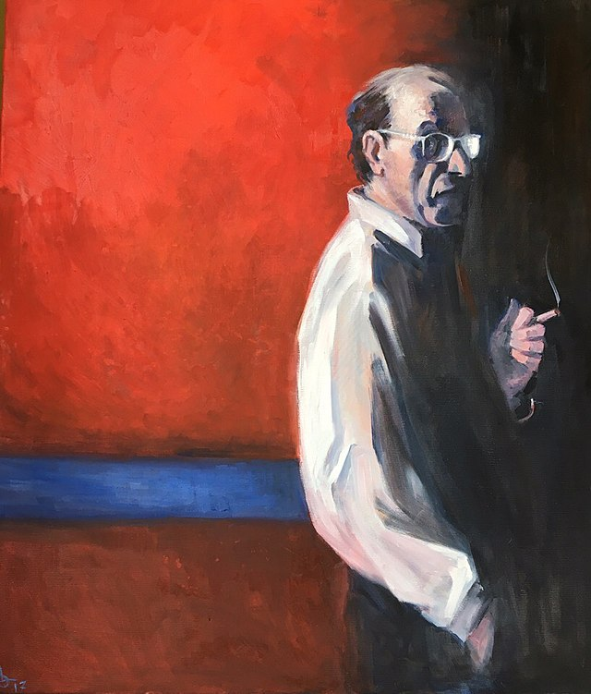
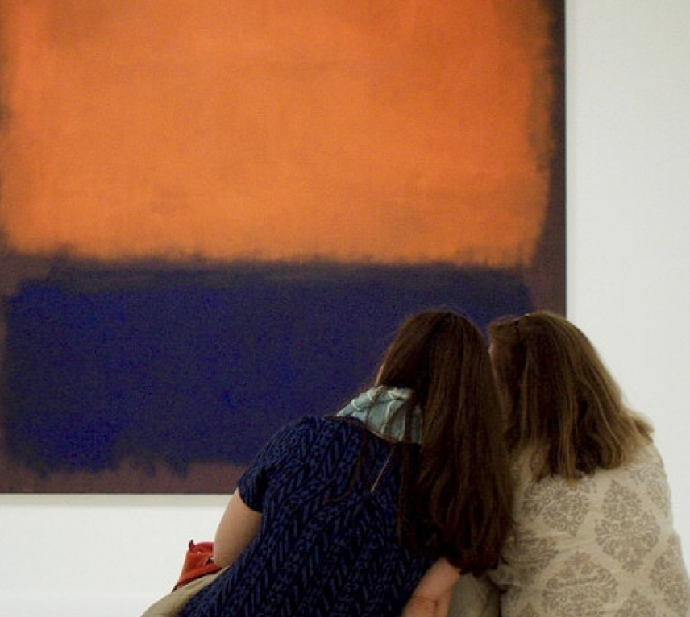
Dewey develops this pragmatic view into a theory of art in which the work of art is understood as an experience. Dewey is critical of other philosophies of art that focus exclusively on either the artist's creative production and experience, the object—the work of art, or the experience of the viewer. In developing his view of art as experience, Dewey explains how the experience of art always involves all three, such that the artist, the work of art, and the viewer are all equally important in the experience of art.
Art as Experience
The Artist
The work of art
The Viewer

Slide 8
In developing this theory Dewey suggests that the success or failure of the work of art is determined by how well it works as an experience. A work of art may be successful for a time, but if it does not continue to be an occasion for further experiences of the work in viewers it will be forgotten, filed away in the hidden collections of a museum, and remembered, if at all, as a mere historical footnote. Great works of art, Dewey suggests, are those that passed the test of time and continue to be relevant in leading to further experiences of that work of art. As Ross puts it in the introduction to the selection in our reader, Dewey's view is similar to Nietzsche's in taking "art to be the model for the highest forms of human achievement" (Ross 19994, 203).
Art as Experience
John Dewey
Portrait by Darren McAndrew, 2019.

Slide 9
The Live Creature In this first section, Dewey is critical of aesthetic theories that identify the work of art with the object, "the building, book, painting, or statue in its existence apart from human experience" and he challenges these views by putting forth the view that "the actual work of art is what the product does with and in experience" (Dewey 1994, 204). He comments how an art work, when it attains classic status, can become "isolated from the human conditions under which it was brought into being and from the human consequences it engenders is actual life-experience " (Dewey 1994, 204). He sees his task as a philosopher of the fine arts to "restore continuity between the refined and intensified forms of experience that are works of art and the everyday events, doings, and sufferings that are universally recognized to constitute experience" (Dewey 1994, 204-05).
Art as Experience
Orange and Tan
Oil on canvas, Mark Rothko, 1954.
National Gallery of Art, Washington, D.C.

Slide 10
Having an Experience Here Dewey explains what he means by an experience. Whereas much of our experience is inchoate, that is, not fully formed, somehow incomplete, Dewey suggests a special sense of having an experience "when the material experienced runs its course to fulfillment" (Dewey 1994, 205). He further describes this experience: "Experience in this vital sense is defined by those situations and episodes that we spontaneously refer to as being 'real experiences'; those things which we say in recalling them, 'that was an experience'" (Dewey 1994, 205).
Art as Experience
Untitled Mural for End Wall
Oil on canvas, Mark Rothko, 1959.
Tate National Gallery of Art, London.

Slide 11
Having an Experience He goes on to describe such an experience as not a static thing, but rather a seamless flow, like a river, as distinct from a pond. "In a work of art," Dewey explains, "different acts, episodes, occurrences melt and fuse into unity, and yet do not disappear and lose their own character as they do so" (Dewey 1994, 206). Dewey goes on to distinguish what he means by experience from "Locke's and Hume's so-called ideas and impressions" which are understood as somehow separate discreet independent things. The work of art, as an experience, is not a static thing, but a process:
Art as Experience
White Center
(Yellow, Pink and Lavender on Rose)
Oil on canvas, Mark Rothko, 1950.
Private collections

Slide 12
Art as Experience
“Art denotes a process of doing or making. This is true of fine art as of technological art. Art involves molding of clay, chipping of marble, casting of bronze, laying on of pigments, construction of buildings, singing of songs, playing of instruments, enacting roles on the stage, going through rhythmic movement in the dance. Every art does something with some physical material, the body or something outside the body, with or without the use of intervening tools, and with a view to productions of something visible, audible, or tangible” (Dewey 1994, 207).
No.5/ No.22
Oil on canvas, Mark Rothko, 1949-50.
Museum of Modern Art, New York

Slide 13
Having an Experience Dewey accepts in some sense Mill's view art aims at "perfection in execution," but he emphasizes that this "perfection in execution" in the work of art is different from that of a pure mechanical production. The craftsmanship of the artist, Dewey explains, "must be 'loving'; it must care deeply for the subject matter upon which skill is exercised" (Dewey 1994, 207). In addition to this active artistic creation, Dewey emphasizes that his conception of art as experience also involves an aesthetic (esthetic) experience which is the experience of appreciating, perceiving, and enjoying the work of art. "To be truly artistic, a work must also be esthetic—that is, framed for enjoyed receptive perception" (Dewey 1994, 207). Dewey then sums up this conception of art as experience:
Art as Experience
Untitled, No. 73
Oil on canvas, Mark Rothko, 1952.
High Museum of Art, Atlanta

Slide 14
Art as Experience
In short, art, in its form, unites the very same relation of doing and undergoing, outgoing and incoming energy, that makes an experience to be an experience. [...] Man whittles, carves, sings, dances, gestures, molds, draws and paints. The doing or making is artistic when the perceived result is of such a nature that its qualities as perceived have controlled the question of production” (Dewey 1994, 208).
Untitled (Green on Maroon)
Oil on canvas, Mark Rothko, 1961.
Museo Nacional Thyssen-Bornemisza, Madrid

Slide 15
The Expressive Object In this section Dewey turns to examine the object, the product of the artist's creation, the "object that is expressive, that says something to us" (Dewey 1994, 208). Here Dewey wants to avoid the tendency to separate too much the artist's expression from the object that is the product of that expression, and thus he argues that in the work of art "expression as personal act and as objective result are organically connected with each other" (Dewey 1994, 208).
Art as Experience
No. 61 (Rust and Blue)
Oil on canvas, Mark Rothko, 1953.
Museum of Contemporary Art, Los Angeles

Slide 16
The Expressive Object Dewey goes on to say something about the question of meaning in the work of art. He distinguishes what goes on in a work of art from something like a signboard, where the meaning of the signboard is in its signs that direct the viewer to a particular experience. He distinguishes the work of art in that it does not direct one to an experience, but is an experience. In this way Dewey distinguishes the poetic from the prosaic, the esthetic from the scientific. "The poem, or painting, does not operate in the dimensions of correct descriptive statement but in that of experience itself" (Dewey 1994, 210).
Art as Experience
“A painting is not a picture of an experience,
but is the experience.” Mark Rothko
Untitled
Oil on canvas, Mark Rothko, 1958.
Kawamura Memorial Museum of Art

Slide 17
The Expressive Object Dewey goes on to say something about the question of meaning in the work of art. He distinguishes what goes on in a work of art from something like a signboard, where the meaning of the signboard is in its signs that direct the viewer to a particular experience. He distinguishes the work of art in that it does not direct one to an experience, but is an experience. In this way Dewey distinguishes the poetic from the prosaic, the esthetic from the scientific. "The poem, or painting, does not operate in the dimensions of correct descriptive statement but in that of experience itself" (Dewey 1994, 210).
Art as Experience
No. 5
Oil on canvas, Mark Rothko, 1958.
National Gallery of Art, Washington, D.C.

Slide 18
Substance and Form Here Dewey considers the traditional distinction between the substance and form of a work of art, the distinction, for example, between the bronze and the form of the statue. Dewey suggests that works of art are a language, and each art has its own medium that is "especially fitted for one kind of communication" (Dewey 1994, 211). He thus rejects the idea that the meaning of a work of art can be translated into words without something crucial being lost in that translation. "In fact, each art speaks an idiom that conveys what cannot be said in another language" (Dewey 1994, 211). Just as language involves a connection between a speaker, what is said, and the listener, the "external object, the product of art, is the connecting link between artist and audience" (Dewey 1994, 211). All language, Dewey, goes on to point out, "involves what is said and how it is said, or substance and form" (Dewey 1994, 211).
Art as Experience
Untitled (Blue Divided by Blue)
Acrylic on paper, Mark Rothko, 1966.
Private collection

Slide 19
Substance and Form Here Dewey suggests that a work of art has to have some self-expression, some free play of individuality. He goes on to say that although the "material out of which a work of art is composed belongs to the common world rather than to the self," and thus, the "material expressed cannot be private," the manner of expression has to be individual, and thus Dewey claims, the work of art must be "induplicable" (Dewey 1994, 212). Here Dewey is ruling out any mechanical reproduction of a work of art.
Art as Experience
Red on Maroon Mural
Oil on canvas, Mark Rothko, 1959.
Tate National Gallery of Art, London.

Slide 20
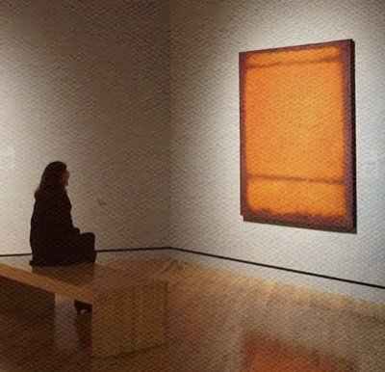
Substance and Form Dewey then goes on to discuss the experience of the perceiver, and there he suggests that each experience in a perceiver is, in some important sense, radically new. He gives an example of a poem, in which no two readers have exactly the same experience. "A new poem is created by every one who reads poetically" (Dewey 1994, 212). Thus, he suggests that a work of art is "recreated every time it is esthetically experienced" (Dewey, 1994, 213).
Art as Experience
No. 210/No. 211, (Orange)
Oil on canvas, Mark Rothko, 1960.
Crystal Bridges Museum of American Art

Slide 21
Substance and Form In the experience of the work of art all three parts, the artist's experience of creating the work of art, the work that is the product of that experience, and the experience of the viewer, are brought together into a whole, that is an experience, the experience of the work of art:
Art as Experience
No 1. (Royal Red and Blue)
Oil on canvas, Mark Rothko, 1954

Slide 22
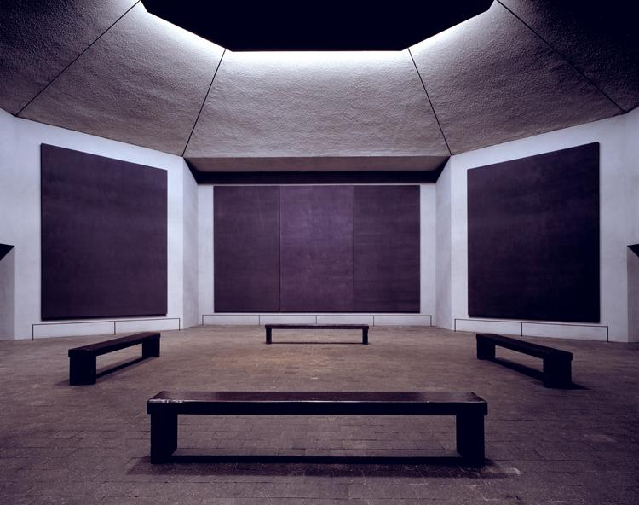
Art as Experience
A work of art elicits and accentuates this quality of being a whole and of belonging to the larger, all-inclusive, whole which is the universe in which we live. This fact, I think, is the explanation of that feeling of exquisite intelligibility and clarity we have in the presence of an object that is experienced. with esthetic intensity. [...] We are carried out beyond ourselves to find ourselves. I can see no psychological ground for such properties of an experience save that, somehow, the work of art operates to deepen and to raise to great clarity that sense of an enveloping undefined whole that accompanies every normal experience. This whole is then felt as an expansion of ourselves. (Dewey 1994, 214)
Rothko Chapel
Installation, Mark Rothko, 1967
Houston, Texas

Slide 23
The Common Substance of the Arts Here Dewey considers the question of the medium of the work of art. Every work of art has its particular medium. Thus, in painting "the medium becomes color alone, and since color alone must now carry the qualities of movement, touch, sound, etc., that are present physically on their own account in ordinary vision, the expressiveness and energy of color are enhanced" (Dewey 1994, 214-15). He goes on to argue that the medium in the work of art is not a mere means. The particular medium is essential to the work. "Colors are the painting, tones are the music. A picture painted with water colors has a quality different from that painted with oil. Esthetic effects belong intrinsically to their medium, when another medium is substituted, we have a stunt rather than an object of art" (Dewey 1994, 216). Because the medium is not a mere means, but essential to the expressiveness of the work of art, Dewey goes on to say that "media and esthetic effect are completely fused" and thus: "Brushstrokes are an integral part of the esthetic effect of a painting when it is perceived" (Dewey 1994, 217).
Art as Experience

Slide 24
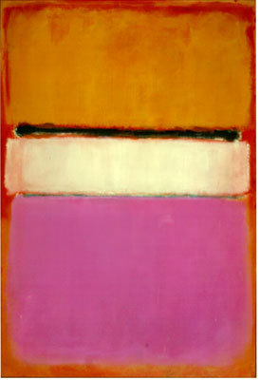
The Challenge to Philosophy Dewey emphasizes the importance of imagination, both in the artistic production of a work of art, and in its appreciation. The work of art, Dewey emphasizes is different from the work of a machine: "The work of art, however, unlike the machine, is not only the outcome of imagination but operates imaginatively rather than in the realm of physical existences. What it does is to concentrate and enlarge an immediate experience. [...] The work of art is thus a challenge to the performance of a like act of evocation and organization, through imagination, on the part of the one who experiences it" (Dewey 1994, 219).
Art as Experience
White Center
Oil on canvas, Mark Rothko, 1950.
Private collection

Slide 25
The Challenge to Philosophy Dewey explains that this aspect of the experience of art presents a challenge to philosophy, especially to the philosophy of art: "Yet philosophies of esthetics have often set out from one factor that plays a part in the constitution of experience, and have attempted to interpret or 'explain' the esthetic experience by a single element; in terms of sense, emotion, reason, of activity; imagination itself is viewed not as that which holds all other elements in solution but as a special faculty" (Dewey 1994, 219). He suggests at the end that the clew that can serve as a guide through the labyrinth of the experience of the work of art, is to pay attention to the experience of the work of art, and allow the "esthetic experience to tell its own tale" (Dewey 1994, 220).
Art as Experience
Untitled [Blue, Green, and Brown]
Oil on canvas, Mark Rothko, 1952.
Private Collection

Slide 26
Dewey, John. 1941. “Propositions, Warranted Assertibility, and Truth”, The Journal of Philosophy, 38(7): 169–186. Dewey, John. 1994. Art as Experience in Art and Its Significance, 3rd ed. Edited by Stephen David Ross. Albany: State University of New York Press. [1934] James, William. 1975. The Meaning of Truth: A Sequel to “Pragmatism”, New York and London: Longmans, Green & Co.; reprinted Cambridge, MA: Harvard University Press, [1909]. Peirce, Charles Sanders. 1986. “How to Make Our Ideas Clear”, Popular Science Monthly, 12(January): 286–302; reprinted in Writings of Charles S. Peirce: A Chronological Edition (Volume 3: 1872–1878), C. Kloesel, M. Fisch, N. et al. (eds.), Bloomington, IN: Indiana University Press, pp. 257–276. [1878]
Bibliography

