Slide 1
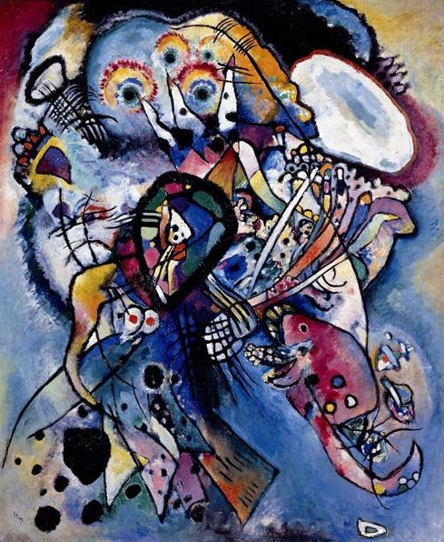
Philosophy of Art
Art as Expression
Composition #218 (Two Ovals)
Oil on canvas, Wassily Kandinsky, 1919. Russian Museum, Saint Petersburg

Slide 2
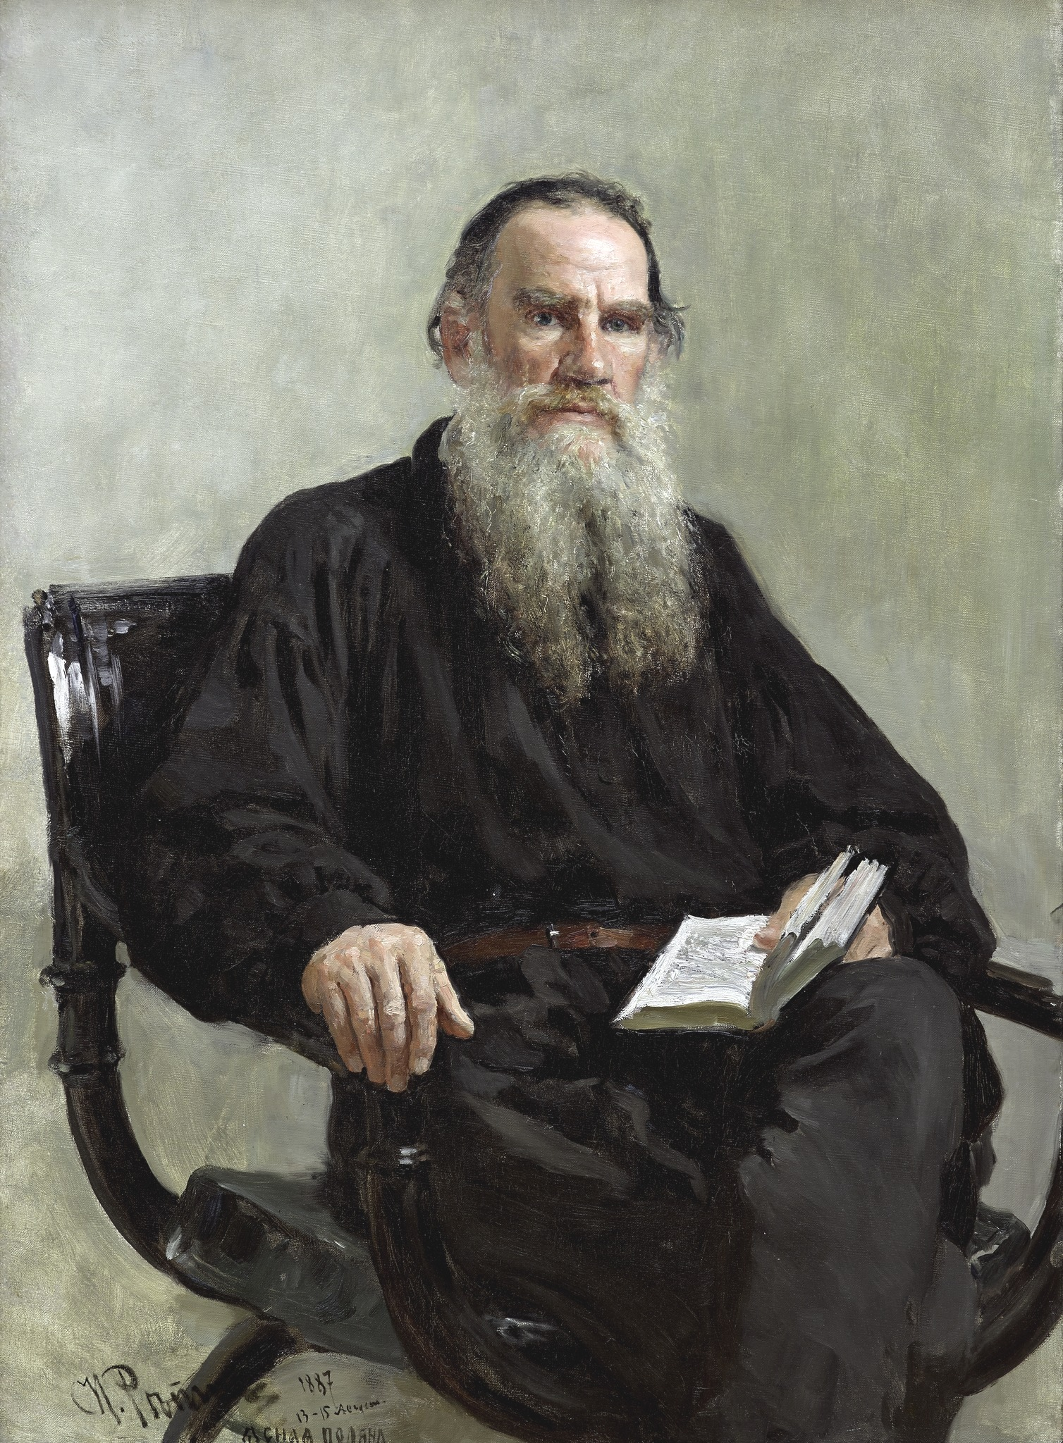
Count Lev Nikolayevich Tolstoy (1828-19210) is generally regarded as one of the greatest novelists of all time. He is best known for the novels War and Peace (1869) and Anna Karenina (1877). In the 1870s Tolstoy experienced a profound moral crisis, followed by what he regarded as an equally profound spiritual awakening, as outlined in his non-fiction work A Confession (1882). His literal interpretation of the ethical teachings of Jesus, centering on the Sermon on the Mount, caused him to become a fervent Christian anarchist and pacifist. Tolstoy's ideas on nonviolent resistance, expressed in such works as The Kingdom of God Is Within You (1894), had a profound impact on such pivotal 20th-century figures as Mahatma Gandhi and Martin Luther King Jr. “He offers the strongest account available of a view of art that is held by many people—that art succeeds when it arouses and transmits emotion, when it brings people together and enriches their common humanity” (Ross 1994, 177).
Portrait of Leo Tolstoy
Oil on canvas, Ilya Efimovich Repin, 1887

Slide 3
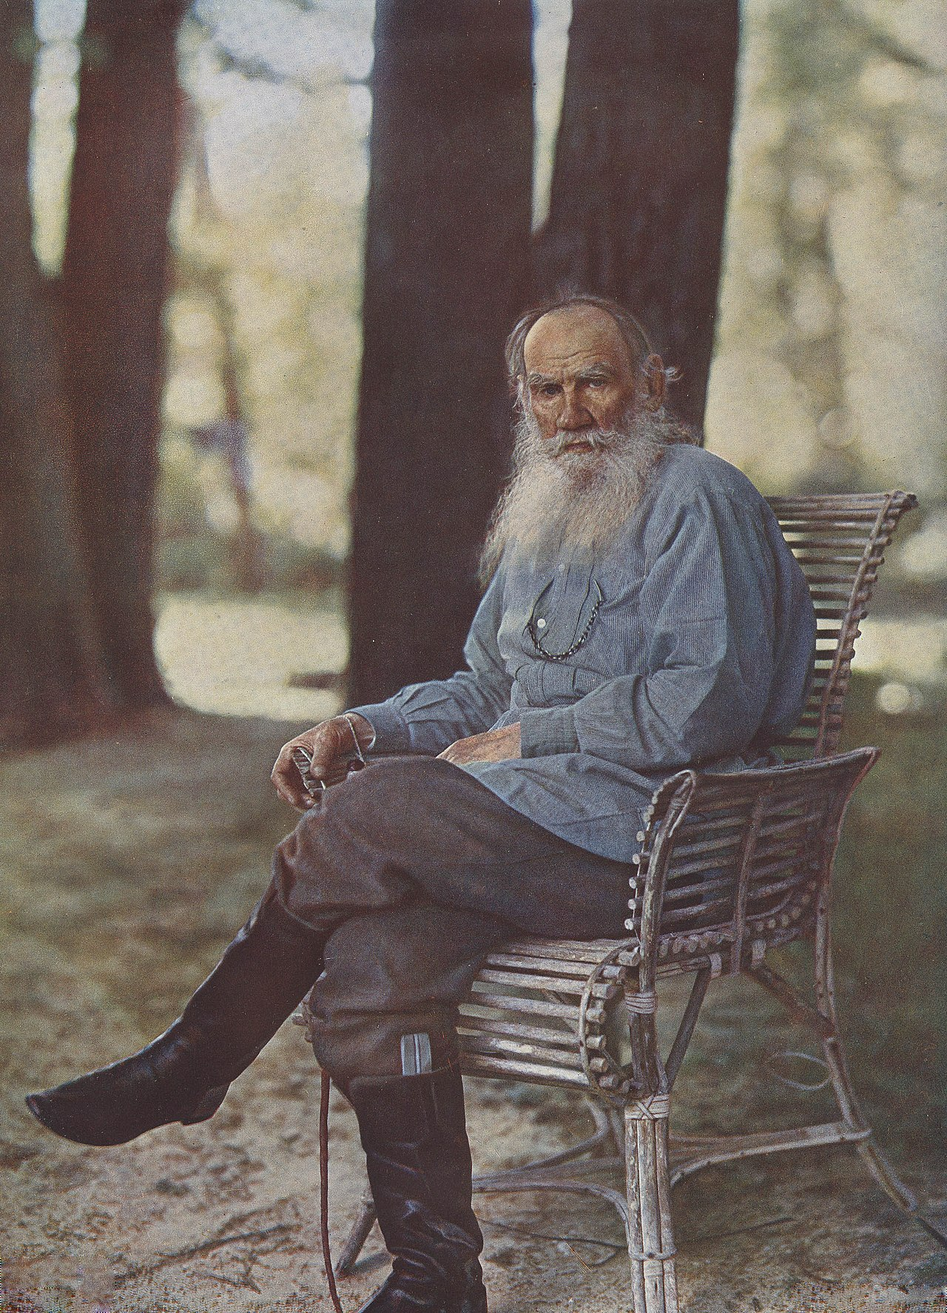
What is Art? One of the commonest beliefs about art is that it is essentially a form of expression, what is more, the expression of feeling. This view is so common that it is often simply assumed to be true by students, critics, and artists. Tolstoy put forth the view that art is the communication of feelings from artist to viewer through certain external signs. Artists are people inspired by emotional experiences. Artists use their skill with words, paint, music, movement, etc., to embody their emotions in a work of art with a view to stimulating the same emotion in an audience. “The activity of art is based on the fact that a man receiving through his sense of hearing or sight another man’s expression of feeling, is capable of experiencing the emotion which moved the man who expressed it” (Tolstoy 1994, 178).
Tolstoy on May 23, 1908
Photo by Sergey Prokudin-Gorsky

Slide 4
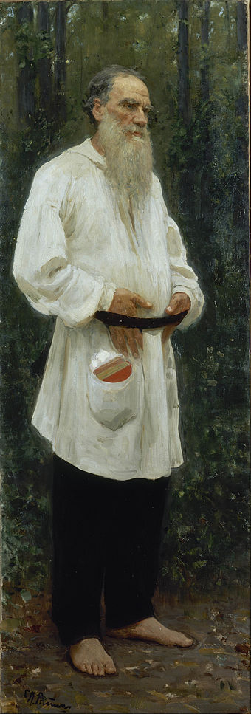
To take the simplest example: one man laughs and another, who hears, becomes merry; or a man weeps and another, who hears, feels sorrow. A man is excited or irritated, and another man, seeing him, is brought to a similar state of mind. By his movements or by the sound of his voice a man expresses courage and determination or sadness and calmness, and this state of mind passes on to others… . And it is on this capacity of man to receive another man’s expression of feeling, and to experience those feelings himself, that the activity of art is based” (Tolstoy 1994, 178). “To evoke in oneself a feeling one has once experienced and, having evoked it in oneself then by means of movements, lines, colours, sounds, or forms expressed in words, so to transmit that feeling that others experience the same feeling—this is the activity of art. Art is a human activity consisting in this, that one man consciously, by means of certain external signs, hands on to others feelings he has lived through, and that others are infected by these feelings and also experience them….” (Tolstoy 1994, 179).
Tolstoy dressed in peasant clothing
Photo by Ilya Repin, 1901

Slide 5
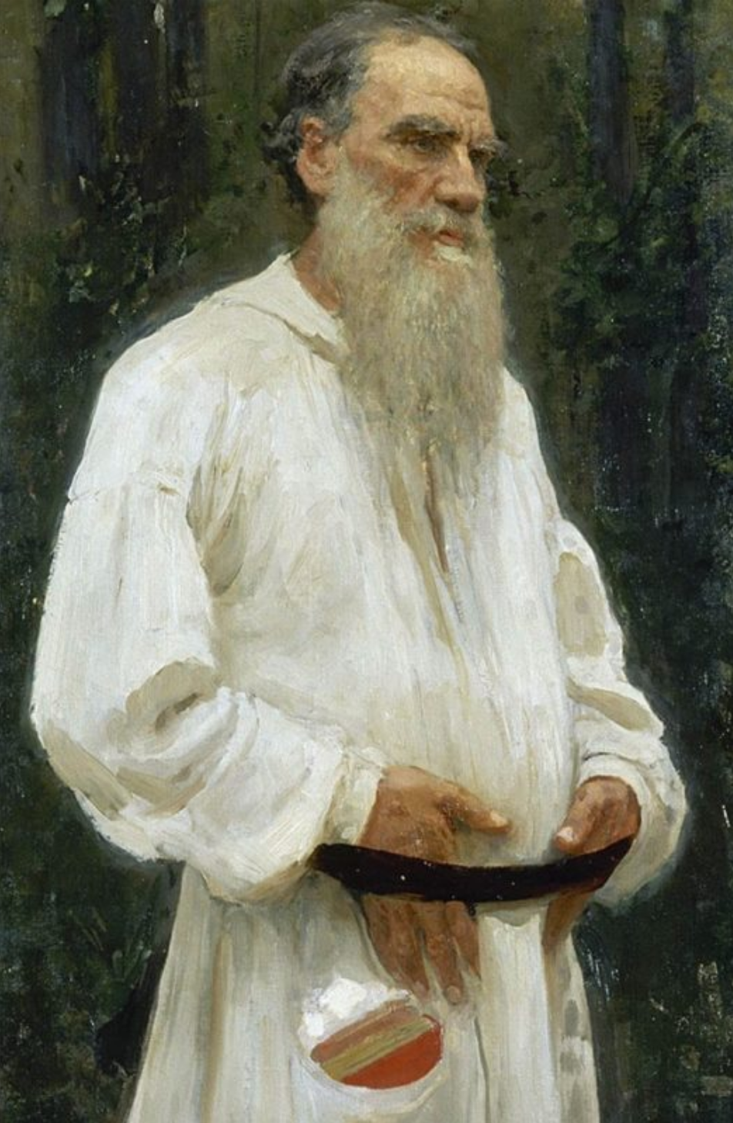
“Without Art Mankind Could Not Exist”: Leo Tolstoy’s Essay What is Art? “If a man is infected by the author’s condition of the soul, if he feels this emotion and this union with others, then the object which has affected this is art; but if there be no such infection, if there be not this union with the author and with others who are moved by the same work—then it is not art. And not only infection a sure sign of art, but the degree of infectiousness is also the sole measure of excellence in art . The stronger the infection the better is the art, as art, speaking now apart from its subject-matter—that is, not considering the quality of the feeling it transmits” (Tolstoy 1994, 179).
Tolstoy dressed in peasant clothing
Photo by Ilya Repin, 1901

Slide 6
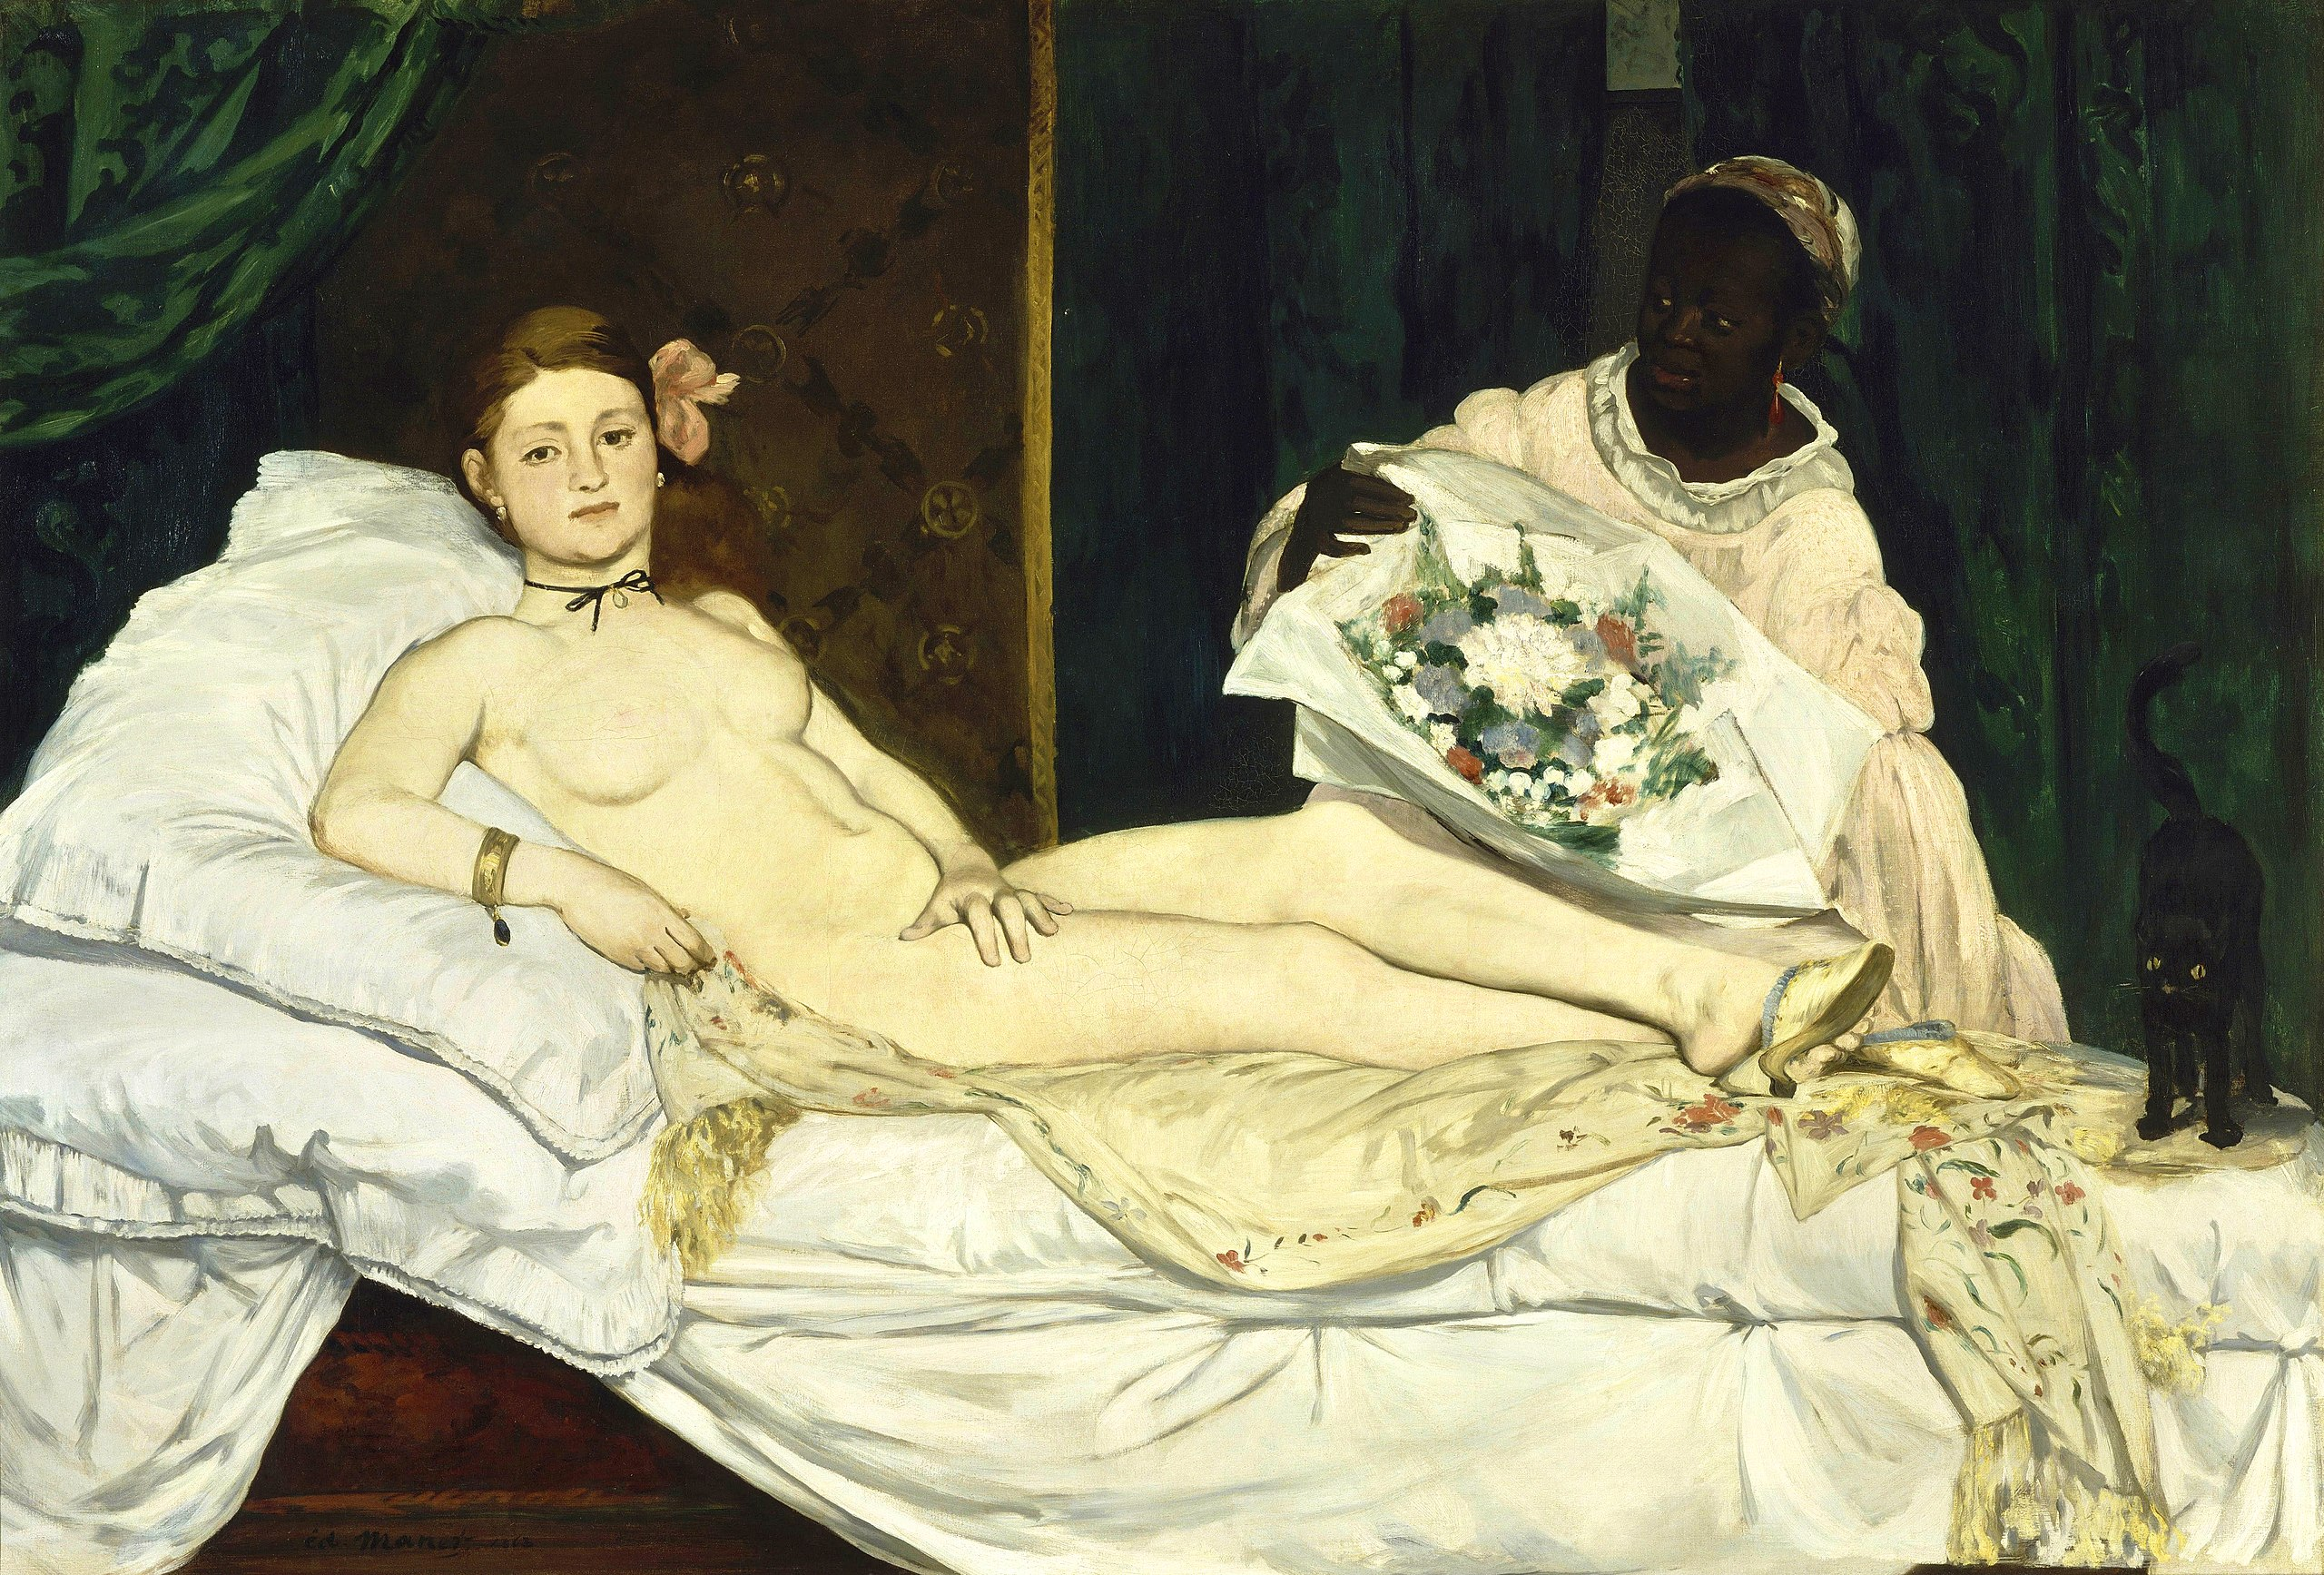
The Importance of Manet’s Conceptualization in Olympia and The Bar at the Folies-Bergère “Olympia in comparison, which took Manet six to seven years just to find a model that suited it, also has an expression of resignedness, but her stare is more bold as if she has grown accustomed to being stared at. The fact that Manet uses this resigned expression in multiple paintings indicates he was trying to make a statement about feelings of repressed women in his society” (Moffat ca. 2001)
Olympia
Oil on canvas, Édouard Manet, 1863
Musée d'Orsay, Paris

Slide 7
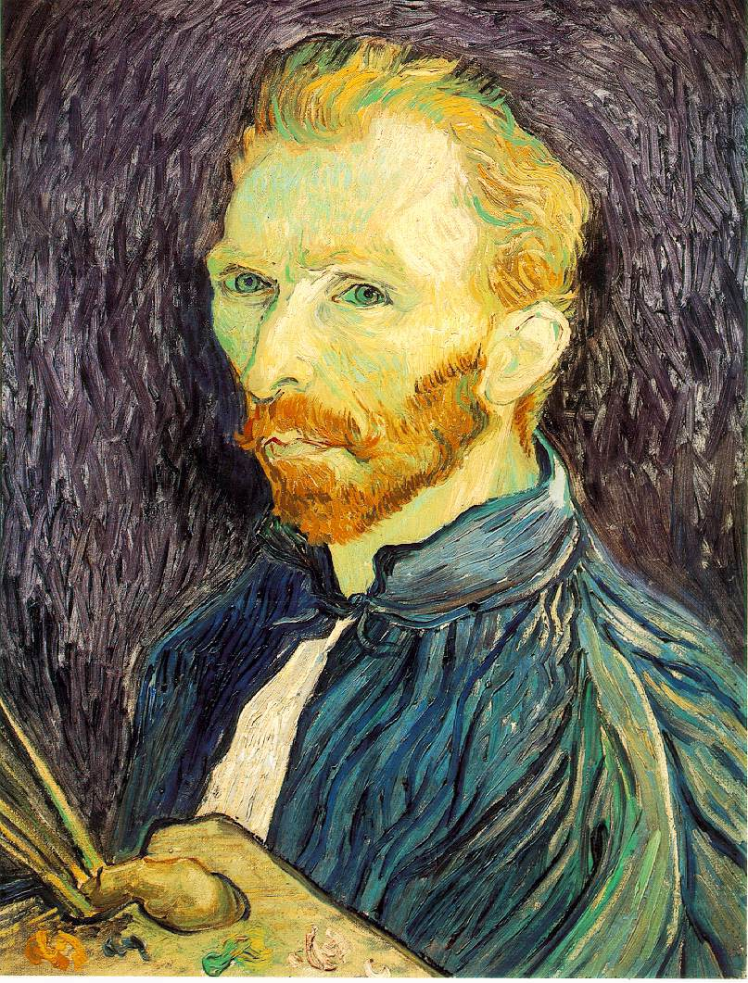
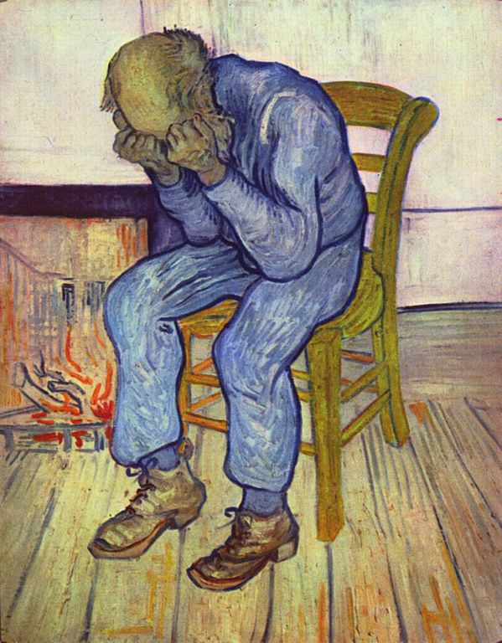
Self-Portrait
Oil on canvas, Vincent Van Gogh, 1889
Van Gogh Museum, Amsterdam
Sorrowing Old Man (‘At Eternity’s Gate’)
Oil on canvas, Vincent Van Gogh, 1890
Kröller-Müller Museum, Otterlo, Netherlands

Slide 8
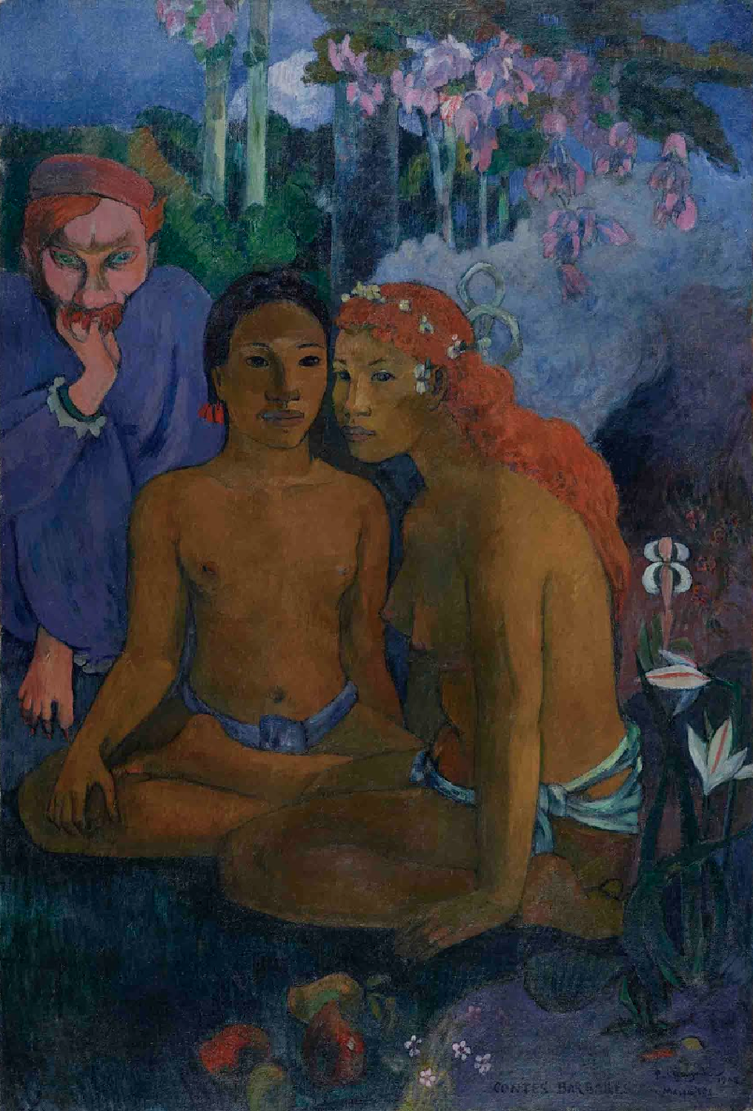
Past and present meet in this painting imbued with the painter's clearly discernable death wish. Pointing to the past is especially the depiction of his friend Jacob Meyer de Haan, who had died in 1895 and who he had met in 1889 in La Pouldu in Brittany, where Gauguin had painted a portrait of him with the strange title of Nirvana. 13 years later Gauguin re-used this diabolic-looking image of his friend in the middle of a South Sea landscape. White tufts of smoke seem like departing clouds after a cleansing shower, fruit like sacrificial offerings, and the lilies are ancient symbols for a simultaneous announcement of life and death. Barbarian Tales
Contes barbares (Barbarian Tales)
Oil on canvas, Paul Gauguin, 1902
Museum Folkwang, Essen, Germany

Slide 9
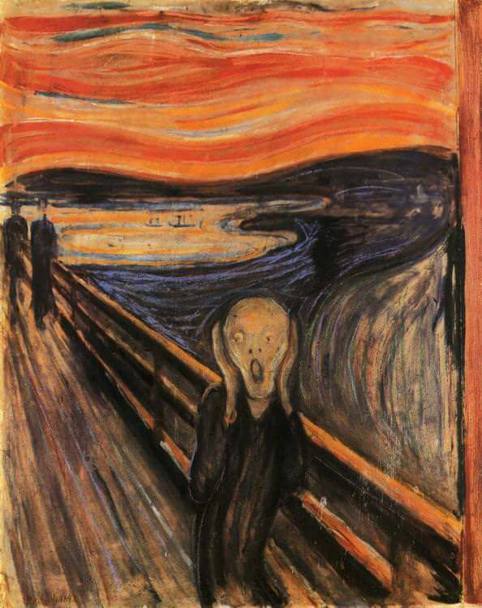
The Scream Munch's The Scream is an icon of modern art, the Mona Lisa for our time. As Leonardo da Vinci evoked a Renaissance ideal of serenity and self-control, Munch defined how we see our own age—wracked with anxiety and uncertainty. Essentially The Scream is autobiographical, an expressionistic construction based on Munch's actual experience of a scream piercing through nature while on a walk, after his two companions, seen in the background, had left him. Here, however, in depicting his own morbid experience, he has let go, and allowed the foreground figure to become distorted by the subjectivized flow of nature; the scream could be interpreted as expressing the agony of the obliteration of human personality by this unifying force.
The Scream
Oil, tempera, pastel and crayon on cardboard.
Edvard Munch, 1893
Munch Museum, Oslo

Slide 10
“And on the degree of the infectiousness of art depends on three conditions: (1) On the greater or lesser individuality of the feeling transmitted; (2) on the greater or lesser clearness with which the feeling is transmitted; (3) on the sincerity of the artist, that is, on the greater or lesser force with which the artist himself feels the emotion he transmits” (Tolstoy 1994, 180).
Tolstoy dressed in peasant clothing
Photo by Ilya Repin, 1901

Slide 11
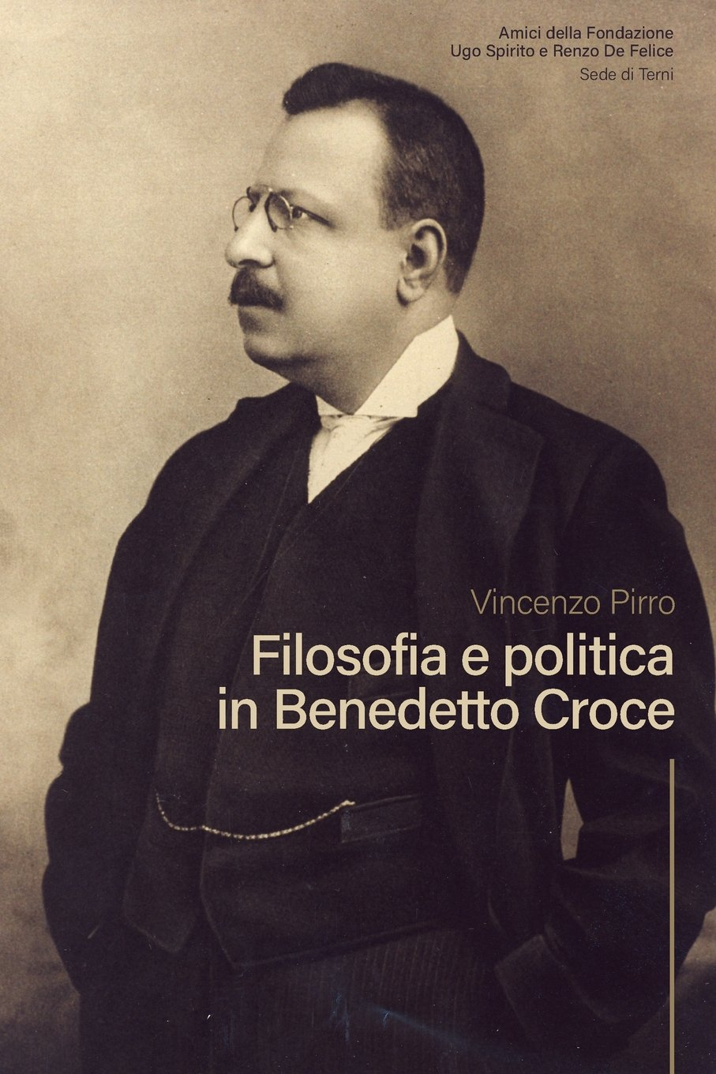
What is Art? Benedetto Croce was an Italian philosopher, historian, and politician. He is most famous in the Philosophy of Art for developing the notion of art as expression. The clearest statement of his view is the essay, “What is Art”? The title is an obvious reference to Tolstoy’s book of the same name. He was trying to distance his expression theory from Tolstoy’s, though it is not easy to see just where this difference lies. His main thesis is that art is intuition, which can also be understood as expression.
Benedetto Croce
(1866-1952)

Slide 12
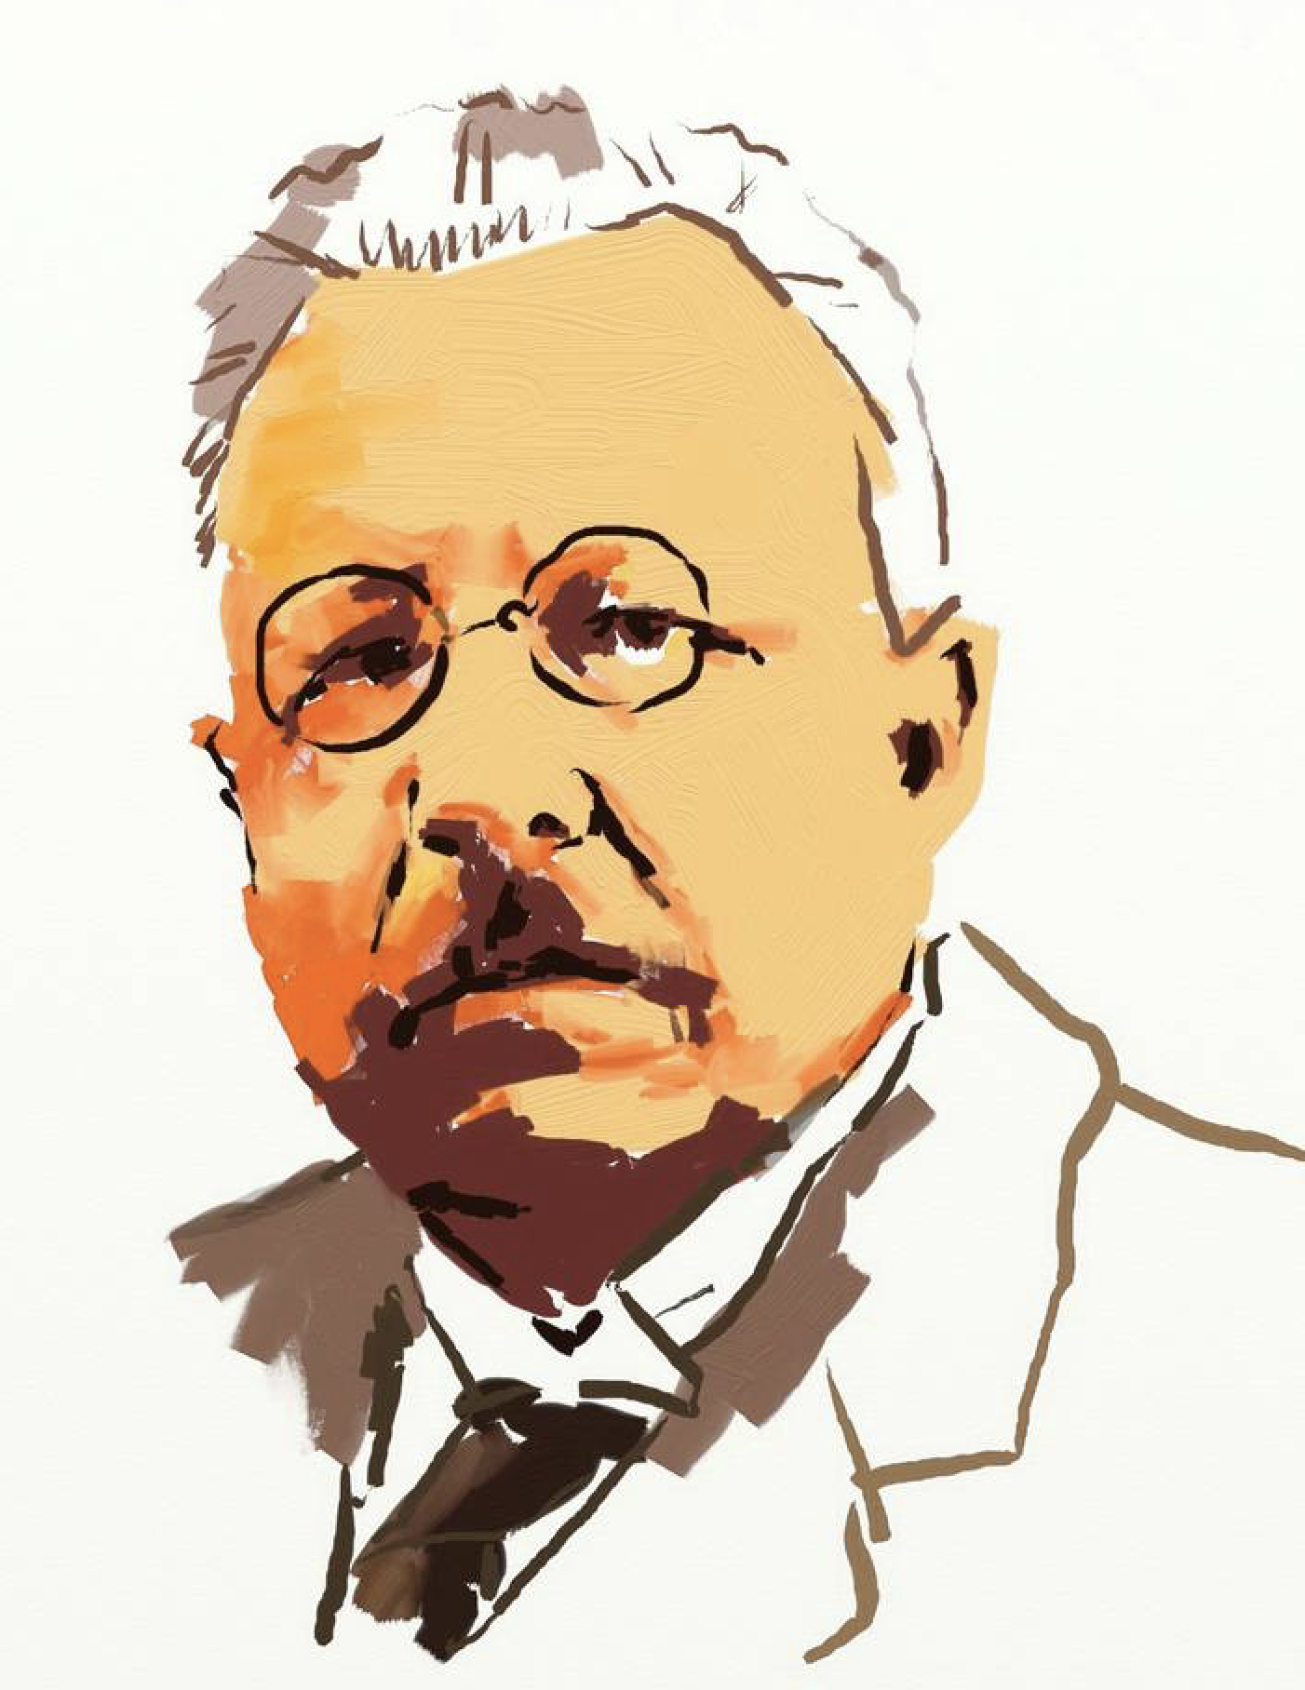
The question as to what is art,—I will say at once, in the simplest manner, that art is vision or intuition. The artist produces an image or a phantasm; and he who enjoys art turns his gaze upon the point to which the artist has pointed, looks through the chink which he has opened, and reproduces that image in himself. “Intuition,” “vision,” “contemplation,” “imagination,” “fancy,” “figurations,” “representations,” and so on, are words continually recurring, like synonyms, when discoursing upon art, and they all lead the mind to the same conceptual sphere which indicates general agreement.”
Benedetto Croce
(1866-1952)

Slide 13
The most striking difference with Tolstoy’s theory is the absence of any reference to art’s effect upon the audience. What does he mean, and why does he say it, when he says that ‘art is intuition’? It is best not to start with first question, as the term ‘intuition’ did not catch on widely, and its everyday meaning is unhelpful. It is sufficient to take it simply as a marker for what is special and distinctive about art. His method is like via negativa, the method of determining the nature of something by making clear what it is not.
Benedetto Croce
(1866-1952)

Slide 14
I. Art is not the physical thing—paint on canvas, bronze, etc. Croce’s first distinction is between art and the physical object. This reflects the plausible claim that art cannot be identified with its physical embodiment. There is more to painting than pigments on canvas, and it is in this ‘more’ that the real painting lies.
Benedetto Croce
(1866-1952)

Slide 15
II. Art is not anything utilitarian Croce denies that art has anything ‘utilitarian’ about it. This also captures a common thought. Most people accept this distinction; but Croce adds a further contention that being productive of pleasure is also a utilitarian end, and thus to be discounted. Most people would not readily agree with this since art seems intrinsically connected with pleasure; for Croce, however, the fact that a thing gives pleasure is insufficient to make it art. This seems obvious and thus requires the further distinction of “aesthetic pleasure.” Thus one still needs an explanation of what makes the pleasure “aesthetic.”
Benedetto Croce
(1866-1952)

Slide 16
III. Art is not a ‘moral act’ For Croce, art does not originate from an act of will. While it makes sense to say that an artistic image can be of something morally praiseworthy or blameworthy, it makes no sense to say that the image is itself either of these things,
Benedetto Croce
(1866-1952)

Slide 17
IV. Art is not conceptual knowledge It is here that the term “intuition” becomes clearer. Conceptual knowledge (philosophy, history, science) is founded upon a distinction between reality and unreality—basically the representational theory of knowledge. For Croce, intuition refers precisely to lack of distinction between reality and unreality. Unlike a scientific theory, a work of art is sufficient to itself. Its value is not measured by its verisimilitude. To understand it’s meaning we need only look at the work itself and can ignore the world beyond the work—whether it represents the world accurately is irrelevant to its aesthetic worth.
Benedetto Croce
(1866-1952)

Slide 18
If art is not physical, utilitarian, moral, or productive of knowledge, then what is it? Croce’s answer: “Art is symbol, all symbol, that is all significant. But symbol of what? Signifying what? Intuition is truly artistic, is truly intuition and not a chaotic accumulation of images, only when it has a vital principle which animates it and makes for its complete unit.” In short, the images of art proper are symbolic expressions of feeling.
Benedetto Croce
(1866-1952)

Slide 19
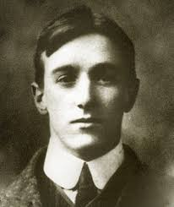
Principles of Art A more sophisticated version of expression theory is found in R.G. Collingwood’s Principles of Art (1938). Collingwood’s theory is based on admiration and awareness of defects of Croce’s theory. He repudiates several features of prior expression theory. Art is thus not concerned with the arousal of emotion at all. He also rejects the notion that art is the expression of an emotion that pre-exists the work. Thus imagination plays a central role in Collingwood’s theory. Art has two equally crucial elements: expression and imagination.
Robert George Collingwood
(1889-1943)

Slide 20
Principles of Art In our selection from his book, Collingwood begins by trying to distinguish art from craft. He then explains the chief characteristics of what is meant by ‘craft’: 1) “Craft always involves a distinction between means and end” (Collingwood 1994, 192). If you are making something just to achieve a certain end, say making a teapot from clay, then it is craft and not art.
Robert George Collingwood
(1889-1943)

Slide 21
Principles of Art 2) Craft involves “a distinction between planning and execution” (Collingwood 1994, 193). If one already has an idea of what one is making, and thus the result is preconceived, then it is craft. 3) In craft the end is thought out first, then the means to achieve that end. But then, in executing the work, producing it, ”the means come first, and the end is reached through them” (Collingwood 1994, 193).
Robert George Collingwood
(1889-1943)

Slide 22
Principles of Art 4) In craft there is a distinction between raw material and finished product. “The raw material is found ready made before the special work of the craft begins” (Collingwood 1994, 193). 5) In craft there is a distinction between from and matter. “The matter is what is identical in the raw material and the finished product; the form is what is different, what the exercise of the craft changes” (Collingwood 1994, 193).
Robert George Collingwood
(1889-1943)

Slide 23
Principles of Art 6) In craft there is a hierarchical relation between various crafts, a hierarchy of “materials, of means, and of parts” (Collingwood 1994, 193). He goes on to conclude this section by admitting that these features do not completely capture the notion of craft; but he thinks that “where most of them are absent from a certain activity that activity is not craft” (Collingwood 1994, 194).
Robert George Collingwood
(1889-1943)

Slide 24
Principles of Art Then he goes on to suggest some things that are different about art. The first point is that the distinction between means and end is not so necessary in a work of art. He admits at first that a “poem is the means to the production of a certain state of mind in the audience” (Collingwood 1994, 194). But then he goes on to question this: “Suppose a poet had read his verses to an audience, hoping that they would produce a certain result; and suppose the result were different, would that in itself prove the poem a bad one?” (Collingwood 1994, 194).
Robert George Collingwood
(1889-1943)

Slide 25
Principles of Art He also suggests the distinction between planning and execution are not as essential in art as they are in craft. “Or suppose a sculptor were not making a Madonna and child, three feet high, in Hoptonwood stone, guaranteed to placate the chancellor of the diocese and obtain a faculty for placing it in the vacant niche over a certain church door; but were simply playing about with clay, and found the clay under his fingers turning into a little dancing man: is this not a work of art because it was done without being planned in advance?” (Collingwood 1994, 195).
Robert George Collingwood
(1889-1943)

Slide 26
Principles of Art He also suggests the distinction raw material and finished product breaks down in thinking about the work of art. What is the raw material of a poem? He goes on to say it is not like in craft, but perhaps there is a raw material of a different kind. And here is where we see his notion of art as expression start to become clear. The raw material of a poem can be a feeling of emotion. He quotes the German poet Heinrich Heine: “Aus meinem grossen Schmerzen mach’ ich die kleinen Lieder” [Out of my great pain I make little songs] (Collingwood 1994, 196).
Robert George Collingwood
(1889-1943)

Slide 27
Principles of Art He continues to point out the other distinctions that are crucial for craft, the distinction between form and matter, and the hierarchy that is characteristic of crafts breaks down in thinking about art. So then he gets to the question of what art is. Our first question is this. Since the artist proper has something to do with emotion, and what he does with it is not to arouse it, what is it that he does?” (Collingwood 1994, 197).
Robert George Collingwood
(1889-1943)

Slide 28
For Collingwood, a work of art expresses emotion, but its creation and appreciation are both acts of imagination. He rejects the notion that art is the expression of an emotion that pre-exists in the object, the painting or sculpture or whatever work of art one may be considering. The real work of art thus really exists only in the imagination. Works of art thus must be recreated in the minds of their audience. The process of artistic creation is thus not a matter of making external what already exists internally. It is instead, a process of imaginative discovery. Thus the peculiar value of art is self-knowledge.
Robert George Collingwood
(1889-1943)

Slide 29
For Collingwood, a work of art expresses emotion, but its creation and appreciation are both acts of imagination. He rejects the notion that art is the expression of an emotion that pre-exists in the object, the painting or sculpture or whatever work of art one may be considering. The real work of art thus really exists only in the imagination. Works of art thus must be recreated in the minds of their audience. The process of artistic creation is thus not a matter of making external what already exists internally. It is interesting to compare what he says about the expression of emotion to what Aristotle and then Nietzsche said about tragedy. He says that in expressing his emotions, the mind of the poet “is somehow lightened and eased” (Collingwood 1994, 198). He goes on to suggest that it resembles Aristotle’s notion of “catharsis.”
Robert George Collingwood
(1889-1943)

Slide 30
“The expression of an emotion by speech may be addressed to some one; but if so it is not done with the intention of arousing a like emotion in him. If there is any effect which we wish to produce in the hearer, it is only the effect which we call making him understand how we feel” (Collingwood 1994, 198). “It follows from this that the expression of emotion, simply as expression, is not addressed to any particular audience. It is addressed primarily to the speaker himself, and secondarily to any one who can understand” (Collingwood 1994, 198).
Robert George Collingwood
(1889-1943)

Slide 31
“The act of expressing it is therefore an exploration of his own emotions. He is trying to find out what these emotions are” (Collingwood 1994, 198). “Expression is an activity of which there can be no technique…” (Collingwood 1994, 1999). He then makes a crucial distinction between expressing and emotion and betraying an emotion. “The characteristic mark of expression proper is lucidity or intelligibility. . . . The artist never rants” (Collingwood 1994, 1999).
Robert George Collingwood
(1889-1943)

Slide 32
“But if his business is not amusement but art, the object at which he is aiming is not to produce a preconceived emotional effect on his audience but by means of a system of expressions, or language, composed partly of speech and partly of gesture, to explore his own emotions: to discover emotions in himself of which he was unaware, and, by permitting the audience to witness the discovery, enable them to make a similar discovery about themselves. In that case it is not her ability to weep real tears that would mark out a good actress; it is her ability to make it clear to herself and her audience what the tears are about” (Collingwood 1994, 199).
Robert George Collingwood
(1889-1943)

Slide 33
Thus, for Collingwood, the end of art is thus self-knowledge, knowledge of our own emotional states. Art becomes a form of introspection. This has the consequence, often a point of criticism of Collingwood’s theory, that art can be of real interest only to the creator. Collingwood attempts to meet this objection by claiming that it is not ‘what I feel’ that the artist articulates but rather ‘what we feel.’ For Collingwood, art then is the expression of emotion in order to gain knowledge and understanding of our emotions. When we look at a work of art, we are not trying to understand what emotions the artist may have had, but rather trying to understand our own emotional life. “it is only bad painters who paint without knowing what they are doing” (Collingwood 1994, 200).
Robert George Collingwood
(1889-1943)

Slide 34
Collingwood’s theory advances Tolstoy’s theory, but the chief merit of this version is that it centers on the work of art and not the artist. Tolstoy’s version lead to inquiring about the artist’s history and psychology. Collingwood is scathing about criticism that focuses on historical tidbits about artists. Similarly, the audience’s emotional experience also drops out of the picture on a closer examination of Collingwood’s theory. Tolstoy’s view holds that emotion is transmitted from artist to audience by being aroused in the audience. Collingwood argues that using art to arouse emotion is a confusion of art with craft. If this is true, it is as much a mistake to try to determine the merits of a work by audience ‘reaction’ as it is to judge it on the artist’s ‘sincerity.’ The advantage of Collingwood’s theory is that it avoids psychologism; but upon closer examination its advantages are won through abandoning the essentials of expression theory.
Robert George Collingwood
(1889-1943)

Slide 35
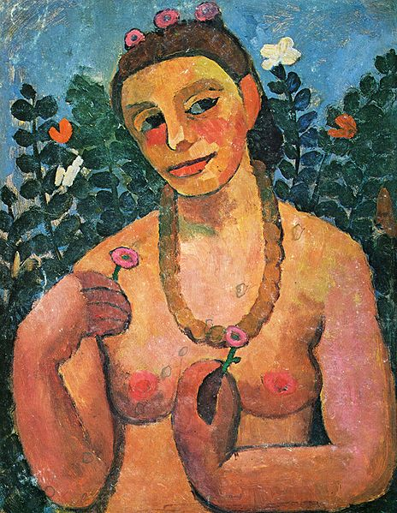
German Expressionism
Self-Portrait with an Amber Necklace,
Oil on canvas, Paula Modersohn-Becker, 1906.
Kunstmuseum, Basel, Switzerland

Slide 36
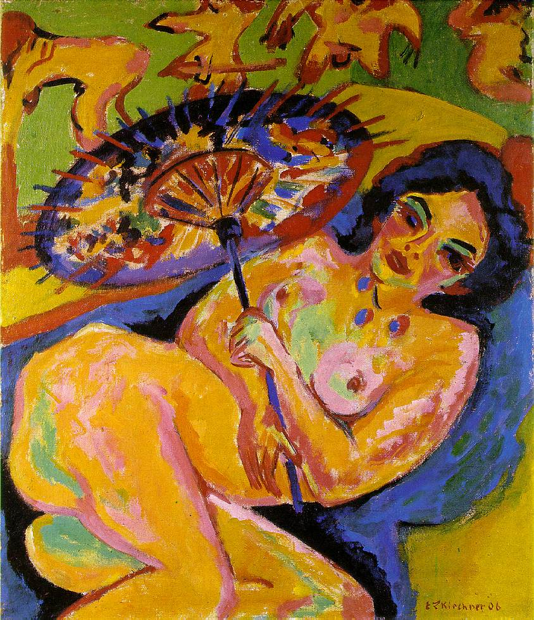
Girl Under a Japanese Parasol,
Oil on canvas, Ernst Ludwig Kirchner, 1909.
Kunstsammlung, Dusseldorf, Germany

Slide 37
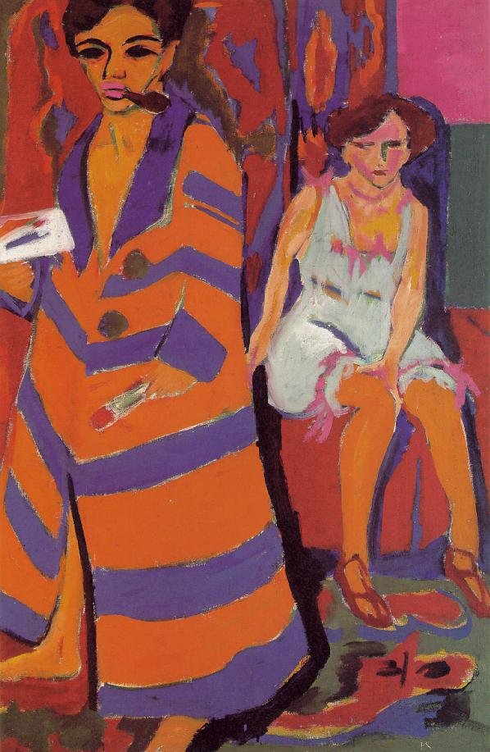
Self-Portrait with Model,
Oil on canvas, Ernst Ludwig Kirchner, 1910/26.
Kunsthalle, Hamburg, Germany

Slide 38
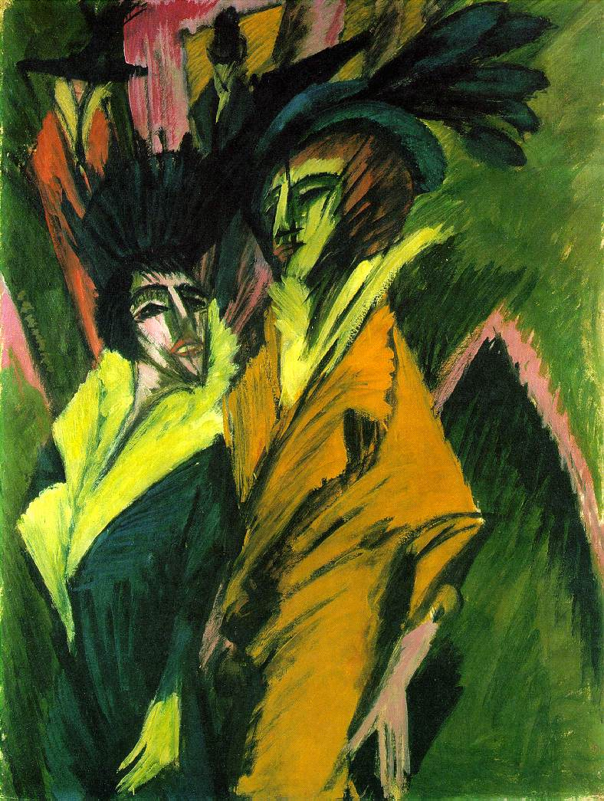
Two Women in the Street,
Oil on canvas, Ernst Ludwig Kirchner, 1914.
Kunstsammlung, Dusseldorf, Germany

Slide 39
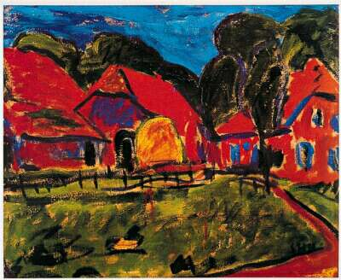
Red House,
Oil on canvas, Eric Heckel, 1908.
Kunstsammlung, Dusseldorf, Germany

Slide 40
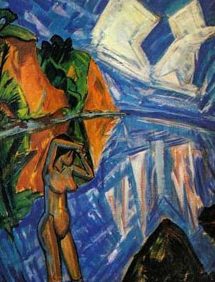
A Crystal Day,
Oil on canvas, Eric Heckel, 1913.
Pinakothekder Moderne, Munich

Slide 41
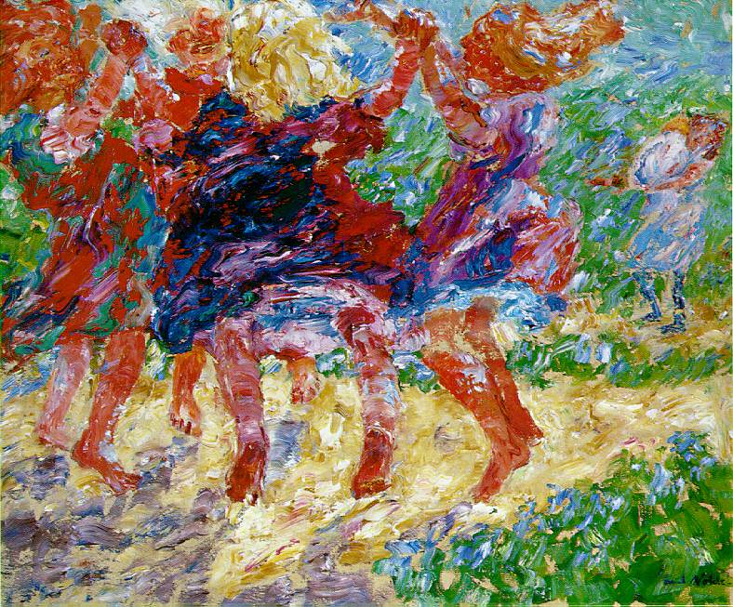
Wildly Dancing Children,
Oil on canvas, Emil Nolde, 1909.
Kunsthalle, Kiel, Germany

Slide 42
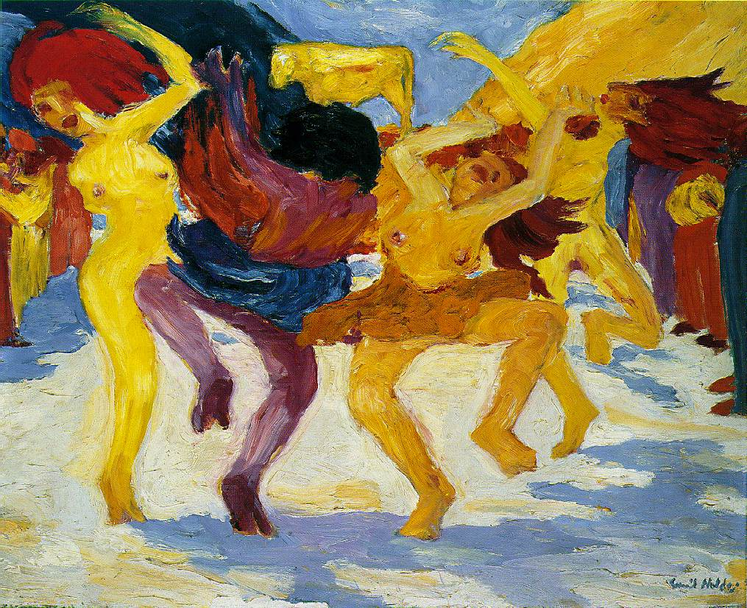
Dance Around the Golder Calf,
Oil on canvas, Emil Nolde, 1910.
Staatsgalerie moderner Kunst, Munich, Germany

Slide 43
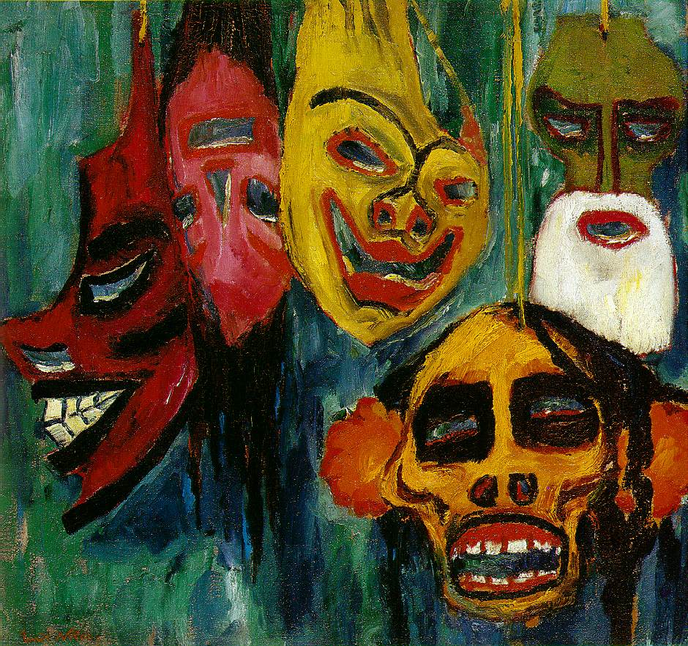
Mask Still Life III,
Oil on canvas, Emil Nolde, 1911.
Nelson Gallery of Art, Atkins-Museum, Kansas City

Slide 44
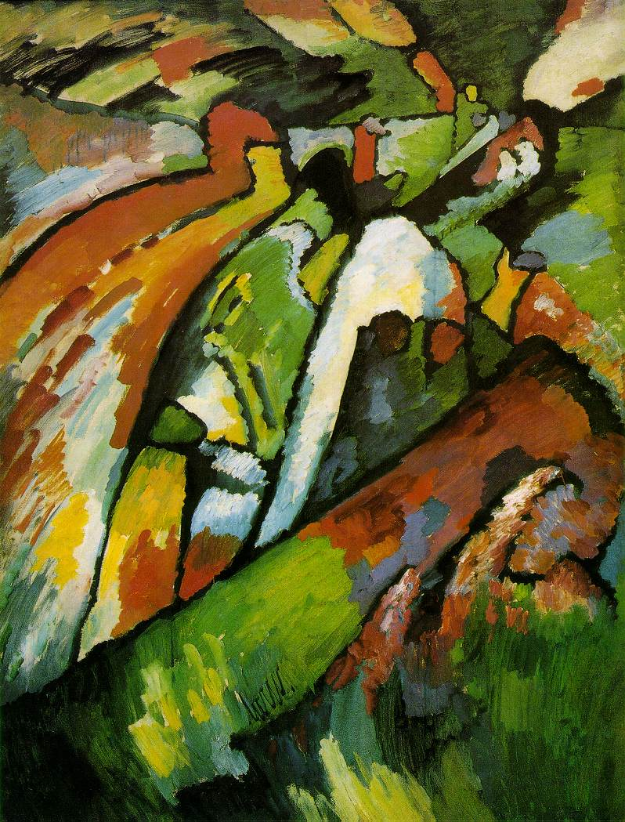
Improvisation 7,
Oil on canvas, Wassily Kandinsky, 1910.
Tretyakov Gallery, Moscow

Slide 45
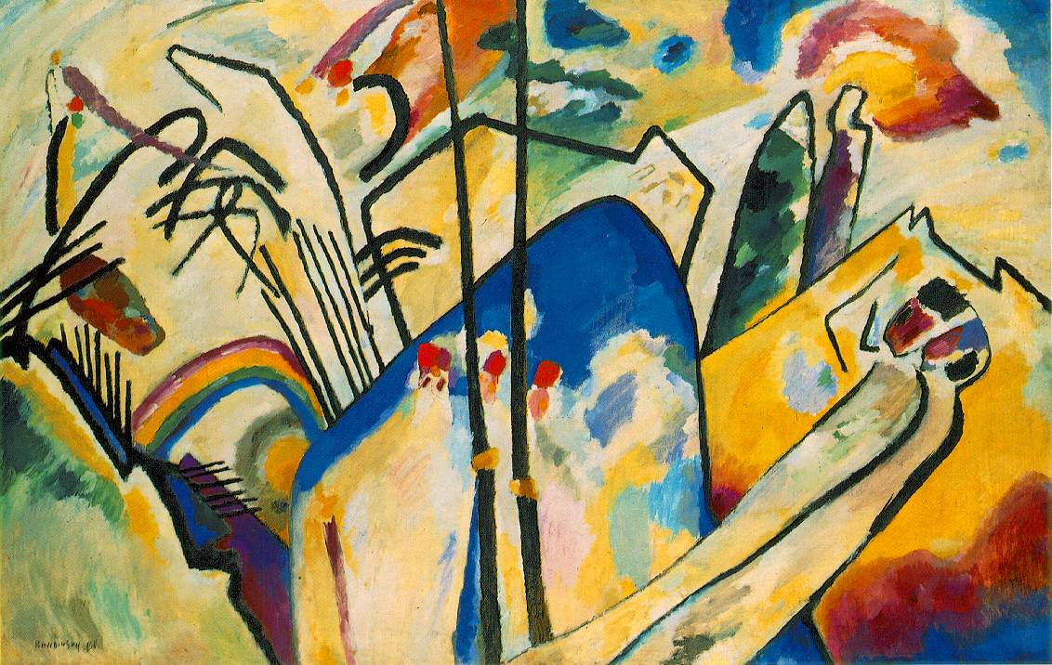
Composition IV,
Oil on canvas, Wassily Kandinsky, 1911.
Kunstsammlung Nordrhein-Westfallen, Düsseldorf

Slide 46
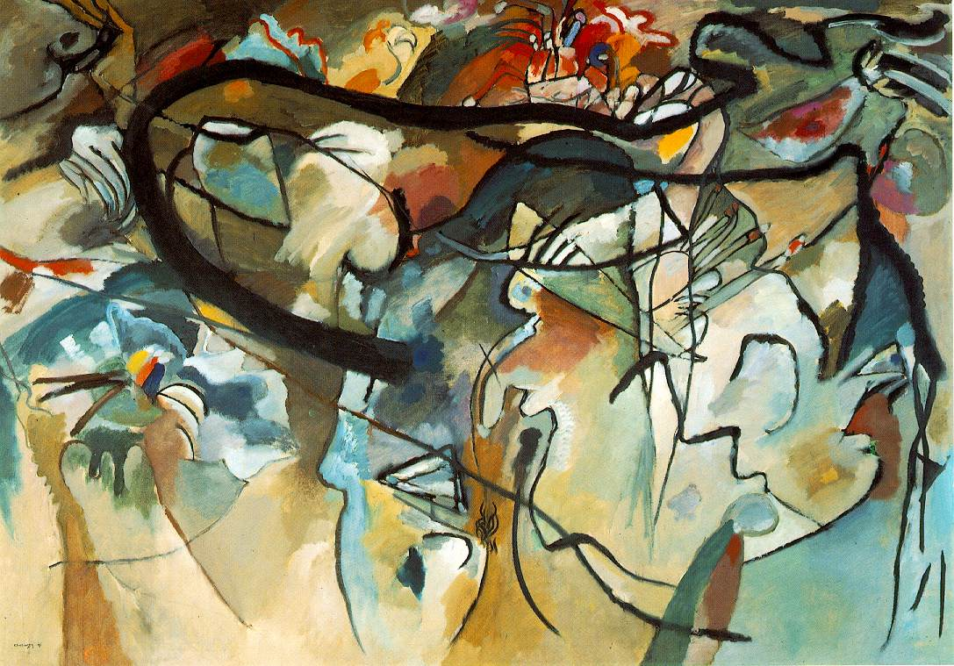
“The anecdote about how Kandinsky arrived at abstract painting has often been told, not lastly by the artist himself. He came home in the evening twilight, saw one of his paintings, turned ninety degrees and standing on its side, and did not recognize it. It seemed to him, that this was the work of a stranger, but he liked what he saw. What Kandinsky saw were only colors and forms, ‘suffused by an inner glow.’ He realized that painting had to become independent of material objects, that representation of them would be detrimental to his art” (Walther 2000, 104).
Composition IV,
Oil on canvas, Wassily Kandinsky, 1911.
Private collection

Slide 47
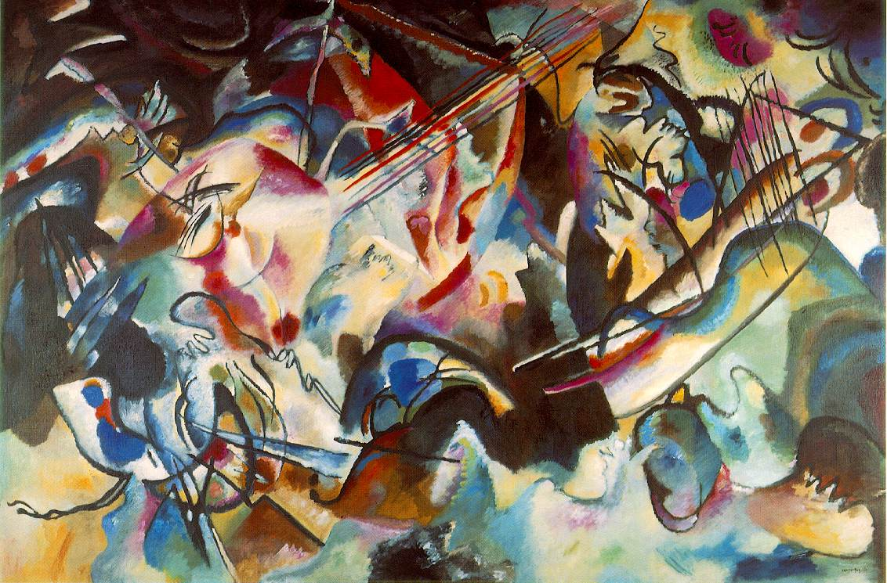
“By reducing outward appearances to their essence, Kandinsky hoped to bring out the character of their painting as an entity independent of the natural model. Through the psychological effects of color even more than through its physical effects, Kandinsky hoped to touch the soul of the viewer. In his own words, ‘In general, then, color is a means to exert a direct influence on the sould.’ Using the analogy of a piano, he went on, ‘Color is the key. The eye is the hammer. The soul is the piano, with many string’” (Walther 2000, 105).
Composition VI,
Oil on canvas, Wassily Kandinsky, 1913.
Hermitage, St. Petersburg

