Slide 1
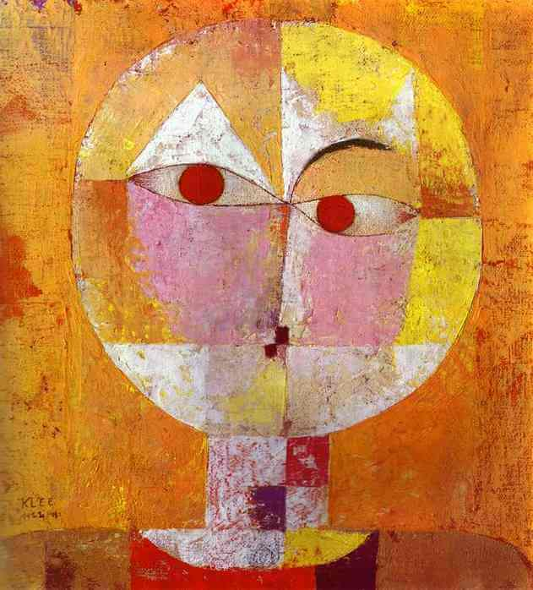
In her book Feeling and Form: A Theory of Art (1953) Suzanne Langer developed a notion first expressed in her book Philosophy in a New Key (1942) that works of art are representations of human feeling and expression. As Ross explains in the introduction to the selection in our reader, she “developed a remarkable and influential theory of art, suggesting that an enriched theory of symbols could explain the nature of expression in art” (Ross 1994, 221). In Philosophy in a New Key, she develops a theory of music, in which the symbolism in music contrasts with the symbols of language and propositional thought. In Feeling and Form, she develops this further into a full theory of art, the notion of art as a symbol of the forms of feeling.
Art as Symbol of Feeling
Senecio
Oil on canvas mounted on panel, Paul Klee, 1922.
Kunstmuseum Basel, Basel, Switzerland

Slide 2
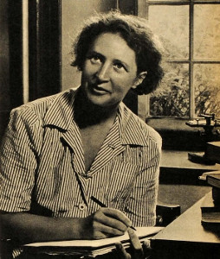
Suzanne Langer was one of the first American women to become an academic philosopher and was the first woman to become popularly and professionally recognized as a philosopher. She is most known for her theories on the influence of art on the mind. She received a doctorate in philosophy from Harvard in 1926 and taught at Radcliffe College from 1927-1942. She went on to teach philosophy at the University of Delaware, Columbia University, Connecticut College, the University of Michigan, New York University, Northwestern University, Ohio University, Smith College, Vassar College, the University of Washington, and Wellesley College.
Suzanne Langer
Suzanne Langer (1895-1985)

Slide 3
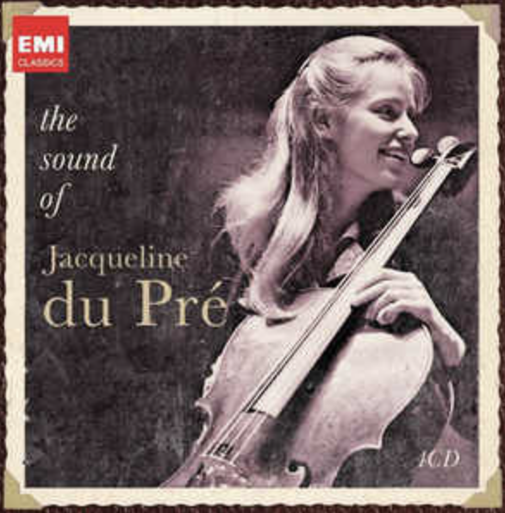
The Symbol of Feeling Langer reviews here the thesis presented in Philosophy in a New Key that music is a symbol of feeling. Langer, it is helpful to note, was also an accomplished musician. Early on she was taught to play piano and cello, and she continued to play cello for the remainder of her life. She begins here to connect music to feeling, emotive life: “The tonal structure we call ‘music’ bear a close logical similarity to the forms of human feeling–forms of growth and of attenuation, flowing and slowing, conflict and resolution, speed, arrest, terrific excitement, calm, or subtle activation and dreamy lapses—not joy and sorrow perhaps, but the poignancy of either and both—the greatness and brevity and eternal passing of everything vitally felt. Such is the pattern, or logical form, of sentience; and the pattern of music is that same form worked out in pure, measures sound and silence. Music is a tonal analogue of emotive life” (Langer 1994, 222).
Feeling and Form: A Theory of Art
Jacqueline du Pré (1945-1987)

Slide 4
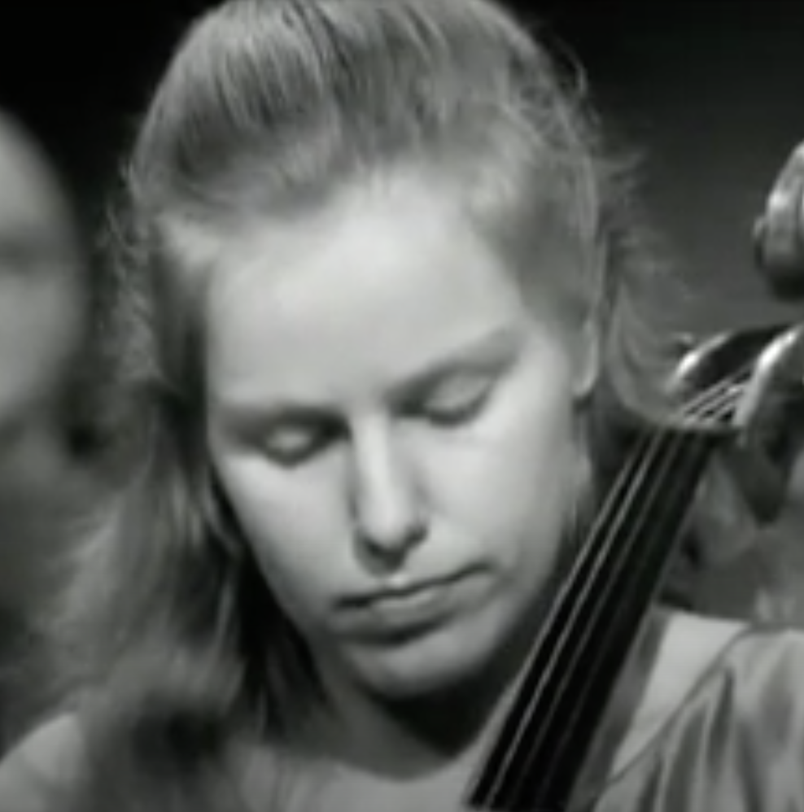
The Symbol of Feeling Langer goes on to explain what is meant by a symbol; she explains that “a symbol is used to articulate ideas of something” (Langer 1994, 223). She further explains how music is not just sound, which can be soothing or exciting. If music was just pleasing sounds it wouldn’t be so important. “An enlightened society usually has some means, public or private, to support artists, because their work is regarded as a spiritual triumph and a claim to greatness for the whole tribe” (Langer 1994, 223). Music, she argues, must be more than producing pleasing sounds. “If music, patterned sound, has no other office than to stimulate and soothe our nerves, pleasing our ears as well-combined foods please our palates, it might be highly popular, but never culturally important” (Langer 1994, 223).
Feeling and Form: A Theory of Art
ELGAR CELLO CONCERTO, 1st movement
JACQUELINE DU PRE

Slide 5
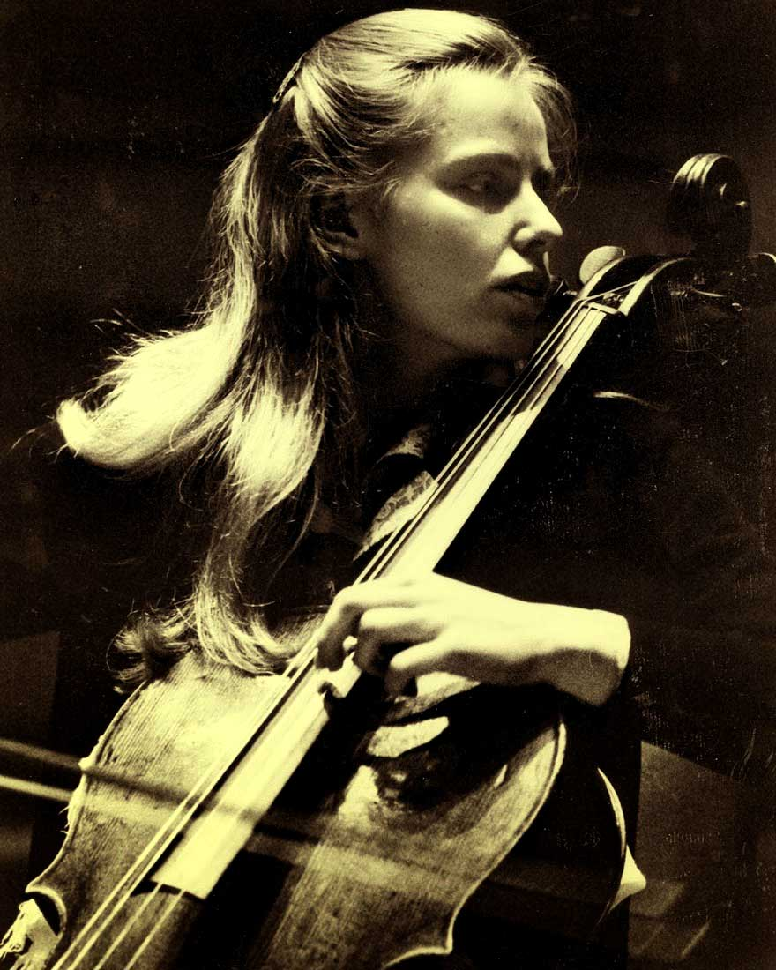
The Symbol of Feeling “Our interest in music arises from its intimate relation to the all-important life of feeling, whatever that relation may be. After much debate on the current theories, the conclusion reached in Philosophy in a New Key is that the function of music is not stimulation of feeling, but the expression of it; and furthermore, not the symptomatic expression of feelings that beset the composer but a symbolic expression of the forms of sentience as he understands them. It bespeaks his imagination of feelings rather than his own emotional state, and expresses what he knows about the so-called ‘inner-life’; and this may exceed his personal case, because music is a symbolic form to him through which he may learn as well as utter ideas of human sensibility” (Langer 1994, 223).
Feeling and Form: A Theory of Art
Tribute to Jacqueline du Pré

Slide 6
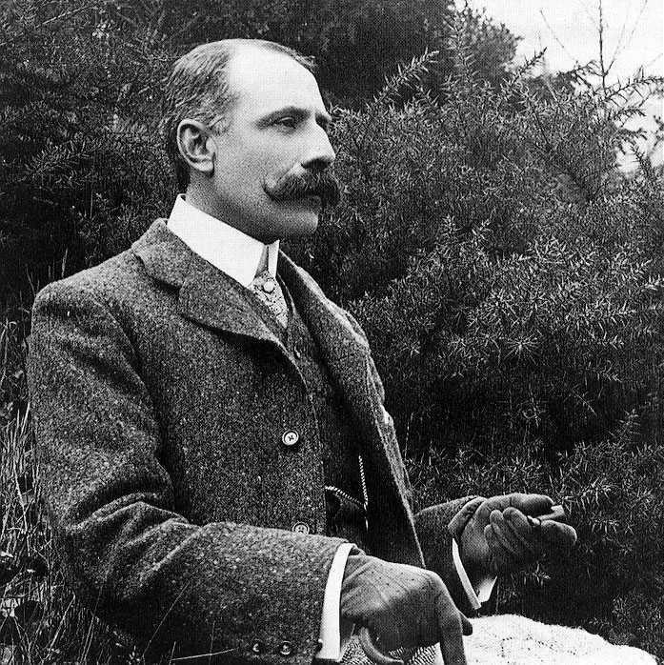
The Symbol of Feeling “Our interest in music arises from its intimate relation to the all-important life of feeling, whatever that relation may be. After much debate on the current theories, the conclusion reached in Philosophy in a New Key is that the function of music is not stimulation of feeling, but the expression of it; and furthermore, not the symptomatic expression of feelings that beset the composer but a symbolic expression of the forms of sentience as he understands them. It bespeaks his imagination of feelings rather than his own emotional state, and expresses what he knows about the so-called ‘inner-life’; and this may exceed his personal case, because music is a symbolic form to him through which he may learn as well as utter ideas of human sensibility” (Langer 1994, 223).
Feeling and Form: A Theory of Art
Edward Elgar (1857-1934)

Slide 7
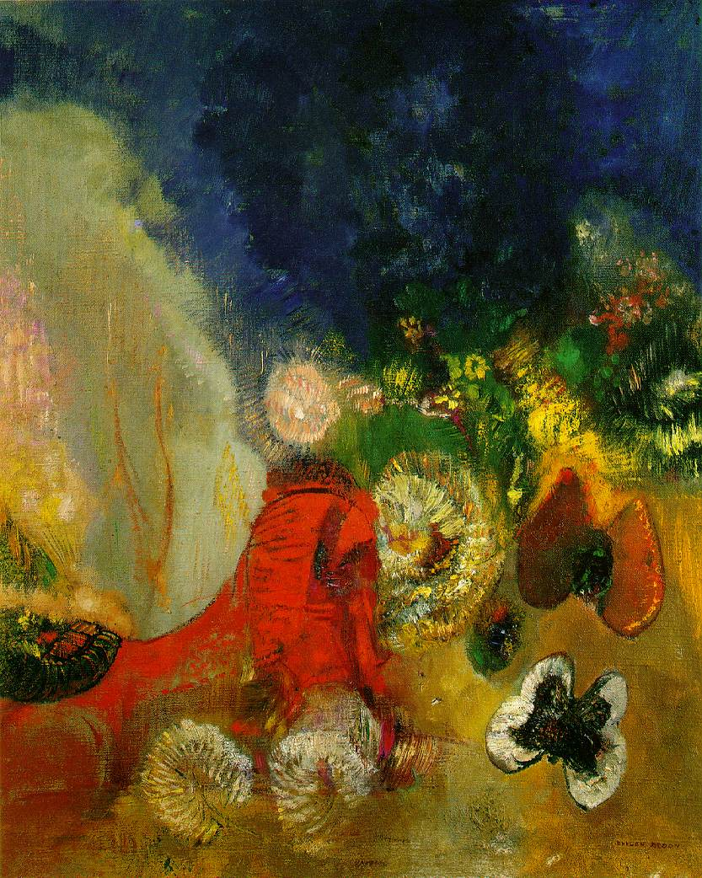
The Symbol of Feeling Langer makes a crucial distinction between music and language: “Probably, the readiest way to understand the precise nature of musical symbolization is to consider the characteristics of language and then, by comparison and contrast, note the different structure of music, and the consequent differences and similarities between the respective functions of those two logical forms. Because the prime purpose of language is discourse, the conceptual framework that has developed under its influence is known as ‘discursive reason’” (Langer 1994, 224). She goes on to say that “music is not a language because it has no vocabulary” (Langer 1994, 226). She uses Bell’s notion of “significant form” to describe what is unique about music: “music is ‘significant form,’ and its significance is that of a symbol, a highly articulated sensuous object, which by virtue of its dynamic structure can express the forms of vital experience which language is peculiarly unfit to convey” (Langer 1994, 226).
Feeling and Form: A Theory of Art
The Red Sphinx Oil on canvas, Odilon Redon, c. 1912 Private collection

Slide 8
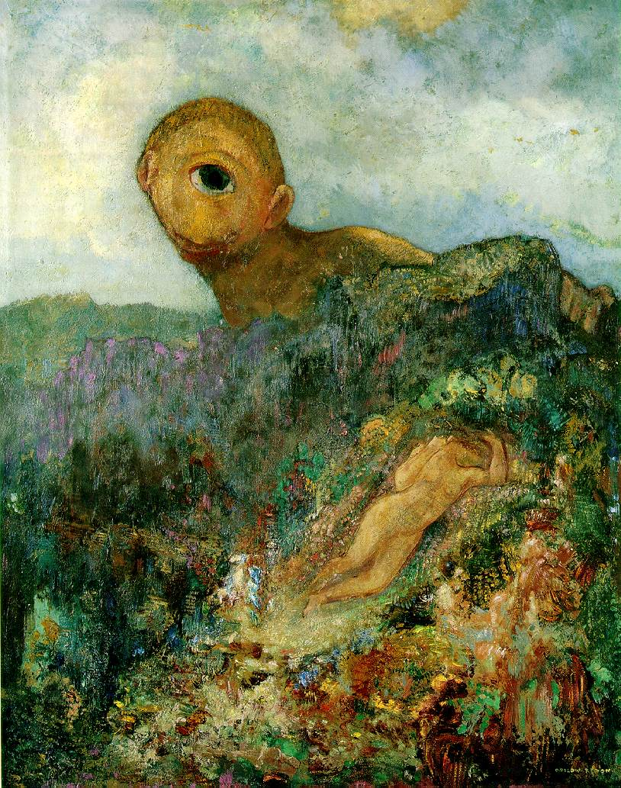
Semblance Langer attempts to develop her theory about music to a general theory about art. She starts here by raising the question about what is actually “created” in a work of visual art. She accepts that the traditional imitation theory is not adequate to understand what is going on in the work of art. A painter produces an image, but the image should not be understood as a mere copy of an object. She turns to the philosophical problem of images: “the philosophical issue that is usually conceived in terms of image and object is really concerned with the nature of images as such and their essential difference from actualities. […] the true power of the image lies in the fact that it is an abstraction, a symbol, the bearer of an idea” (Langer 1994, 227).
Feeling and Form: A Theory of Art
The Cyclops Oil on canvas, Odilon Redon, c. 1914
Museum Kroller-Mueller, Otterlo, The Netherlands

Slide 9
Semblance “How can a work of art that does not represent anything-–a building, a pot, a patterned textile—be called an image? It becomes an image when it presents itself purely to our vision, i.e., as a sheer visual form instead of a locally and practically related object. If we receive is as a completely visual thing, we abstract its appearance from its material existence. What we see in this way becomes simply a thing of vision—a form, an image. […] An image in this sense, something that exists only for perception, abstracted from the physical and causal order, is the artist’s creation. The image presented on a canvas is not a new ‘thing’ among the things in the studio. The canvas was there, the paints were there; the painter has not added to them. Some excellent critics, and painters too, speak of his ‘arranging’ forms and colors, and regard the resultant work primarily as an ‘arrangement.’ […] Something arises from the process of arranging colors on a surface, something that is created, not just gathered and set in a new order: that is the image” (Langer 1994, 227). She then goes on to explain what an image is: “An image is, indeed, a pure virtual ‘object.’ Its importance lies in the fact that we do not use it to guide us to something tangible and practical, but treat it as a complete entity with only visual attributes and relations. It has no others; its visible character is its entire being” (Langer 1994, 228).
Feeling and Form: A Theory of Art

Slide 10
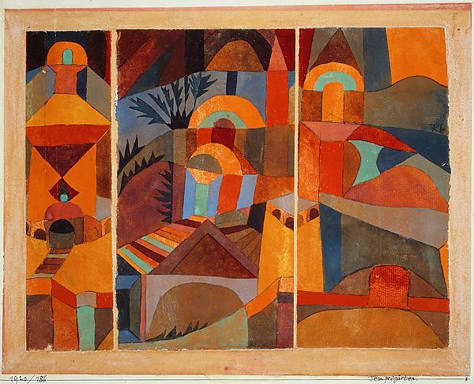
Virtual Space Langer then goes on to explain what she means by this virtual space that an artist creates with an image. She first distinguishes this virtual space from the space in which we live: “the space in which we live and act is not what is generated in art at all. The harmoniously organized space in a picture is not experiential space, known by sight and touch, by free motion and restraint, far and near sounds, voices lost or re-echoed. It is an entirely visual affair; for touch and hearing and muscular action it does not exist” (Langer 1994, 228). ”This virtual space is the primary illusion of all plastic art. Every element of design, every use of color and semblance of shape, serves to produce and support and develop the picture space that exists for vision alone. Being only visual, this space has no continuity with the space in which we live; it is limited by the frame, or by surrounding blanks, or incongruous other things that cut it off” (Langer 1994, 228).
Feeling and Form: A Theory of Art
Temple Gardens Oil on canvas, Paul Klee, c. 1920
The Metropolitan Museum of Art, New York

Slide 11
The Modes of Virtual Space Here in this section Langer discusses what is unique about sculpture and architecture in term of the virtual space created. The visual arts all create virtual space in different way. She points out this is what distinguishes the visual arts from other arts like music. “Let us return to the primary illusion of the plastic arts, virtual space in its several modes. The fact that these modes are just so many ways of creating space relates them as definitely as it distinguishes them, and suggests good reasons why diverse minds find expression, respectively, through the diverse basic abstractions giving rise to the great forms, and yet have a far greater affinity for forms of plastic art other than their own than for arts which to not create virtual space at all; to speak in specific instances, why a painter is likely to be a more competent judge or architecture, sculpture, textile design, jewelry, pottery, or any other visual space creation, but is no more likely than any layman, (and, of course, no less likely either) to have a special understanding of music or literature” (Langer 1994, 232).
Feeling and Form: A Theory of Art

Slide 12
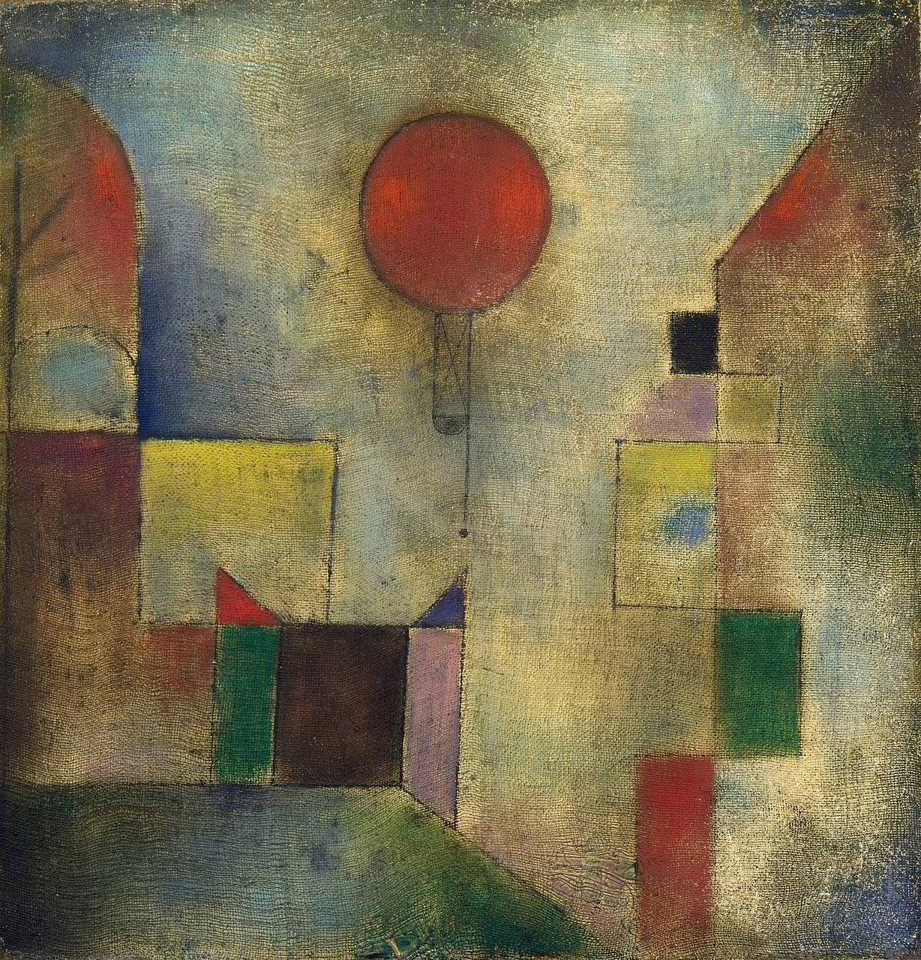
The Modes of Virtual Space After making clear what distinguishes the different arts, Langer attempts to state what all art shares: “The deep division among the arts are those that set apart their very worlds, namely the differences in what the various arts create, or differences of primary illusion. Many people—artists, critics, and philosophers—are averse to any serious study of these divisions, because they feel that somehow art is one, and the unity is more real than the multiplicity which, they insist, can be only specious, due to material differences, purely technical, at the most skin-deep. Yet such a hasty rejection of a problem usually bespeaks fear of it rather than a firm conviction of its unimportance. I also believe that art is essentially one, that the symbolic function is the same in every kind of artistic expression, all kinds equally great, and their logic is all of a piece, the logic of non-discursive form” (Langer 1994, 232).
Feeling and Form: A Theory of Art
The Red Balloon Oil on canvas, Paul Klee, c. 1922
Solomon R. Guggenheim Museum, New York

Slide 13
Langer, Suzanne. 1994. Feeling and Form: A Theory of Art in Art and Its Significance, 3rd ed. Edited by Stephen David Ross. Albany: State University of New York Press. [1953]
Bibliography

