Slide 1
Philosophy of Art
Nietzsche
The Birth of Tragedy and later writings
Nietzsche (detail)
Oil and tempera on canvas, Edvard Munch, 1906. Munch Museum, Oslo

Slide 2
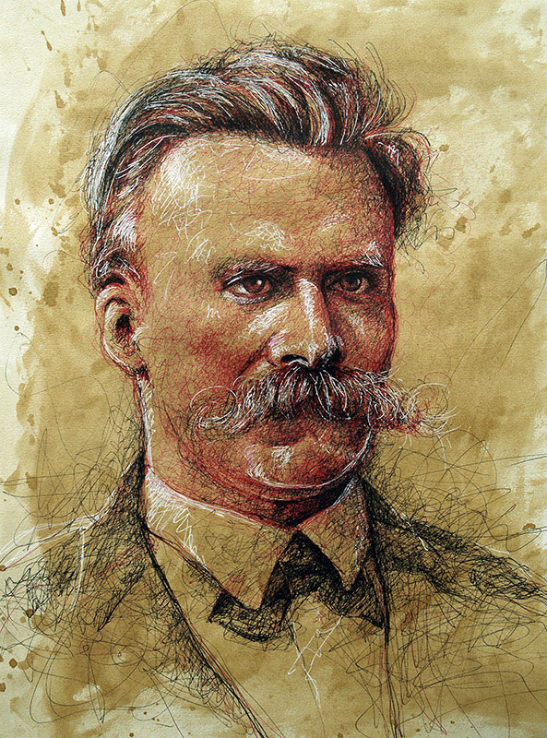
Friedrich Nietzsche (1844-1900) was a late 19th Century German philosopher whose writings have had a profound influence in our time, impacting developments across a wide spectrum of modern and postmodern culture. His suggestion that art could be its own thing, not limited to representations of reality, opened the door to modern art, influencing many early 20th century visual artists. He influenced many of the giants of modern art, painters such as Munch, Kandinsky, and Picasso, and sculptors Rodin and Giacometti. His critique of the foundations of Western culture and call for a new beginning after a radical break with the past opened up new directions shaping modern literature, poetry, drama, music, and architecture. His explorations into the depths of human consciousness and his recognition of the importance of dreams strongly influenced Freud and Jung and the development of depth psychology.
Nietzsche (1844-1900)
Pen on paper, Liu Ling after a photograph, 1876

Slide 3
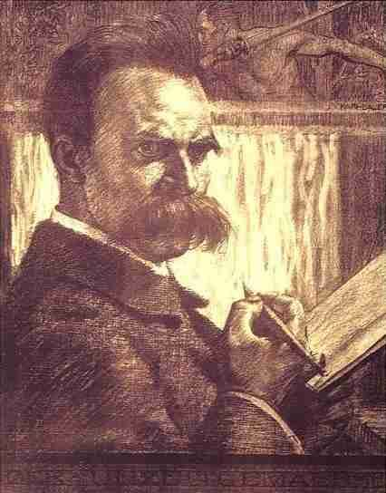
In philosophy he was one of the important thinkers in the development of the 20th century movement known as Existentialism, influencing philosophers such as Martin Heidegger, John-Paul Sartre, Simone de Beauvoir, and Albert Camus. Nietzsche was a huge influence on modernity, on many facets of early 20th century thought and culture; but in recent years he has also been considered something of a postmodern prophet, becoming a decisive influence on what is sometimes referred to a Postmodern Philosophy, a movement that began in France in the 1960s with thinkers such as Jacques Derrida, Michel Foucault, and Gilles Deleuze.
Nietzsche
Pen and ink on paper, Karl Bauer

Slide 4
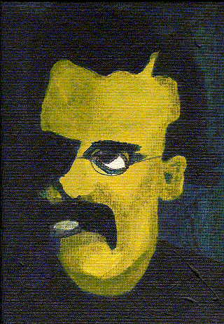
Nietzsche’s pervasive influence can be explained in part by the powerful and provocative nature of his writings, but perhaps even more so because of the sense in which his thought seemed to have anticipated the “crisis of modernity.” In a time when European culture was still confident of achieving its Enlightenment ideal of the progress of human society, progress towards unlocking the secrets of nature, and progress towards founding society upon universal foundation of reason, Nietzsche’s writings anticipated a cataclysmic crisis:
The Crisis of Modernity
What I relate is the history of the next two centuries. I describe what is coming, what can no longer come differently: the advent of nihilism. This history can be related even now; for necessity itself is at work here. This future speaks even now in a hundred signs, this destiny announces itself everywhere; for this music of the future all ears are cocked even now. For some time now, our whole European culture has been moving as toward a catastrophe, with a tortured tension that is growing from decade to decade: restlessly, violently, headlong, like a river that wants to reach the end, that no longer reflects, that is afraid to reflect. (The Will to Power, Preface, §2)
Nietzsche
Unknown source

Slide 5
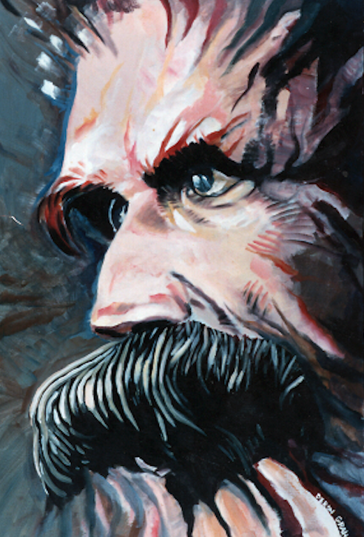
The Death of God
The madman. —Have you not heard of that madman who lit a lantern in the bright morning hours, ran to the market place, and shouted incessantly: ‘I seek God! I seek God’? As there were many people standing together who did not believe in God, he caused much amusement. ‘Is He got lost?’ asked one. ‘Did He wander off like a child?’, asked another. ‘Or is He hiding? Is He afraid of us?’ ‘Has He gone to sea? Has He emigrated?’ And in this manner they shouted and laughed. Then the madman leaped into their midst, and looked at them with piercing eyes and cried, ‘Where did God go? I will tell you! We have killed Him—you and I! We are all his murderers! But how did we do this? How were we able to drink up the sea? Who gave us the sponge to wipe away the whole horizon? What did we do when we unchained this earth from its sun? Where is it heading? Where are we heading? Away from all suns? Are we not constantly falling? Backwards, sidewards, forwards, in all directions? Is there still an above and below? Are we not straying as through an infinite nothingness? Do we not feel the breath of empty space? Has it not become colder? Is night not falling evermore? Musn’t lanterns be lit in the morning? Do we hear nothing yet of the noise of the gravediggers who are burying God? Do we smell nothing yet of the divine putrefaction? For even gods putrefy! God is dead! God remains dead! And we have killed him! (Nietzsche 2018, 134)
Nietzsche
Unknown medium, Deron Graham, ca. 1990s

Slide 6
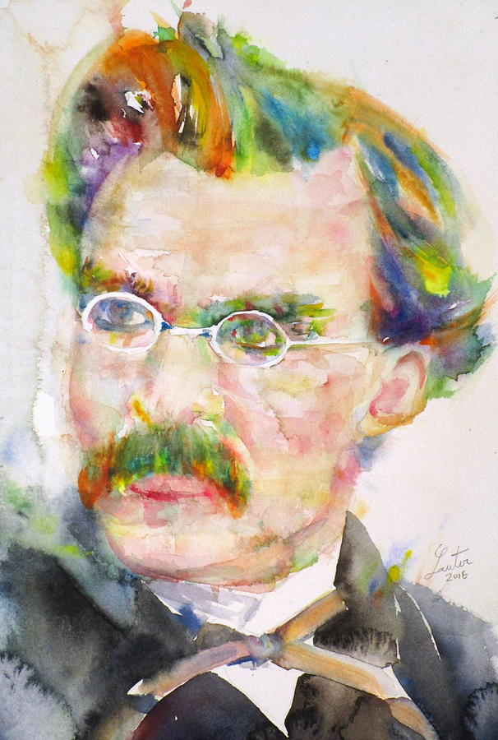
Art as Countermovement to Nihilism
From The Birth of Tragedy (1872) to the late writings, Nietzsche never strays far from the emphasis on the importance of art, stressing that art is the key to overcoming the crisis of modernity. In summing up his treatment of Nietzsche’s thinking about art, Richard Schacht comments that “of all the points he seeks to make none is of greater interest and importance than his contention that art is the clue and key to the possibility of discovering a way beyond nihilism” (Schacht 1983, 529). In the notes from his last year of writing (1888) Nietzsche emphasizes art as the countermovement to nihilism:
“Our religion, morality, and philosophy are decadence forms of man. The countermovement: art” (Nietzsche 1968, 419).
“We possess art lest we perish of the truth” (Nietzsche 1968, 435).
“Art and nothing but art! It is the great means of making life possible, the great seduction to life, the great stimulant of life.
Art as the only superior counterforce to all will to denial of life, as that which is anti-Christian, anti-Buddhist, antinihilist par excellence” (Nietzsche 1968, 452).
Nietzsche
Watercolor, Fabrizio Cassetta, 2016.

Slide 7
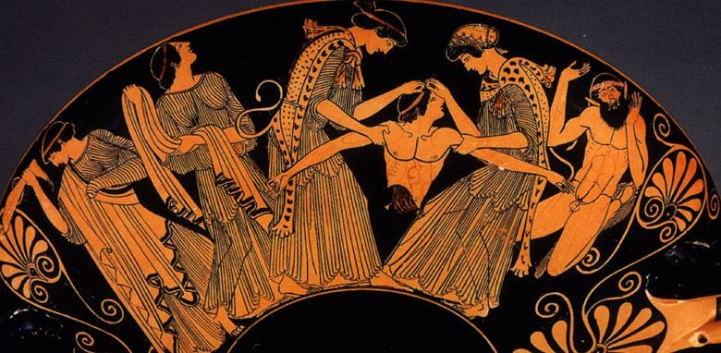
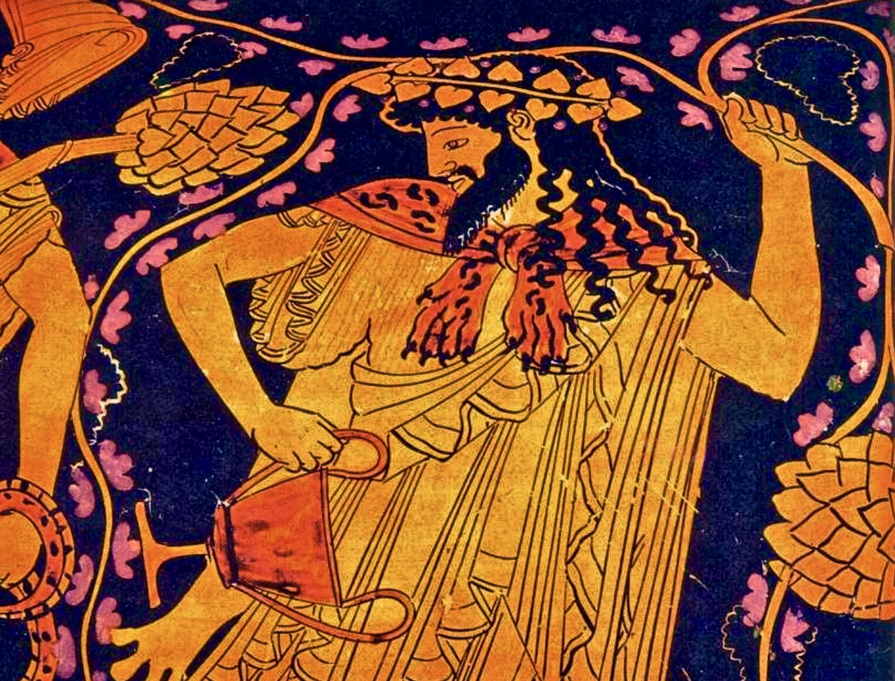
The Birth of Tragedy
The Death of Pentheus, Attic Red-Figure Kylix, attributed to Douris, c. 480 BCE.
Kimball Museum of Art, Dallas, Texas.
Dionysus, Attic Red-Figure Amphora, by the Kleophrades Painter, ca. 490 BCE.
Influenced as it was by Romanticism and Schopenhauer, The Birth of Tragedy elevates art to the highest importance. What made the book so controversial when it first appeared in 1872 was Nietzsche’s thesis that the high point of Greek culture, was not Socrates and Plato, but Aeschylus and Sophocles, thus not philosophy but art, in Greek Tragedy, with the poets Plato had condemned. In suggesting that the deeper truth of reality is revealed through Greek tragedy, in Dionysian ecstasies, and in the music in particular, Nietzsche was following Schopenhauer pretty closely, in putting forth a Romanticist view on the importance of art.

Slide 8
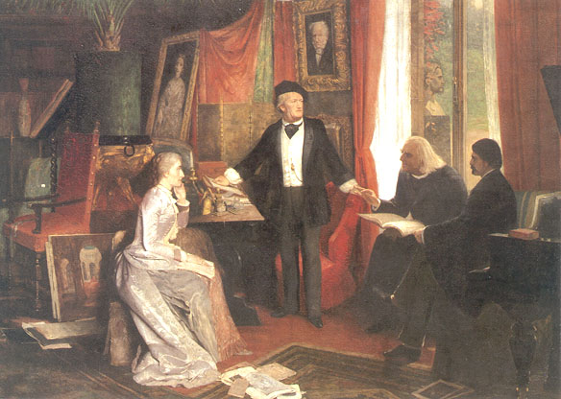
In the Preface, written at the end of 1871, Nietzsche dedicates The Birth of Tragedy to Wagner:
“But perhaps such readers will find it offensive that an aesthetic problem should be taken so seriously—assuming they are unable to consider art more than a pleasant sideline, a readily dispensable tinkling of bells that accompanies the ‘seriousness of life,’ just as if nobody knew what was involved in such a contrast with the ‘seriousness of life.’ Let such ‘serious’ readers learn something from the fact that I am convinced that art represents the highest task and the truly metaphysical activity of this life, in the sense of that man to whom, as my sublime predecessor on this path, I wish to dedicate this essay” (Nietzsche 1967, 31-32).
Nietzsche listens intently to Richard Wagner, who stands before a portrait of Schopenhauer, perhaps expounding on the importance of music. To Wagner’s left is Franz Liszt, the great Hungarian composer, virtuoso pianist, conductor, music teacher, arranger, and organist of the Romantic era. Liszt is widely regarded as one of the greatest pianists of all time. To Wagner’s right, listening intently, is Liszt’s daughter Cosima, who was Wagner’s wife.

Slide 9
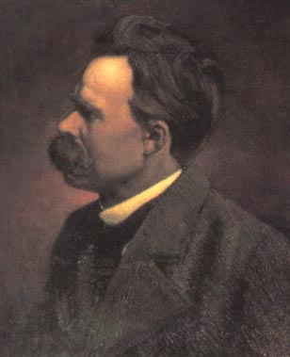
An Impossible Book
In the “Attempt at a Self-Criticism,” written in 1886 and attached as a Preface to the 2nd edition of the the text, Nietzsche is critical of his youthful romanticism, and disdainful of his infatuation with romantic German music (Wagner). He calls his first book ”an impossible book”:
To say it once more: today I find it an impossible book: . . . What found expression here was anyway—this was admitted with as much curiosity as antipathy—a strange voice, the disciple of a still "unknown God," one who concealed himself for the time being under the scholar's hood, under the gravity and dialectical ill humor of the German, even under the bad manners of the Wagnerian. Here was a spirit with strange, still nameless needs, a memory bursting with questions, experiences, concealed things after which the name of Dionysus was added as one more question mark. What spoke here—as was admitted, not without suspicion—was something like a mystical, almost maenadic soul that stammered with difficulty, a feat of the will, as in a strange tongue, almost undecided whether it should communicate or conceal itself. It should have sung, this "new soul"—and not spoken! (Nietzsche 1994, 170)

Slide 10
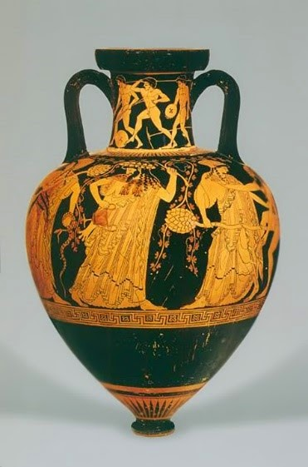
The Birth of Tragedy was an impossibility forged even in the very first sentence. Instead of with the voice of a lyric poet, Nietzsche begins with the voice of a scholar announcing an advance in “the science of aesthetics” (Nietzsche 1994, 162).
By proposing to reveal the origin of tragedy, to provide an answer to the question "what is tragedy?”, The Birth of Tragedy puts the Socratic question to art; and yet the story it has to tell pivots on the opposition between Socrates and the tragic poets, between Socratism and art.
If Socrates and tragedy are so opposed, how is a theoretical account of art possible? Does not tragedy die by the very posing of this question? Thus, the task the book sets out on, to disclose for all the origin of tragedy, revealing her true identity, is fated to fail. The opposition between Socrates and the tragic poets, as John Sallis remarks, “will both structure the book and perpetually threaten it from within by putting into question the very space of its writing” (Sallis 1991, 13).
Dionysian Revelry, Attic Red-Figure Amphora, by the Kleophrades Painter, ca. 490 BCE.

Slide 11
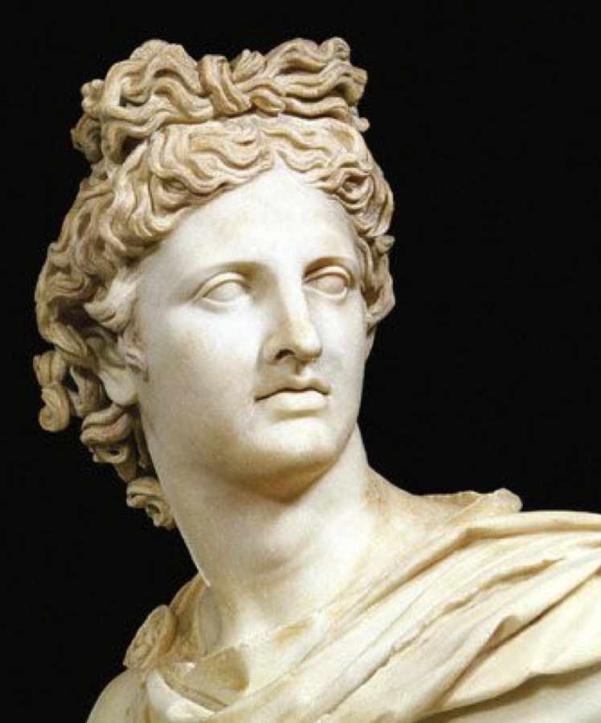
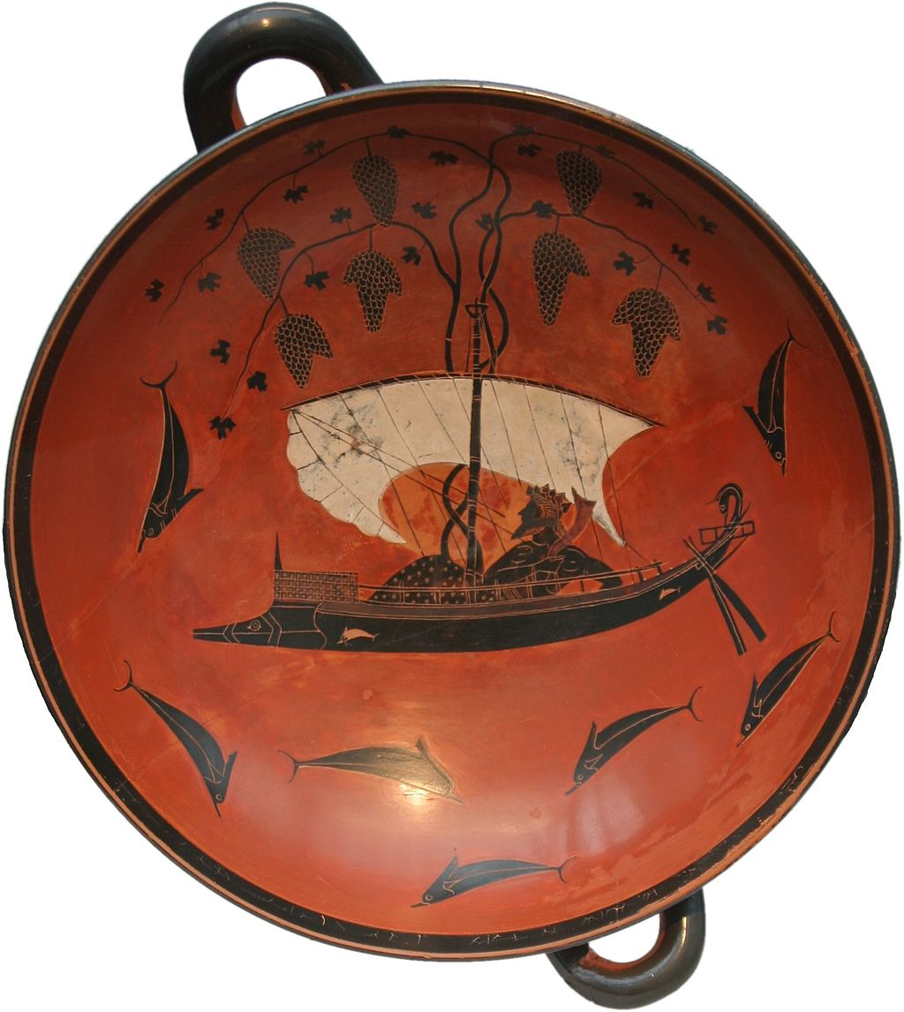
Apollinian and Dionysian Art
“The terms Dionysian and Apollinian we borrow from the Greeks, who disclose to the discerning mind the profound mysteries of their view of art, not to be sure, in concepts, but in the intensely clear figures of their gods. Through Apollo and Dionysus, the two art deities of the Greeks, we come to recognize that in the Greek world there existed a tremendous opposition, in origin and aims between the Apollinian art of sculpture, and the nonimagistic, Dionysian art of music” (Nietzsche 1994, 162).
Apollo of the Belvedere
White Marble, Circa AD 120–140
Dionysian and Dolphins
Attic Red-Figure Kylix, Exekias, ca. 530 BCE.

Slide 12
Romanticism of The Birth of Tragedy
One could easily read The Birth of Tragedy, its exalted expectations of art, its critique of reason and science, its belief in music, as massively, inextricably, bound to Schopenhauer and romanticism. The dualism at the core of The Birth of Tragedy, the antagonism between the Apollinian and Dionysian, might be read as only an echo of Schopenhauer's dualism between the World as Representation and the World as Will.
Appearance (the cave)
Art
Dreaming
Veiling, illusion
the senses
The Phenomenal World
The world that appears to us
Knowable by reason
The World as Representation
The visual or plastic arts
Representational Art
The Apollinian
Art of sculpture
dreaming
Reality (outside the cave)
Philosophy
Waking reality
Revealing, truth
Reason
The Noumenal World
The world as it is in-itself
Unknowable
Will
The underlying reality
Music
The Dionysian
Music
Intoxication, Ecstasy (Rausch)
Plato
Kant
Schopenhauer
Nietzsche

Slide 13
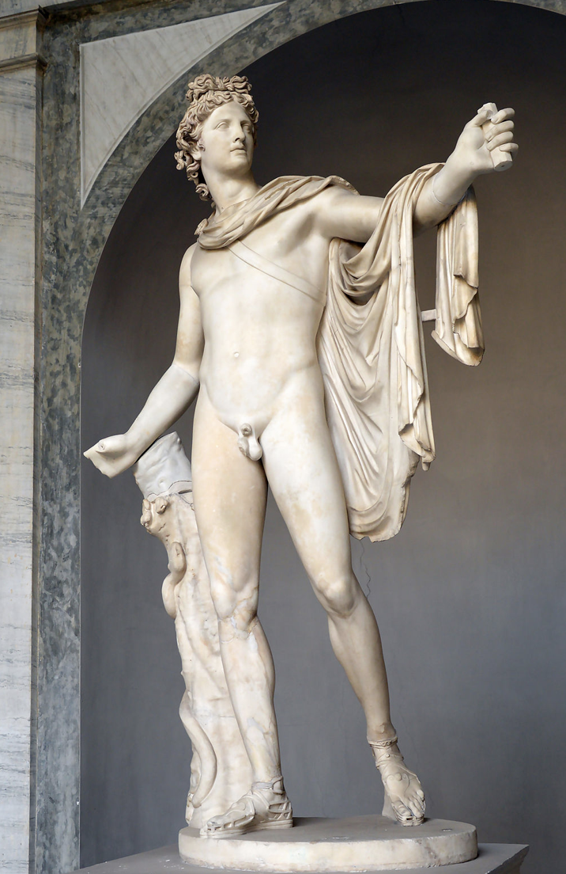
Shining Apollo
In order to gain access to the secret teachings of the Greeks concerning Apollinian art, Nietzsche discloses in the opening section of the book a number of features of the figure of Apollo drawn from Apollinian art. First of all there is Apollo's proper name, which, as Nietzsche notes, etymologically justifies designating the "god of light" as the "shining one" (Nietzsche 1994, 164).
When Nietzsche names Apollo "the shining one" he also deems him to be the "ruler over the beautiful shining of the inner world of fantasy" (Nietzsche 1994, 164). Apollo is the ruler of the inner world where images shine forth in dreams in their radiant, sometimes illusory, semblance. The first glimpse into the proto-artistic Apollinian force is thus through the understanding of the dream. As an art-impulse of nature, the Apollinian is the drive to the fashioning of images, to the production of beautifully shining figures. As art-state of nature, the Apollinian is the state of absorption in these images and figures. Dreaming is thus a particularly appropriate analogy for the Apollinian in that it involves both the production of and absorption in images.
He refers to the dream experience, embodied by the Greeks in Apollo as healing, and this dreaming as analogous to "the arts generally, which make life possible and worth living” (Nietzsche 1994, 164).
Apollo of the Belvedere
White Marble, Circa AD 120–140

Slide 14
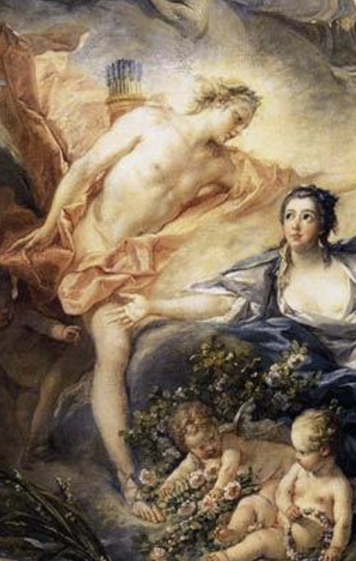
Shining Apollo
In dreams all human beings are artists, according to Nietzsche, insofar as they participate in the creation of the beautiful illusion or shining of the dream worlds. It is this "beautiful shining" that allows Nietzsche to draw the connection between dreaming and Apollinian art:
“The beautiful illusion of the dream worlds, in the creation of which every man is truly and artist, is the prerequisite of all plastic art, and, as we shall see, of an important part of poetry also. In our dreams we delight in the immediate understanding of figures; all forms speak to us; there is nothing unimportant or superfluous. But even when this dream reality is most intense, we still have, glimmering through it, the sensation that it is mere appearance” (Nietzsche 1994, 163).
Apollo is thus "the god of all imagistic powers” and therefore "the sculptor god,” the one who, with those powers, brings forth shining figures out of rough stone or soft clay. Apollinian art should not be thought, however, simply in terms of the paradigmatically Apollinian art of sculpture; but rather, it should be understood as any bringing forth of images, of any bringing forth that allows a figure to stand out against a ground.
Apollo and Issa (detail)
Oil on canvas, François Boucher (1703-1770)

Slide 15
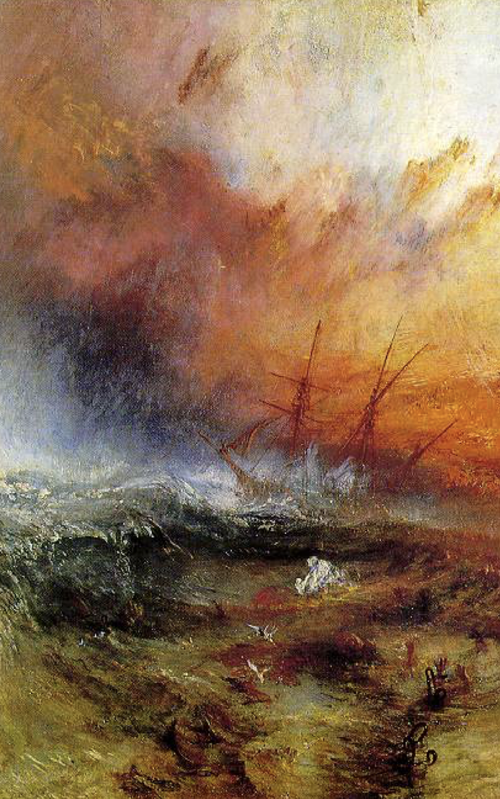
Apollinian Shining
Nietzsche applies to Apollo the words of Schopenhauer when speaking of man wrapped in veil of maya:
"Just as in a stormy sea that, unbounded in all directions, raises and drops mountainous waves, howling, a sailor sits in a boat and trusts in his frail bark: so in the midst of a world of torments the individual human being sits quietly, supported by and trusting in the principium individuationis” (Nietzsche 1994, 164).
The Apollinian is thus connected to the principle of individuality, of identity.
The Apollinian art drive is thus the drive to establish identity, draw boundaries, to carve a form out of an uncarved block of stone, to draw a figure with line and color, to make sense out of chaos. All of our attempts to make sense of existence, all of our “truths,” are the product of this Apollinian drive.
The Slave Ship (detail)
Oil on canvas, J.M.W. Turner, 1840.

Slide 16
Dionysian Ecstasy
As with the Apollinian, to discern something of the secret teachings of the Greeks concerning the Dionysian, it is still a matter of attending to the figure of the god. And yet, except for one key reference, Nietzsche says very little concerning the figure of Dionysus, especially in contrast to what he says about shining Apollo. Nevertheless, this is not surprising since things are all together different with the sylvan god. For the figure of Dionysus, as Sallis puts it, is withdrawn, or at least it can be drawn only "in such a manner that it can have no direct image” (Sallis 1991, 42).
For Nietzsche, Dionysian art is associated with ecstasy or intoxication (Rausch). Rausch is often translated as “intoxication,” which makes some sense as Dionysus is the god of wine; but the experience Nietzsche is thinking of is obviously not a mere drunkenness. Rausch can also be translated as “ecstasy” and “ecstasy” literally means “to stand outside oneself.” The movement of ecstasy thus breaks through Apollinian boundaries. It bursts or dissolves identities.

Slide 17
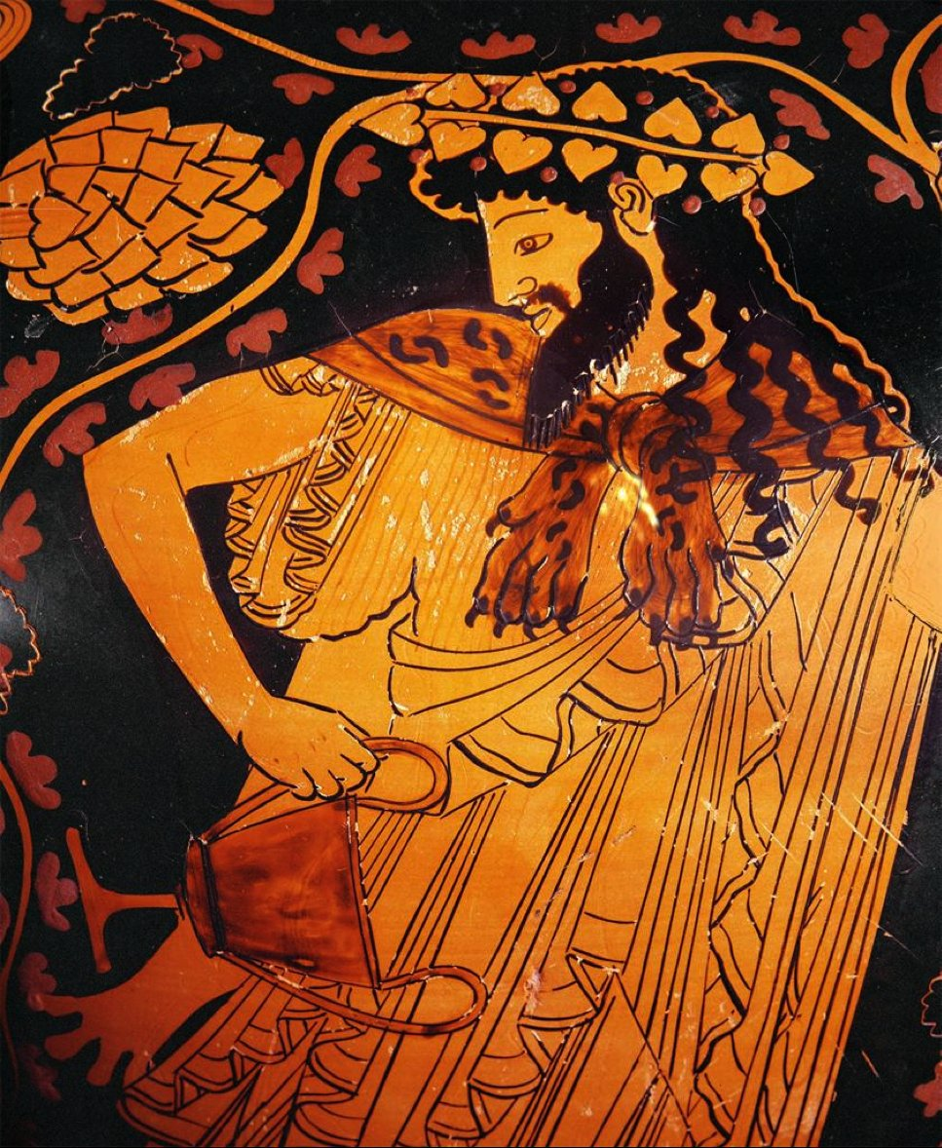
Dionysian Ecstasy
The Dionysian is then the collapse of the principle of individuality. Nietzsche refers to the blissful ecstasy that wells up within man in these Dionysian states of intoxication or ecstasy. In such Dionysian experiences our separate identities are dissolved:
“Now, with the gospel of universal harmony, each one feels himself not only united, reconciled, and fused with his neighbor, but as one with him, as if the veil of maya had been torn aside and were now merely fluttering in tatters before the mysterious primordial unity” (Nietzsche 1994, 165).
Here is where the youthful romanticism and the influence of Schopenhauer is most apparent. In Dionysian ecstasy, the deeper truth of reality is revealed:
“In the Dionysian dithyramb man is incited to the greatest exaltation of all his symbolic faculties; something never before experienced struggles for utterance—the annihilation of the veil of maya, oneness as the soul of the race an of nature herself” (Nietzsche 1994, 167).

Slide 18
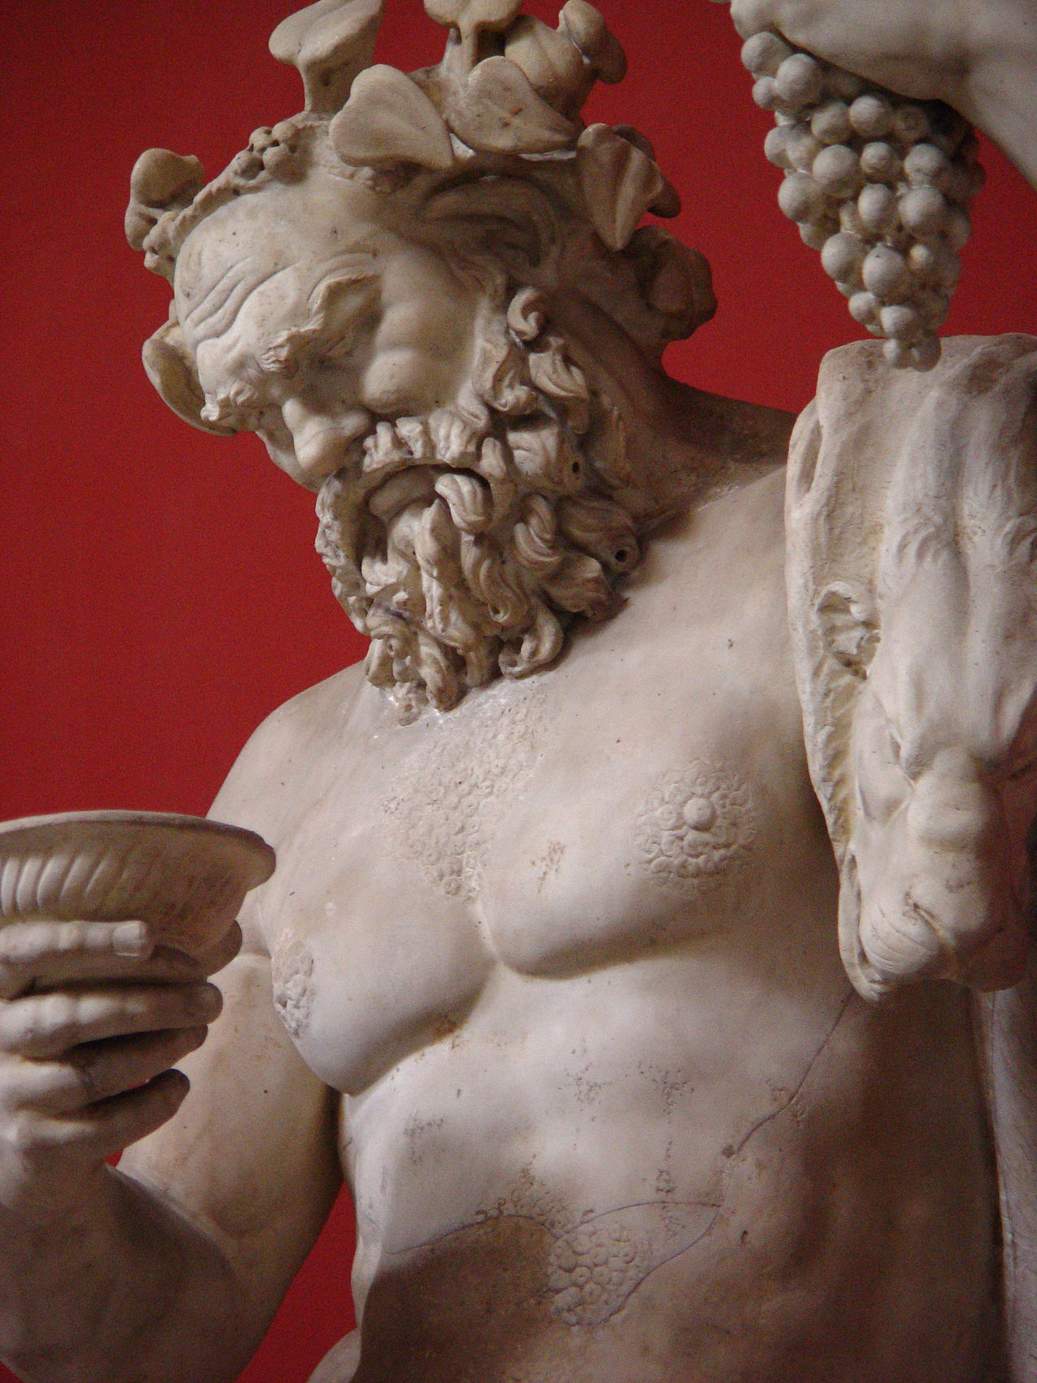
The Wisdom of Silenus
In order to better understand the healing capacity of the Apollinian shining of dreams, Nietzsche recounts a story from Greek mythology:
“There is an ancient story that King Midas hunted in the forest a long time for the wise Silenus, the companion of Dionysus, without capturing him. When Silenus at last fell into his hands, the king asked what was the best and most desirable of all things for man. Fixed and immovable, the demigod said not a word, till at last, urged by the king, he gave a shrill laugh and broke out into these words: ‘Oh, wretched ephemeral race, children of chance and misery, why do you compel me to tell you what it would be most expedient for you not to hear? What is best of all is utterly beyond your reach: not to be born, not to be, to be nothing. But the second best for you is—to die soon’" (Nietzsche 1967, 42).
Statue of Silenus
Rustic god of winemaking.
Vatican Museum, Rome

Slide 19
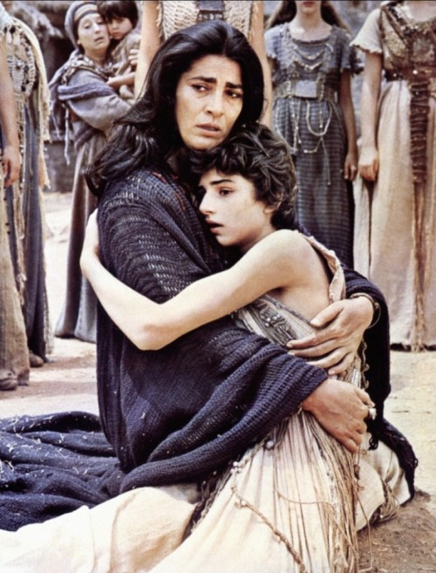
The Tragic Character of Existence
What Silenus reveals is the tragic character of existence. The truth revealed here is not at all the beautiful truth of Plato; it is a terrible truth, an abysmal truth.
This is what Iphigenia realizes when she has to die because the winds won’t blow. In the film, based Euripides’s play Iphengia at Aulis, she confronts the tragic character of existence when she asks her mother:
“Where did the wind go? Why doesn’t it come to Aulis? Imagine that in the open sea people are drowning, begging the gods for the wind to stop. What an injustice!” (Cacoyannis 1977).

Slide 20
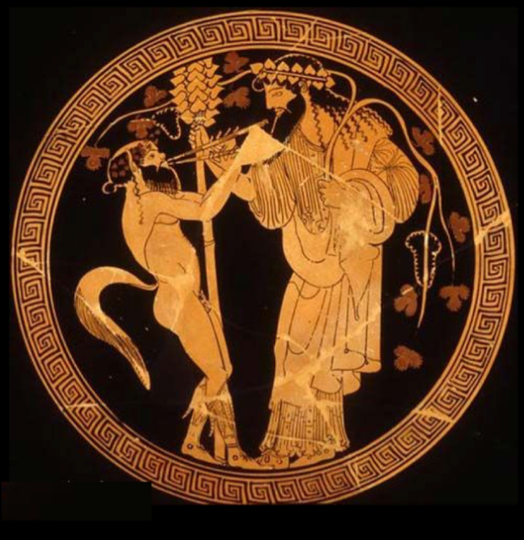
The Tragic Character of Existence
In The Birth of Tragedy, Nietzsche suggests that Greek Tragedy enabled the Greeks of the tragic age to go on living despite the tragic character of existence. The first part of this is the recognition of the healing capacity of the Apollinian art. We thus have art, the Apollinian art of illusion, the beautiful illusion of the dreamworld, lest we perish of the truth:
“The same drive which calls art into life, as the complement and of existence, seducing one to a continuation of life, was also the cause of the Olympian world which the Hellenic ‘will’ made use of as a transfiguring mirror. Thus do the gods justify the life of man” (Nietzsche 1967, 43).
The Cult of Dionysus:
Dionysus and a satyr face each other.
Attic red-figure Kylix, the potter Hieron and painted by Makron, ca. 480 BCE

Slide 21
The Tragic Character of Existence
In “The Attempt at a Self-Criticism” Nietzsche explains that the underlying thesis of The Birth of Tragedy is a rejection of Schopenhauer’s philosophy. There he raises the question “What after all, did Schopenhauer think of tragedy.” He goes on to quote from The World as Will and Representation where Schopenhauer writes:
That which bestows on everything tragic its peculiar elevating force is the discovery that the world, that life, can never give real satisfaction and hence it is not worthy of our affection: this constitutes the tragic spirit—it leads to resignation.
(Schopenhauer 1907, 495; Nietzsche 1994, 173)
Philosopher Jacques Taminiaux explains that Schopenhauer’s view of tragedy is that "we have art in order to learn how to die, once we have overcome the deceptive order of representation, and contemplated the absurdity of the will” (Taminiaux 1987, 85).
The Cult of Dionysus:
Dionysus and a satyr face each other.
Attic red-figure Kylix, the potter Hieron and painted by Makron, ca. 480 BCE

Slide 22
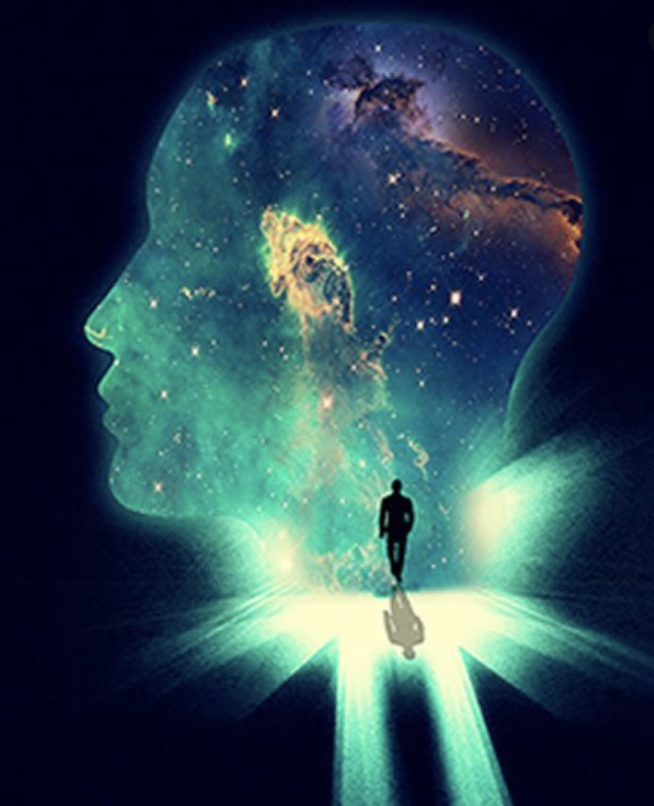
Lucid Dreaming
The key to The Birth of Tragedy is understanding how Nietzsche thought that Greek Tragedy, in bringing together these two opposed art drives, could overcome this resignation with life and enable one to affirm life despite the tragic character of existence. The coming together of the Apollonian and Dionysian is suggested in the metaphor of the lucid dream. Whereas the Apollonian is connected with dreaming, and the Dionysian with the shattering of the dream, when they are brought together, Nietzsche suggests, is the awareness that one is dreaming:
“Now the dream analogy may throw some light on the naïve artist. Let us imagine the dreamer: in the midst of the illusion of the dream world and without disturbing it, he calls out to himself: ‘It is a dream, I will dream on.’ What must we infer? . . . Though it is certain that of the two halves of our existence, the waking and the dreaming states, the former appeals to us as infinitely preferable, more important, excellent, and worth of being lived—yet in relation to that mysterious ground of our being of which we are the phenomena, I should, paradoxical as it may seem, maintain the very opposite estimate of the value of dreams” (Nietzsche 1967, 44).

Slide 23
Lucid Dreaming
The Birth of Tragedy is still romanticist in those passages that would suggest the Dionysian experience is an awakening from the dream as if one finally wakes up to the truth of reality. But when it is recognized that the truth revealed in the Dionysian experience is not a truth that could serve as a ground, but truth as Excess (Übermass), then The Birth of Tragedy perhaps offers a preview of Nietzsche’s mature philosophy.
“And now let us imagine how into this world, built of mere appearance and moderation and artificially dammed up, there penetrated, in tones ever more bewitching and alluring, the ecstatic sound of the Dionysian festival; how in these strains all of nature's excess in pleasure, grief, and knowledge became audible, even in piercing shrieks; and let us ask ourselves what the psalmodizing artist of Apollo, with his phantom harp-sound, could mean in the face of this demonic folk-song! The muses of the arts of "illusion" paled before an art that, in its intoxication (Rausch), spoke the truth. The wisdom of Silenus cried "Woe! woe!" to the serene Olympians. The individual, with all his restraint and proportion, succumbed to the self-oblivion of the Dionysian states, forgetting the precepts of Apollo. Excess revealed itself as truth” (Nietzsche 1967, 46).

Slide 24
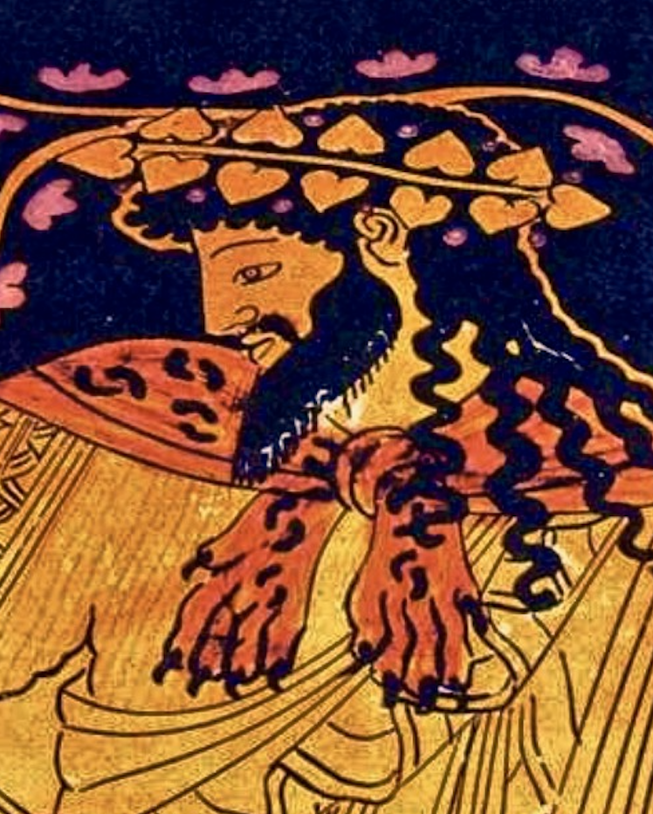
The Dionysian Experience
All of our truths, Nietzsche suggests, are the result of the Apollonian drive to carve the figure out of the stone—the drive to make sense of the chaos of existence; but Dionysian insight, however, reveals truth as excess—despite all our attempts to make sense of existence, it always exceeds all those attempts as it is always capable of being interpreted otherwise. Here is truth, not as origin, as ground, but as abyss. The preview of Nietzsche’s mature thought lies in confronting the abyss that is revealed in the Dionysian experience. At first, as Nietzsche explains here, the Dionysian experience is nauseating:
“In this sense the Dionysian man resembles Hamlet: both have once looked truly into the essence of things, they have gained knowledge, and nausea inhibits action; for their action could not change anything in the eternal nature of things; they feel it to be ridiculous or humiliating that they should be asked to set right a world that is out of joint. Knowledge kills action; action requires the veils of illusion: that is the doctrine of Hamlet, not that cheap wisdom of Jack the Dreamer who reflects too much and, as it were, from an excess of possibilities does not get around to action. Not reflection, no—true knowledge, an insight into the horrible truth, outweighs any motive for action, both in Hamlet and in the Dionysian man” (Nietzsche 1967, 60).

Slide 25
Greek Tragedy as Saving Sorceress
In this suggestion of lucid dreaming,
“Now no comfort avails any more; longing transcends a world after death, even the gods; existence is negated along with its glittering reflection in the gods or in a immortal beyond. Conscious of the truth he has once seen, man now sees everywhere only the horror or absurdity of existence; now he understands what is symbolic in Ophelia’s fate; now he understands the wisdom of the sylvan god, Silenus: he is nauseated.
Here, when the danger to the will is greatest, art approaches as a saving sorceress, expert at healing. She alone knows how to turn these nauseous thoughts about the horror or absurdity of existence into notions with which one can live” (Nietzsche 1967, 46).

Slide 26
Greek Tragedy as Saving Sorceress
The Birth of Tragedy perhaps offers a startling preview of Nietzsche’s mature philosophy. Instead of naively believing we have woken up and discovered the truth of reality, the philosophers of the future, whom Nietzsche often looks forward to in later writings, have gone through the Dionysian experience revealing the abysmal nature of existence. But instead of ending in tragic resignation, remaining paralyzed with nausea, they come out of the experience with the courage to go on dreaming, affirming life despite the tragic character of existence.
“In the total effect of tragedy, the Dionysian predominates once again. Tragedy closes with a sound which could never come from the realm of Apollinian art. And thus the Apollinian illusion reveals itself as what it really is—the veiling during the performance of the tragedy of the real Dionysian effect; but the latter is so powerful that it ends by forcing the Apollinian drama itself into a sphere where it begins to speak with Dionysian wisdom and even denies itself and its Apollinian visibility. Thus the intricate relation of the Apollinian and Dionysian in tragedy may really be symbolized by a fraternal union of the two deities: Dionysus speaks the language of Apollo; and Apollo, finally the language of Dionysus; and so the highest goal of tragedy and of all art is attained” (Nietzsche 1967, 130).

Slide 27
The Highest Aim of Art
At the end of The Birth of Tragedy Nietzsche explains what he thinks the highest aim of art is, which he thought had been attained in Greek tragedy. In the first part of this statement, Nietzsche opens the door to Modern Art. Rejecting the tradition which, since Plato, accepted that art is imitation of the reality of nature, Nietzsche suggests that art is a “metaphysical supplement of the reality of nature.” What he means by this, is that art can be its own thing, placed beside the reality of nature instead of imitating the reality of nature. But he goes on to say that the highest aim of art is the intention to transfigure. The highest aim of art, Nietzsche is here suggesting, is its capacity to change us.
“That life is really so tragic would least of all explain the origin of an art form—assuming that art is not merely imitation of the reality of nature but rather a metaphysical supplememt of the reality of nature, placed beside it for its overcoming. The tragic myth, too, insofar as it belongs to art at all, participates fully in this metaphysical intention of art to transfigure. But what does it transfigure when it presents the world of appearance in the image of the suffering hero? Least of all the "reality" of this world of appearance, for it says to us: "Look there! Look closely! This is your life, this is the hand on the clock of your existence” (Nietzsche 1967, 140).

Slide 28
The Death of Tragedy
In The Birth of Tragedy, Nietzsche also tells the story, in addition to telling the strange story about the birth of tragedy, of the death of Greek tragedy. He explains that Greek tragedy died by suicide at the hands of Euripides. The last of the great tragedians, Euripides was a contemporary of Socrates, and Nietzsche argues that Euripides was influenced by the Socratic optimism, emphasized in Plato’s philosophy that knowledge leads to virtue, and eternal happiness. Nietzsche argues that this took the gaze of the Greeks away from confronting the Dionysian abysmal truth, and this killed tragedy. One might get a sense of what Nietzsche was getting at if one compares the 1997 film Iphigenia, directed by Michael Cacoyannis, with the original play, Iphegenia at Aulis, by Euripides. Cacoyannis changed the ending, perhaps influenced by Nietzsche’s thought. In Euripides, Iphegenia is not sacrificed at the end. When the smoke clears, Agamemnon sees that the goddess Artemis has replaced Iphigenia with a fawn. Iphegenia has been taken up to heaven to live with the gods.

Slide 29
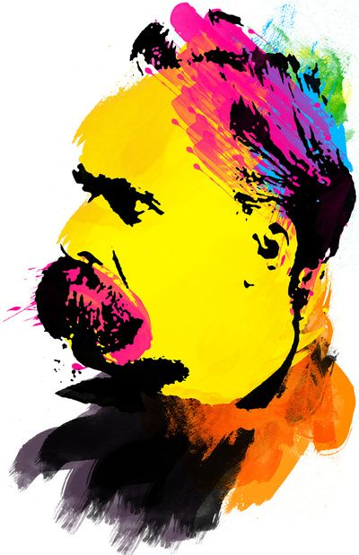
Later Writings
The Will to Power
“We possess art lest we perish of the truth”
(Nietzsche 1968, 435).

Slide 30
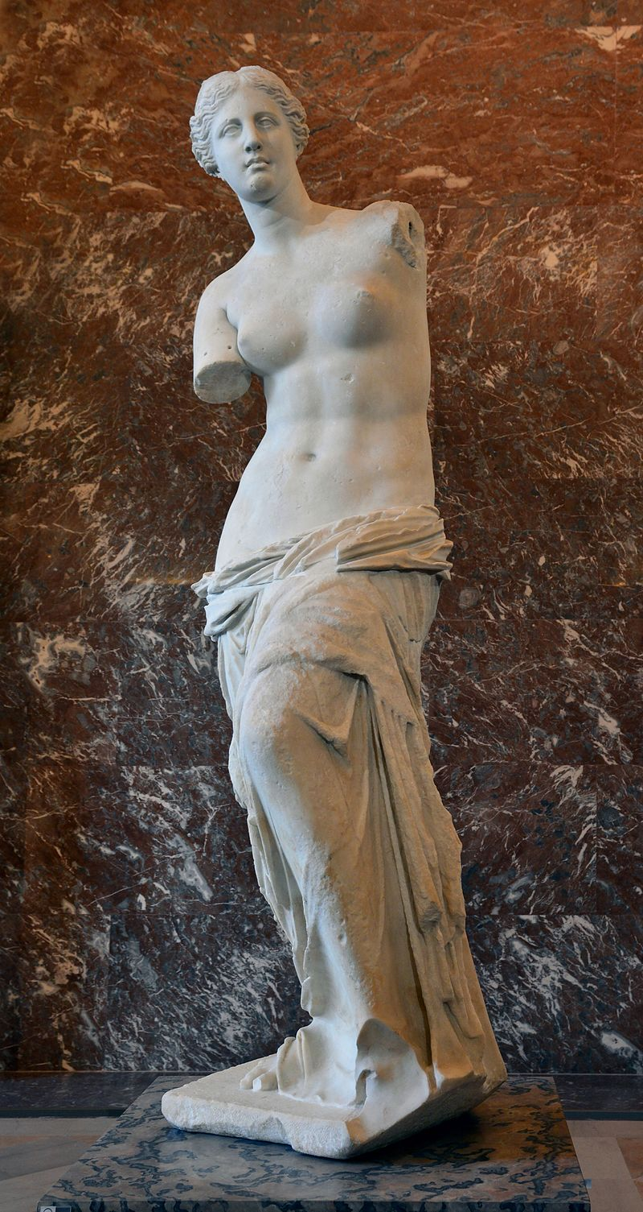
The Joyous Science
No, if we convalescents still need art, it is another kind of art—a mocking, light, fleeting, divinely untroubled, divinely artificial art that, like a pure flame, licks into unclouded skies. Above all, an art for artists, for artists only! We know better afterward what above all is needed for this: cheerfulness, any cheerfulness, my friends—also as artists: let me prove it. There are a few things we now know too well, we knowing ones: oh, how we now learn to forget well, and to be good at not knowing, as artists!
And as for our future, one will hardly find us again on the paths of those Egyptian youths who endanger temples by night, embrace statues, and want by all means to unveil, uncover, and put into a bright light whatever is kept concealed for good reasons. No, this bad taste, this will to truth, to "truth at any price," this youthful madness in the love of truth have lost their charm for us: for that we are too experienced, too serious, too merry, too burned, too profound. We no longer believe that truth remains truth when the veils are withdrawn; we have lived too much to believe this. Today we consider it a matter of decency not to wish to see everything naked, or to be present at everything, or to understand and "know" everything.
"Is it true that God is present everywhere?" a little girl asked her mother; "I think that's indecent"—a hint for philosophers! One should have more respect for the bashfulness with which nature has hidden behind riddles and iridescent uncertainties. Perhaps truth is a woman who has reasons for letting us see her reasons? Perhaps her name is—to speak Greek—Baubo?
Oh, those Greeks! They knew how to live. What is required for that is to stop courageously at the surface, the fold, the skin, to adore appearance, to believe in forms, tones, words, in the whole Olympus of appearance. Those Greeks were superficial—out of profundity. And is not this precisely what we are again coming back to, we daredevils of the spirit who have climbed the highest and most dangerous peak of present thought and looked around from up there—we who have looked down from there? Are we not, precisely in this respect, Greeks? Adorers of forms, of tones, of words? And therefore—artists?
(Nietzsche 1974, 37-38).
Venus de Milo
Marble, Alexandros of Antioch,
ca. 130-100 BCE
Musée du Louvre, Paris

Slide 31
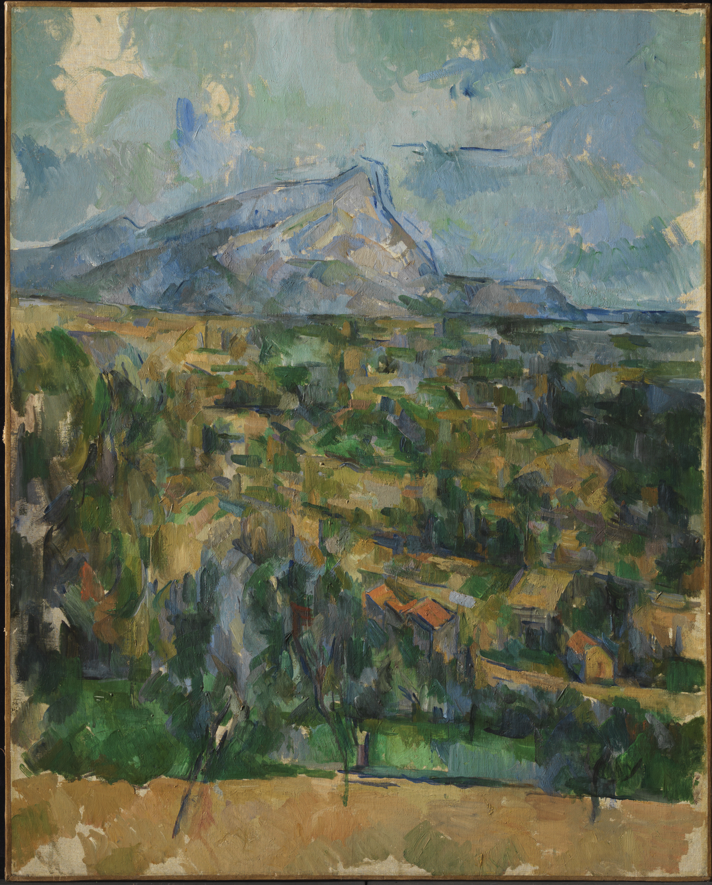
The Joyous Science
To the Realists. —You sober people who feel well armed against passion and fantasies and would like to turn your emptiness into a matter of pride and an ornament: you call yourselves realists and hint that the world really is the way it appears to you. As if reality stood unveiled before you only, and you yourselves were perhaps the best part of it—O you beloved images of Sais! But in your unveiled state are not even you still very passionate and dark creatures compared to fish, and still far too similar to an artist in love? You are still burdened with those estimates of things that have their origin in the passions and loves of former centuries. Your sobriety still contains a secret and inextinguishable drunkenness. Your love of "reality," for example—oh, that is a primeval "love." Every feeling and sensation contains a piece of this old love; and some fantasy, some prejudice, some unreason, some ignorance, some fear, and ever so much else has contributed to it and worked on it. That mountain there! That cloud there! What is "real" in that? Subtract the phantasm and every human contribution from it, my sober friends! If you can! If you can forget your descent, your past, your training—all of your humanity and animality. There is no "reality" for us—not for you either, my sober friends. We are not nearly as different as you think, and perhaps our good will to transcend intoxication is a respectable as your faith that you are altogether incapable of intoxication.
(Nietzsche 1974, 37-38).
Mont Sainte-Victoire
Oil on canvas, Paul Cézanne, 1904

Slide 32
The Joyous Science
Only as creators! —This has given me the greatest trouble and still does: to realize what things are called is comparably more important than what they are. The reputation, name, appearance, the usual measure and weight of a thing, what it counts for—originally almost always wrong and arbitrary, thrown over things like a dress and altogether foreign to their nature and even to their skin—all this grows from generation unto generation, merely because people believe in it, until it gradually grows to be part of the thing and turns into its very body. What at first was appearance becomes in the end, almost invariably, the essence and is effective as essence. How foolish it would be to suppose that one only needs to point out this origin and this misty shroud of delusion in order to destroy the world that counts for real, so-called "reality." We can destroy only as creators. —But let us not forget this either: it is enough to create new names and estimations and probabilities in order to create in the long run new "things."
(Nietzsche 1974, 121-122).
Mont Sainte-Victoire
Oil on canvas, Paul Cézanne, 1904

Slide 33
The Joyous Science
Our ultimate gratitude to art.—If we had not welcomed the arts and invented this kind of cult of the untrue, then the realization of general untruth and mendaciousness that now comes to us through science—the realization that delusion and error are conditions of human knowledge and sensation—would be utterly unbearable. Honesty would lead to nausea and suicide. But now there is a counterforce against our honesty that helps us to avoid such consequences: art as the good will to appearance. We do not always keep our eyes from rounding off something and, as it were, finishing the poem; and then it is no longer eternal imperfection that we carry across the river of becoming—then we have the sense of carrying a goddess, and feel proud and childlike as we perform this service. As an aesthetic phenomenon existence is still bearable for us, and art furnishes us with eyes and hands and above all the good conscience to be able to turn ourselves into such a phenomenon. At times we need a rest from ourselves by looking upon, by looking down upon, ourselves and, from an artistic distance, laughing over ourselves or weeping over ourselves. We must discover the hero no less than the fool in our passion for knowledge; we must occasionally find pleasure in our folly, or we cannot continue to find pleasure in our wisdom. Precisely because we are at bottom grave and serious human beings—really, more weights than human beings—nothing does us as much good as a fool's cap: we need it in relation to ourselves—we need all exuberant, floating, dancing, mocking, childish, and blissful art lest we lose the freedom above things that our ideal demands of us. It would mean a relapse for us, with our irritable honesty, to get involved entirely in morality and, for the sake of the over-severe demands that we make on ourselves in these matters, to become virtuous monsters and scarecrows. We should be able also to stand above morality—and not only to stand with the anxious stiffness of a man who is afraid of slipping and falling any moment, but also to float above it and play. How then could we possibly dispense with art—and with the fool? —And al long as you are in any way ashamed before yourselves, you do not yet belong with us.
(Nietzsche 1974, 163-64)

Slide 34
The Joyous Science
The consciousness of appearance.— How wonderful and new and yet how gruesome and ironic I find my position vis-à-vis the whole of existence in the light of my insight! I have discovered for myself that the human and animal past, indeed the whole primal age and past of all sentient being continues in me to invent, to love, to hate, and to infer. I suddenly woke up in the midst of this dream, but only to the consciousness that I am dreaming and that I must go on dreaming lest I perish—as a somnambulist must go on dreaming lest he fall. What is “appearance” for me now? Certainly not the opposite of some essence: what could I say about any essence except to name the attributes of its appearance! Certainly not a dead mask that one could place on an unknown x or remove from it!
Appearance is for me that which lives and is effective and goes so far in its self-mockery that it makes me feel that this is appearance and will-o’-wisp and a dance of spirits and nothing more—that among these dreamers, I, too, who “know,” am dancing my dance; that the knower is a means for prolonging the earthly dance and thus belongs to the masters of ceremony of existence; and that the sublime consistency and interrelatedness of all knowledge perhaps is and will be the highest means to preserve the universality of dreaming and the mutual comprehension of all dreamers and thus also the continuation of the dream.
(Nietzsche 1974, 116)

Slide 35
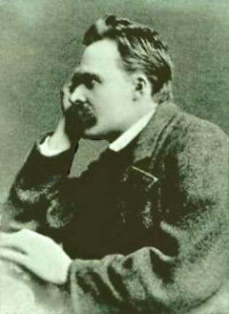
The Joyous Science
Our new ‘infinite’—How far the perspective character of existence extends or indeed whether existence has any other character than this; whether existence without interpretation, without "sense," does not become "nonsense"; whether, on the other hand, all existence is not essentially actively engaged in interpretation that cannot be decided even by the most industrious and most scrupulously conscientious analysis and self-examination of the intellect; for in the course of this analysis the human intellect cannot avoid seeing itself in its own perspectives, and only in these. We cannot look around our own corner: it is a hopeless curiosity that wants to know what other kinds of intellects and perspectives there might be . . . But I should think that today we are at least far from the ridiculous immodesty that would be involved in decreeing from our corner that perspectives are permitted only from this corner. Rather has the world become "infinite" for us all over again, inasmuch as we cannot reject the possibility that it may include infinite interpretations.
(Nietzsche 1974, 336-37)

Slide 36
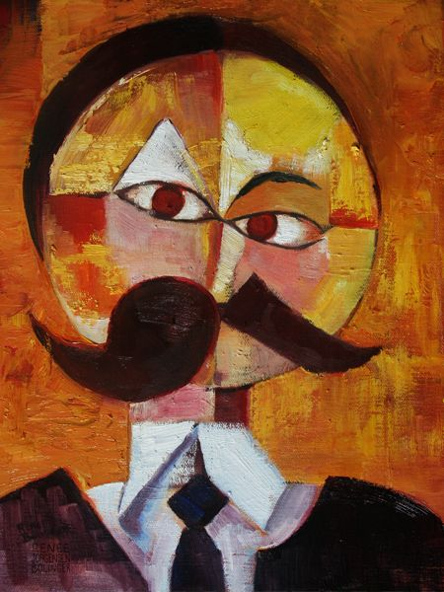
On The Genealogy of Morals
Henceforth, my dear philosophers, let us be on guard against the dangerous old conceptual fiction that posited a "pure, willess, painless, timeless knowing subject"; let us guard against the snares of such contradictory concepts as "pure reason," "absolute spirituality," "knowledge in itself": these always demand that we should think of an eye that is completely unthinkable, an eye turned in no particular direction, in which the active and interpreting forces, through which alone seeing becomes seeing something, are supposed to be lacking; these always demand of the eye an absurdity and a nonsense. There is only a perspective "knowing"; and the more affects we allow to speak about one thing, the more eyes, different eyes, we can use to observe one thing, the more complete will our "concept" of this thing, our "objectivity," be. But to eliminate the will altogether, to suspend each and every affect, supposing we were capable of this—what would that mean but to castrate the intellect?
(Nietzsche 2000, 555)

Slide 37
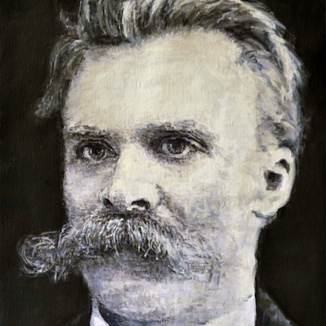
The Joyous Science
The delusion of the contemplatives. . . he calls his own nature contemplative and overlooks that he himself is really the poet who keeps creating this life. . . . We who think and feel at the same time are those who really continually fashion something that is not there yet: the whole eternally growing world of valuations, colors, accents, perspectives, scales, affirmations, and negations. This poem that we have invented is continually studied by so-called practical human beings . . . who learn their roles and translate everything into flesh and actuality, into the everyday. Whatever has value in our world now does not have value in itself, according to its nature—nature is always value-less, but has been given value at some time, as a present — and it was we who gave and bestowed it. Only we have created the world that concerns humanity! —But precisely this knowledge we lack, and when we occasionally catch it for a fleeting moment we always forget it again immediately; we fail to recognize our best power and underestimate ourselves, the contemplatives, just a little. We are neither as proud nor as happy as we might be.
(Nietzsche 1974, 241-242)

Slide 38
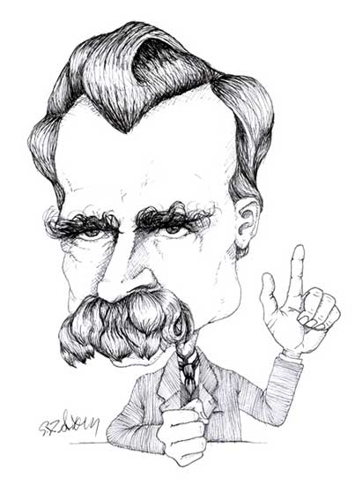
Beyond Good and Evil
Forgive me the joke of this gloomy grimace and trope; for I myself have learned long ago to think differently, to estimate differently with regard to deceiving and being deceived, and I keep in reserve at least a couple of jostles for the blind rage with which the philosophers resist being deceived. Why not? It is no more than a moral prejudice that truth is worth more than mere appearance; it is even the worst proved assumption there is in the world. Let at least this much be admitted: there would be no life at all if not on the basis of perspective estimates and appearances; and if, with the virtuous enthusiasm and clumsiness of some philosophers, one wanted to abolish the "apparent world" altogether well suppose you could do that, at least nothing would be left of your "truth" either. Indeed, what forces us at all to suppose that there is an essential opposition of "true" and "false"? Is it not sufficient to assume degrees of apparentness and, as it were, lighter and darker shadows and shades of appearance different "values," to use the language of painters? Why couldn't the world that concerns us be a fiction?
(Nietzsche 1966, 46-47)

Slide 39
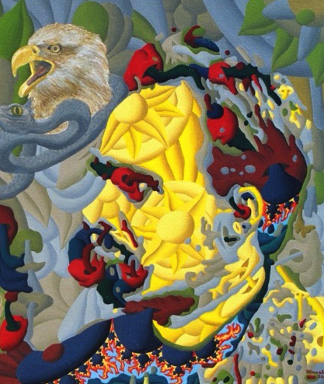
Twilight of the Idols
The psychology of the orgiastic as an overflowing feeling of life and strength, where even pain still has the effect of a stimulus, gave me the key to the concept of tragic feeling, which had been misunderstood both by Aristotle and, quite especially, by our modern pessimists. Tragedy is so far from proving anything about the pessimism of the Hellenes, in Schopenhauer's sense, that it may, on the contrary, be considered its decisive repudiation and counter-instance. Saying Yes to life even in its strangest and hardest problems, the will to life rejoicing over its own inexhaustibility even in the very sacrifice of its highest types—that is what I called Dionysian, that is what I guessed to be the bridge to the psychology of the tragic poet. Not in order to be liberated from terror and pity, not in order to purge oneself of a dangerous affect by its vehement discharge Aristotle understood it that way but in order to be oneself the eternal joy of becoming, beyond all terror and pity that joy which included even joy in destroying.
And herewith I again touch that point from which I once went forth: The Birth of Tragedy was my first revaluation of all values. Herewith I again stand on the soil out of which my intention, my ability grows I, the last disciple of the philosopher Dionysus—I, the teacher of the eternal recurrence. (TI X, 5)
(Nietzsche 1954, 562-563).

Slide 40
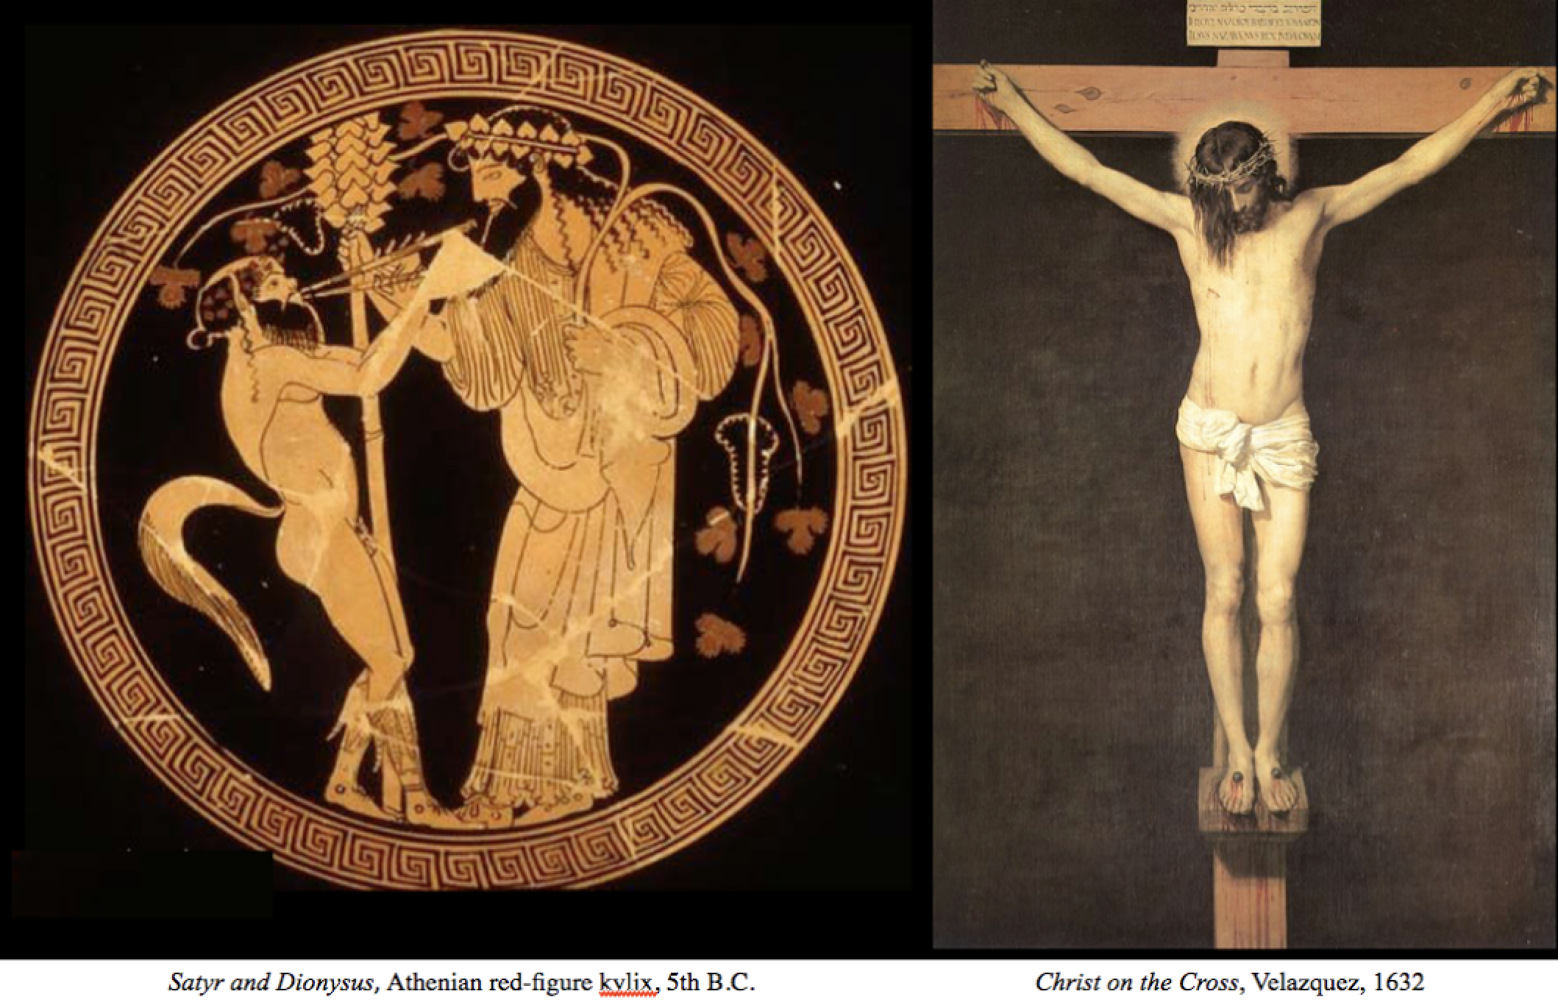
Ecce Homo
“Have I been understood? —Dionysus against the crucified one. . . ”
(Nietzsche 2007, 95)

Slide 41
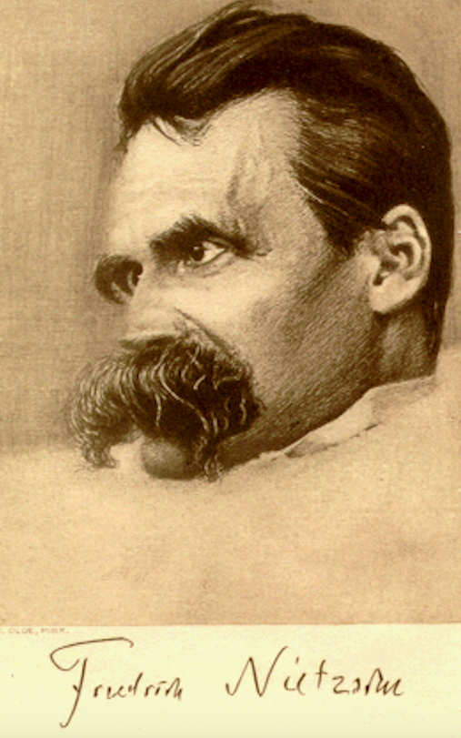
Attempt at a Self-Criticism
In truth, nothing could be more opposed to the purely aesthetic interpretation and justification of the world which are taught in this book than the Christian teaching, which is, and want to be, only moral and which relegates art, every art, to the realm of lies; with its absolute standards, beginning with the truthfulness of God, it negates, judges, and damns art. Behind this mode of thought and valuation, which must be hostile to art if it is at all genuine, I never failed to sense a hostility to art—a furious vengeful antipathy to life itself: for all of life is based on semblance, art, deception, points of view, and the necessity of perspectives and error.
(Nietzsche 1994, 23).

Slide 42
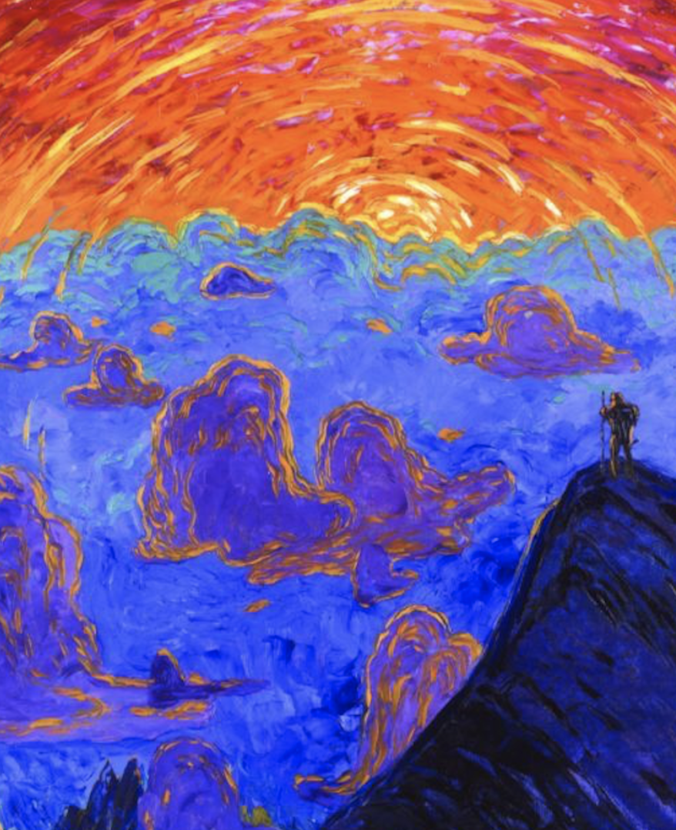
Thus Spoke Zarathustra
Incipit Tragoedia. When Zarathustra was thirty years old, he left his home and Lake Urmi and went into the mountains. There he enjoyed his spirit and his solitude, and for ten years did not tire them. But in the end his heart changed, and one morning he arose with the dawn and, facing the sun, spoke to it thus: ”Oh, you great star! What happiness would you enjoy, without those for whom you shine?
(Nietzsche 2018, 221).
Sunset over Montblanc, Wenzel Hablik 1906

Slide 43
The Joyous Science
The greatest weight.—What, if some day or night a demon were to steal after you into your loneliest loneliness and say to you: "This life as you now live it and have lived it, you will have to live once more and innumerable times more; and there will be nothing new in it, but every pain and every joy and every thought and sigh and everything unutterably small or great in your life will have to return to you, all in the same succession and sequence—even this spider and this moonlight between the trees, and even this moment and I myself. The eternal hourglass of existence is turned upside down again and again, and you with it, speck of dust!”
Would you not throw yourself down and gnash your teeth and curse the demon who spoke thus? Or have you once experienced a tremendous moment when you would have answered him: "You are a god and never have I heard anything more divine." If this thought gained possession of you, it would change you as you are or perhaps crush you. The question in each and every thing, "Do you desire this once more and innumerable times more?" would lie upon your actions as the greatest weight. Or how well disposed would you have to become to yourself and to life to crave nothing more fervently than this ultimate eternal confirmation and seal?
(Nietzsche 1974, 273-74)

