Slide 1
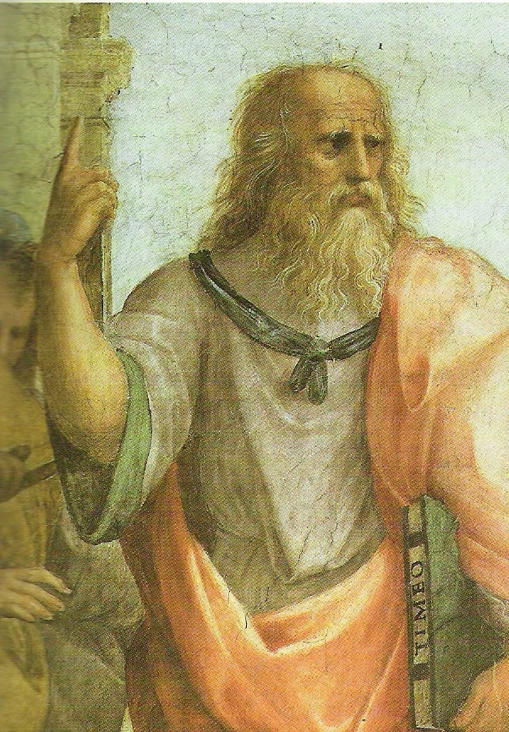
Plato’s Philosophy of Art
Art as Imitation
mīmēsis

Slide 2
What is art?
The Greek word for ‘art’ is techne, (tékhnē), (τέχνη)
It refers to a kind of making or doing, like a craft.
Plato doesn’t distinguish between art and craft.
We get the term, technology, from this word.
Plato thought that all ‘art’ in the sense of the techne of painting or sculpting aims at imitation,
mīmēsis (μίμησις).
Just as it was said that the tradition of (Western) philosophy has been nothing but footnotes to Plato, we could also say that the history of art (Western) bears Plato’s influence inasmuch as the guiding idea of art, up until the birth of Modern Art, was the notion of imitation or representation.
τέχνη
μίμησις

Slide 3
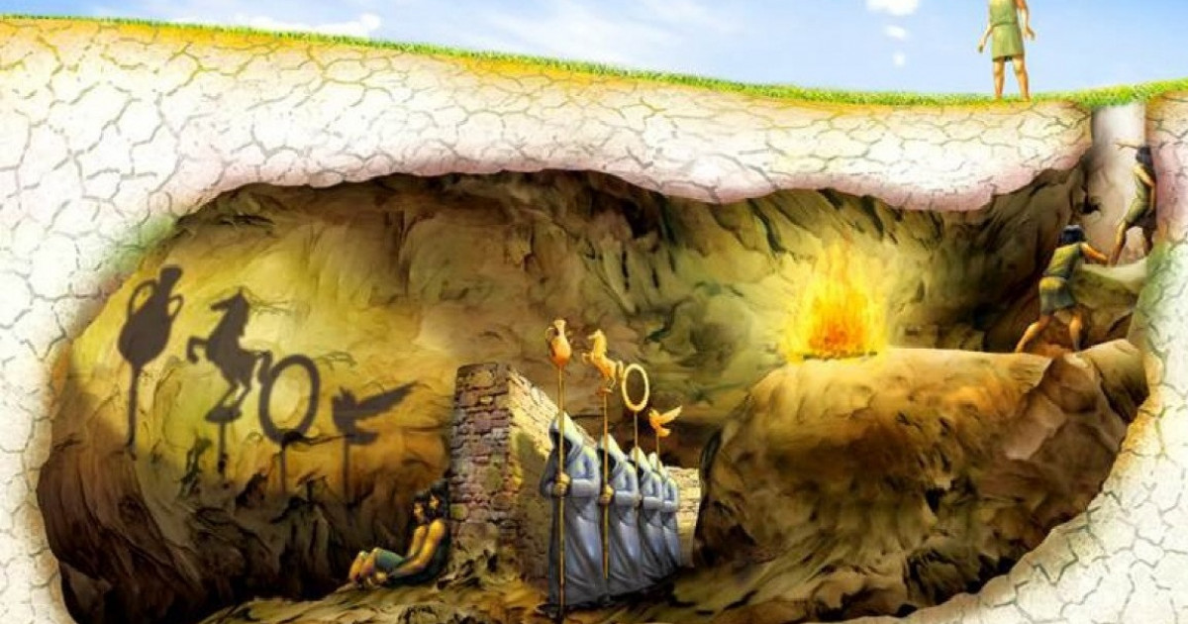
Plato’s Philosophy in the Myth of the Cave
Appearance (The Visible World)
Images of things / Particular sensible things
Shadows on the wall / objects casting the shadows
painting of a bed / bed you sleep on
Imagination / Sensation
Reality (The Intelligible World)
Lower Forms / Higher Forms
Forms of things like beds / Forms of beauty, justice
Thought / Understanding

Slide 4
Plato’s Philosophy
Appearance
(The Visible World)
The Dreamworld
Particular things
Changing
Senses
The body
Lies, illusion, fiction
Art
Writing
Painting
Women
Reality
(The Intelligible World)
Waking Reality
Universal Forms or Ideas
Unchanging
Pure Reason
The soul
Truth
Philosophy
Speech
Logos (Argument)
Men

Slide 5
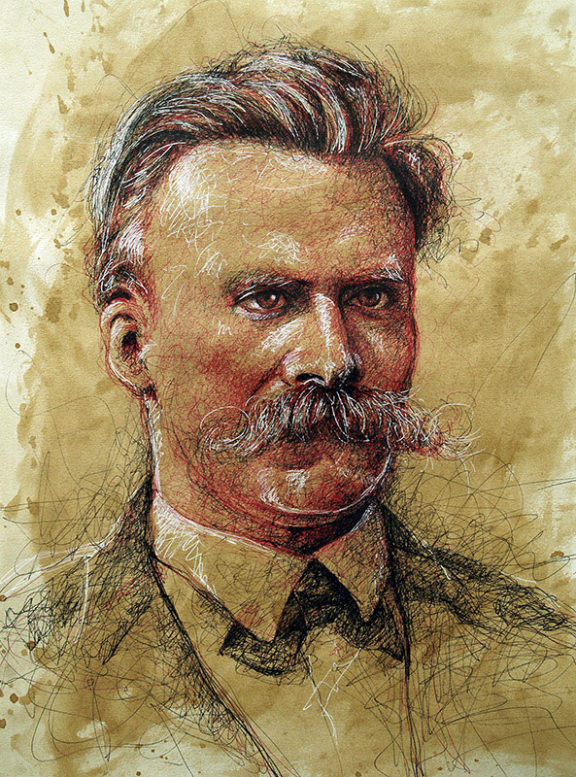
Postmodern Critique of Plato
"Is it not sufficient to assume degrees of apparentness and, as it were, lighter and darker shadows and shades of appearance different "values," to use the language of painters? Why couldn't the world that concerns us—be a fiction?”
Friedrich Nietzsche, Beyond Good and Evil (1886) (New York: Vintage Books, 1966), 46-47.

Slide 6
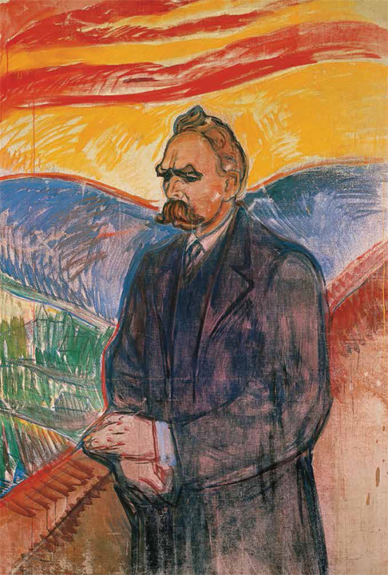
Alas, what are you after all, my written and painted thoughts! It was not long ago that you were still so colorful, young, and malicious, full of thorns and secret spices—you made me sneeze and laugh—and now? You have already taken off your novelty, and some of you are ready, I fear, to become truths: they already look so immortal, so pathetically decent, so dull! And has it ever been different? What things do we copy, writing and painting, we mandarins with Chinese brushes, we immortalizers of things that can be written— what are the only things we are able to paint? Alas, always only what is on the verge of withering and losing its fragrance! Alas, always only storms that are passing, exhausted, and feelings that are autumnal and yellow! Alas, always only birds that grew weary of flying and flew astray and now can be caught by hand—by our hand! We immortalize what cannot live and fly much longer—only weary and mellow things! And it is only your afternoon, you, my written and painted thoughts, for which alone I have colors, many colors perhaps, many motley caresses and fifty yellows and browns and greens and reds: but nobody will guess from that how you looked in your morning, you sudden sparks and wonders of my solitude, you my beloved—wicked thoughts!
Friedrich Nietzsche, Beyond Good and Evil (1886) (New York: Vintage Books, 1966), 236-37.
Nietzsche, oil on canvas, Edvard Munch, c. 1906.
Munch-museet, Oslo, Norway

Slide 7
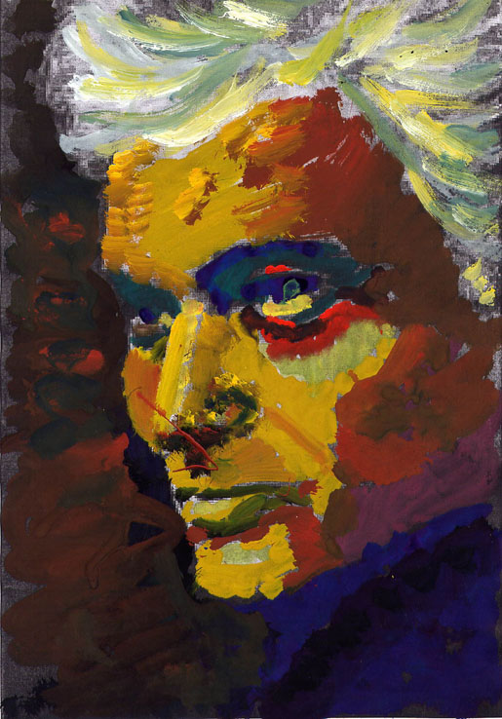
"Now, on the one hand, Plato is bent on presenting writing as an occult, and therefore suspect power. Just like painting, to which he will later compare it, and like optical illusions and the techniques of mīmēsis in general.”
Jacques Derrida, Dissemination (1972) (Chicago: University of Chicago Press, 1981), 97.
Jacques Derrida

Slide 8
The Republic
The word "republic" is from Latin: Res publica, from res ‘concern’ + publicus ‘of the people, the public’ thus meaning "public matters" or "the state."
In Greek, the title was the Politeia (πολιτεία), from polis ‘the city,’ organization of, thus Government or Constitution.
Plato’s central concern in the Republic is justice—dikaiosyne (δικαιοσύνη).

Slide 9
Justice
The Soul
Rational
Spirited
Appetitive
The State
Rulers
Guardians
Producers

Slide 10
The Republic
Book II
concerning the education of the guardians:
“And what shall be their education? Can we find a better than the traditional sort?—and this has two divisions, gymnastic for the body, and music for the soul” (9).

Slide 11
The Republic
Book II
concerning the education of the guardians:
“Then the first thing will be to establish a censorship of the writers of fiction, and let the censors receive any tale of fiction which is good, and reject the bad” (10).
“Whenever an erroneous representation is made of the nature of the gods and heroes, —as when a painter paints a portrait not having the shadow of a likeness to the original” (11).

Slide 12
The Republic
Book III
Continuing this discussion about the necessity of censorship:
“Then we must assume a control over the narrators of this class of tales as well as over the others, and beg them not simply to revile, but rather to commend the world below, intimating to them that their descriptions are untrue, and will do harm to our future warriors” (17).
“Then, I said, we shall have to obliterate many obnoxious passages…” (17).

Slide 13
The Republic
Book III
Continuing this discussion about the necessity of censorship:
“And we must beg Homer and the other poets not to be angry if we strike out these and other similar passages, not because they are unpoetical, or unattractive to the popular ear, but because of the greater the poetical charm of them, the less are they meet for the ears of boys and men who are meant to be free, and who should fear slavery more than death” (17).

Slide 14
The Republic
Book III
They will even have to ban laughter:
"Neither ought our guardians to be given to laughter . . . persons of worth, even in only mortal men, must not be represented as overcome by laughter" (19).

Slide 15
The Republic
Book III
Now the introduction of the idea of the Noble Lie:
“Again truth should be highly valued; if, as we were saying, a lie is useless to the gods, and useful only as a medicine to men, then the use of such medicines should be restricted to physicians; private individuals have no business with them. . .
Then if any one at all is to have the privilege of lying, the rulers of the state should be the persons; and they in their dealings either with enemies or with their own citizens, may be allowed to lie for the public good” (20).

Slide 16
The Republic
Book III
More on what will not be allowed in the state:
“And let us equally refuse to believe, or allow to be repeated, the tale of Theseus son of Poseidon, or of Peirithous son of Zeus, going forth as they did to perpetrate a horrid rape, or of any other hero or son of a god daring to do such impious and dreadful things…
We will not have them trying to persuade our youth that the gods are the authors of evil, and that heroes are no better than men—sentiments which, as we were saying, are neither pious nor true…
And further they are likely to have a bad effect on those who hear them; for everybody will begin to excuse his own vices when he is convinced that similar wickedness are always perpetrated by—the kindred of the gods” (22).

Slide 17
The Republic
Book III
On the problem with tragedy, where actors play bad characters:
“In saying this, I intend to imply that we must come to an understanding about the mimetic art,—whether the poets, in narrating their stories, are to be allowed by us to imitate, and if so, whether in whole or in part, and if the latter, in what parts; or should all imitation be prohibited?” (25).

Slide 18
The Republic
Book III
The only imitation that will be allowed, Socrates leads his friends to agree, is the "imitation of virtue" (28).
Here we see the crucial concern with arête (ἀρετή), rendered here as "virtue" and elsewhere as "excellence."
Socrates and the Sophists shared this primary concern with arête, as opposed to the metaphysical speculations of the pre-Socratics. But against the Sophists, who held that "man is the measure of all things," Socrates and Plato were convinced there must be a universal truth of arête, a pattern or Form that is the standard or measure.

Slide 19
The Republic
Book III
Knowledge=virtue=happiness
The optimism of Plato's philosophy is that the truth will set one free. If one is able to gain true knowledge, and then know the truth of virtue (arête), then the soul will be liberated from the prison of the body and earthly existence and have eternal life.
The only imitation that will be allowed is thus imitation of arête, but the problem remains how the imitation can be anything more than a poor copy. If art is to be allowed at all, it must at the least aspire to the accurate imitation of arête.

Slide 20
The Republic
Book III
There is a long section on music, what should be allowed and what censored:
“ And therefore, I said, Glaucon, musical training is a more potent instrument than any other, because rhythm and harmony find their way into the inward place of the soul, on which they mightily fasten, imparting grace, and making the soul of him who is rightly educated graceful, or of him who is ill-educated ungraceful…” (32).

Slide 21
The Republic
Book X
Here we have the famous section on Plato's condemnation of art. Notice how Socrates has to put it:
"Speaking in confidence, for I should not like to have my words repeated to the tragedians and the rest of the imitative tribe" (32).
Artists would certainly not like to hear his words, as he goes on to say that "all poetical imitation are ruinous to the understanding of the hearers" (32).

Slide 22
The Republic
Book X
In order to explain his condemnation of art, Socrates then goes on to inquire into the nature of imitation in general.
All art (tékhnē), for Plato is mīmēsis, but what exactly is mīmēsis?
Socrates explains by using the common examples of beds and tables. The true, unchanging reality are the Ideas or Forms, and the carpenter makes a bed, imitating the Idea of bed. Being changeable and multiple, each visible bed is a poor copy of the unchanging Idea, and then the painting of the bed is a poor copy of the poor copy.

Slide 23
The Republic
Book X
So there are three beds, the Form or Idea of bed made by God, the bed one sleeps in made by a carpenter, and then the painting of the bed. Like the painter, the tragic poet is an imitator, and thus, "like all other imitators, he is thrice removed from the king and the truth" (35).
Thus, art is not going to be allowed because, confined to the sensible, visible realm, it can only produce poor copies of poor copies. They are, Socrates explains "but imitations thrice removed from the truth, and could easily be made without any knowledge of the truth, because they are appearances only and not realities" (36).

Slide 24
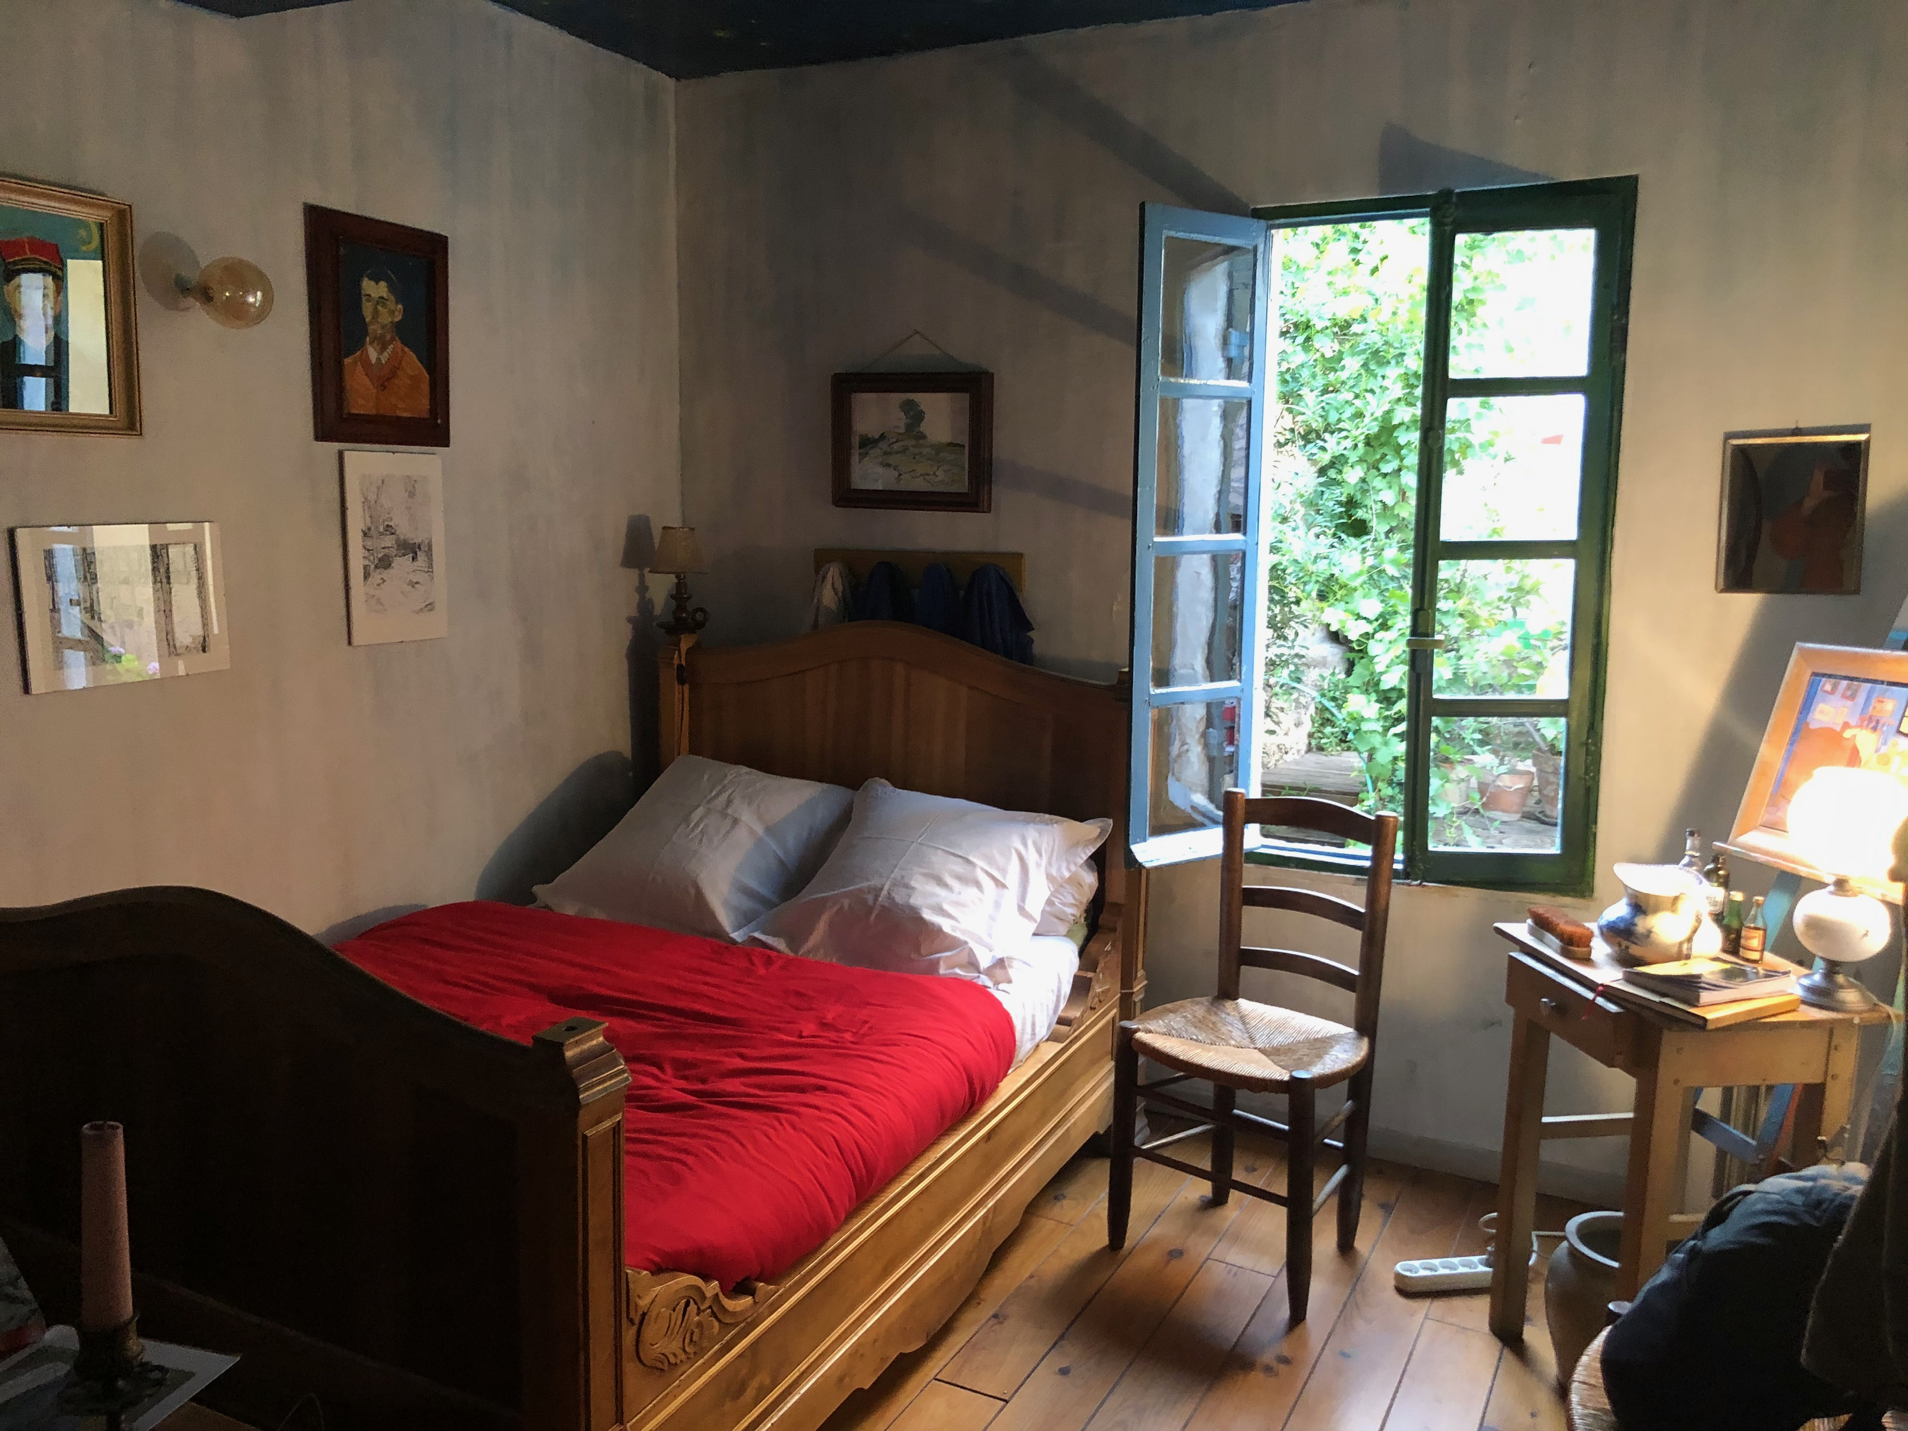
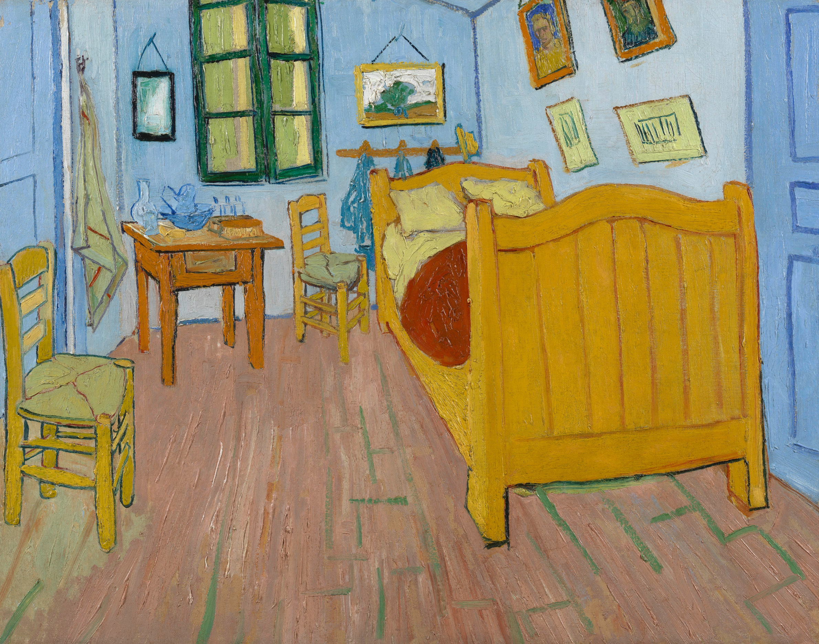
Plato’s Beds
Form or Idea of Bed
Eternal
Universal
Physical Bed
Ephemeral/Particular
Poor copy of the Form of Bed
Painting of a Bed
Poor copy of a poor copy
A bedroom in Arles
Bedroom at Arles,
Oil on canvas, Vincent Van Gogh, 1888

Slide 25
The Republic
Book X
The chiefest and noblest subjects of his poems concern military tactics, politics, and education, but Socrates asserts that Homer did not really have knowledge of these concerns. The carpenter must at least have some knowledge in order to make a bed, but the painter only paints a poor copy, from a particular perspective, and may not know anything about the making of a real bed. Just so, Socrates argues, Homer is not like the carpenter, only in the second remove from truth, but rather like the painter, thrice removed from truth. Socrates suggests that Homer has not really been able "to educate and improve mankind" (37).
Again, Socrates suggest something about the power of music:
"And I think that you must have observed again and again what a poor appearance the tales of poets make when stripped of the colours which music puts upon them" (37).

Slide 26
The Republic
Book X
Whereas the carpenter can at least gain "correct belief" or "true opinion" of the bed, the painter "will have no more true opinion than he will have knowledge about the goodness or badness of his imitations" (38).
Thus the poet, writers of tragedies, are like the painter in two ways:
"his creations have an inferior degree of truth...and he is also like him in being concerned with an inferior part of the soul" (42).

Slide 27
The Republic
Book X
But the worst danger is "the power which poetry has of harming even the good" (42). This happens through arising the passions.
Whereas men should be manly, the poet stirs our feelings, making one more like a woman.
Poetry, Socrates explains, "feeds and waters the passions instead of drying them up; she lets them rule, although they ought to be controlled, if mankind are ever to increase in happiness and virtue" (43).

Slide 28
The Republic
Book X
In summing up, Socrates tells of the "ancient quarrel between philosophy and poetry" (43). If poetry is to be allowed she must prove to be useful, not just pleasant. Socrates warns that we should "not fall away into the childish love of her which captivates the many" (44). Socrates then concludes:
"At all events we are well aware that poetry being such as we have described is not to be regarded seriously as attaining to the truth; and he who listens to her, fearing for the safety of the city which is within him, should be on his guard against her seductions and make our words his law" (44).

Slide 29
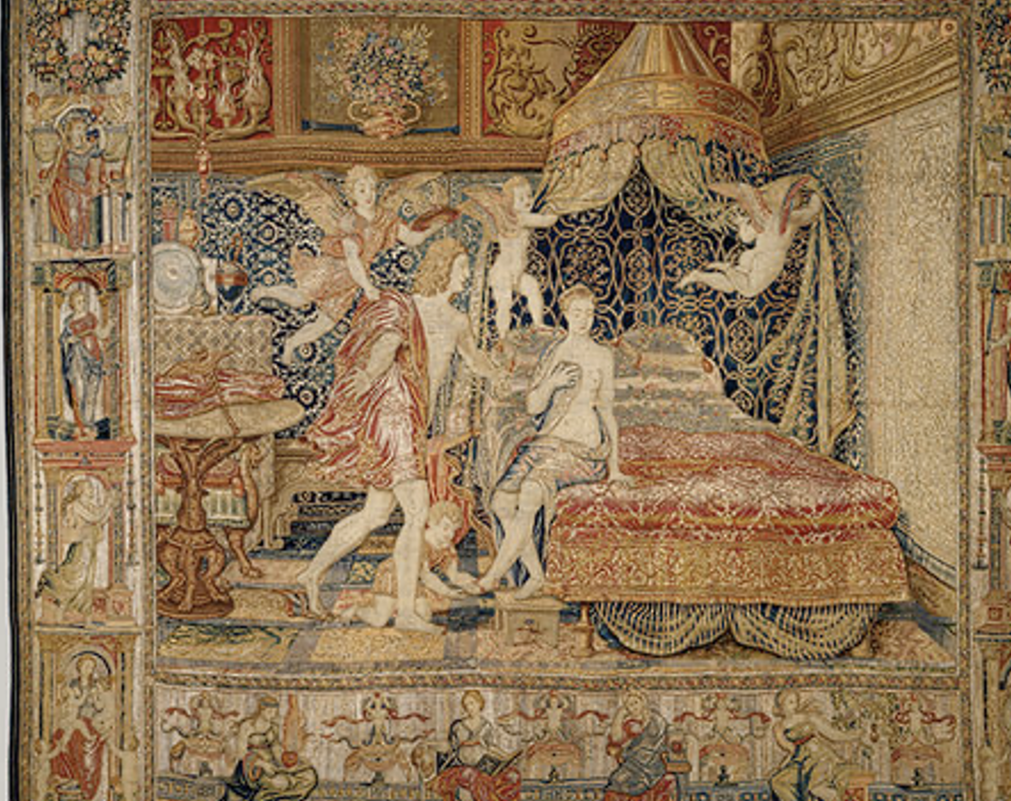
Some beds in art
The Bridal Chamber of Herse,
Wool, silk, silver, silver-gilt thread, Workshop of Willem de Pannemaker, ca. 1550 Made/manufactured: Brussels, Southern Netherlands

Slide 30
Vincent Van Gogh’s Bed
Bedroom at Arles, Oil on canvas, Vincent Van Gogh, 1888

Slide 31
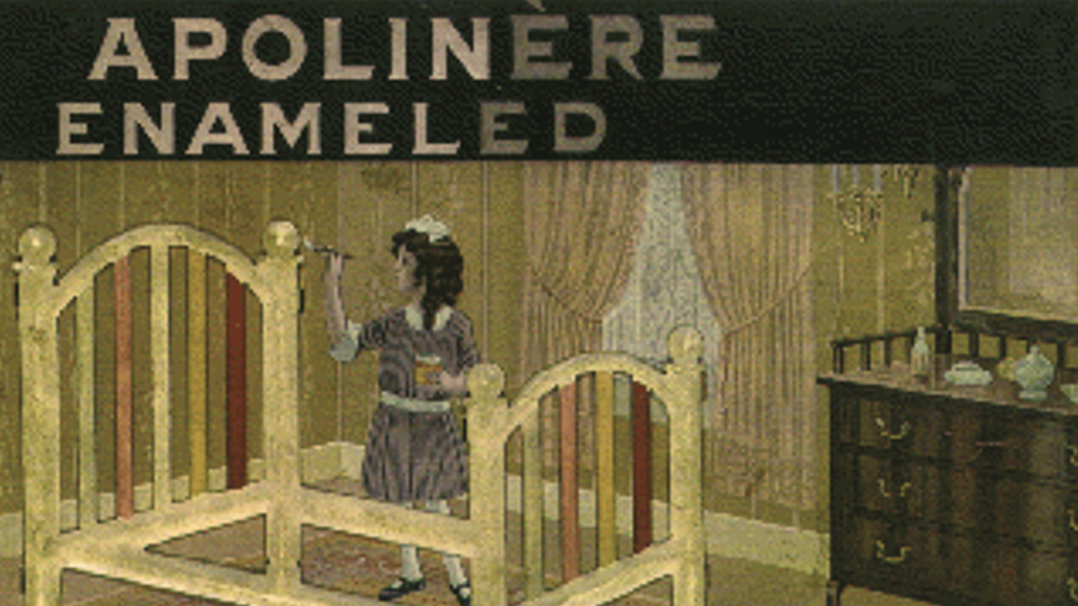
Marcel Duchamp’s Bed
Apolinère Enameled, tin plate on cardboard, Marcel Duchamp, 1916-1917.

Slide 32
Sherrie Levine’s Bed
Lit de Marcel, tin on cardboard, wood frame (Sapolin Enamel Advertising Sign), Sherrie Levine, 1977.

Slide 33
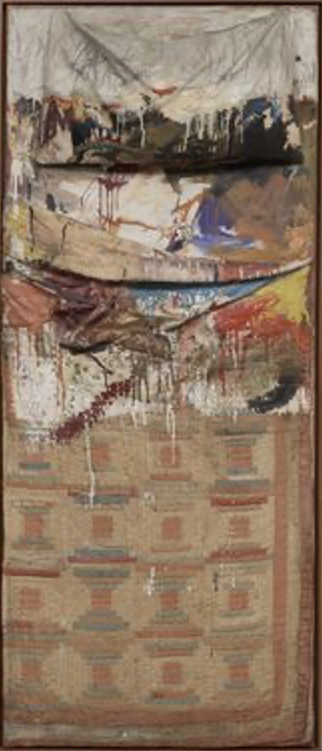
Robert Rauchenberg’s Bed
Bed, Oil and pencil on pillow, quilt, and sheet on wood supports,
Robert Rauschenberg, 1955.

Slide 34
Tracey Emin’s Bed
My Bed, Mattress, linens, pillows, objects.
Tracey Emin, 1998.

Slide 35
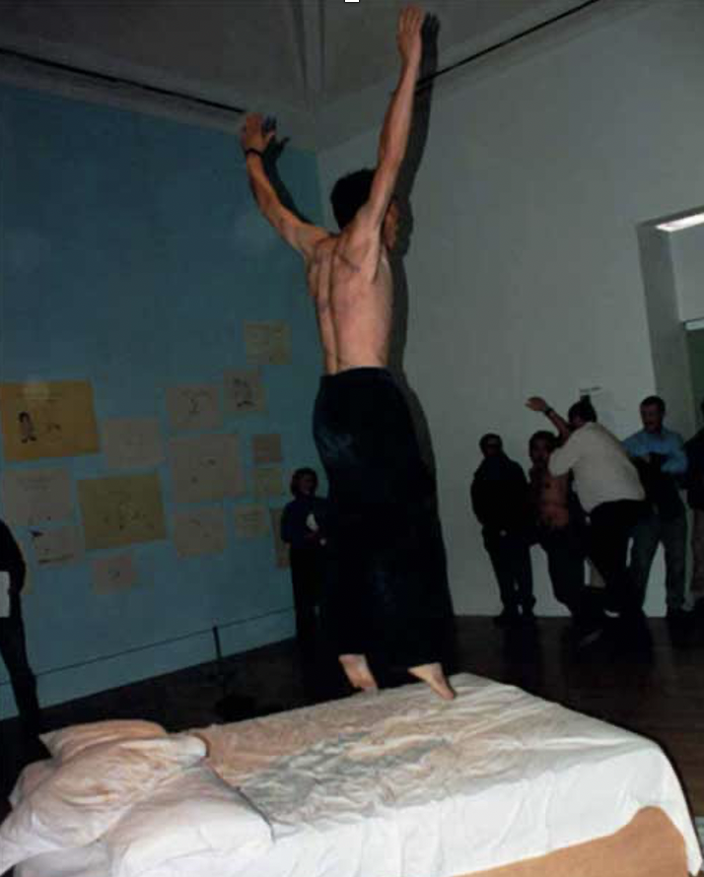
Two Artists Jump on Tracey Emin’s Bed Tate Gallery, London, 1999.

Slide 36
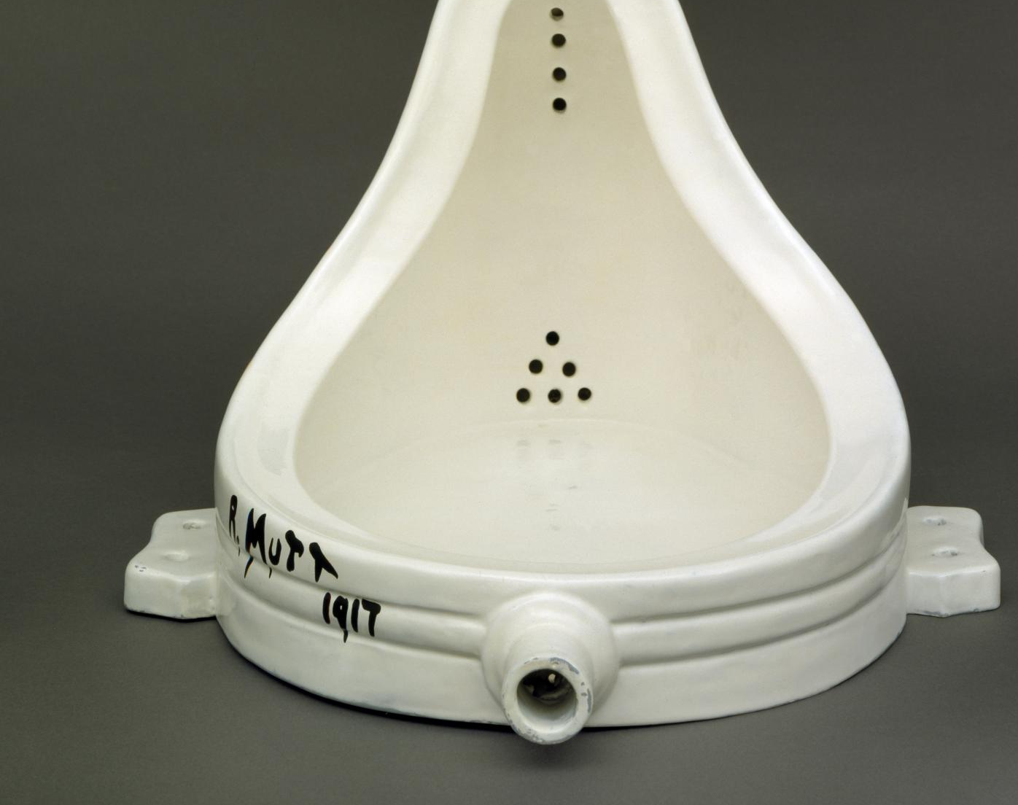
Fountain, Marcel Duchamp, 1917.
Replica, 1964.
Tate Gallery, London

Slide 37
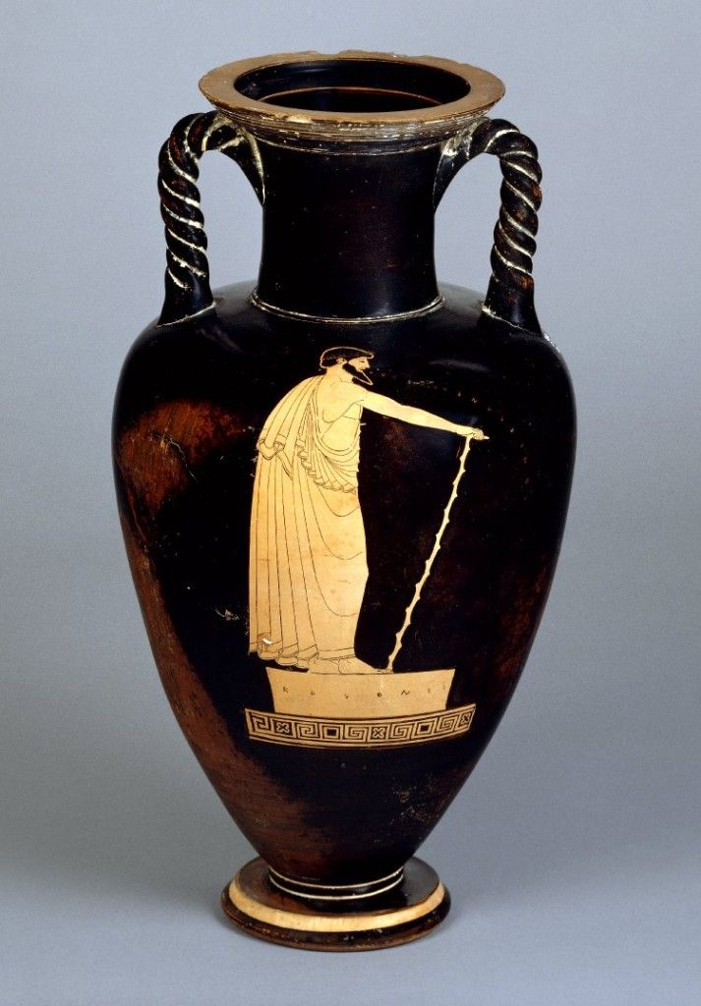
The Ion
In this dialogue, Socrates questions the Rhapsode Ion about his art. A Rhapsode (ῥαψῳδός, rhapsōidos) was a professional performer of epic poetry in the 5th and 4th centuries B.C.E. Ion has just come from a festival where he won first prize in his performance of Homer.
In his interrogation of Ion, Socrates comes to the conclusion that a rhapsode such as Ion, as well as a poet such as Homer, do not have knowledge of what they speak and write, and thus have no real art (techne). What they do comes not from knowledge, but from divine inspiration. Poetry, and the rhapsodist’s performance, proceeds from a kind of madness, a divine madness as they are “out of their minds” inspired by the Muses.
Victorious Rhapsode Reciting,
red-figured neck-amphora with twisted handles, attributed to the Kleophrades Painter, ca. 490BC-480 B.C.E. The British Museum, London.

Slide 38
The Ion
The dialogue deals not only with the nature of poetry, and all art, but also with the problem of interpretation and the subject of art criticism, the issue of whether evaluative judgments of art are possible.
Socrates notes at the outset that Ion is well dressed, having just come from his prize winning performance as a rhapsode. Socrartes even suggests here that he is envious of the profession of the rhapsode, but he wants to find out more about just what it is that a rhapsode does. Socrates thinks that a rhapsode must at least have knowledge about what he speaks:
“And no man can be a rhapsode who does not understand the meaning of the poet. For the rhapsode ought to interpret the mind of the poet to his hearers, but how can he interpret him well unless he knows he means? All this is greatly to be envied” (45).

Slide 39
The Ion
As he questions Ion, Socrates finds it puzzling that he claims to only know Homer and not other poets. He remarks that Homer and Hesoid often cover the same subjects, and thus if Ion has knowledge about the subject, then he should be able to talk about both Homer and Hesiod.
He gives an example of arithmetic. If someone knows arithmetic, he should be able to be a good judge of any speaker on the subject of arithmetic.
This suggests that the capable art critic is one who has knowledge of the subject, that is to say, knowledge of what the art depicts. If the poem is about war, for example, then the only capable judge of the poem is one who knows the art of warfare. That Ion only knows about Homer suggests to Socrates that Ion doesn’t really have knowledge:
“No one can fail to see that you speak of Homer without any art or knowledge. If you were able to speak of him by rules of art, you would have been able to speak of all other poets; for poetry is a whole” (47).

Slide 40
The Ion
Socrates goes on to make the claim that Ion does not have knowledge of what he speaks, that his performance comes not from knowledge, but rather, divine inspiration. In this, he uses the famous metaphor of the magnet:
“The gift which you possess of speaking excellently about Homer is not an art, but, as I was saying, an inspiration; there is a divinity moving you, like that contained in the stone of Heraclea. This stone not only attracts iron rings, but also imparts to them a similar power of attracting other rings; and sometimes may see a number of pieces of iron and rings suspended from one another so as to form quite a long chain: and all of them derive their power of suspension from the original stone. In like manner the Muse first of all inspires men herself; and from these inspired persons a chain of other persons is suspended, who take the inspiration. For all good poets, epic as well as lyric, compose their beautiful poems not by art, but because they are all inspired and possessed” (48).

Slide 41
The Ion
Socrates goes on to say that the poets “are not in their right mind” as they are inspired and possessed” (48).
Here Socrates makes a very interesting suggestion when he says that the poets are “like Bacchic maidens who draw milk and honey from the rivers when they are under the influence of Dionysus but not when they are in their right mind. And the soul of the lyric poet does the same, as they themselves say; for they tell us that they bring songs from honeyed fountains, culling them of the gardens and dells of the Muses; they like the bees, winging their way from flower to flower. And this is true. For the poet is a light and winged and holy thing, and there is no invention in him until he has been inspired and is out of his senses, and the mind is no longer in him” (48-49).

Slide 42
The Ion
Socrates continues to describe this divine madness of the poet:
“Many are the noble words in which poets speak concerning the actions of men; but like yourself when speaking about Homer, they do not speak of them by any rules of art: they are simply inspired to utter that to which the Muses impels them [. . .] for not by art does the poet sing, but by power divine. Had he learned by rules of art, he would have known how to speak not of one theme only, but of all; and therefore God takes away the minds of poets, and uses them as his ministers, as he also uses diviners and holy prophets” (49).

Slide 43
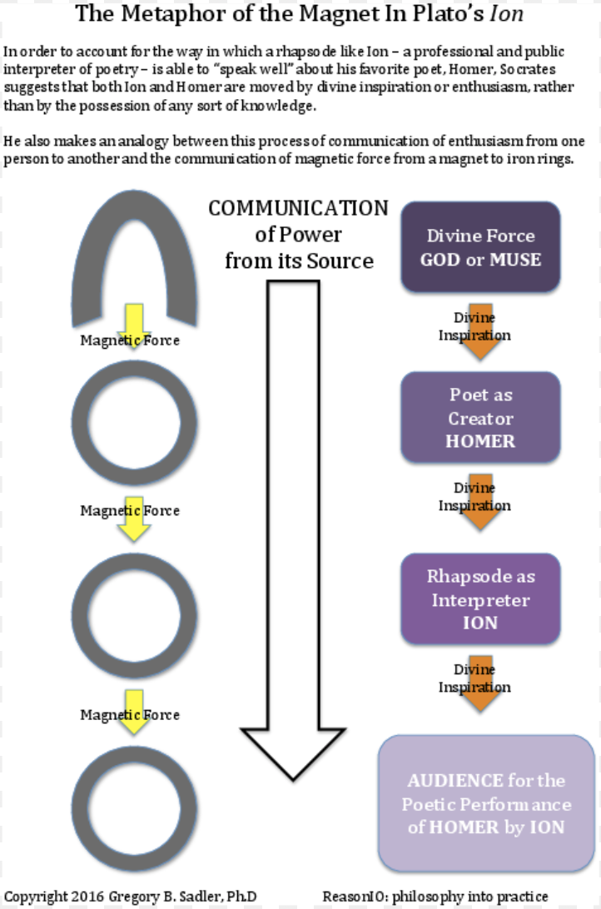
The Ion
Socrates further develops the metaphor of the magnet to describe this divine inspiration:
“Do you know that the spectator is the last of the rings which, as I am saying, receive the power of the original magnet from one another? The rhapsode like yourself and the actor are intermediate links, and the poet himself is the first of them. Through all these the God sways the souls of men in any direction which he pleases, and makes one man hang down from another. Thus there is a vast chain of dancers and masters and undermasters of choruses, who are suspended, as if from the stone, at the side of the rings which hang down from the Muse. And every poet has some Muse from whom he is suspended, and by whom he is said to be possessed” (50).

Slide 44
The Ion
Socrates goes on to say some more things that concern the judgment of art. He suggests again that the only capable judgment of art comes from one who has knnwledge of the subject that is the concern of the work of art. So, for example, he thinks that to adequately judge a passage from Homer where he describes a chariot race, that one must know something about driving a chariot to be a judge of what Homer says.
Like he later states in The Republic, in order to adequately evaluate a painting of a bed, one must know something about beds. At least the carpenter knows something about beds in order to make one, but the painter he thinks doesn’t really have to have this knowledge, and thus is further distanced from true knowledge, and thus not capable of evaluating a painting of a bed.
“Then he who has no knowledge of a particular art will have no right judgment of the sayings and doings of that art” (52).

Slide 45
The Ion
The dialogue concludes with Socrates giving Ion a choice. Since he doesn’t really have knowledge of what he speaks, then Ion is ”only a deceiver.” Then Socrates acknowledges that Ion’s deceit is perhaps not intentional:
“But if, as I believe, you have no art, but speak all these beautiful words about Homer unconsciously under his inspiring influence, then I acquit you of dishonesty, and shall only say that you are inspired. Which do you prefer to be thought, dishonest or inspired?” Ion admits that of the two alternatives, he would rather be thought of as inspired rather than dishonest. Thus Socrates concludes: “Then, Ion, I shall assume the nobler alternative; and attribute to you in your praises of Homer inspiration, and not art” (55).

Slide 46
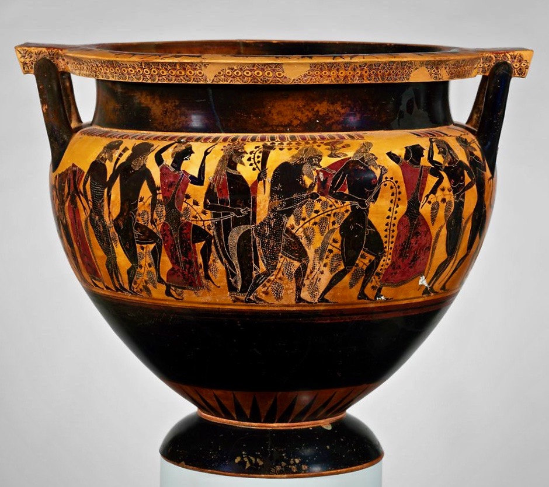
The Symposium
In this dialogue, Socrates attends a Symposium or drinking party in which the subject for discussion is the nature of love. After all the other speakers have given their speeches on love (eros), Socrates gives his speech on love in which he tells of the wisdom he learned from the woman Diotima, a famed prophetess and philosopher.
In this discourse we get Plato’s famous ‘ladder of love’ in which it is suggested that the vision of a sensuous beauty can lead upward from the sensuous realm to the intelligible realm and the vision, in the mind’s eye, of absolute beauty. In contrast to Plato’s condemnation of art in The Republic, we get at least the suggestion that art can lead to knowledge and truth.
Dionysus and Revelers at a Symposium,
terracotta column-krater (bowl for mixing wine and water), attributed to Lydos, ca. 550 B.C.
The Metropolitan Museum of Art, New York.

Slide 47
The Symposium
At the beginning of Socrates’ speech he explains how Diotima instructed him on the nature of love. They are talking about the god Eros, and Diotima explains that this god is neither fair and good, nor evil and foul. Love is a means between wisdom and ignorance.
Eros is not even a god she convinces Socrates, because on Socrates’ own account, the gods must be happy and fair, and Eros is always in want of something good and fair. Thus Eros is really not a god, nor a mortal, but again, something in between: “he is neither mortal nor immortal, but in a mean between the two” [. . .] “He is a great spirit (daimon), and like all spirits he is intermediate between the divine and mortal” (57).
She goes on to explain that Eros is the intermediary between gods and humans: “’He interprets,’ she replied, ‘between gods and men, and to men the commands and replies of the gods; he is mediator who spans the chasm which divides them” (57).

Slide 48
The Symposium
Diotima tells the story of the birth of Eros from the coupling of his father Plenty, and his mother Poverty. As a mean between wisdom and ignorance, Eros is “a philosopher at all times” (58). Here Plato makes a most interesting connection between philosophy and love. There are at least six different words for different kinds of love in Greek. Of course, the word ‘philosophy’ comes from ‘philia’, often translated as friendship. Here, Plato is certainly suggesting also an erotic element in philosophy.
“No god is a philosopher or seeker after wisdom, for he is wise already; nor does any man who is wise seek after wisdom. Neither do the ignorant seek after wisdom. For herein is the evil of ignorance, that he who is neither good nor wise is nevertheless satisfied with himself” (58).
“Love is also a philosopher or lover of wisdom, and being a lover of wisdom is in a mean between the wise and the ignorant” (58).

Slide 49
The Symposium
Diotima goes on to explain that love is a desire for what one lacks, and that what all men desire is the beautiful and the good.
“’For there is nothing which men love but the good. Is there anything?’ ‘Certainly, I should say that there is nothing.’ ‘Then,’ she said, ‘the simple truth is, that men love the good.’” She goes on to add that love ”’may be described generally as the love of the everlasting possession of the good’” (59).
She goes on to say that erotic love leads to generation and birth, and that this desire to give birth is a desire for some sense of immortality. It is through this love that “the mortal body, or mortal anything, partakes of immortality” (60).

Slide 50
The Symposium
The most famous part of the dialogue, is toward the end of Socrates’ speech, when he tells what he learned from Diotima about, what has been called the ‘ladder of love’, a series of steps that lead from the love of a particular person, of the beauty in that individual, to higher and higher stages of love.
“For he who would proceed aright in the matter should begin in youth to visit beautiful forms; and first, if he be guided by his instructor aright, to love one such form only—out of that he should create fair thoughts; and soon he will of himself perceive that the beauty of one form is akin to the beauty of another; and then if beauty of form in general is his pursuit, how foolish would he be not to recognize that the beauty in every form is one and the same! And when he perceives this he will abate his violent love of the one, which he will despise and deem a small thing, and will become a lover of all beautiful forms; in the next stage he will consider that the beauty of the mind is more honourable than the beauty of the outward form” (62).

Slide 51
The Symposium
“’He who has been instructed thus far in the things of love, and who learned to see the beautiful in due order and succession, when he comes toward the end will suddenly perceive a nature of wondrous beauty (and this, Socrates, is the final cause of all our former toils)—a nature which in the first place is everlasting, not growing and decaying, or waxing and waning; secondly, not fair in one point of view and foul in another, or at one time or in one relation or at one place fair, at another time or in another relation or an another place foul, as if fair to some and foul to others, or in the likeness of a face or hands or any other part of the bodily frame, or in any form of speech or knowledge, or existing in any other being, as for example, in an animal, or in heaven, or in earth, or in any other place; but beauty absolute, separate, simple, and everlasting’” (62-63).

Slide 52
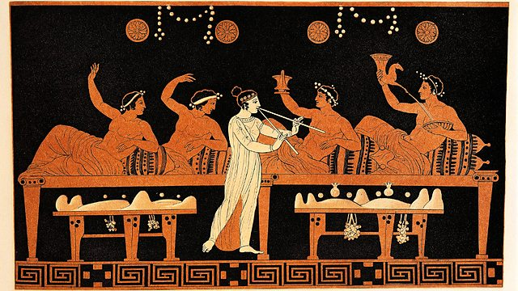
The Symposium
“‘And the true order of going, or being led by another, to the things of love, is to begin from the beauties of the earth and mount upwards for the sake of that other beauty, using these as steps only, and from one going on to two, and from two to all fair forms, and from fair forms to fair practices, and from fair practices to fair notions, until from fair notions he arrives at the notion of absolute beauty, and at last knows what the essence of beauty is’” (62-63).
Symposium scene: banqueters playing the kottabos game while a girl plays the aulos, Attic red-figure bell-krater, attributed to Nikias, the painter, ca. 420 BCE.

