Slide 1
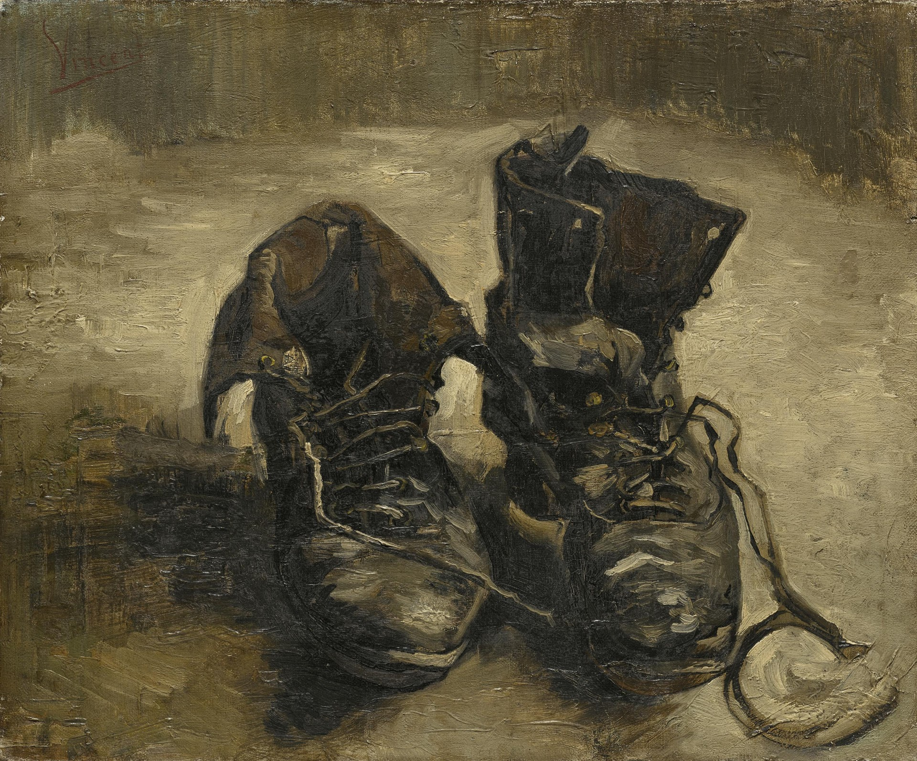
A pair of peasant shoes and nothing more. And yet— From the dark opening of the worn insides of the shoes the toilsome tread of the worker stares forth. In the stiffly rugged heaviness of the shoes there is the accumulated tenacity of her slow trudge through the far-spreading and ever-uniform furrows of the field swept by a raw wind. On the leather lie the dampness and richness of the soil. Under the soles slides the loneliness of the field-path as evening falls. In the shoes vibrates the silent call of the earth, its quiet gift of the ripening grain and its unexplained self-refusal in the fallow desolation of the wintry field. (Heidegger 1994, 257)
The Origin of the Work of Art
A Pair of Shoes
Oil on canvas, Vincent Van Gogh, 1886.
Van Gogh Museum, Amsterdam

Slide 2
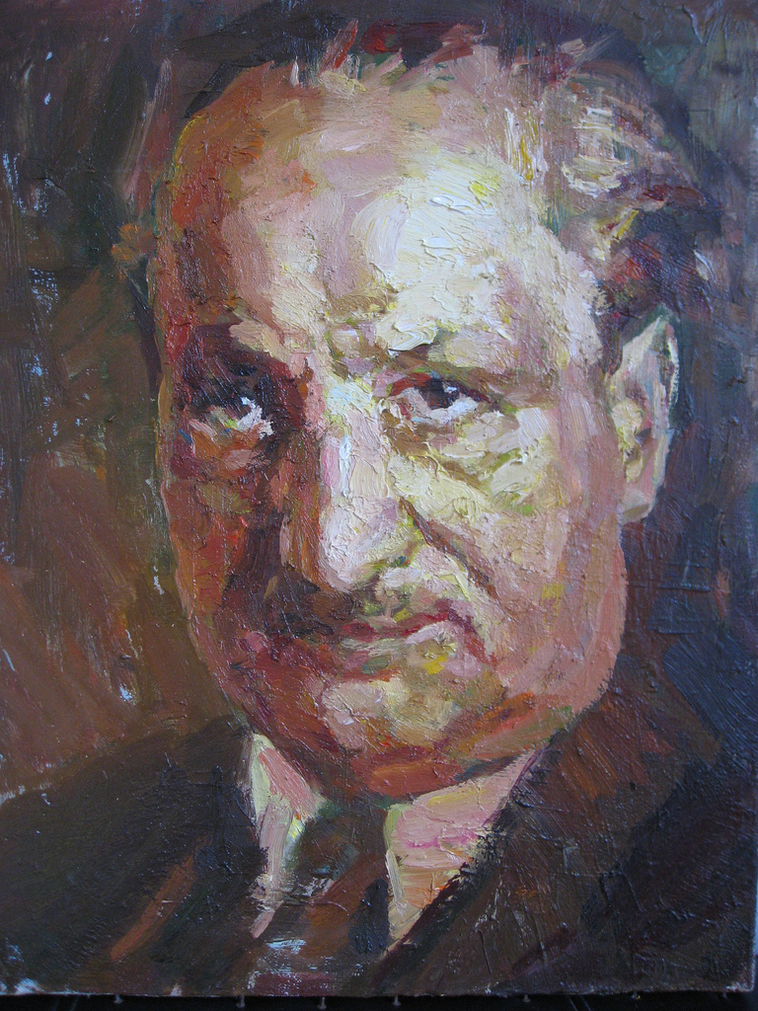
Martin Heidegger is widely acknowledged to be one of the most original and important philosophers of the 20th century, while remaining one of the most controversial. His thinking has contributed to such diverse fields as phenomenology (Merleau-Ponty), existentialism (Sartre, Ortega y Gasset), hermeneutics (Gadamer, Ricoeur), political theory (Arendt, Marcuse, Habermas), psychology (Boss, Binswanger, Rollo May), and theology (Bultmann, Rahner, Tillich). His critique of traditional metaphysics and his opposition to positivism and technological world domination have been embraced by leading theorists of postmodernity (Derrida, Foucault, and Lyotard). On the other hand, his involvement in the Nazi movement has invoked a stormy debate. Although he never claimed that his philosophy was concerned with politics, political considerations have come to overshadow his philosophical work. (Internet Encyclopedia of Philosophy)
Martin Heidegger
Martin Heidegger (1889-1976)

Slide 3
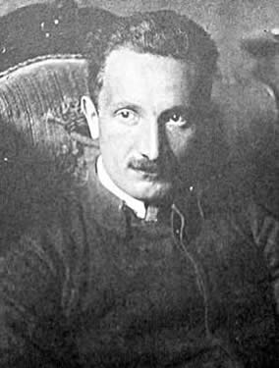
At the outset of Being and Time, Heidegger explains that he wants to ask a question, a question which has long been forgotten, but which may be the most important question of all, the Question of Being. To ask this question, Heidegger suggests, might rekindle the ancient battle, the conflict Plato made reference to in the Sophist, “a battle of Giants concerning Being” (Heidegger 1977, 41). What Plato was referring to was the battle between Heraclitus and Parmenides, the two Pre-Socratic philosophers who had radically different views concerning reality. Heraclitus held that reality was constantly changing, like a river, while Parmenides argued that all change is an illusion, and reality has to be unchanging. In the history of Western philosophy Parmenides won this battle, influencing Plato and the subsequent development of Western thought. Heidegger attempts to reopen this question, siding with Heraclitus, in understanding reality as constantly changing, as Being and Time.
Being and Time

Slide 4
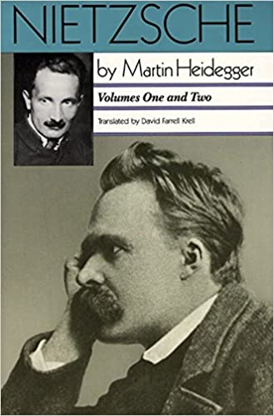
The essay, The Origin of the Work of Art, was originally written in 1935-37 and later reworked for publication in 1950 and again in 1960. The essay thus occupies a critical position in Heidegger’s writings, in the middle between the early work marked by the success of Being and Time, and the later work in the post war period beginning with the Letter on Humanism (1947). The essay was first drafted during the time in which Heidegger was also giving extensive lectures on Nietzsche. These lectures would later be published in the massive, four-volume work, Nietzsche. It is clear that his critical engagement with Nietzsche’s thought shapes his concern in The Origin of the Work of Art. Not only does the title of Heidegger’s essay echo that of Nietzsche’s first book, the central concern of Heidegger’s essay is also the underlying concern of The Birth of Tragedy—and this is the relationship between art and truth.
The Origin of the Work of Art

Slide 5
In Volume I: The Will to Power as Art of his Nietzsche lectures, Heidegger focuses considerable attention to what he calls “The Raging Discordance Between Art and Truth” (Heidegger, 1979, 142). Earlier in his lecture, Heidegger draws attention to a note from Nietzsche’s late unpublished notebooks:
The Origin of the Work of Art
Very early in life I took the question of the relation of art to truth seriously: even now I stand in holy dread in the face of this discordance. My first book was devoted to it. The Birth of Tragedy believes in art on the background of another belief—that it is not possible to live with truth, that the "will to truth" is already a symptom of degeneration. (Heidegger 1979, 74)
Heidegger finds it significant that this discordance between art and truth, which The Birth of Tragedy was devoted to, is still raging in Nietzsche’s late writings.

Slide 6
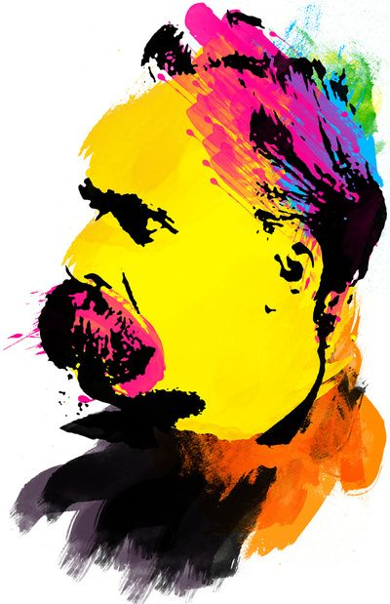
The Raging Discordance Between Art and Truth
“We possess art lest we perish of the truth”
(Nietzsche 1968, 435).

Slide 7
In these lectures Heidegger focuses on the theme that becomes explicit in Nietzsche’s late notebooks—of art as the countermovement to nihilism. Since he finds the discordance between art and truth still raging in the late notebooks, Heidegger concludes that this indicates that Nietzsche was not quite successful in his attempt to think of art as the response to the crisis of modernity. Heidegger concludes that nihilism is not overcome in Nietzsche’s thought; Nietzsche will thus be the “last metaphysician” and it is left to Heidegger to thus chart a new path of thinking beyond that which has framed Western thought since the time of Socrates and Plato. We see this new path in “The Origin of the Work of Art” where Heidegger attempts to rethink the relationship between art and truth. Heidegger attempts to rethink art and truth so that they are no longer in discordance. This rethinking has profound implications for both art and philosophy
The Origin of the Work of Art

Slide 8
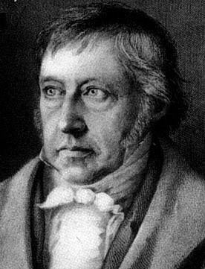
It is also clear in “The Origin of the Work of Art” that Heidegger is also responding to Hegel’s thesis about the end of art. In the Epilogue (not included in the selection in our reader), Heidegger cites the famous passage from Hegel:
The Origin of the Work of Art
Art no longer counts for us as the highest manner in which truth obtains existence for itself.
One may well hope that art will continue to advance and perfect itself, but its form has ceased to be the highest need of the spirit.
In all these relationships art is and remains for us, on the side of its highest vocation, something past.
(Hegel 1975, 11; Heidegger 1975, 80).
Heidegger goes on to explain that Hegel’s thesis about the end of art is a consequence of the discordance between art and truth that begins with Plato's determination of truth as intelligible and art consigned to be nothing more than imitation of sensible things.
G. W. F. Hegel (1770-1831)

Slide 9
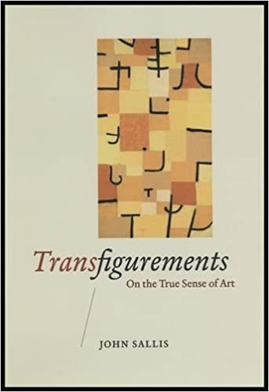
In his book Transfigurements: On the True Sense of Art (2008), John Sallis draws out the line of thought that leads to the thesis of end of art: "if, as with Hegel, art is determined as the sensible presentation of truth, then the further inference to its pastness requires only that truth be shown to exceed the possibility of sensible presentation" (Sallis 2008, 154). The future or the promise of art can thus only be opened in twisting free of the metaphysical opposition of the intelligible and the sensible, and the discordance between art and truth. This would involve both a rethinking of truth and a new interpretation of the sensible, or as Sallis puts it, "a redetermination of the sense of truth and the truth of sense," and this, as Sallis explains, is Heidegger's objective in “The Origin of the Work of Art” (Sallis 2008, 171).
The Origin of the Work of Art

Slide 10
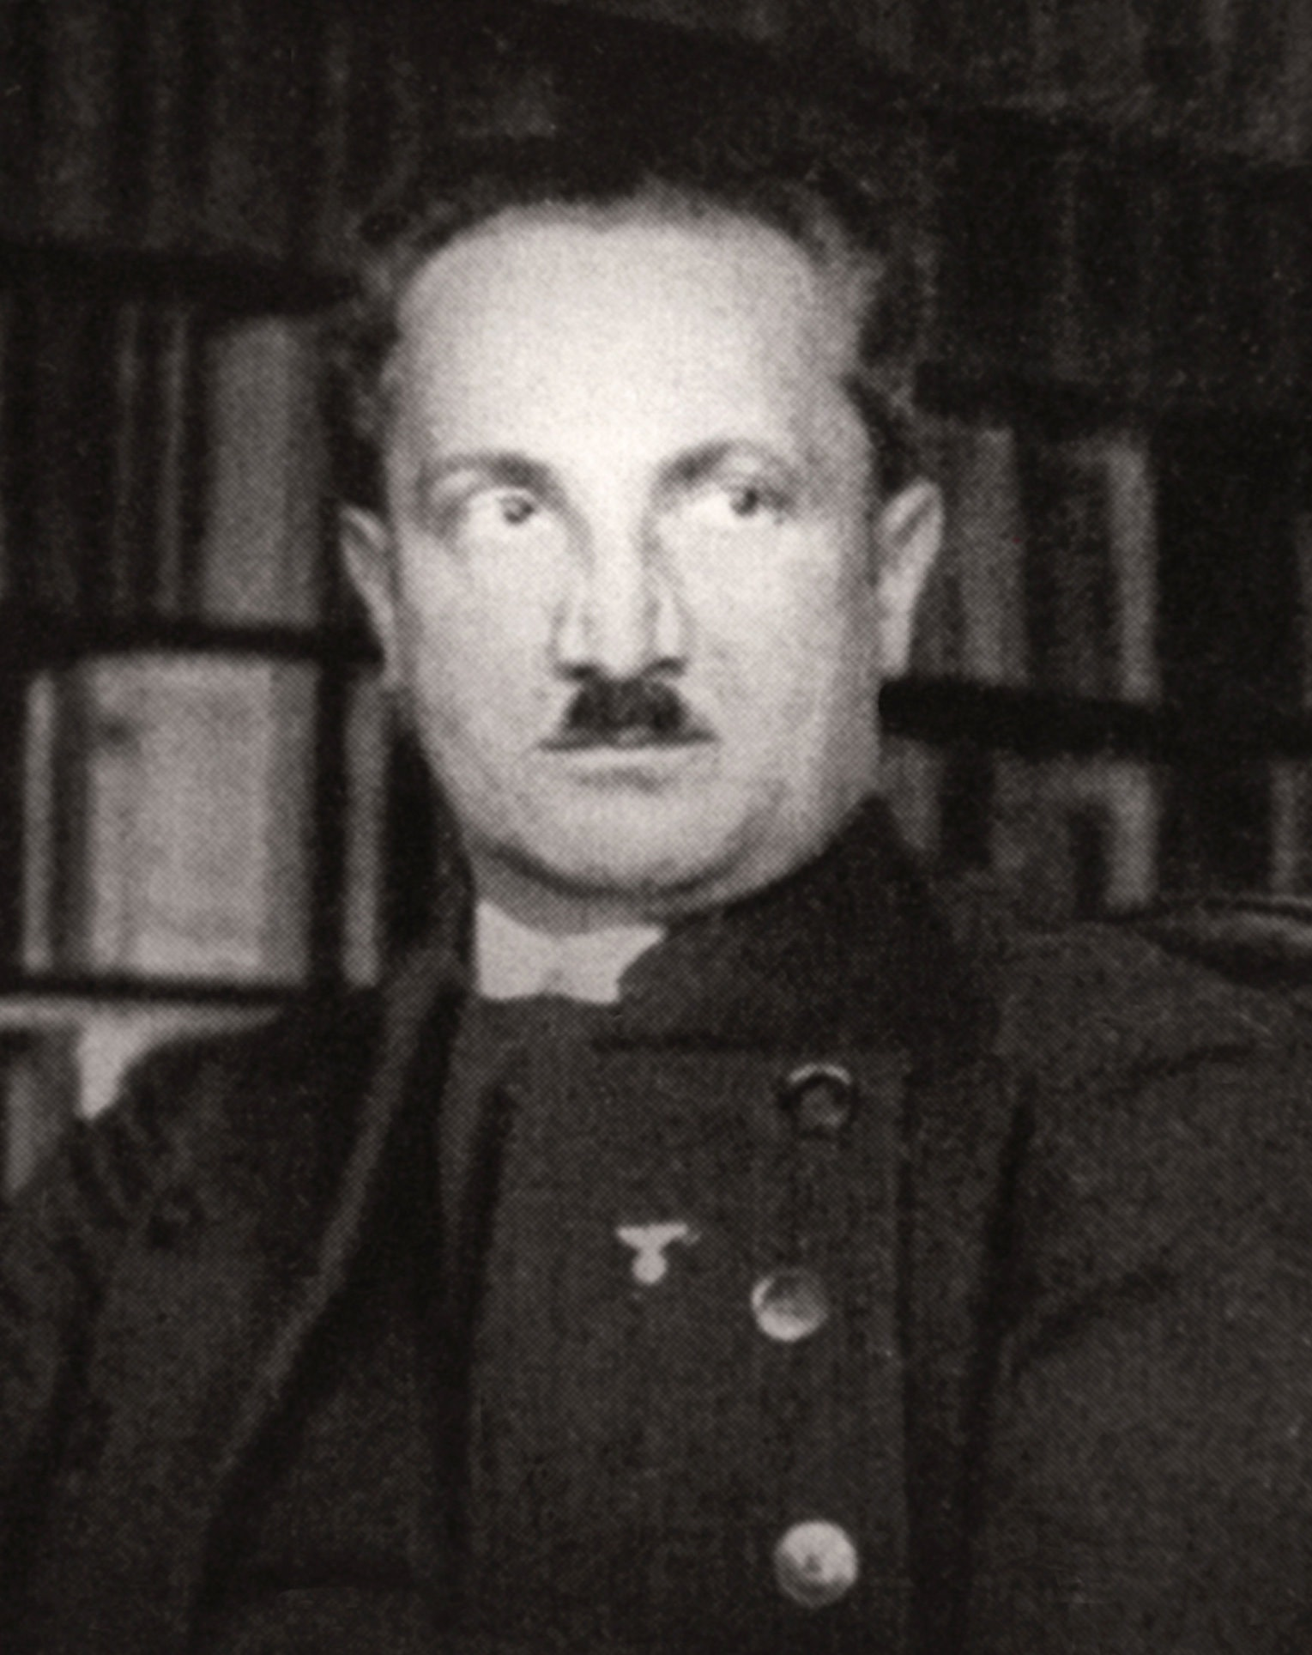
Heidegger was critical of previous aesthetics which focused either too much on the viewer, and the mere-enjoyment of art, or too much on the experience of the artist. Heidegger suggests another approach, an inquiry into art that would begin altogether differently, proceeding neither from the perspective of the viewer, nor from that of the artist, but from the work of art itself. In The Origin of the Work of Art Heidegger attempts to reopen the future of art by resolving the discordance between art and truth with the thesis that art is a happening of truth. This involves a rethinking of the notion of truth as well as the essence of art, and also a redetermination of the sensible.
The Origin of the Work of Art
(Heidegger in 1933)

Slide 11
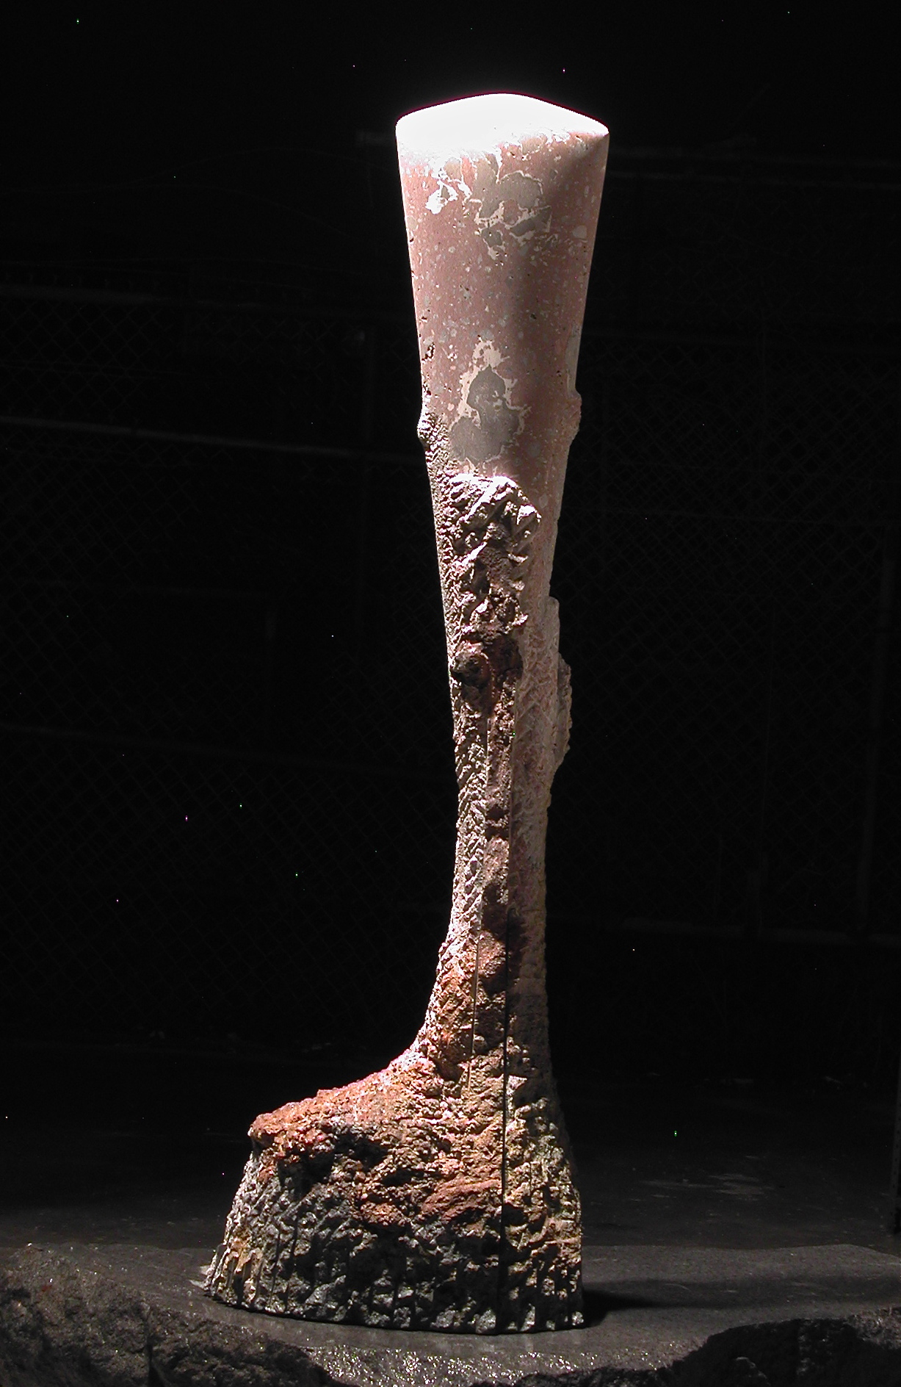
Heidegger begins by examining the thingly character of the work of art: ‘‘There is something stony in a work of architecture, wooden in a carving, colored in painting, spoken in a linguistic work, sonorous in a musical composition’’ (Heidegger 1994, 255). And yet Heidegger goes on in the first part of the essay to question this thingly character; and thus, even though Heidegger does acknowledge the materiality of the work, as for example, in the stone, the wood, or the color, the work of art is not a mere thing.
The Origin of the Work of Art
Navel of the Earth
Terrazzo, Randy Shiroma, 2012

Slide 12
Heidegger only discusses two works of art, a Van Gogh painting and a Greek temple, and it is at this point that he turns his attention to the painting. It is a painting of a pair of shoes. Though Van Gogh made numerous paintings of pairs of shoes, Heidegger does not identify which painting he is considering, but it really doesn’t matter, as what he says could be applied to any of the paintings. Most viewers likely continue to see the painting as a representation of shoes. Heidegger’s interpretation, in which the shoes are described as belonging to a peasant woman, generated some controversy when the art critic Meyer Shapiro claimed that Heidegger misinterpreted the painting, as the shoes, Shapiro claimed, were really Van Gogh’s own shoes. Jacques Derrida pointed out that Shapiro missed entirely the point of Heidegger’s essay. The representational theory of art had already been decisively rejected, and thus it doesn’t matter what shoes Van Gogh was looking at in painting his painting. (Freeman 2013, 53-54)
The Origin of the Work of Art
A Pair of Shoes
Oil on canvas, Vincent Van Gogh, 1886.
Van Gogh Museum, Amsterdam

Slide 13
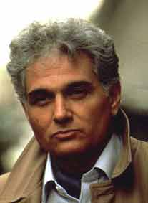
Derrida points out that the truth that is at work in the painting of shoes is not a matter of correspondence to something that is outside the painting, but is rather something that takes place within the frame of the painting. Shapiro thus still moves entirely within the framework of art as imitation while Heidegger’s essay is situated outside this framework. Derrida explains: ‘‘Thus Shapiro is mistaken about the primary function of the pictorial reference. He also gets wrong a Heideggerian argument which should ruin in advance his own restitution of the shoes to Van Gogh: art as ‘putting to work of truth’ is neither an ‘imitation,’ nor a ‘description’ copying the ‘real,’ nor a ‘reproduction,’ whether it represents a singular thing or a general essence. For the whole of Shapiro’s case, on the other hand, calls on real shoes: the picture is supposed to imitate them, represent them, reproduce them. Their belonging has then to be determined as a belonging to a real or supposedly real subject, to an individual whose extremities, outside the picture, should not remain bare [déchaussées; also, ‘‘loose’’ (of teeth)] for long’’ (Derrida 1994, 423).
The Origin of the Work of Art
Jacques Derrida (1930-2004)

Slide 14
What is happening in the painting then if it is not an imitation of a pair of shoes? Heidegger admits that when we look at the painting we see only a pair of shoes in an undefined space. There is no context to suggest where the shoes are; and yet, Heidegger suggests that the artwork brings forth the world of the peasant woman and ‘‘lets us know what shoes are in truth’’ (Heidegger 1994, 259). This is where Heidegger gives us that rather poetic description of the shoes of a peasant woman. Rejecting the notion of truth as an accurate representation or static correspondence, Heidegger rethinks truth as an event, something that happens. Recalling that the Greek term for ‘truth’ (aletheia) implies an uncovering or revealing, Heidegger emphasizes the event in which the pair of shoes ‘‘emerges into the unconcealedness of its being’’ (Heidegger 1994, 259).
The Origin of the Work of Art
A Pair of Shoes
Oil on canvas, Vincent Van Gogh, 1886.
Van Gogh Museum, Amsterdam

Slide 15
So what is happening in the work of art. Heidegger explains: “The art work opens up in its own way the Being of beings. This opening up, i.e., this deconcealing, i.e., the truth of beings, happens in the work. In the art work, the truth of what is has set itself to work. Art is truth setting itself to work. What is truth itself, that it sometimes comes to pass as art? What is this setting-itself-to-work?” (Heidegger 1994, 261). As Heidegger describes this event of the happening of truth, it involves a double movement, a ‘‘setting up of a world and the setting forth of the earth’’ (Heidegger 1994, 267). Both ‘‘world’’ and ‘‘earth’’ are, for Heidegger, poetic terms; they refer not to objects that can be seen, but rather to these two movements that take place in the event of truth
The Origin of the Work of Art
A Pair of Shoes
Oil on canvas, Vincent Van Gogh, 1886.
Van Gogh Museum, Amsterdam

Slide 16
In the movement where a ‘‘world’’ opens up, something comes forth, is unconcealed. But this revealing always takes place against a background where something else is concealed. The ‘‘earth’’ for Heidegger is this sheltering background: ‘‘That into which the work sets itself back and which it causes to come forth in this setting back of itself we called the earth. Earth is that which comes forth and shelters’’ (Heidegger 1994, 265-66). These two movements of revealing and concealing, of bringing forth and setting back, are diametrically opposed and yet somehow brought together at once.
The Origin of the Work of Art
A Pair of Shoes
Oil on canvas, Vincent Van Gogh, 1886.
Van Gogh Museum, Amsterdam

Slide 17
Heidegger refers to the meeting place, the site of conflict, where these two opposed movements come together as a ‘‘rift’’ and the conflict that ensues in this rift zone as ‘‘strife.’’ What is going on here in this happening of truth, Heidegger then makes clear, can be understood in terms of the Gestalt figure-ground composition: ‘‘The strife that is brought into the rift and thus set back into the earth and thus fixed in place is figure, shape, Gestalt. Createdness of the work means: truth’s being fixed in place in the figure. Figure is the structure in whose shape the rift composes and submits itself. This composed rift is the fitting or joining of the shining of truth’’ (Heidegger 1994, 277).
The Origin of the Work of Art
A Pair of Shoes
Oil on canvas, Vincent Van Gogh, 1886.
Van Gogh Museum, Amsterdam

Slide 18
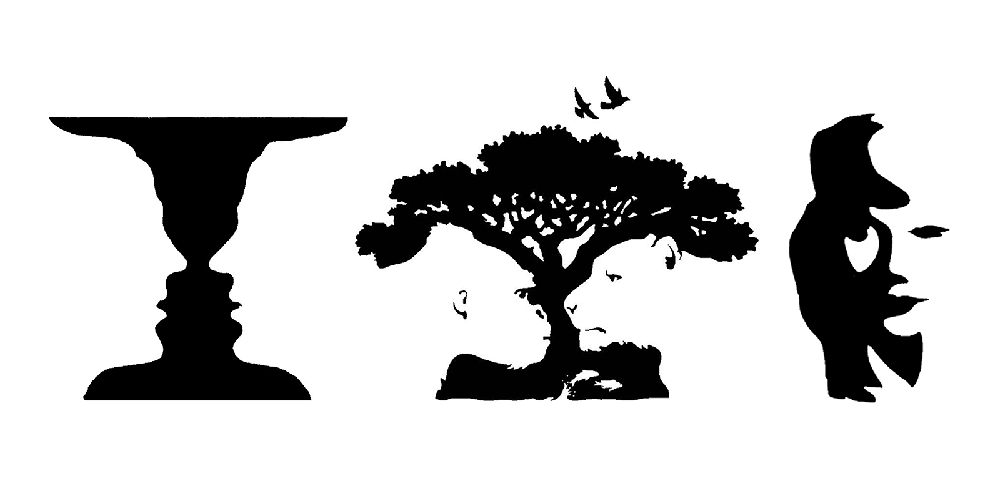
What did Heidegger mean by the term Gestalt? There is a theory that developed in Germany in the early 20th century called Gestalt Theory which has had considerable influence in cognitive psychology. As explained in that link, “There is no perfect English translation of the term ‘gestalt’. But we can interpret it as ‘totality’, ‘figure’, ‘structure’, ‘configuration’ or ‘organized unity’”. What Heidegger is referring to as “world” and “earth” is this figure-ground composition.
Gestalt Theory

Slide 19
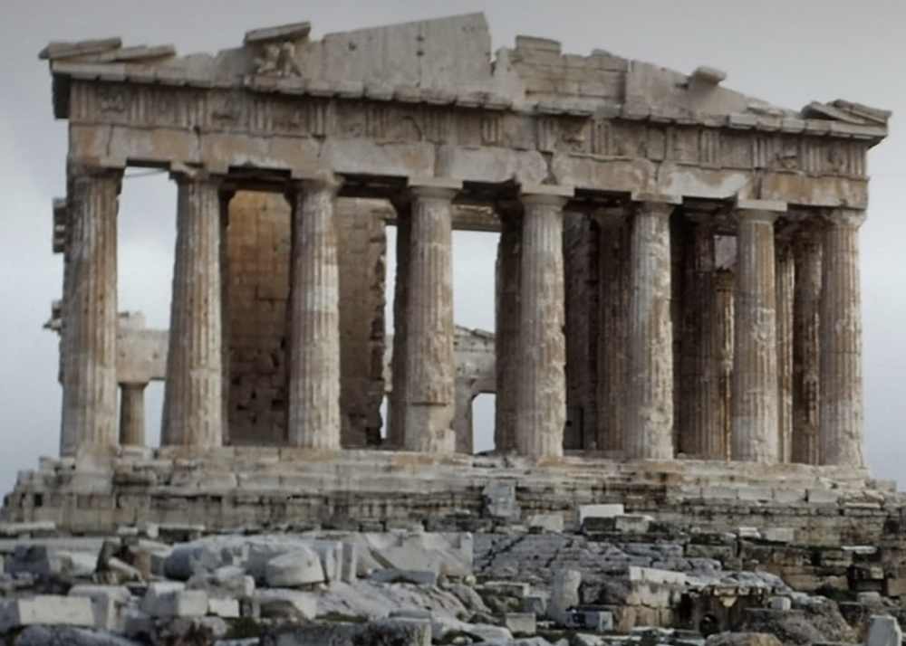
Heidegger’s investigation into how the sensible emerges in the work of art takes place in his consideration of the Greek temple. The temple is chosen as an example precisely because it, as Heidegger asserts, ‘‘cannot be ranked as representational art’’ (Heidegger 1994, 262). Heidegger draws attention to two features of the work of art that occur in the temple: once again, we have the setting up of a ‘‘world’’ and the setting forth of the ‘‘earth.’’ The temple opens up the ‘‘world’’ of the Greeks, but it does this against the background of the ‘‘earth.’’ In opening up a ‘‘world’’ against this background of ‘‘earth,’’ the work of art sets forth the ‘‘earth’’ in the sense that we first become aware of the background from which a ‘‘world’’ arose. We become aware of the ‘‘earth’’ as background, and thus, as Heidegger emphasizes, ‘‘The work lets the earth be an earth’’ (Heidegger 1994, 266).
The Origin of the Work of Art
The Parthenon, Athens

Slide 20
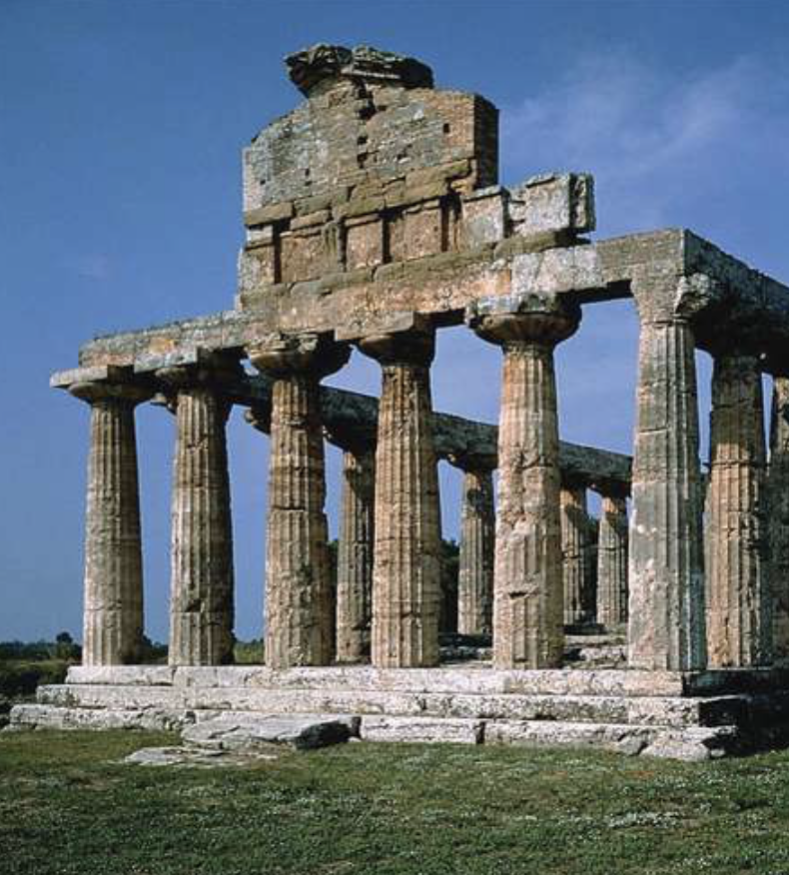
It is important to keep in mind the Gestalt figure-ground composition and thus that which Heidegger means by setting forth the ‘‘earth’’ should not be understood as a bringing forth into the foreground. The ‘‘earth’’ that is set forth is not what stands out clear and present in the foreground but is the background from which all emergence comes forth. ‘‘The earth appears openly cleared as itself,’’ Heidegger cautions, ‘‘only when it is perceived and preserved as that which is by nature undisclosable, that which shrinks from every disclosure and constantly keeps itself closed up’’ (Heidegger 1994, 266).
The Origin of the Work of Art
Temple to Athena, Paestum, Italy

Slide 21
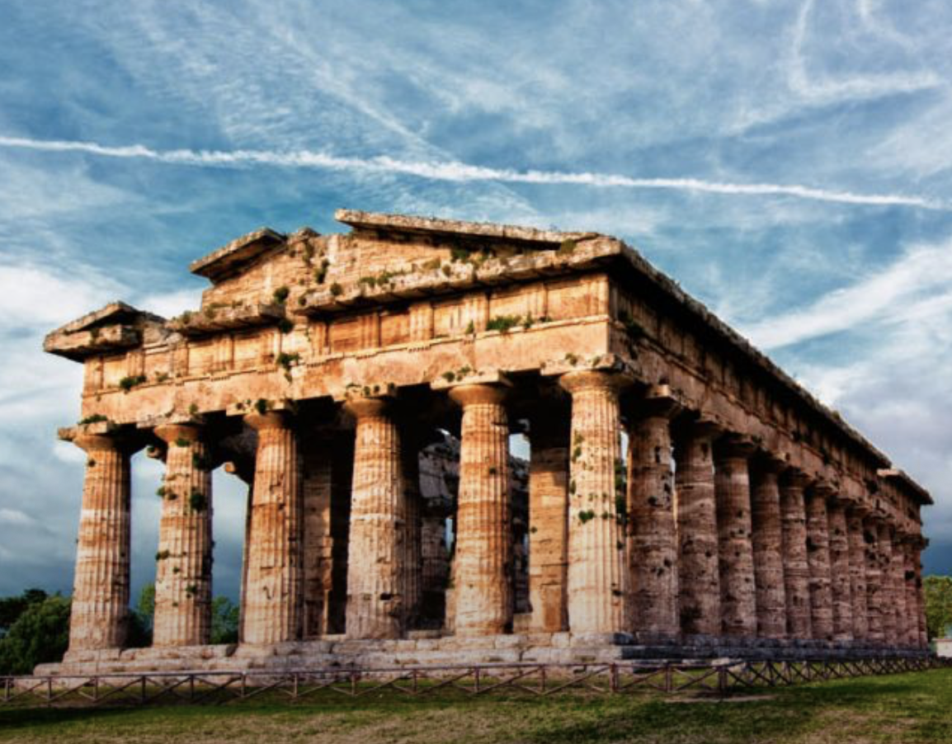
This interaction of ‘‘world’’ and ‘‘earth’’ is crucial in understanding Heidegger’s rethinking of the sensible in the work of art. Heidegger observes that works are set forth in this or that material—stone, wood, metal, color, language, tone. Heidegger insists that in the work of art the material does not disappear, but rather comes forth ‘‘for the very first time’’ in the setting up of a ‘‘world’’ (Heidegger 1994, 266). Heidegger writes:
The Origin of the Work of Art
The rock comes to bear and rest and so first becomes rock; metals come to glitter and shimmer, colors to glow, tones to sound, the word to say. All this comes forth as the work sets itself back into the massiveness and heaviness of stone, into the firmness and pliancy of wood, into the hardness and luster of metal, into the brightening and darkening of color, into the sounding of tone, and into the naming power of the word. (Heidegger 1994, 265)
Temple to Hera, Paestum, Italy

Slide 22
Heidegger continues to try and think through this notion of truth as aletheia, as something that happens, an event that involves this double movement of revealing and concealing. Thus he rejects the notion of truth as correspondence, a matter of correctly representing something. So in the truth that happens in the work of art that is a Greek temple he explains: “Truth happens in the temple’s standing where it is. This does not mean that something is correctly represented and rendered here, but that what is as a whole is brought into unconcealedness and held therein” (Heidegger 1994, 271). He goes on to say that this is also what happens in the painting of shoes: “Truth happens in Van Gogh’s painting. This does not mean that something is correctly portrayed, but rather that in the revelation of the equipmental being of the shoes, that which is as a whole—world and earth in their counterplay—attains to unconcealedness” (Heidegger 1994, 272).
The Origin of the Work of Art
A Pair of Shoes
Oil on canvas, Vincent Van Gogh, 1886.
Van Gogh Museum, Amsterdam

Slide 23
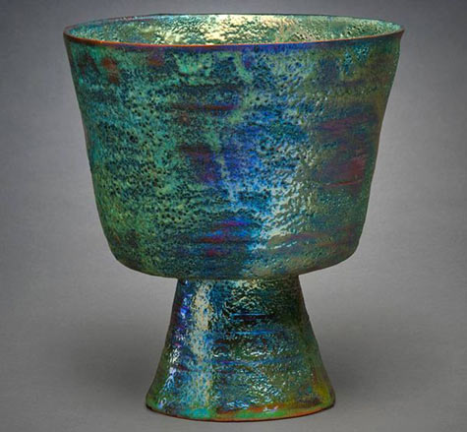
Truth and Art In the final section of the essay Heidegger turns to address this question: What is truth, that it can happen as, or even must happen, as art? How is it that art exists at all? (Heidegger 1994, 273). Heidegger begins by inquiring into the process of creation, and thus the activity of the artist. What is it that the artist does in bringing forth a work of art? In examining this question he draws out the contrast between the “bringing forth” of something in art versus in handicraft—the difference between the making of some utilitarian object versus the work of art, a difference between a making and a creating. What he says has interesting implications for the question about ceramics. Is a ceramic vessel a work of craft, or can it be a work of art?
The Origin of the Work of Art
Ceramic Vessel, Beatrice Wood
American Modernist Ceramic Artists

Slide 24
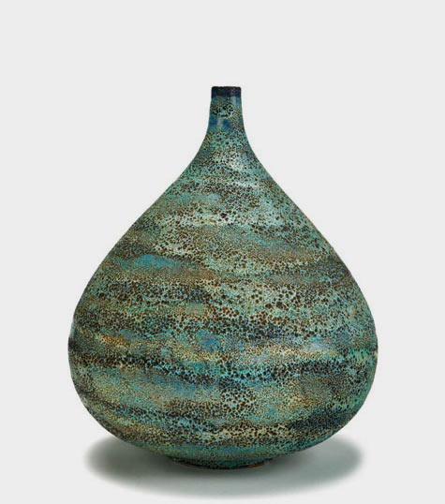
In order to understand the difference between mere handicraft and art, Heidegger examines what is mean by the Greek concept of techne. For the Greeks, techne is not a mere making, neither of a craft object or work of art. Its more primary sense denotes a mode of knowing, and knowing, Heidegger explains, consists in the uncovering of beings, or again this notion of truth as aletheia. Heidegger notes that great artists prize craftsmanship most highly; but he distinguishes the creating that goes on in bringing forth a work of art from mere craft. What the artist does in creating a work of art is: “to create is to cause something to emerge as a thing that has been brought forth. The work’s becoming a work is a way in which truth becomes and happens” (Heidegger 1994, 274).
The Origin of the Work of Art
Monumental vase, Gertrud & Otto Natzler, 1957

Slide 25
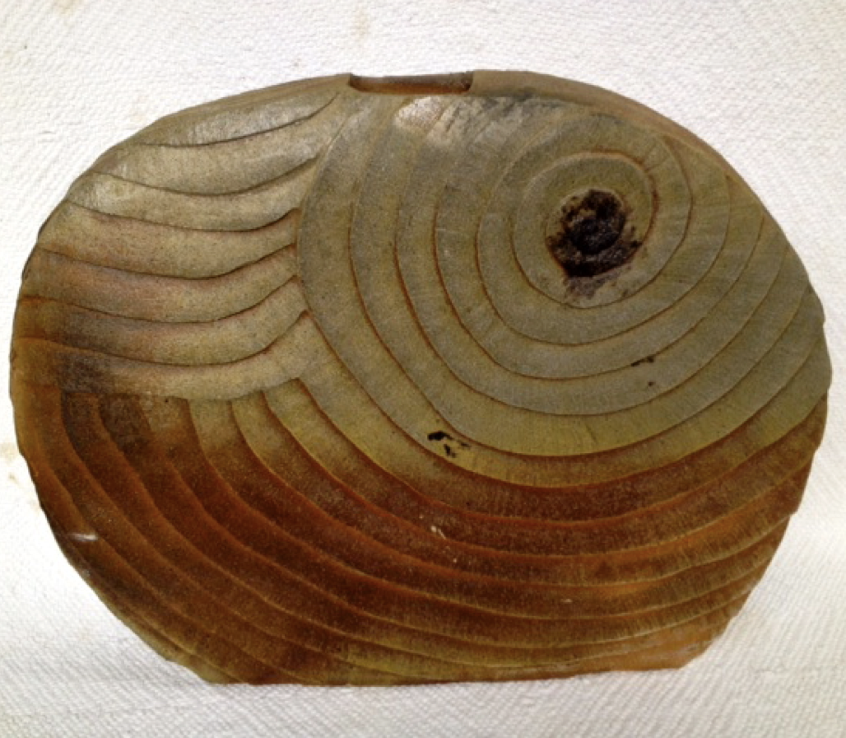
But what is truth that happens in the work of art? Heidegger again refers to this double-movement of revealing and concealing; something emerges and something is hidden. Heidegger goes on to say that the happening of truth is not unique to works of art. He lists several other ways truth happens, for example in the political realm: “Another way in which truth occurs is the act that founds a political state” (Heidegger 1994, 275). The implication here is that in an important sense the Constitution of the United States is like a work of art. Another interesting point brought out here is that what emerges in the happening of truth is unique—it occurs once and once only: “The establishing of truth in the work is the bringing forth of a being such as never was before and will never come to be again” (Heidegger 1994, 276).
The Origin of the Work of Art
Pi'ihonua, III, Clayton Amemiya, 2012

Slide 26
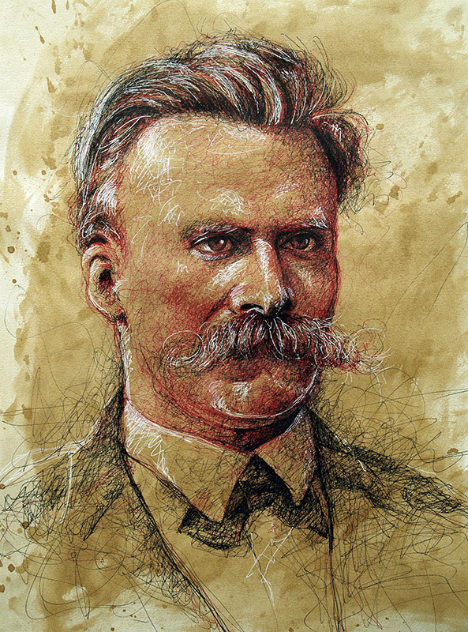
Vita Femina. For seeing the ultimate beauties of a work, no knowledge or good will is sufficient; this requires the rarest of lucky accidents: The clouds that veil these peaks have to lift for once so that we see them glowing in the sun. Not only do we have to stand in precisely the right spot in order to see this, but the unveiling must have been accomplished by our own soul because it needed some external expression and parable, as if it were a matter of having something to hold on to and retain control of itself. But it is so rare for all of this to coincide that I am inclined to believe that the highest peaks of everything good, whether it be a work, a deed, humanity, or nature, have so far remained concealed and veiled from the great majority and even from the best human beings. But what does unveil itself for us, unveils itself for us once only. The Greeks, to be sure, prayed: "Everything beautiful twice and even three times!" They implored the gods with good reason, for ungodly reality gives us the beautiful either not at all or once only. I mean to say that the world is overfull of beautiful things but nevertheless poor, very poor when it comes to beautiful moments and unveilings of these things. But perhaps this is the most powerful magic of life: it is covered by a veil interwoven with gold, a veil of beautiful possibilities, sparkling with promise, resistance, bashfulness, mockery, pity, and seduction. Yes, life is a woman. (Nietzsche 1974, 271-72)
It might be interesting to compare what Heidegger says with this passage from Nietzsche

Slide 27
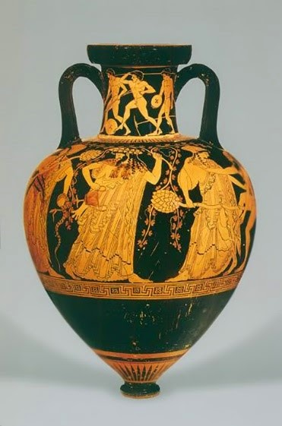
Nevertheless, perhaps the most remarkable echo of The Birth of Tragedy in The Origin of the Work of Art might be the Apollonian/Dionysian Gestalt configuration in Nietzsche’s thinking resounding in the configuration of ‘‘world’’ and ‘‘earth’’ in Heidegger’s account of the origin of the work of art. That the projection of ‘‘world’’ in Heidegger’s thought echoes the Apollonian shining forth of images might be more obvious, but how, one might question, is Nietzsche’s thought of the Dionysian related to Heidegger’s conception of ‘‘earth’’? The key to this connection lies in understanding the background from which all projection comes forth in both Nietzsche and Heidegger’s thinking regarding the work of art. To recapitulate, the figure of Dionysus is that which is hidden behind the mask. The ‘‘earth,’’ for Heidegger, is that which is also hidden, the undisclosable background from which all emergence comes forth. Both the Dionysian and Heidegger’s ‘‘earth’’ must be thought of as the abyss, this abysmal ground, against which and from which all shining forth comes into presence not only in the work of art but in all our attempts to make sense of existence. (Freeman 2013, 60-61)
Dionysian Revelry, Attic Red-Figure Amphora, by the Kleophrades Painter, ca. 490 BCE.

Slide 28
If we return now to the Van Gogh painting we might consider just what, in Heidegger’s thinking, the element of ‘‘earth’’ is in this particular work of art. It is certainly not the earthy color of the painting, nor some depiction of earth, as in clods of soil on the shoes. This is specifically what Heidegger says we do not see in the painting: ‘‘From Van Gogh’s painting we cannot even tell where the shoes stand. There is nothing surrounding this pair of peasant shoes in or to which they might belong—only an undefined space. There are not even clods of soil from the field or the field-path sticking to them, which would at least hint at their use. A pair of peasant shoes and nothing more’’ (Heidegger 1994, 257).
The Origin of the Work of Art
A Pair of Shoes
Oil on canvas, Vincent Van Gogh, 1886.
Van Gogh Museum, Amsterdam

Slide 29
There are perhaps two senses to Heidegger’s notion of ‘‘earth’’ in this work. The first sense has to do with the composition of the painting. Perhaps the reason why Heidegger chose this particular painting to illustrate his thinking is that the composition of the painting is such a simple figure-ground configuration. The shoes stand out against this background that is only an ‘‘undefined space.’’ The ‘‘earth’’ then is this undefined space, this ‘‘nothing more.’’ What comes forth from this background of ‘‘earth’’ is this ‘‘world.’ (Freeman 2013, 61).
The Origin of the Work of Art
A Pair of Shoes
Oil on canvas, Vincent Van Gogh, 1886.
Van Gogh Museum, Amsterdam

Slide 30
What marks Nietzsche’s thinking on art is the possibility of finding ourselves transfigured in the experience of art. This thought might be there in Heidegger as well. Heidegger says two curious things about the experience of standing before the Van Gogh painting: ‘‘This painting spoke. In the vicinity of the work, we were suddenly somewhere else than we usually tend to be’’ (Heidegger 1994, 258-59). Strangely enough the painting speaks. This explains why, at the end of the essay [in a section not included in our reader), Heidegger says that the ‘‘nature of art is poetry’’ (Heidegger 1971, 75). In this saying, in the shimmering shining of the truth that occurs in the painting, we find ourselves transported to another place. Perhaps this suggests the possibility of finding ourselves transfigured and points also to what Heidegger was getting at in the later work, when he suggests, echoing Nietzsche’s thought in The Birth of Tragedy once again, that art is a ‘‘saving power’’ in opening up a ‘‘poetic dwelling’’ that is a different mode of being-in-the- world than that which still today, more than ever, threatens to consume the earth and every living thing upon it. (Freeman 2013, 65)
The Origin of the Work of Art
A Pair of Shoes
Oil on canvas, Vincent Van Gogh, 1886.
Van Gogh Museum, Amsterdam

Slide 31
Derrida, Jacques. 1994. The Truth in Painting in Art and Its Significance, 3rd ed. Edited by Stephen David Ross. Albany: State University of New York Press. [1987] Freeman, Timothy J. 2013. “The Shimmering Shining: The Promise of Art in Heidegger and Nietzsche,” Comparative & Continental Philosophy 5.1: 49-66. Heidegger, Martin. 1975. “The Origin of the Work of Art” in Poetry, Language, Thought, translated by Albert Hofstadter. New York: Harper and Row. Heidegger, Martin. 1994. “The Origin of the Work of Art” in Art and Its Significance, 3rd ed. Edited by Stephen David Ross. Albany: State University of New York Press. [1953] Hegel, G.W.F. 1975 . Aesthetics. Lectures on Fine Art, trans. T.M. Knox, 2 vols. Oxford: Clarendon Press. Nietzsche, Friedrich. 1974. The Gay Science, translated by Walter Kaufmann. New York: Vintage Books.
Bibliography

