Slide 1
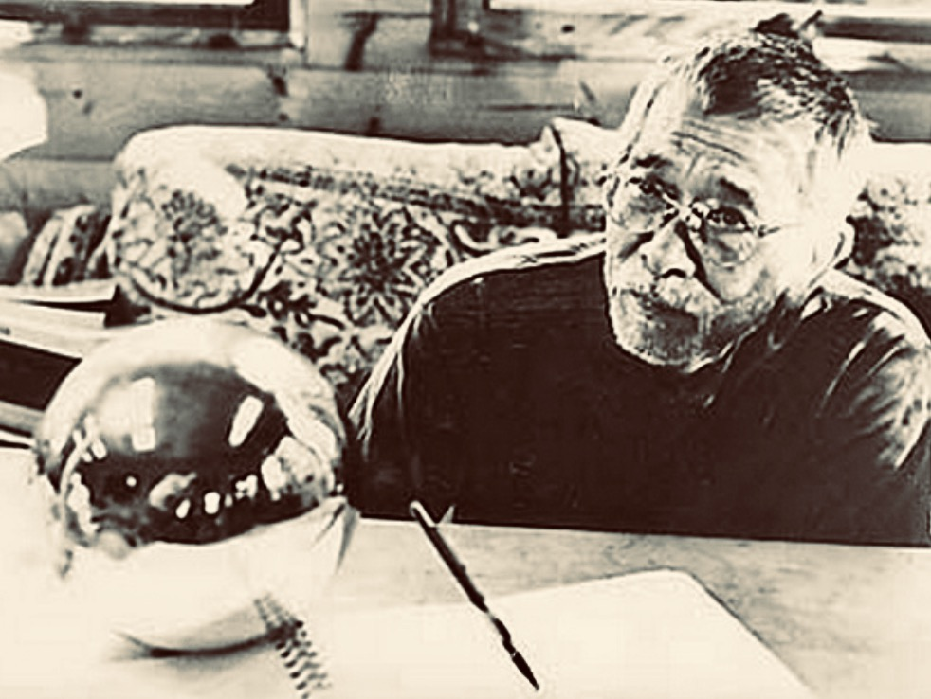
IT’S ZENSATIONAL
A REFLECTION ON
ALBERT SAIJO’S ZEN
Tim Freeman
Saijo House
Volcano, Hawaiʻ i
April 22, 2020

Slide 2
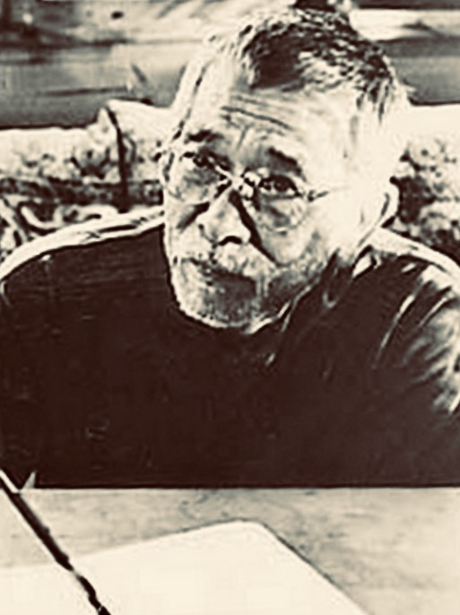
It is a most fortunate circumstance, during this worldwide pandemic where we all have been confined to our homes, I am confined to a home built by Albert Saijo. It’s an extraordinary house, built by Albert entirely without power tools, only about three miles from the center of the summit crater of Kīlauea, the most active volcano on the Big Island of Hawaiʻi.

Slide 3
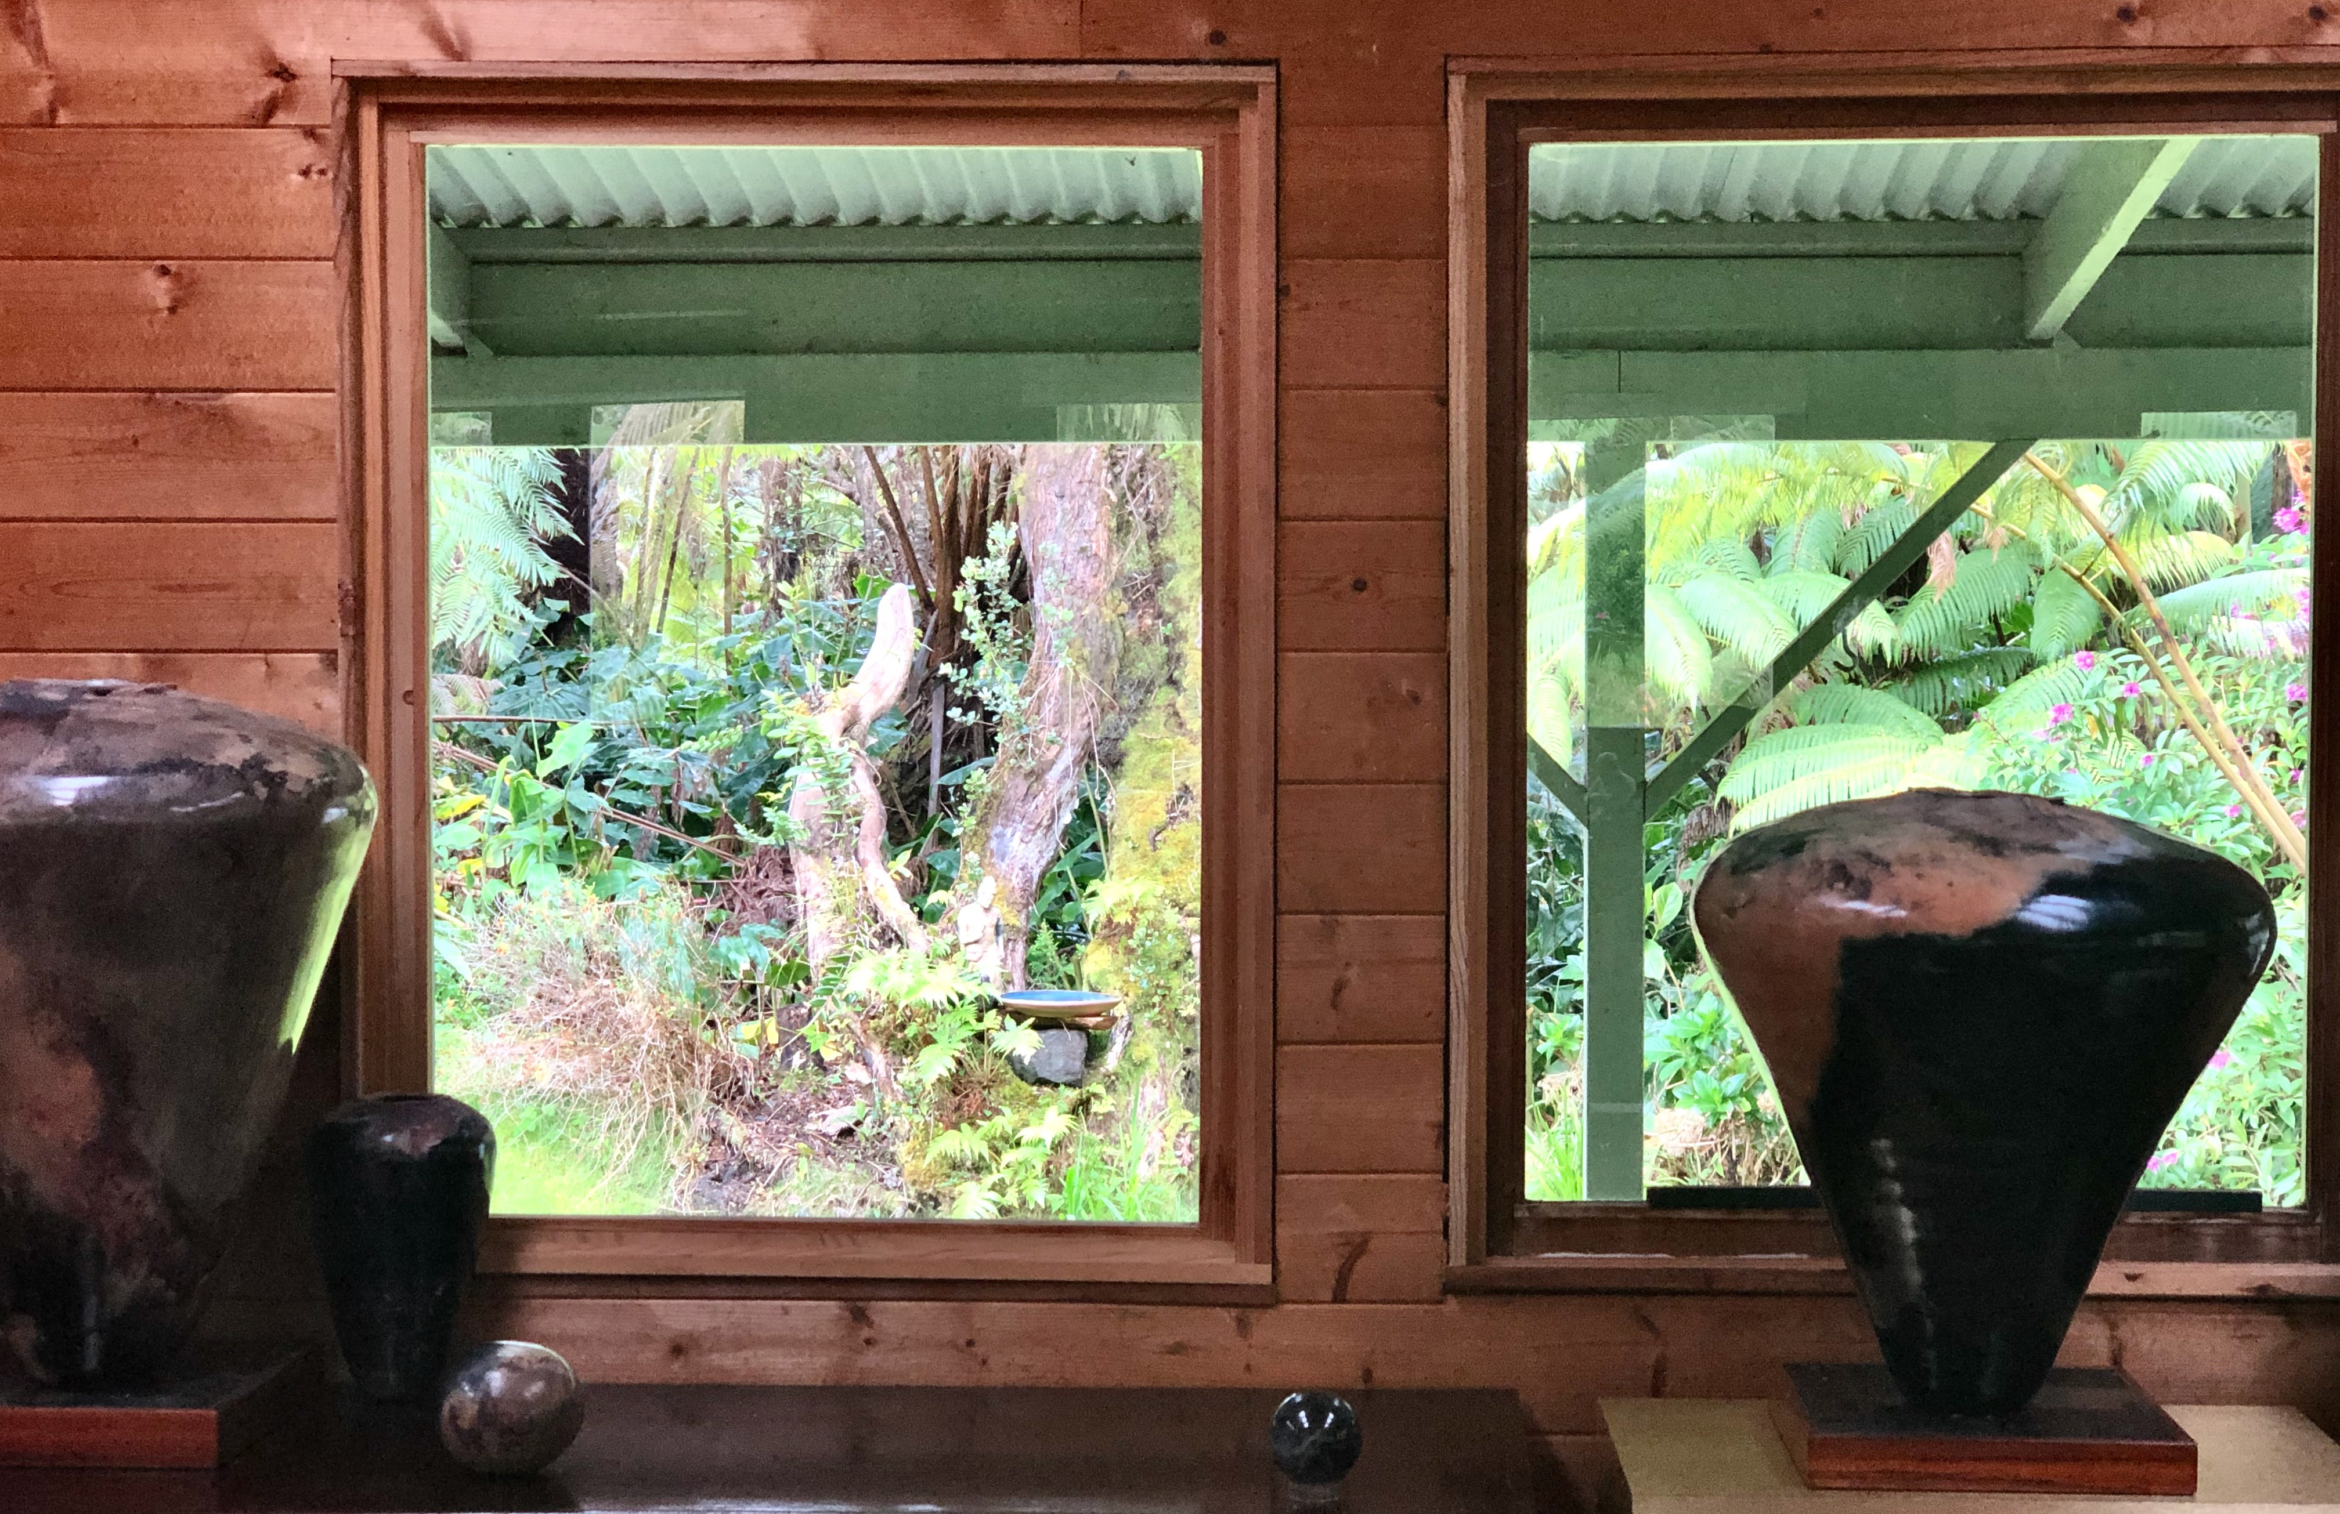
One of my large pit-fired Volcano Vessels now stands about where Albert was sitting in that photo.
I feel very blessed to have somehow been plopped down by the Great Clod, as Zhuangzi once put it, in this wonderful space created by the poet Albert Saijo. Only a poet, and a very good one at that, and one who embodied that Zen appreciation of our interdependence with the natural world, could have built such a house.
I met him only once, at an art opening, an exhibition of work by my friend Kevin Diminyatz, who was a good friend of Albert’s.

Slide 4
The house is nestled in a beautiful, almost pristine native Hawaiian forest. The enchanting songs of the scarlet apapane, which are abundant here, resound all the day long. Although I have only just moved to the Saijo house, I have lived in this area for many years. I have always loved living in this amazing forest, and now this very simple, but wonderful house, is my most favorite place I have ever lived.

Slide 5
What makes the house so special is not only the fine skill of Albert’s carpentry, but the way he brought light, and the surrounding forest, into the house. It is a simple rectangle; but he has put windows in all around, and plenty skylights too.
I am astonished when I consider that he didn’t start building this house until he was 70 years old, and then made every cut carefully by hand.

Slide 7
I would like to think that Albert would appreciate the art that I have brought into the space he created, my own ceramic work and the work of a few mutual friends. The wood sculpture here in the center is one of Randy Takaki’s guardian figures. Randy was inspired by a medieval Japanese Zen monk who carved thousands of Buddhas, leaving them wherever he travelled in his wanderings throughout Japan. I’m pretty sure Albert and Randy must have been good friends and that Albert would be happy to see this here.
But what now of Albert’s Zen?

Slide 8
Albert Fairchild Saijo (1926-2011) was one of the poets associated with the ‘Beat’ movement that developed in the San Francisco Bay area in the 1950s.
In an influential essay in the mid 1960s, historian Lynn White Jr. traces the roots of our ecological crisis back to the separation between humans and the natural world that is part of the legacy of Christianity. There he praises the ‘beatniks’ for their affinity for Zen in which there is a very different understanding of that relationship.
During World War II, Albert was imprisoned along with the rest of his family at the Heart Mountain Relocation Center in Wyoming. He was the editor of the camp newspaper. In the camp Albert was introduced to Zen by Rinzai Zen monk Nyogen Senzaki who lectured and led zazen sessions.

Slide 9
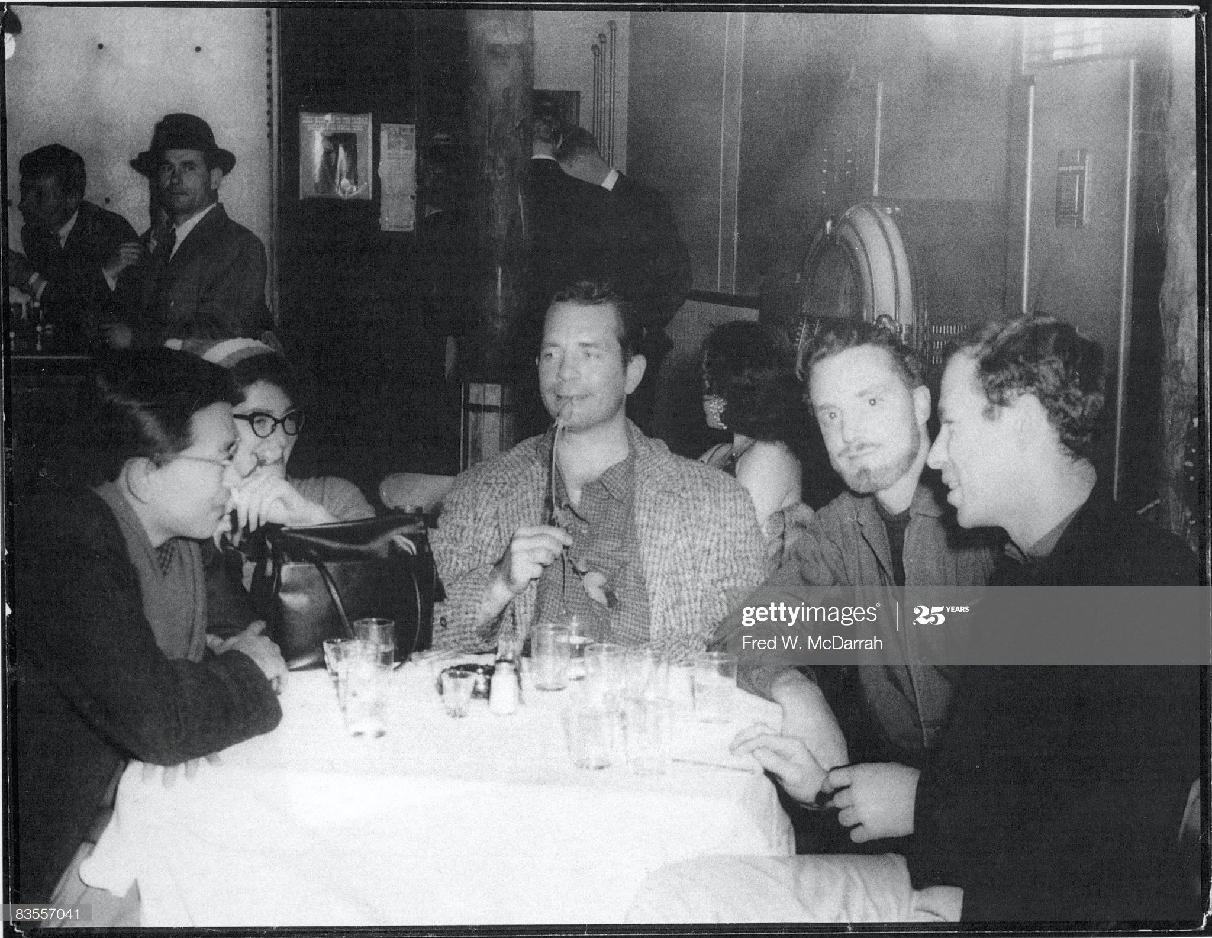
After completing high school at Heart Mountain, Albert fought in Italy with the 442nd Regimental Combat Team. After the war he lived in Los Angeles and continued his zazen practice with Nyogen Senzaki. By the mid 50s he was in San Francisco and in the heart of the Beat movement. Although the others were aware of Zen through Alan Watts, it is likely that Albert was at least to some extent personally responsible for the beat writer’s affinity for Zen. Many Americans, including myself, were first introduced to Zen through Jack Kerouac’s novel Dharma Bums. This photo shows Saijo with Kerouac and Lew Welch after their famous trip across country. Kerouac later memorialized the trip in his novel Big Sur, and the character George Baso, based on Saijo, is described as “the little Japanese Zen master hepcat sitting crosslegged in the back of Dave’s [Lew’s] jeepster.”
See “Albert Saijo: Karmic Heart” by Patricia Wakida
Beats Dine Out
American writers Albert Saijo (left, with scarf), Jack Kerouac (1922 - 1969) (center, with rose in his mouth), and Lew Welch (1926 - 1971) (second right) sit with soon-to-be married couple Gloria Schoffel (second left) and photographer Fred McDarrah (right) at a table at the Egyptian Gardens restaurant (301 W. 29th St.), New York, New York, December 10, 1959. They celebrate the completion of 'This is a Poem by Albert Saijo, Lew Welch, and Jack Kerouac' (later published as 'Trip Trap'), and was based on the trio's journey from San Francisco to New York in Welch's car and had been written that day at Schoffel and McDarrah's apartment. (Photo by Fred W. McDarrah/Getty Images)

Slide 10
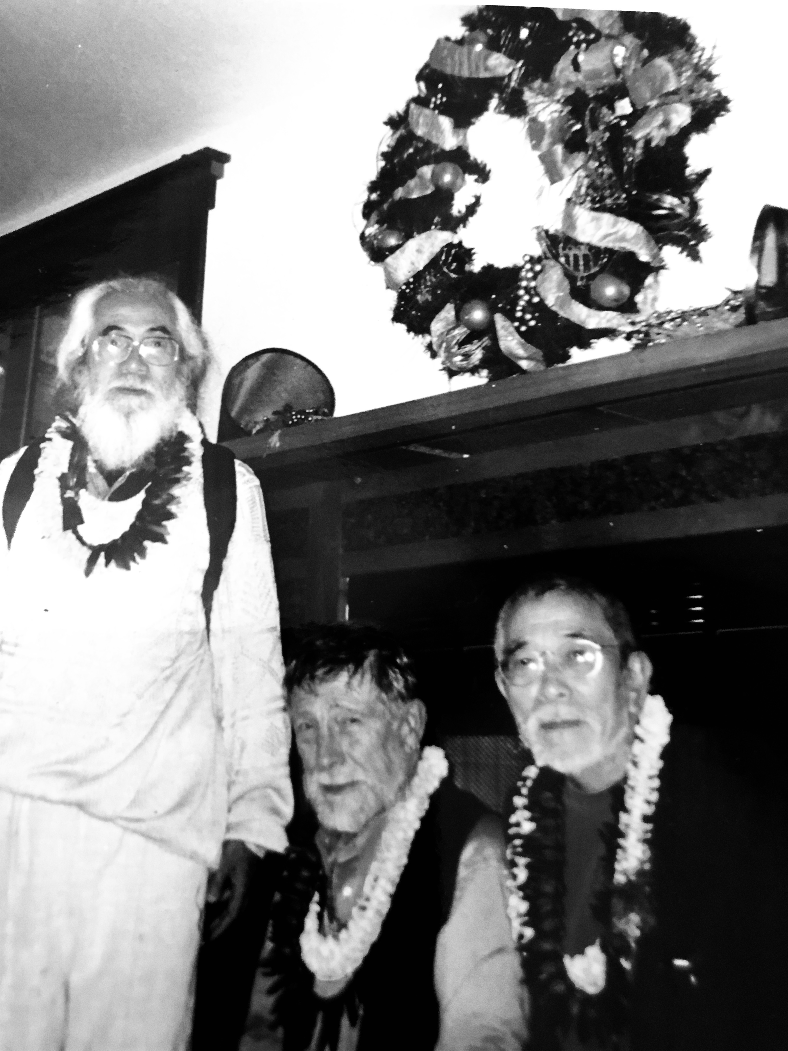
Albert Saijo and Gary Snyder, one of the dharma bums characterized in Kerouac’s novel as Japhy Ryder, were longtime friends, from their days in the emergence of the Beat movement in San Francisco in the 1950s to Albert’s last years in Volcano. Here he is with Snyder and Nanoa Sakaki, another longtime friend and poet from Japan, when they gave a reading together in Volcano in 2000.

Slide 11
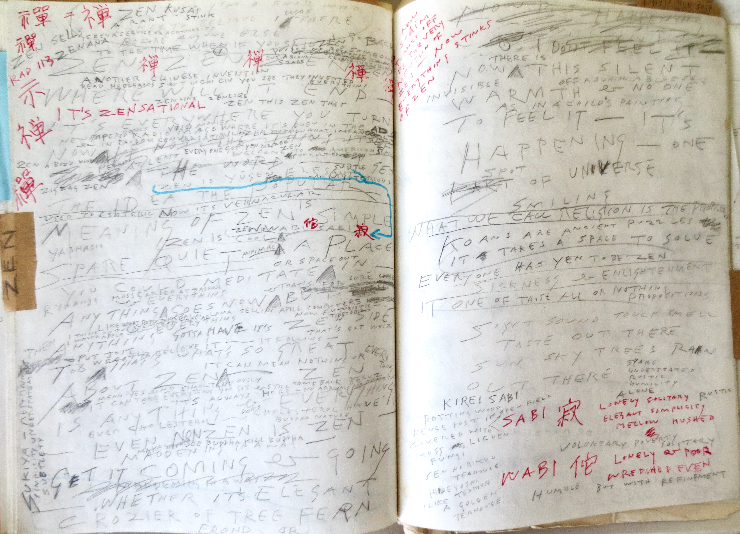

Slide 12
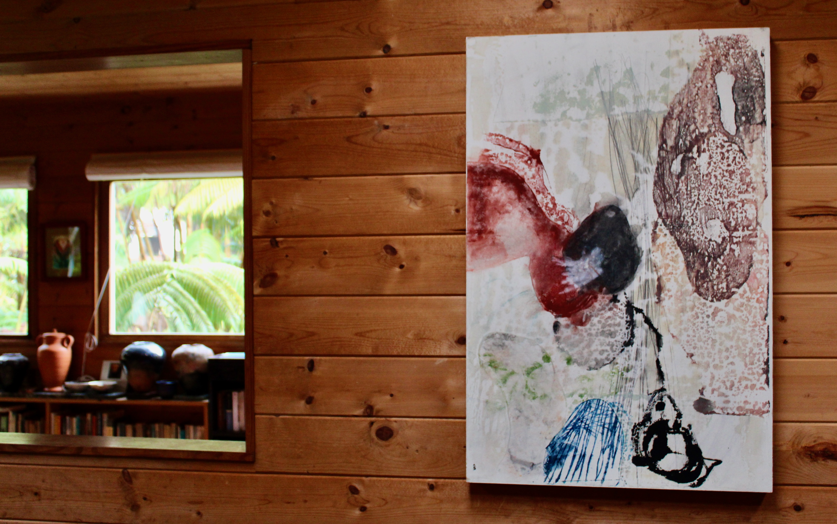
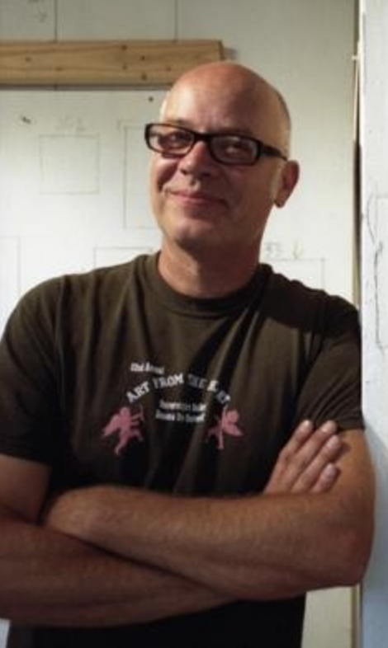
LOOK LIKE WHAT IT MEANS
In the Spring of 2015 Kevin Diminyatz put together an art exhibition honoring Albert and he asked me to contribute to the accompanying symposium. What follows is a development of my presentation at that symposiusm.
Exotica- Untitled#14, Encaustic Monotype On Wood Panel,
Kevin Diminyatz, 2015.

Slide 13
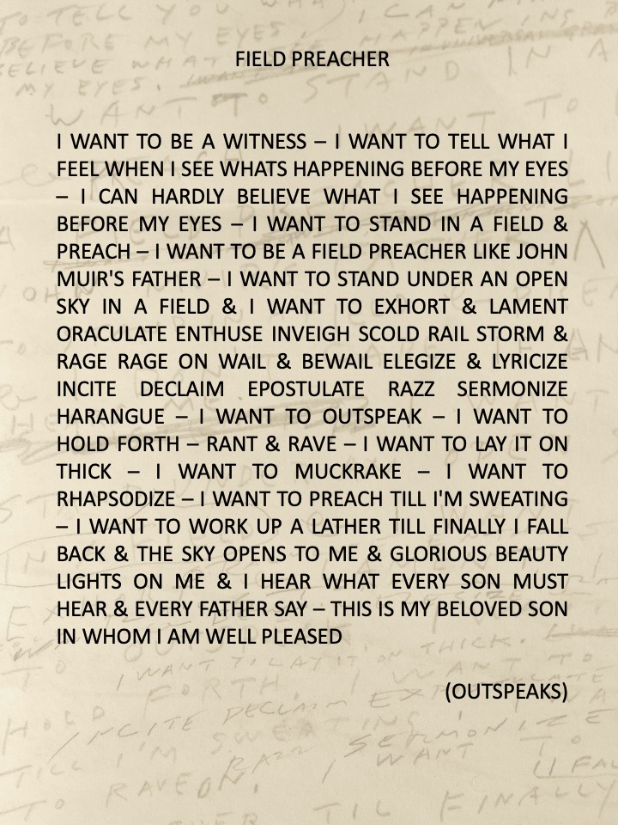
I would like to begin with a couple of poems from
OUTSPEAKS: A RHAPSODY.
In these two poems, coming at the beginning of that work, Saijo tells us who he is and what he wants to do in his writing.
In the first he tells us what he wants:

Slide 14
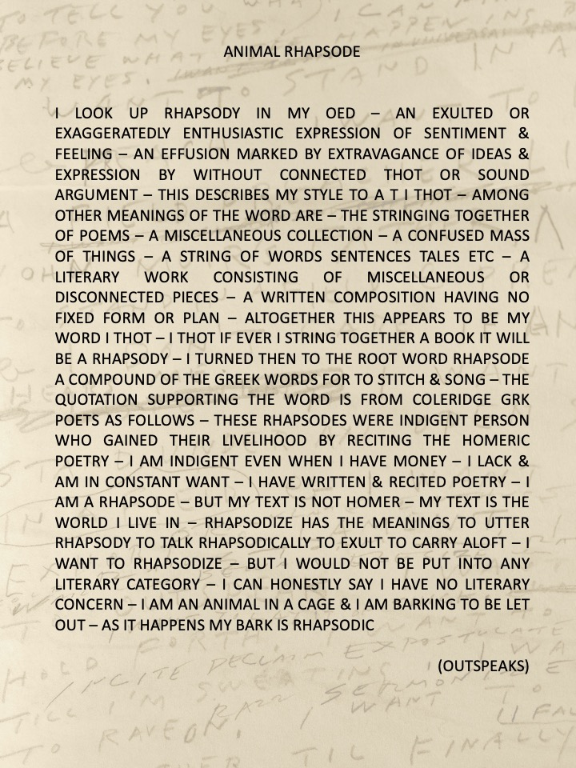
In the next poem he tells us about rhapsody:

Slide 15
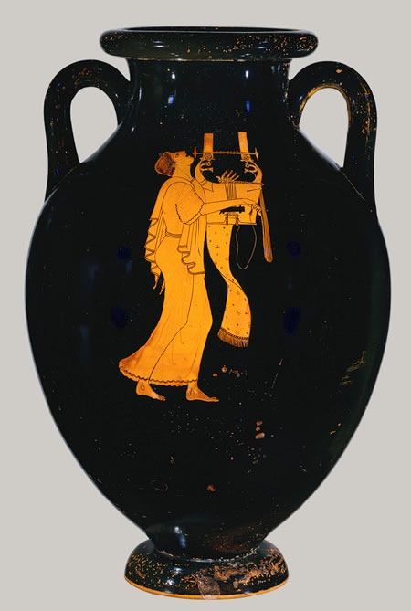
Saijo identifies himself here as a rhapsode. One might recall here the quarrel, already ancient according to Plato, between philosophy and poetry. One might recall Socrates' condemnation of the rhapsode Ion in the dialogue that bears the latter's name. The problem with the poets, Plato's Socrates tells us – illustrated so well by the rhapsode Ion, one of those who indeed did gain his livelihood from reciting Homeric poetry – is that he doesn't really have knowledge about what he speaks. The source of his rhapsody is inspiration not knowledge. The inspiration that moves the rhapsode is like the power of a magnet that moves from the stone through iron rings, the poet is like one of the rings the power moves through. The poets, Socrates says, “are inspired and possessed when they write all these beautiful poems.” The poets “are not in their right minds,” he goes on to say, “when they make their beautiful songs. Like ecstatic dancers they are “out of their wits dancing about.”

Slide 16
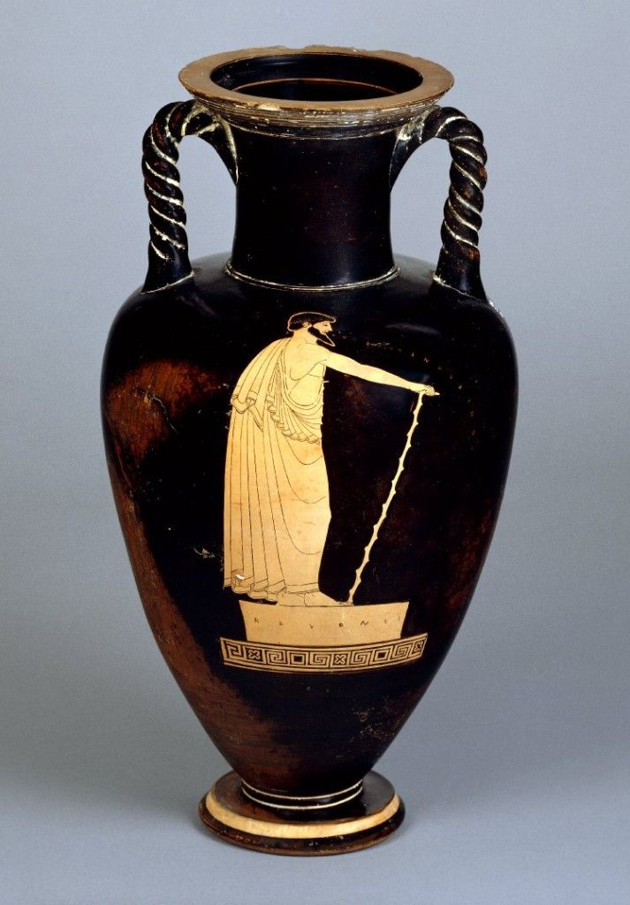
In declaring himself a rhapsode, Saijo declares his allegiance in the ancient quarrel between philosophy and poetry. Certainly Saijo rails against much of what might be seen as the legacy of Socrates and Plato in the development of Western civilization. And yet, Saijo is not like Ion in an important sense. He is not like the rhapsode who merely recites the poems of another, like Ion who makes his livelihood reciting Homer. For Saijo is a thinker with a voice of his own. He does have a lot to say on a multitude of topics. Saijo's poetry, like the writings of his “Beat Generation” compatriots – Gary Snyder and Jack Keroauc, Allen Ginsburg, Lew Welch – is quite philosophical, even if in a subversive way. These writings challenge the opposition that begins with Plato and structures so much of Western thought and civilization, the opposition between philosophy and art, or philosophy and poetry.

Slide 17
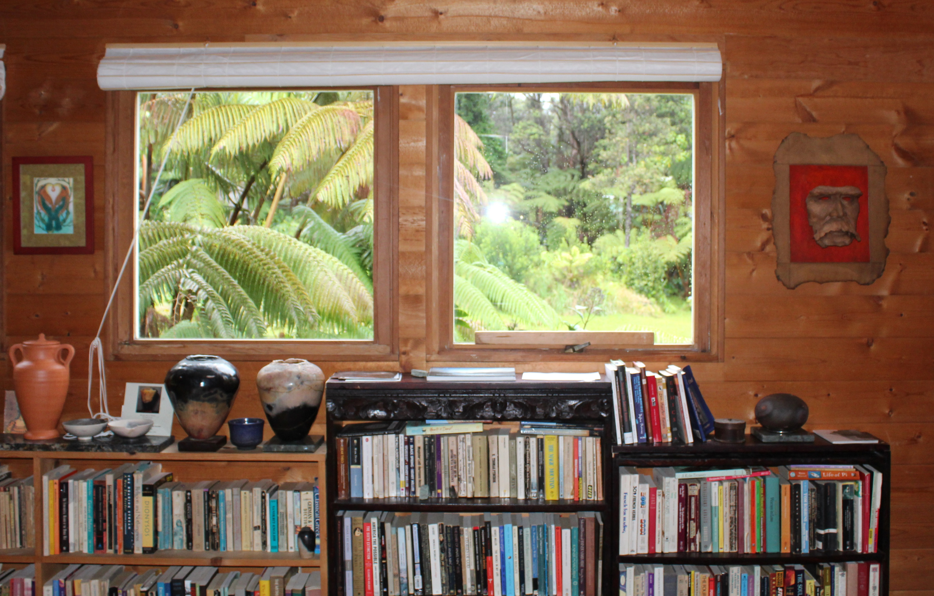
This issue of the relationship between philosophy and art, philosophy and poetry is at the forefront in the contemporary debate in philosophy about the nature of philosophy. Nietzsche challenged Plato and deconstructs these oppositions in his first work, The Birth of Tragedy, when he suggested the high point of Greek culture was not Socrates and Plato, but rather a century earlier, with the poets Aeschylus and Sophocles. He later acknowledged that his first work was an “impossible book” because it set out to be too scientific and reveal the truth about tragedy. He said he should have shaken off the scholar's hood and “sung” rather than “spoken.” In his mature work he attempted to break from the “history of an error” that began with Socrates and Plato. The description of a rhapsody as being “a literary work consisting of miscellaneous or disconnected pieces” could easily be applied to several of Nietzsche's later works that were collections of disconnected aphorisms. The Joyous Science even includes a prelude of poems. Thus Spoke Zarathustra is a rhapsodic narrative.
One of my Nietzsche masks, made while a graduate student in 1985, now hangs in the house built by the rhapsode Albert Saijo.

Slide 18
In the 20th century, Martin Heidegger makes a decisive turn to poetry in his later philosophy. In the famous “Essay Concerning Technology” Heidegger traces the whole problem of our modern Western civilization back to the ancient Greeks – to a way of being-in-the-world that reduces everything, including human beings, to be a mere resource to be used up, like trees understood only as lumber. Against this, Heidegger suggests that maybe only poetry can save us. Here he points to a different mode of dwelling upon the earth – what he calls “poetic dwelling.”

Slide 19
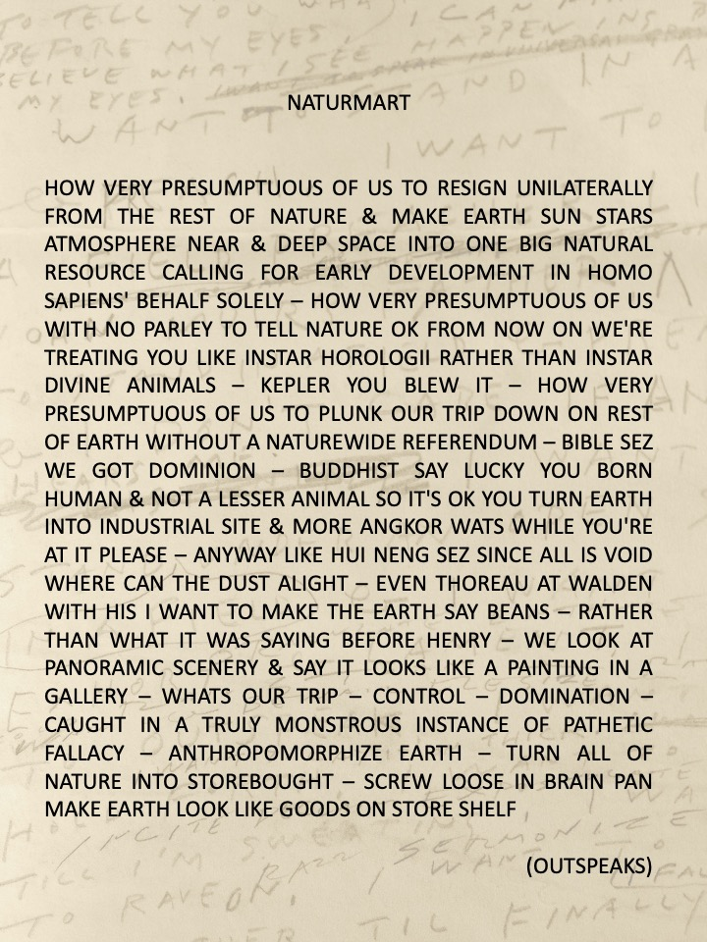
While I might be able to imagine Nietzsche at home with Saijo and the Beats, perhaps on a vigorous hike in the mountains, I cannot quite picture the same with Heidegger.
Nonetheless, Saijo's poem NATURMART certainly seems to resonate with Heidegger's diagnosis of the problem with modern civilization.
Here we also hear a reference to The Platform Sutra, and the famous verse of Hui Neng.

Slide 20
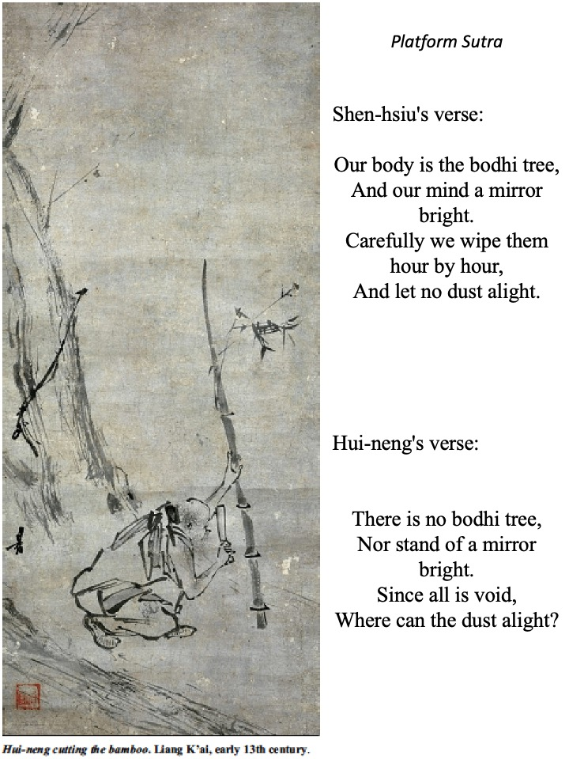
With the reference to Hui-neng one can see the lineage where Saijo's poetry is most closely connected. The Platform Sutra is one of the key texts that the origins of Zen Buddhism can be traced to in China. The sutra tells the story of how Hui-neng became the 6th Patriarch of Chan Buddhism.
Hui-neng was a young illiterate rice pounder in the kitchen of the monastery where the 5th Patriarch was trying to determine his successor. As he knew his days were numbered the Patriarch gave the monks the challenge of writing a brief verse expressing enlightenment. All of the monks but the head monk didn't even dare taking on the challenge as they assumed the head monk, Shen-hsiu, would surely be the next Patriarch. Shen-hsiu, for his part, struggled mightily with the assignment, and finally secretly writes his verse on a courtyard wall in the middle of the night. His strategy was to own up to it only if the Patriarch thought it worthy. The next day the Patriarch sees the verse and orders the monks to pay homage to it. Shen-hsiu steps forward to claim his reward only to be told by the Patriarch that he really doesn't get it.
Meanwhile, the whole story gets around eventually to the kitchen and Hui-neng asks to be taken to the courtyard to see the verse. Since he is illiterate he has to get someone to read it for him. He thinks for a moment and then says he has a verse, and being illiterate, he asks his friend to write it on a wall for him. The next day the Patriarch sees the verse and passes on the lineage to Hui-neng.
So what was the difference between the verses? Shen-hsiu's verse expresses a view that would have been entirely consistent with an understanding of the mind and the process of meditation in much of the history of early Buddhism. Hui-neng's verse, however, gets the main point of the Heart Sutra, perhaps the most important of the Prajñāpāramitā Sutras that are the starting point of Mahāyāna Buddhism in India

Slide 21
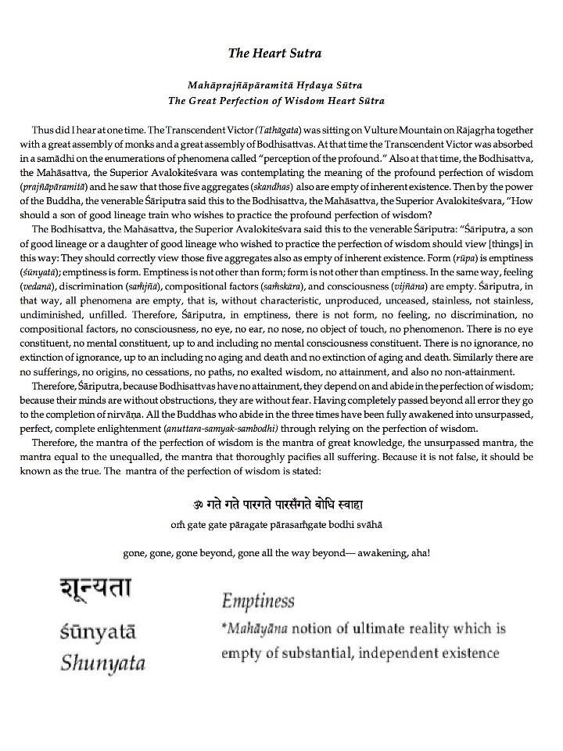
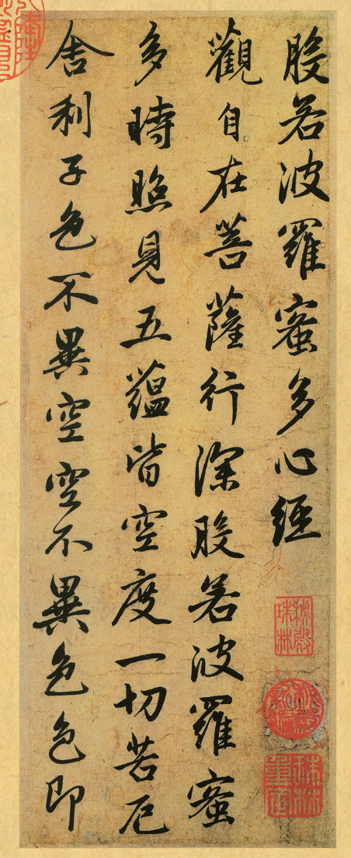
There is no bodhi tree,
Nor stand of a mirror bright.
Since all is void,
Where can the dust alight?
The point of The Heart Sutra was the teaching of emptiness, or Śūnyatā in the original Sanskrit. I'll come back to this later as Saijo takes up the Heart Sutra in one of his poems. For now I just want to note that it was this kind of brief verse in this Chinese text that influenced Japanese poetry. From what I understand it was Saijo who introduced haiku to the Beats. Trip Trap (1972) is a collection of haiku by Saijo, Keroauc and Lew Welch written during their famous trip across country to New York. This form of poetry can be traced back in Japan to Bashō in the 17th century, but further back to China and these verses from The Platform Sutra.

Slide 22
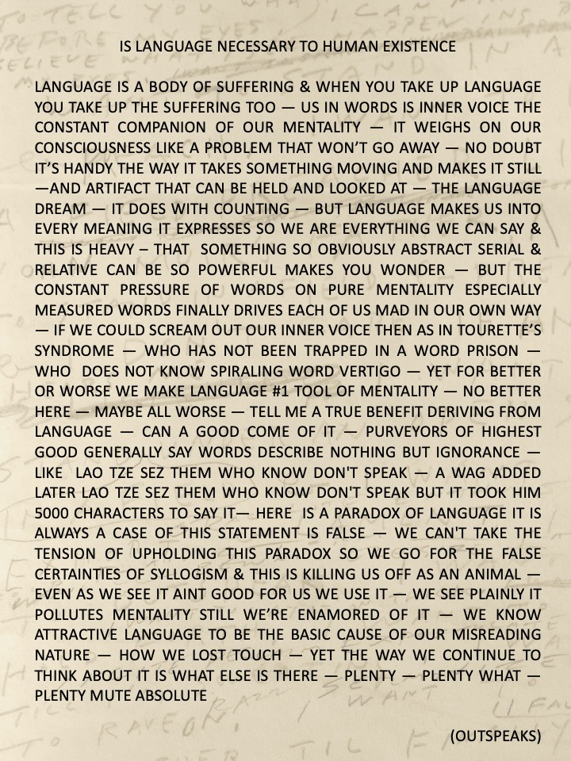
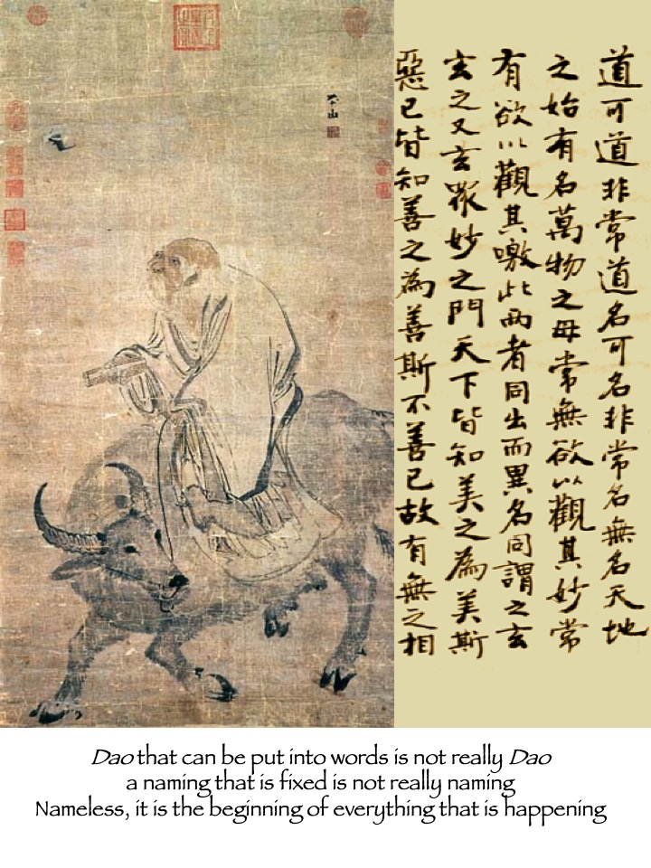
One might even go further back and trace it to the origins of Daoism in ancient China. The distinctive character of the Chan/Zen school of Buddhism in China and Japan is its melding together of elements from Mahāyāna Buddhism and Daoism.
The famous opening line of the Daodejing raises the fundamental question about language, the difficulty of expressing something about the Dao at all in words.
Saijo reflects on this problem with language in this poem.

Slide 23
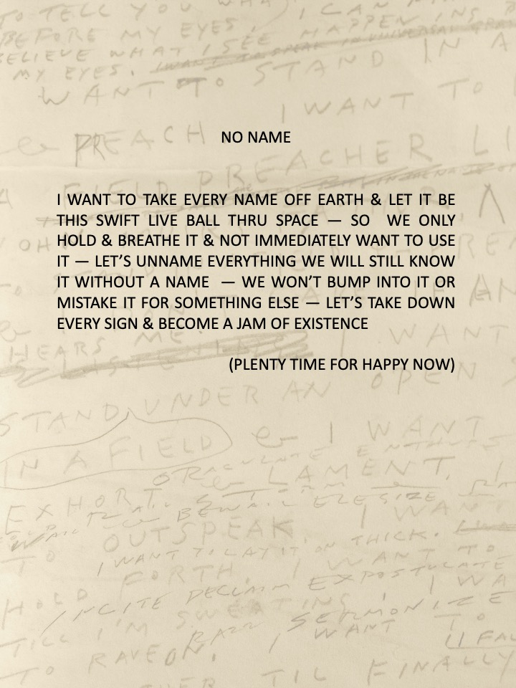
無名 Wuming
Confucius had placed a great emphasis on the proper naming of things, while Laozi emphasizes the nameless (Wuming).
Saijo's poem No NAME shows his affinity with Laozi.

Slide 24
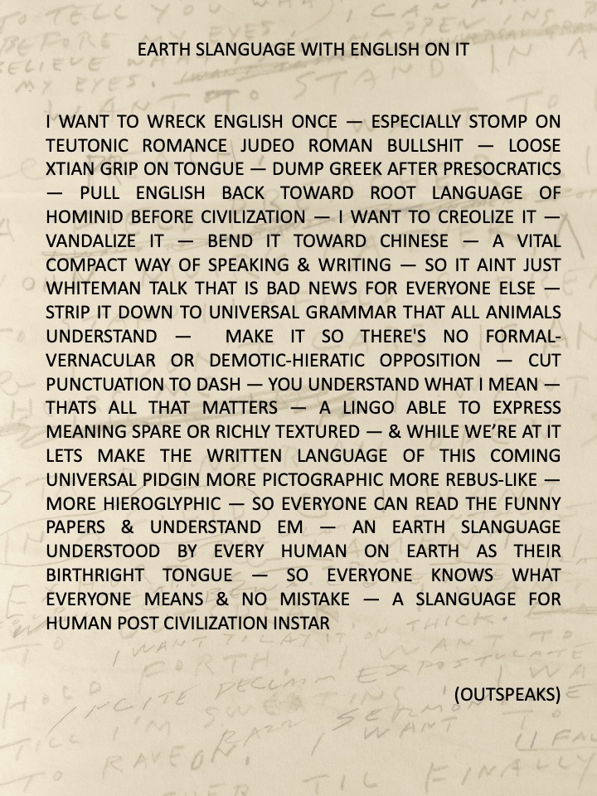
This affinity with Laozi leads Saijo to challenge the English language and write the way that he does.

Slide 25
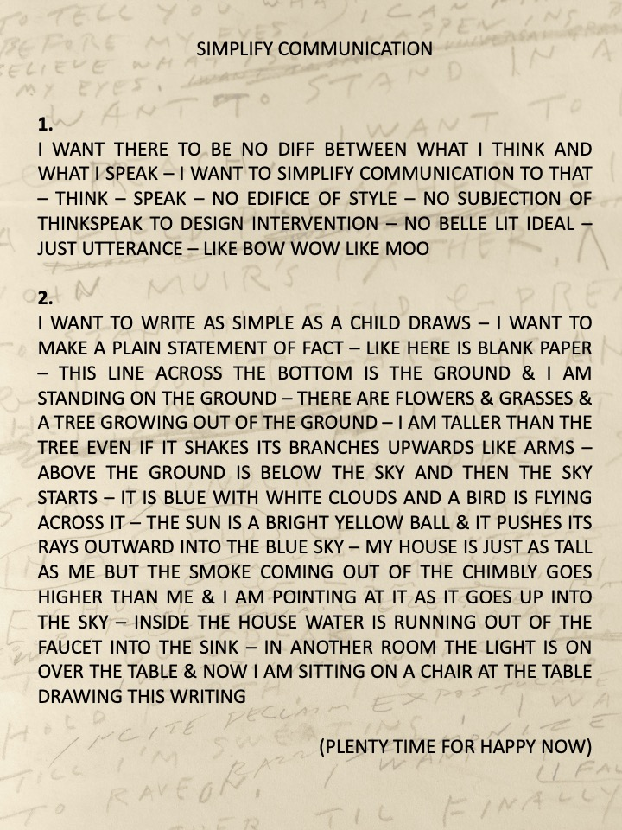
In writng in capitals and reducing punctuation to a dash, Saijo seeks a more simplified, spontaneous, child-like communication.
He attempts to bend English toward Chinese in writing in a way that is like drawing.

Slide 26
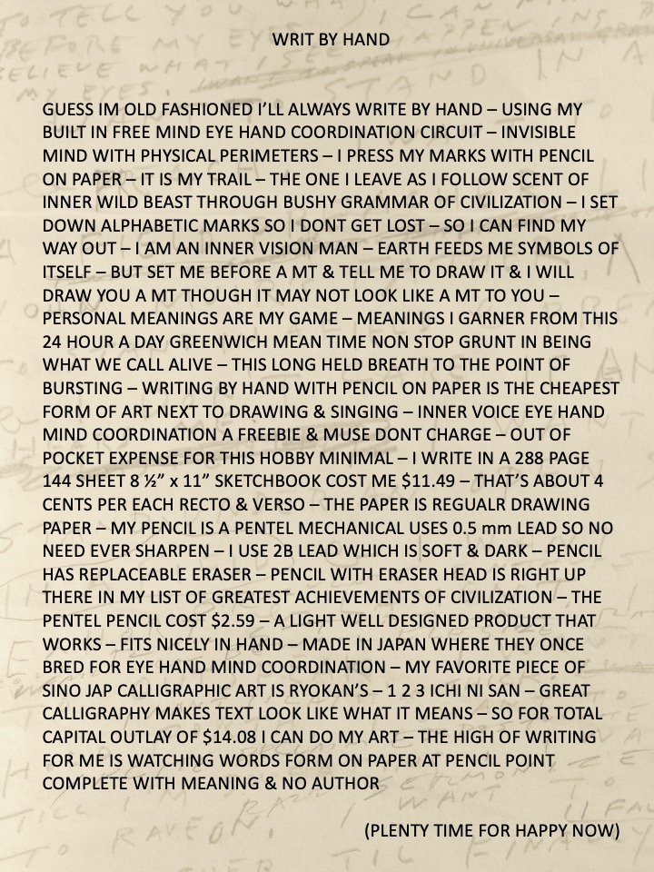
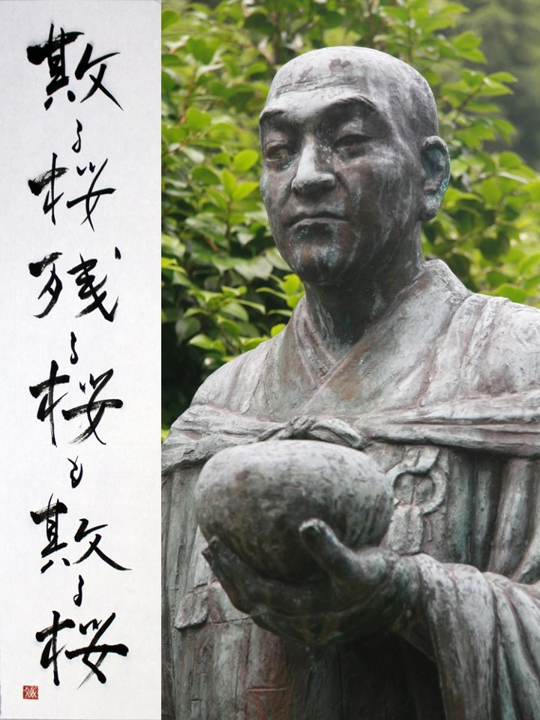
LOOK LIKE WHAT IT MEANS
The connection between writing and drawing is what leads to the line that was taken for the title of the art exhibition honoring Saijo's work.
Great calligraphy, like Ryōkan's 1 2 3, makes text looks like what it means.
It seems that Saijo was perhaps quite like Ryōkan, the late 18th and early 19th century eccentric Sōtō Zen Buddhist monk famous for his poetry and calligraphy. Like Ryōkan's, Saijo's poetry is often very simple and inspired by nature.

Slide 27
When I sit here throughout the day I hear not only the song of the apapane, but also a little percussive popping—from the metal roof and the wood interior expanding and contracting as the temperature changes. As the metal and the wood pop in different tones, it’s a kind of musical accompaniment to the chorus of apapane. Sometimes it breaks out
like jazz
and I realize that Albert made a house
that sings.

Slide 28
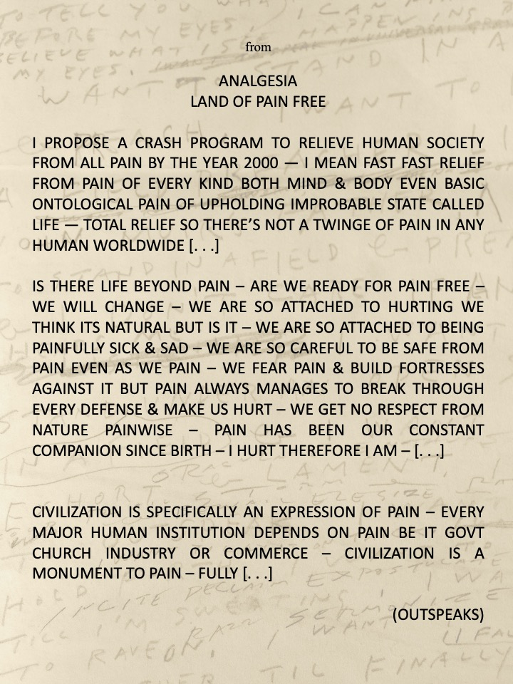
Saijo's poetry turns often to basic teachings of Buddhism in addressing the problems in the world today. This poem might be said to be a statement of the Buddha's first noble truth.

Slide 29
It is a strange incongruity—sitting here in this amazing place, listening to the music of the apapane and the house, and thinking about all the pain and suffering that so many are now experiencing as a result of the coronavirus.
Is there life beyond pain?
Are we ready for it,
Are we ready for pain free?

Slide 30
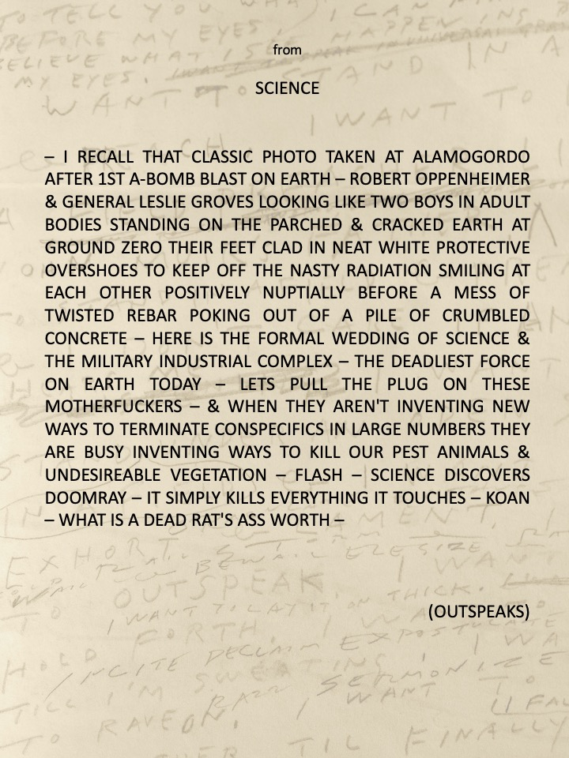
Many of Saijo's poems rage against the madness of our civilization and its tendency to perpetuate pain and suffering.

Slide 31
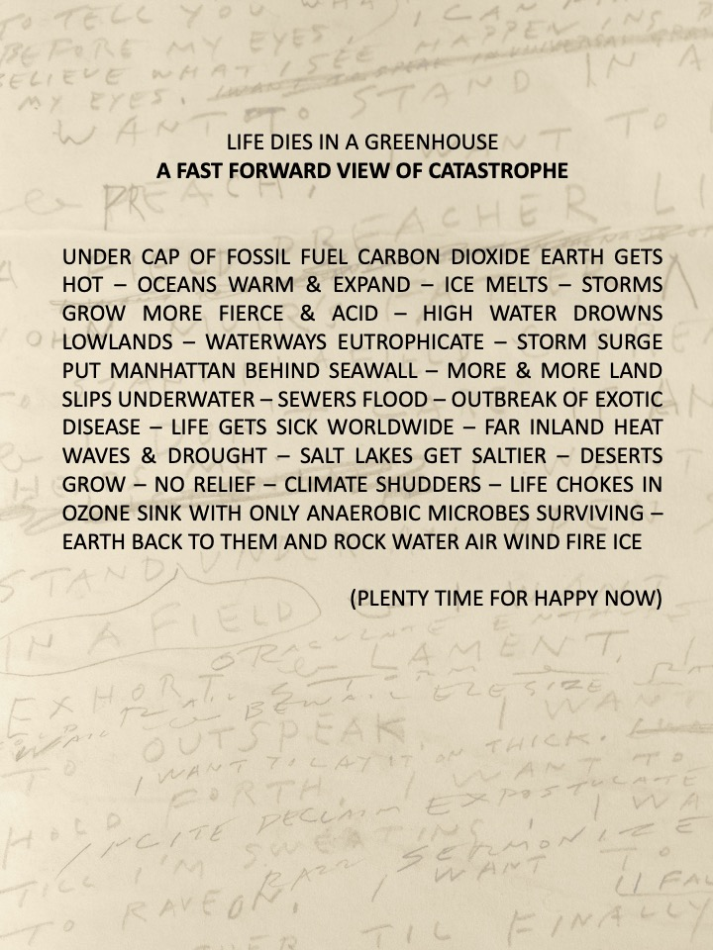
LIFE DIES IN A GREENHOUSE
This poem calls attention to the real potential for the extinction of all life on earth
due to anthropogenic climate change.

Slide 32
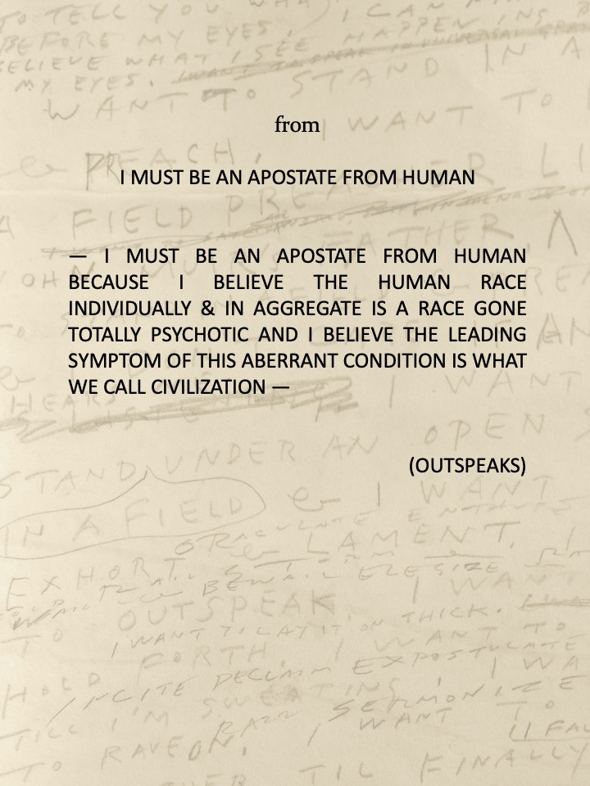
An indictment of humanity for having gone totally psychotic:

Slide 33
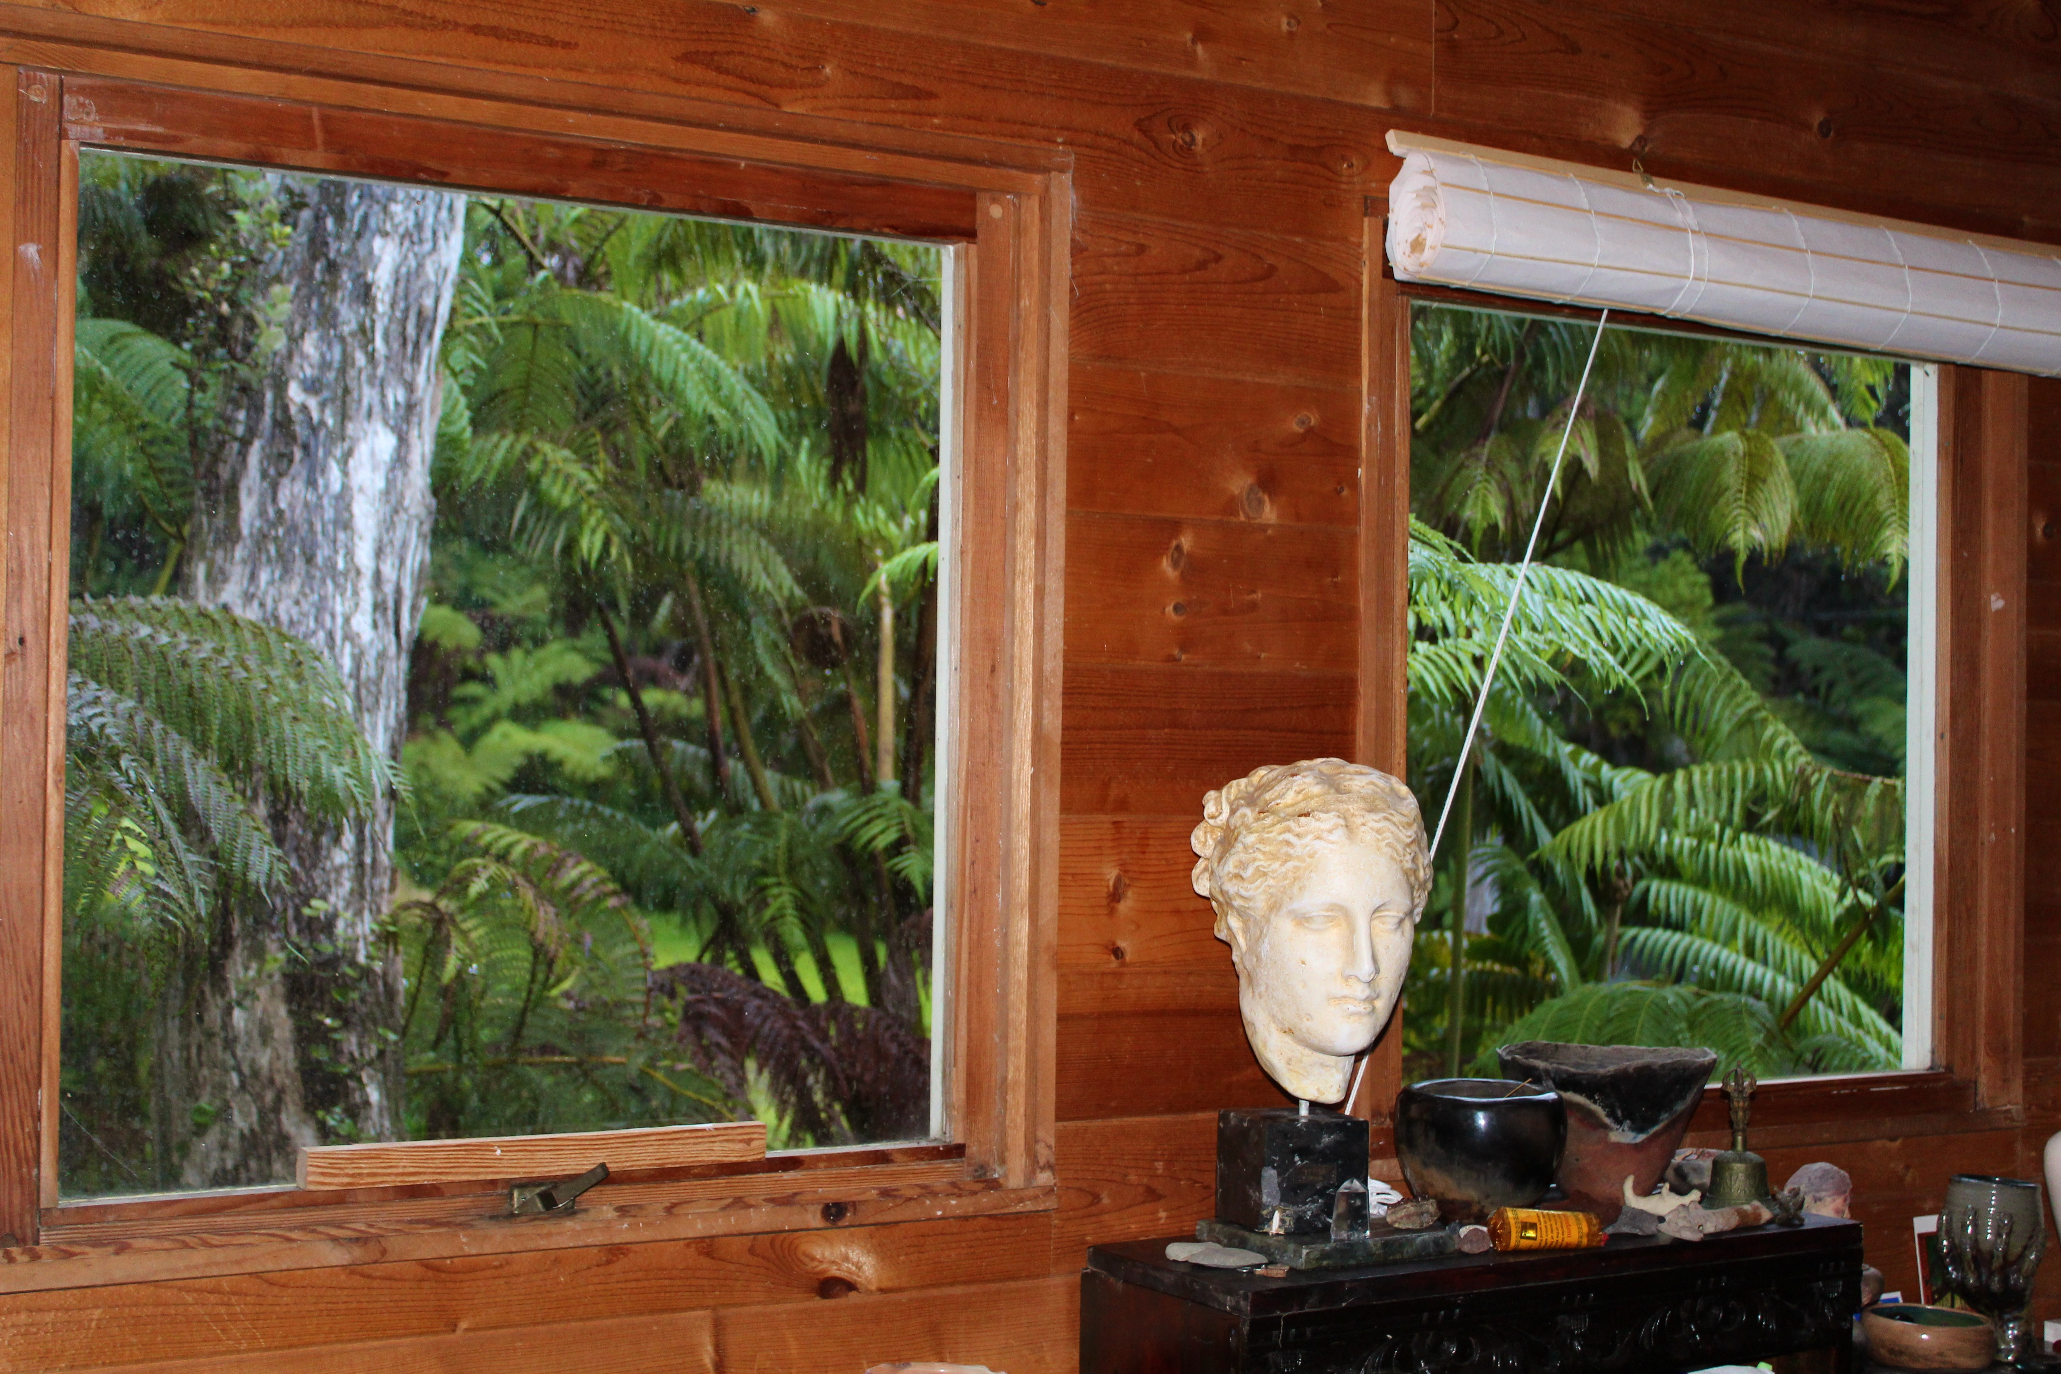
A replica of a famous Greek sculpture of Hygieia,
the goddess of healing, looks on beside
my desk as I write.
Are we ready for healing?
Are we ready for pain free?

Slide 34
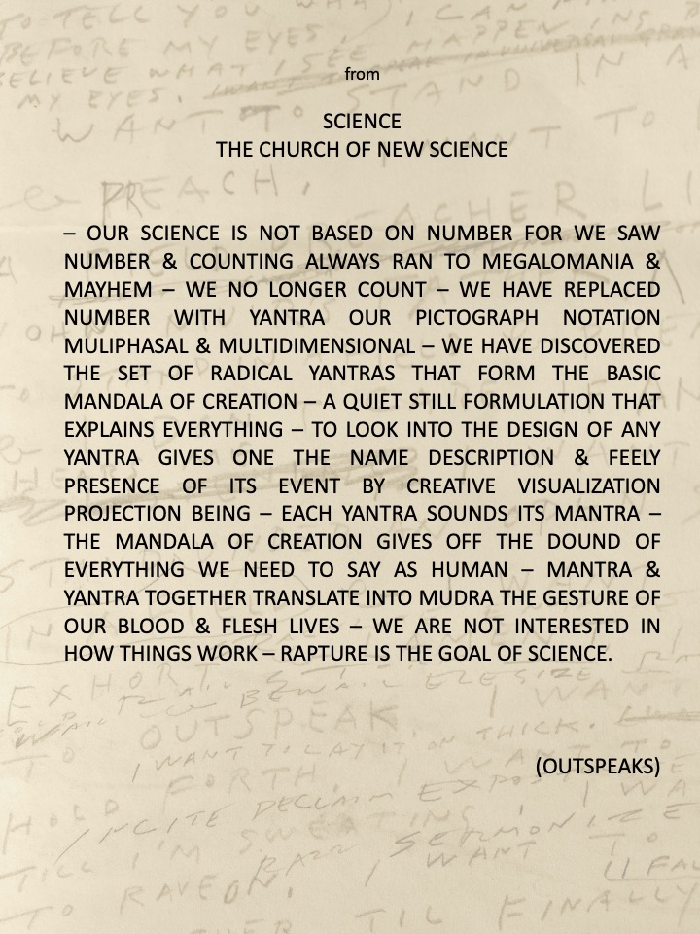
Against the madness of our civilization brought on by a way of thinking that reduces all of nature to a mere resource and by a science that has become mostly a means of calculation in the service of this need, Saijo suggests a different kind of science, something more like Buddhist Tantric art.

Slide 35
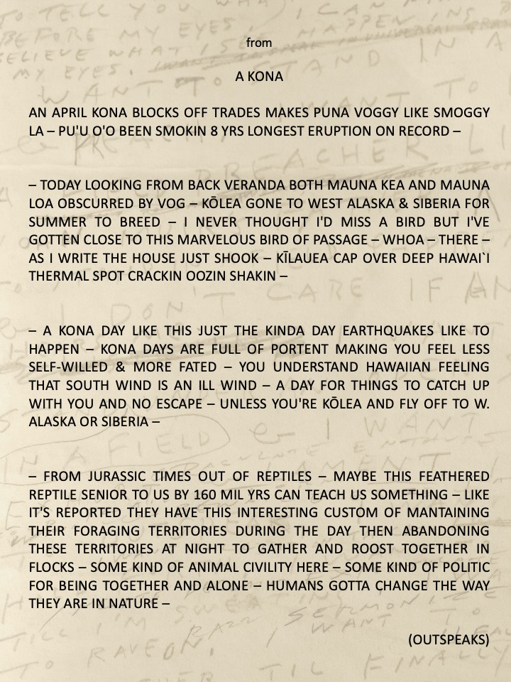
HUMANS GOTTA CHANGE
THE WAY THEY ARE IN NATURE
Saij's poems also frequently turn to his immediate experience living here near the summit of Kīlauea. We can all relate to what he says here about the vog and an experience of a little earthquake. Yet he turns his reflection toward what we might learn from the Kōlea birds, a kind of animal civility more civil than human civilization.

Slide 36
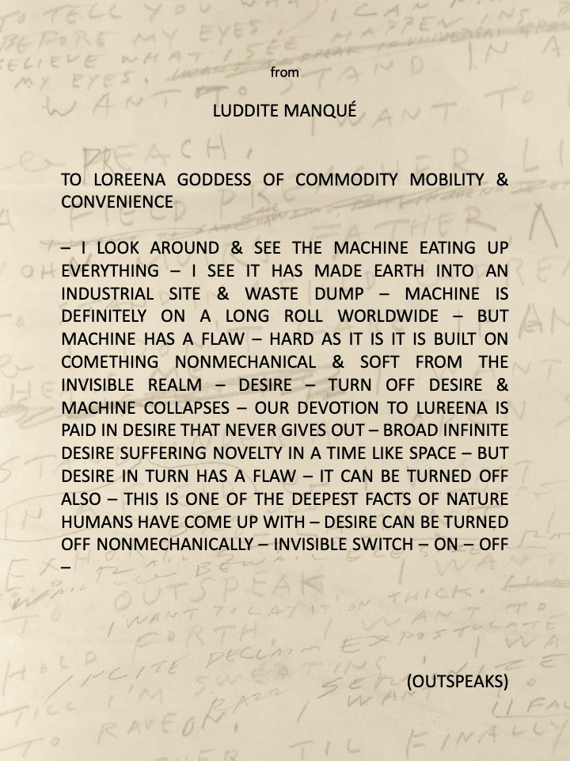
HUMANS GOTTA CHANGE
THE WAY THEY ARE IN NATURE
One of Saijo's main themes is that we need to find a different way of dwelling in nature.
In this poem he offers what might be the key to that change. The poem might be said to state the 2nd and 3rd noble truths of the Buddha.
If the 1st truth is the problem of pain and suffering, the sickness of the machine eating up everything, the 2nd truth is the diagnosis of the cause of this pain and the sickness of modern civilization – and that is desire.
The 3rd noble truth is the prognosis, and the Buddha's teaching was that there is a cure to this condition, and that is to turn off desire.

Slide 37
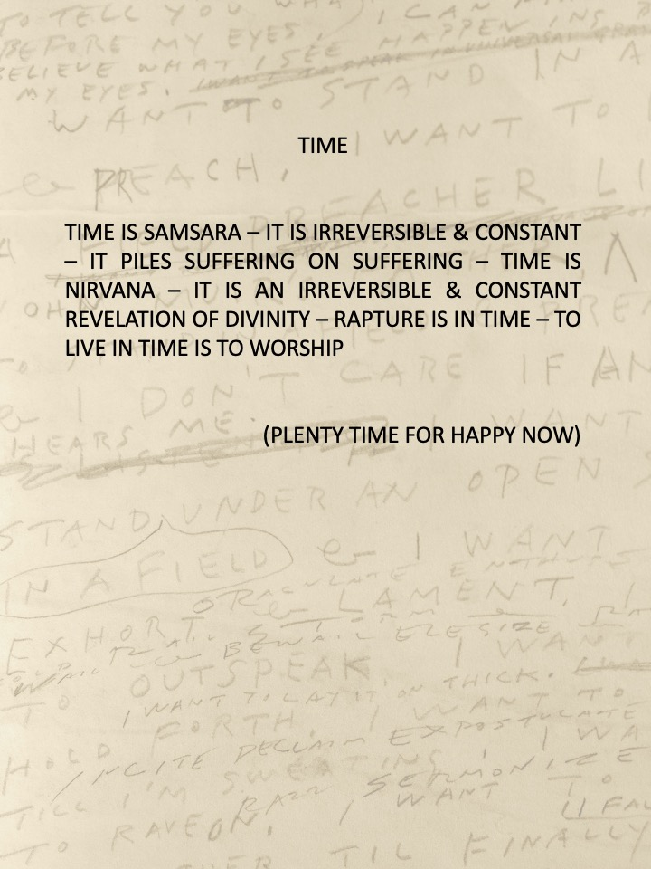
One of the most discussed Buddhist teachings is the statement that was surely shocking at the time when it was written, by the 2nd century C.E. Indian philosopher Nāgārjuna, that there is fundamentally no difference between samsara and nirvana.
Saijo offers here the insight here that samsara and nirvana are just two different ways of being here and living in time.

Slide 38
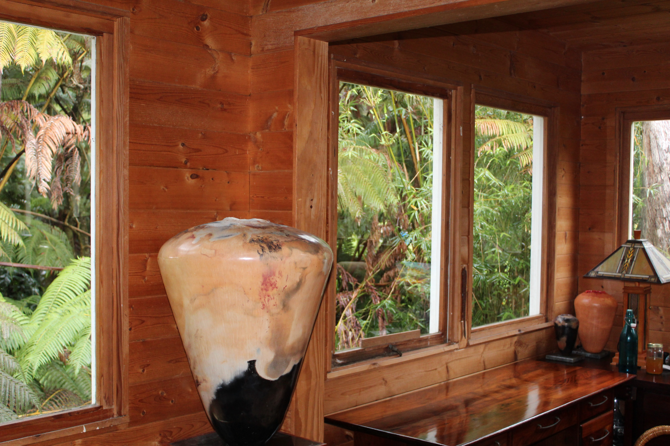
These pit-fired ceramic vessels are made from a deep sense of gratitude for being alive at all on this earth, as perilous as it often is, an attempt to honor that fiery elemental force, perhaps what Hawaiians know as Pele, the volcano goddess whose home is so very close by.

Slide 39
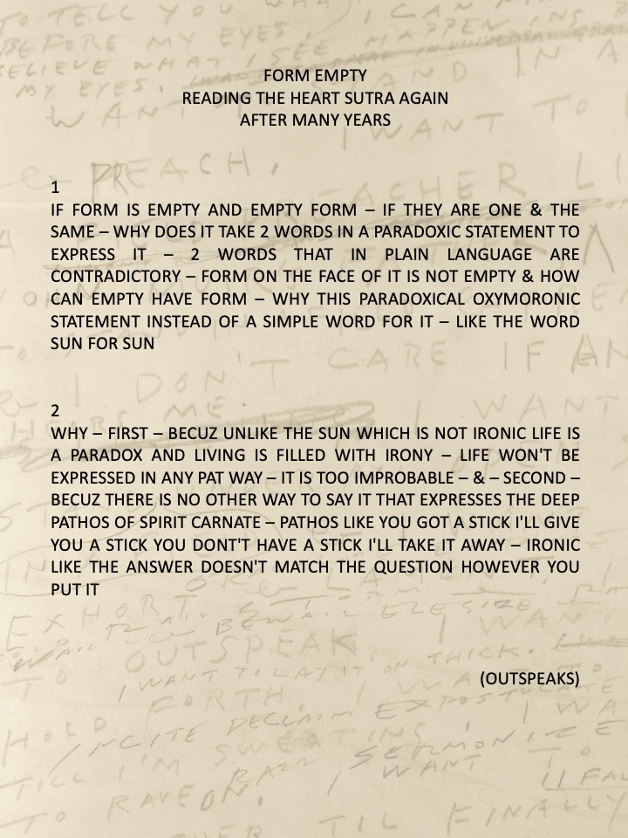
The text where we find Nāgārjuna 's surprising declaration is primarily concerned with explaining the fundamental teaching of The Heart Sutra, the notion of Śūnyatā or emptiness.
The most well-known line of the text is the statement “Form is emptiness; emptiness is form.” Saijo reflects here on this “parodoxical oxymoronic statement.”

Slide 40
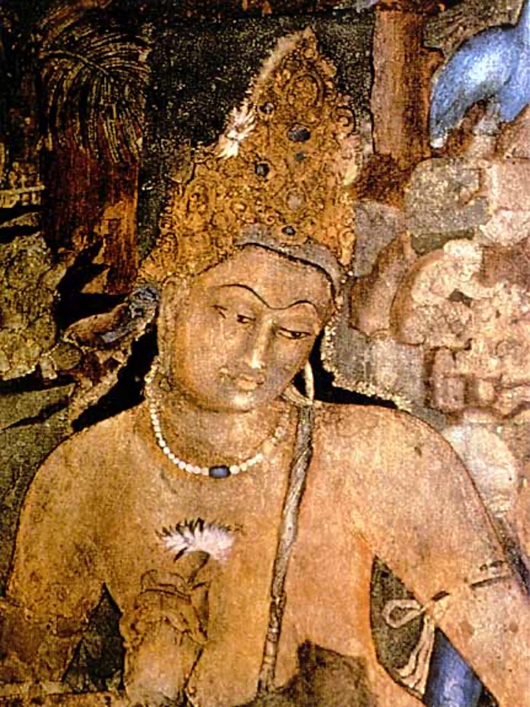
The main point emphasized by The Heart Sutra is that wisdom (prajñā) leads to compassion (karuna). The wisdom of The Heart Sutra is the teaching of Śūnyatā, emptiness. Is it really such a “parodoxical oxymoronic statement” when the Bodhisattva Avalokiteśvara says that “Form is emptiness; emptiness is form”? Sometimes I wonder if the East Asian understanding of this line as paradoxical simply reflects the difference between the Sanskrit and Chinese texts.
When the Bodhisattva initially explains this profound perfection of wisdom that is emptiness, the Sanskrit text clearly says that the “five skandhas (parts of the self) are empty of inherent existence (svābhava), whereas the Chinese text simply says that they are empty.
When the Bodhisattva goes on to explain that “form (rūpa) is emptiness, emptiness is form” he is really talking about the body, as rūpa as the first of the skandhas, is the body. And if one understand this, then the statement is not really paradoxical at all as the body is most obviously empty of inherent or independent existence. If we think about all that we have taken in to produce the body that we have today, all the nourishment, and all that helped produce what we take in, from plants, animals, worms, bees, as well as all the human beings that produced that food, from farmers to cooks, store clerks and waitresses, then we realize the profound teaching of interdependence.

Slide 41
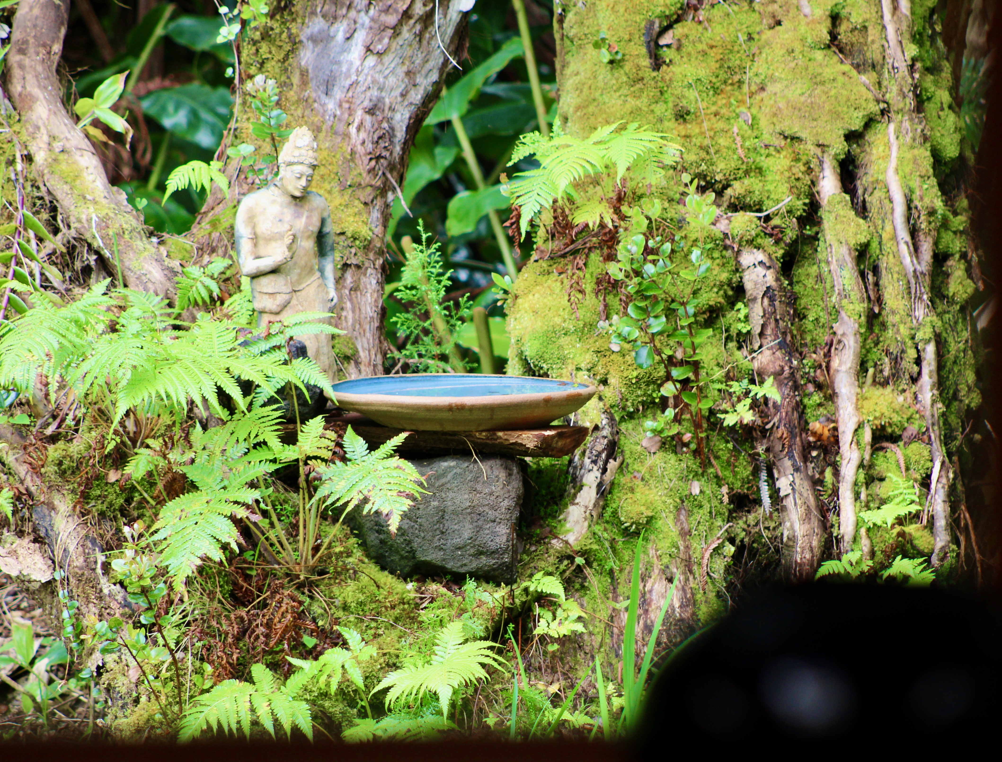
If nothing else, this global crisis brought on by the virus should make clear this Buddhist teaching of interdependence. We really are all in this together. We can no longer ignore that our actions can affect everyone. If we get the wisdom of The Heart Sutra, then compassion should follow.
It should be no surprise then, if one gets this, why the notion of the Bodhisattva is emphasized in The Heart Sutra, for the Bodhisattva is the one who surrenders being concerned only with his/her enlightenment, and is thus the one who vows to come back again to this life again and again as long as there is life in order to help all beings overcome pain and suffering and realize nirvana.

Slide 42
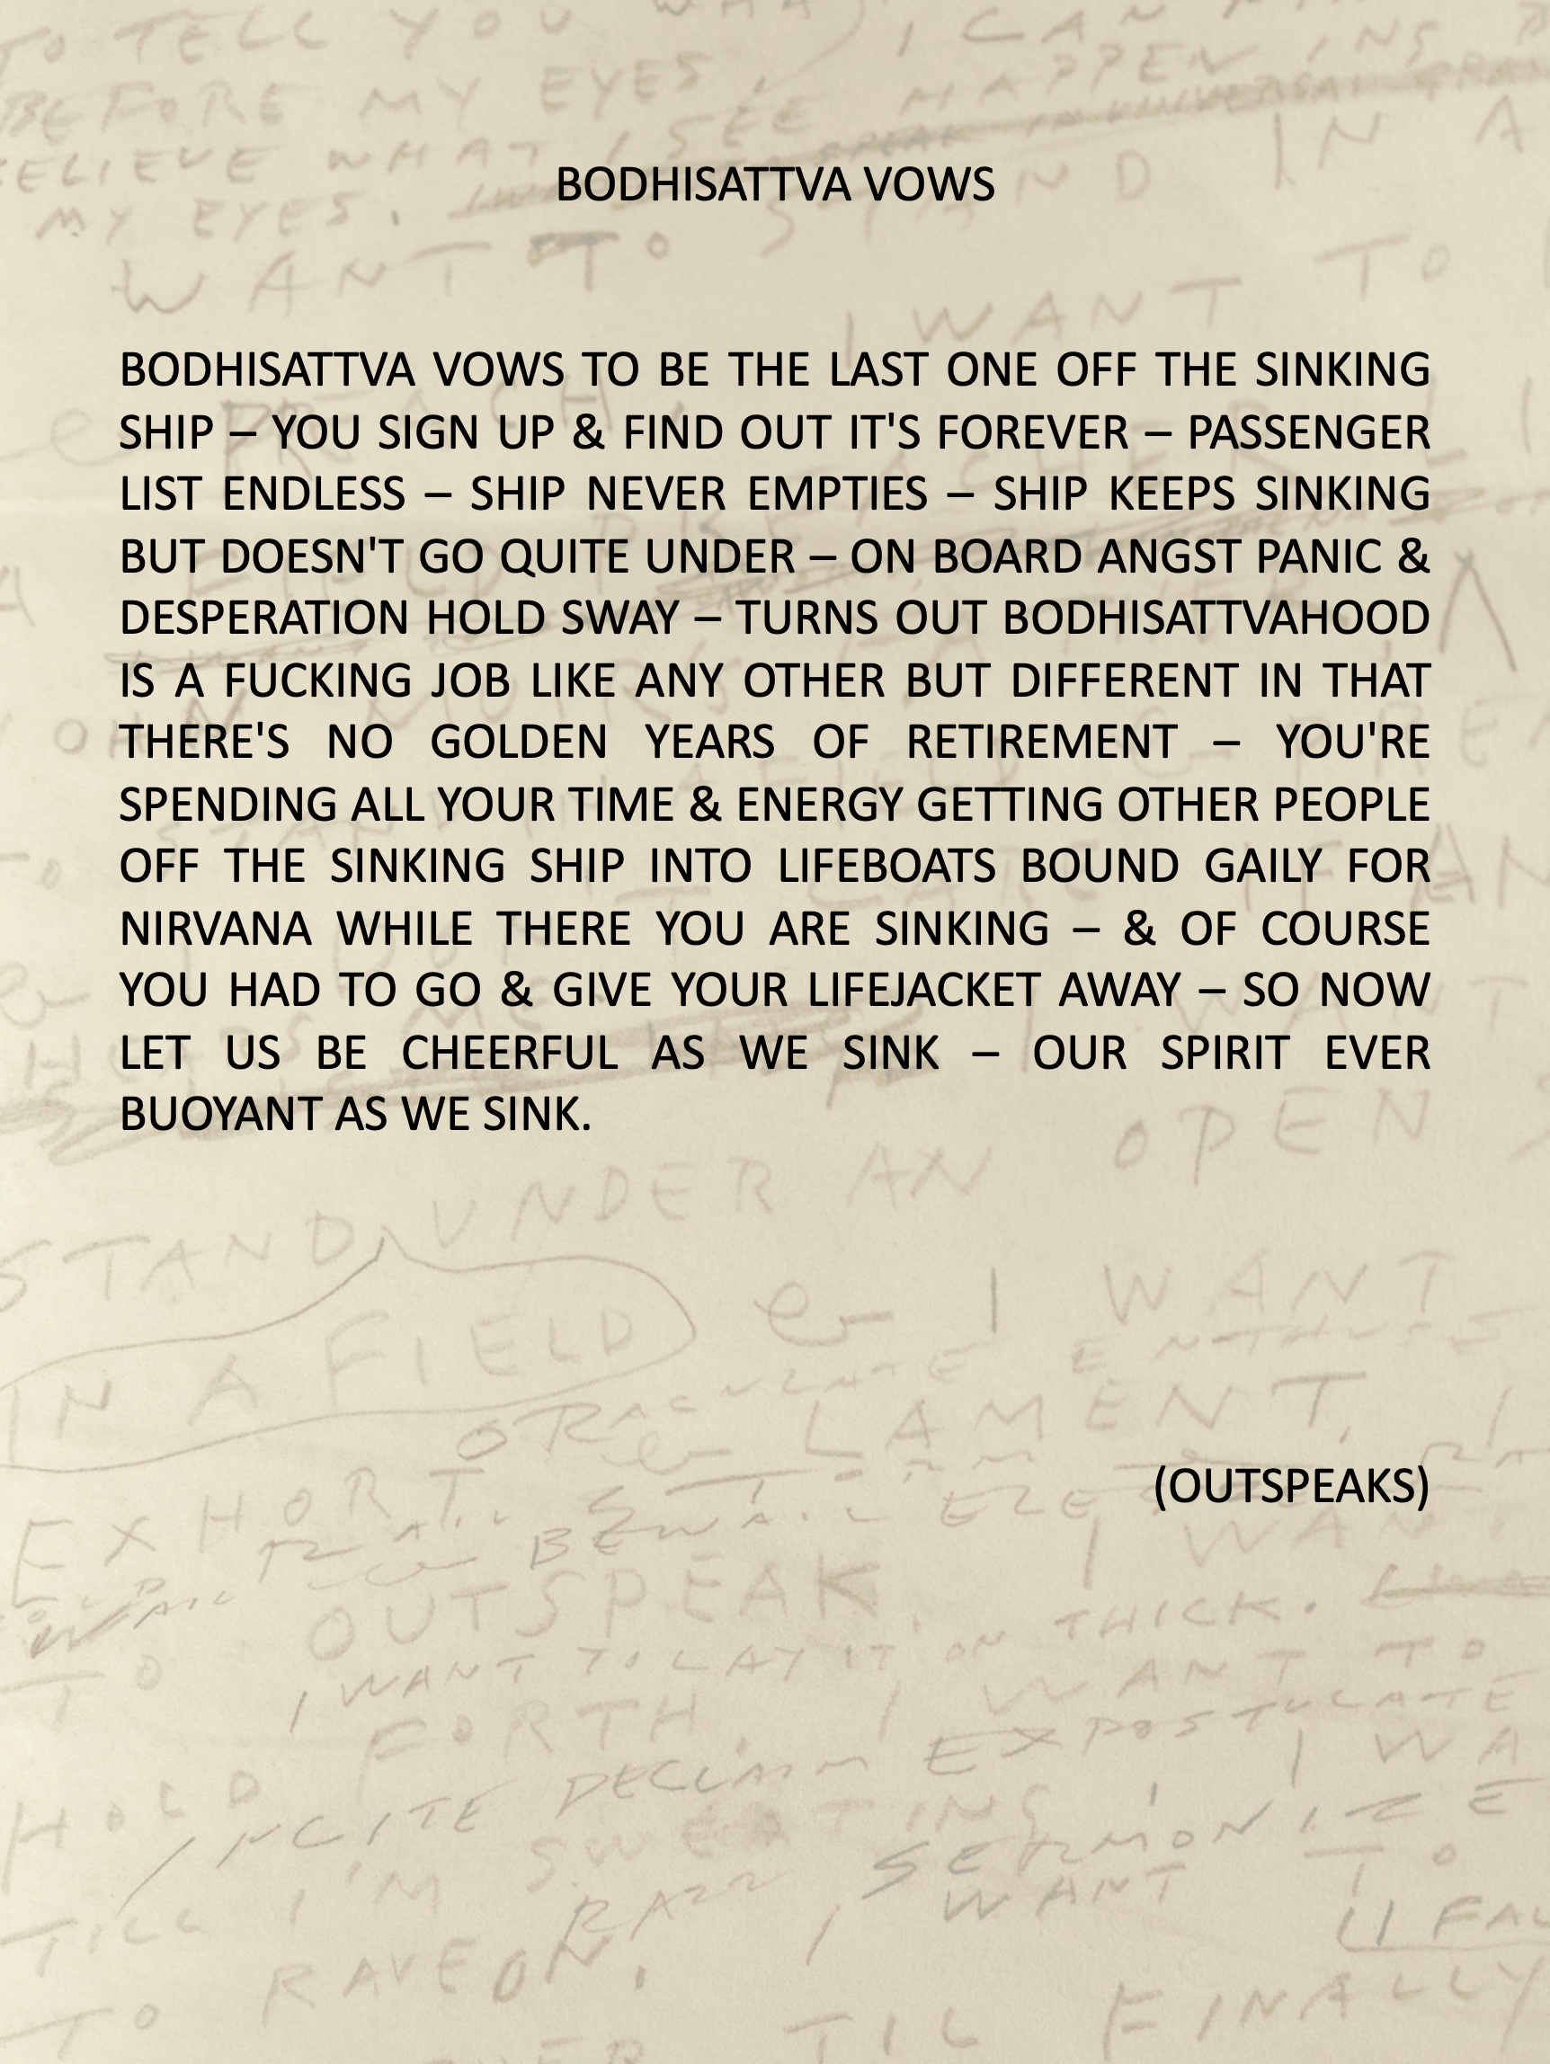
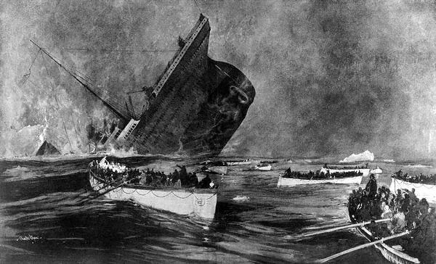
In this poem we find Saijo's reflection on these Bodhisattva vows.
Saijo’s reflection seems perhaps even more relevant today. As bad as the pandemic is, it is still not nearly as threatening as the climate crisis. If we pass the tipping point of climate change, then the mortality rate will be 100%. If we understand this, then it becomes obvious that we are all on the Titanic now, except that there really are no lifeboats to save us. How do we exist in this profound time of worldwide crisis?
To take the Bodhisattva vows we have to be the last one off the sinking ship and remain cheerful to the end, doing our best to help others, even as we sink.

Slide 43
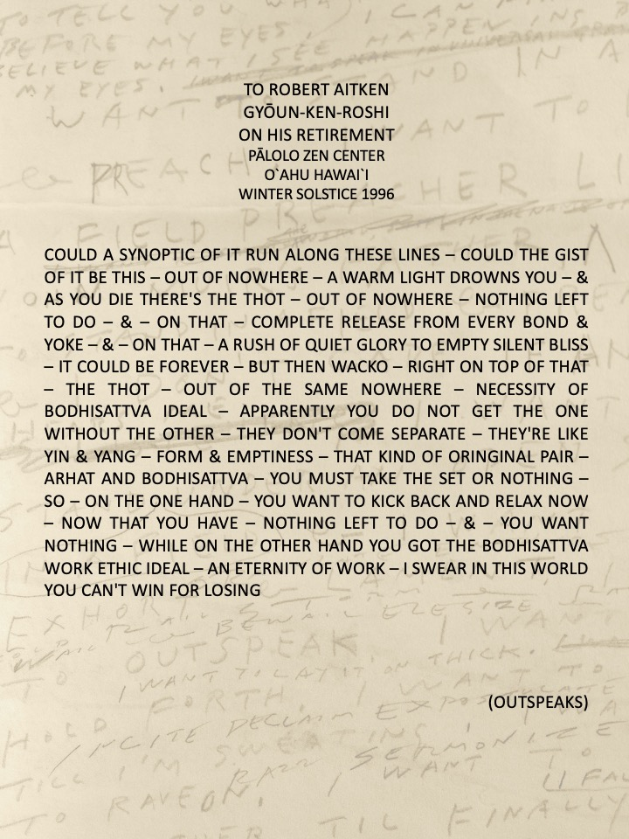
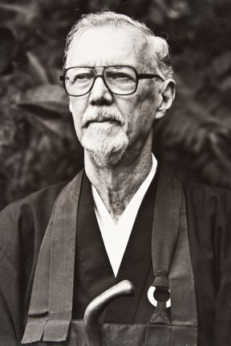
Albert Saijo and Robert Aitken were longtime friends. They had both experienced incarceration during World War II, Aitken as a prisoner of war in a Japanese prison camp, while Saijo was interned by the U.S. government as so many Japanese-Americans had been.

Slide 44
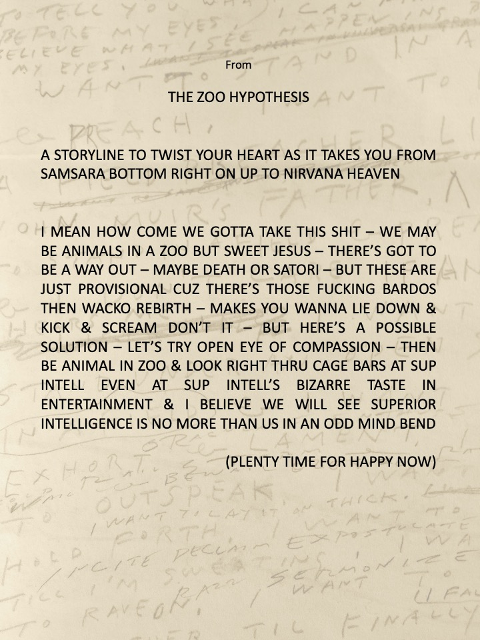
In the end, one might say that Saijo's poetry takes up the Bodhisattva vows. The aim of his poetry is perhaps revealed in this poem. Let’s try to open the eye of compassion.

