Slide 1
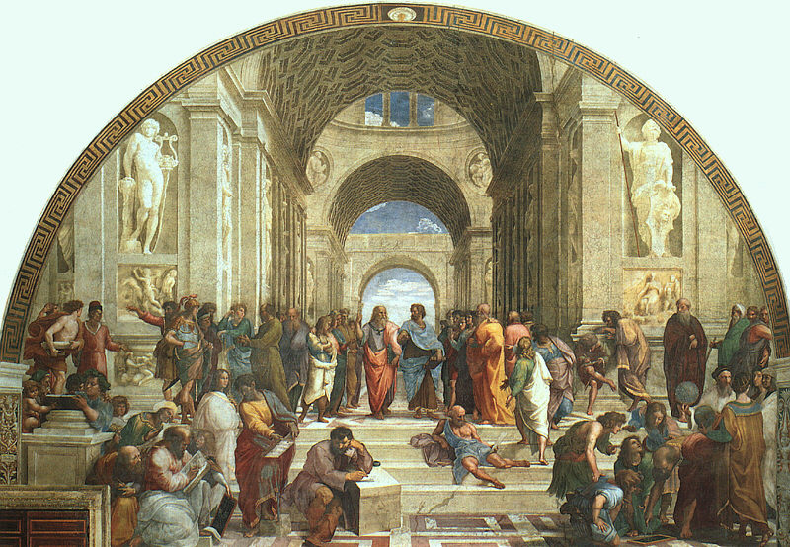
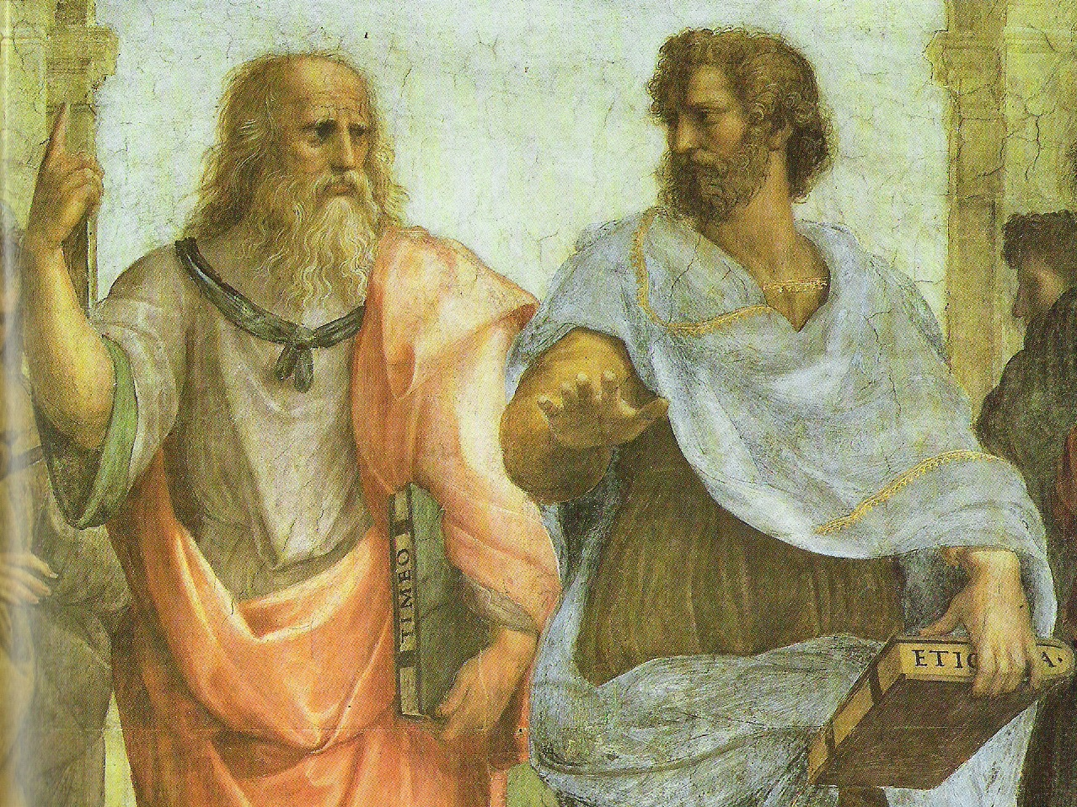
Plato’s Philosophy
The School of Athens, fresco, Raphael, 1509-11
Apostolic Palace, Vatican City
Plato’s philosophy is suggested in the famous Renaissance painting, The School of Athens. Plato is pictured in the center, standing next to his pupil Aristotle. Plato points upward, signifying that the real world is the upper world, not the visible world we know through the senses, but the intelligible world of the Forms or Ideas, knowable only through pure reason.

Slide 2
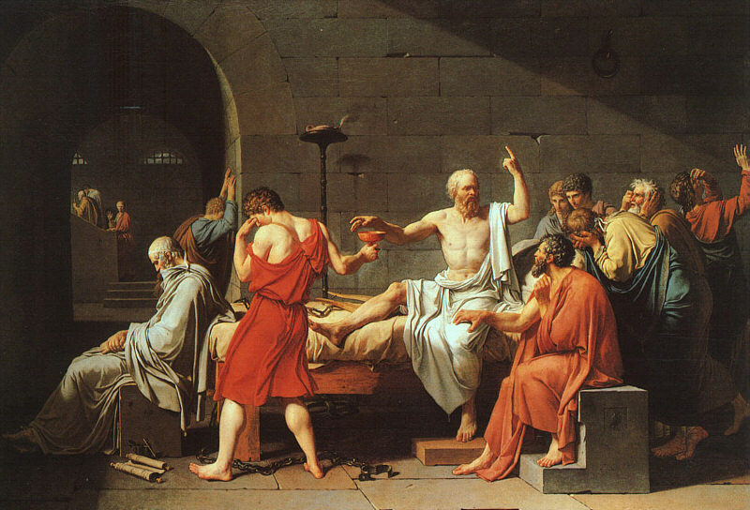
Plato’s philosophy is also suggested in this painting, The Death of Socrates. Like Plato in The School of Athens, Socrates is pointing upward, to the real world. He is also calm and composed in the face of death, while all of his friends are overcome with emotion.
The Death of Socrates, oil on canvas, Jacques Louis David, 1787.
The Metropolitican Museum of Art, New York

Slide 3
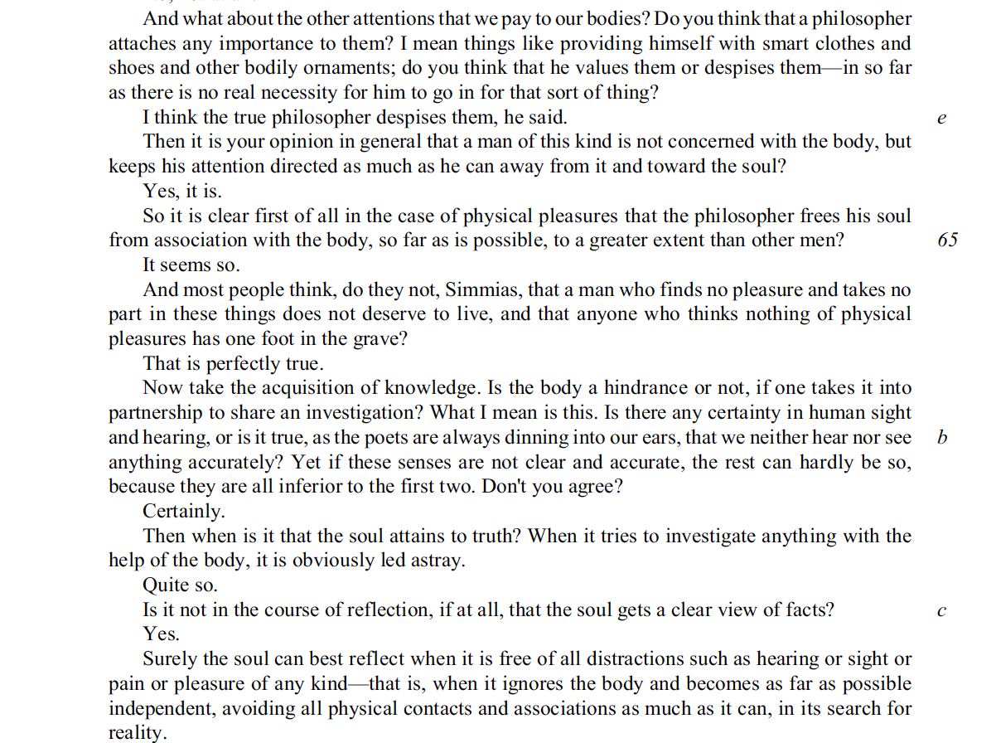
Plato’s Epistemology: Rationalism
Plato’s epistemology, or theory of knowledge, is Rationalism, the view that knowledge comes not from the senses but from pure thinking, reason.
Plato, The Phaedo, 64e-65c

Slide 4
Plato’s Philosophy
Appearance
(The Visible World)
The Dreamworld
Particular things
Changing
Senses
The body
Lies, illusion, fiction
Art
Writing
Painting
Woman
Reality
(The Intelligible World)
Waking Reality
Universal Forms or Ideas
Unchanging
Pure Reason
The soul
Truth
Philosophy
Speech
Logos
Man

Slide 5
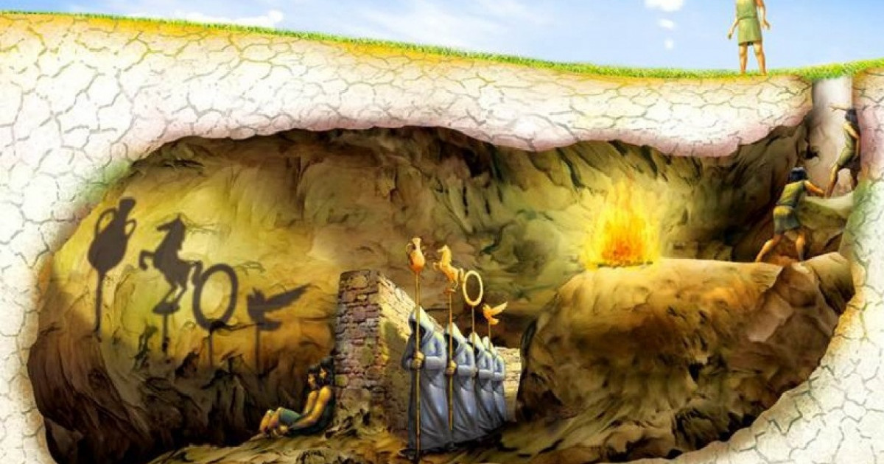
Plato’s Philosophy in the Myth of the Cave
Appearance (The Visible World)
Images of things / Particular sensible things
Shadows on the wall / objects casting the shadows
painting of a bed / bed you sleep on
Imagination / Sensation
Reality (The Intelligible World)
Lower Forms / Higher Forms
Forms of things like beds / Forms of beauty, justice
Thought / Understanding

Slide 6
True Justice
Justice A
Justice B
Justice C
Justice D
Justice E
Is there a universal truth of Justice or is “man the measure of all things”?

