Slide 1
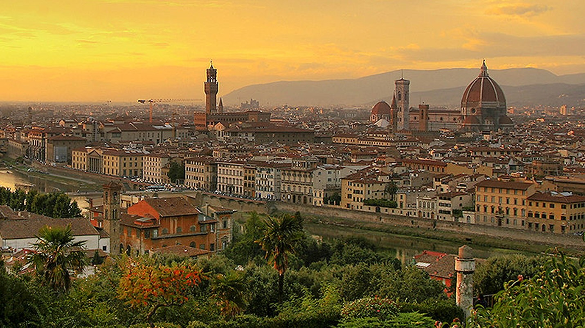
The Renaissance
Florence, the birthplace of the Rinascimento in the early 14th century

Slide 2
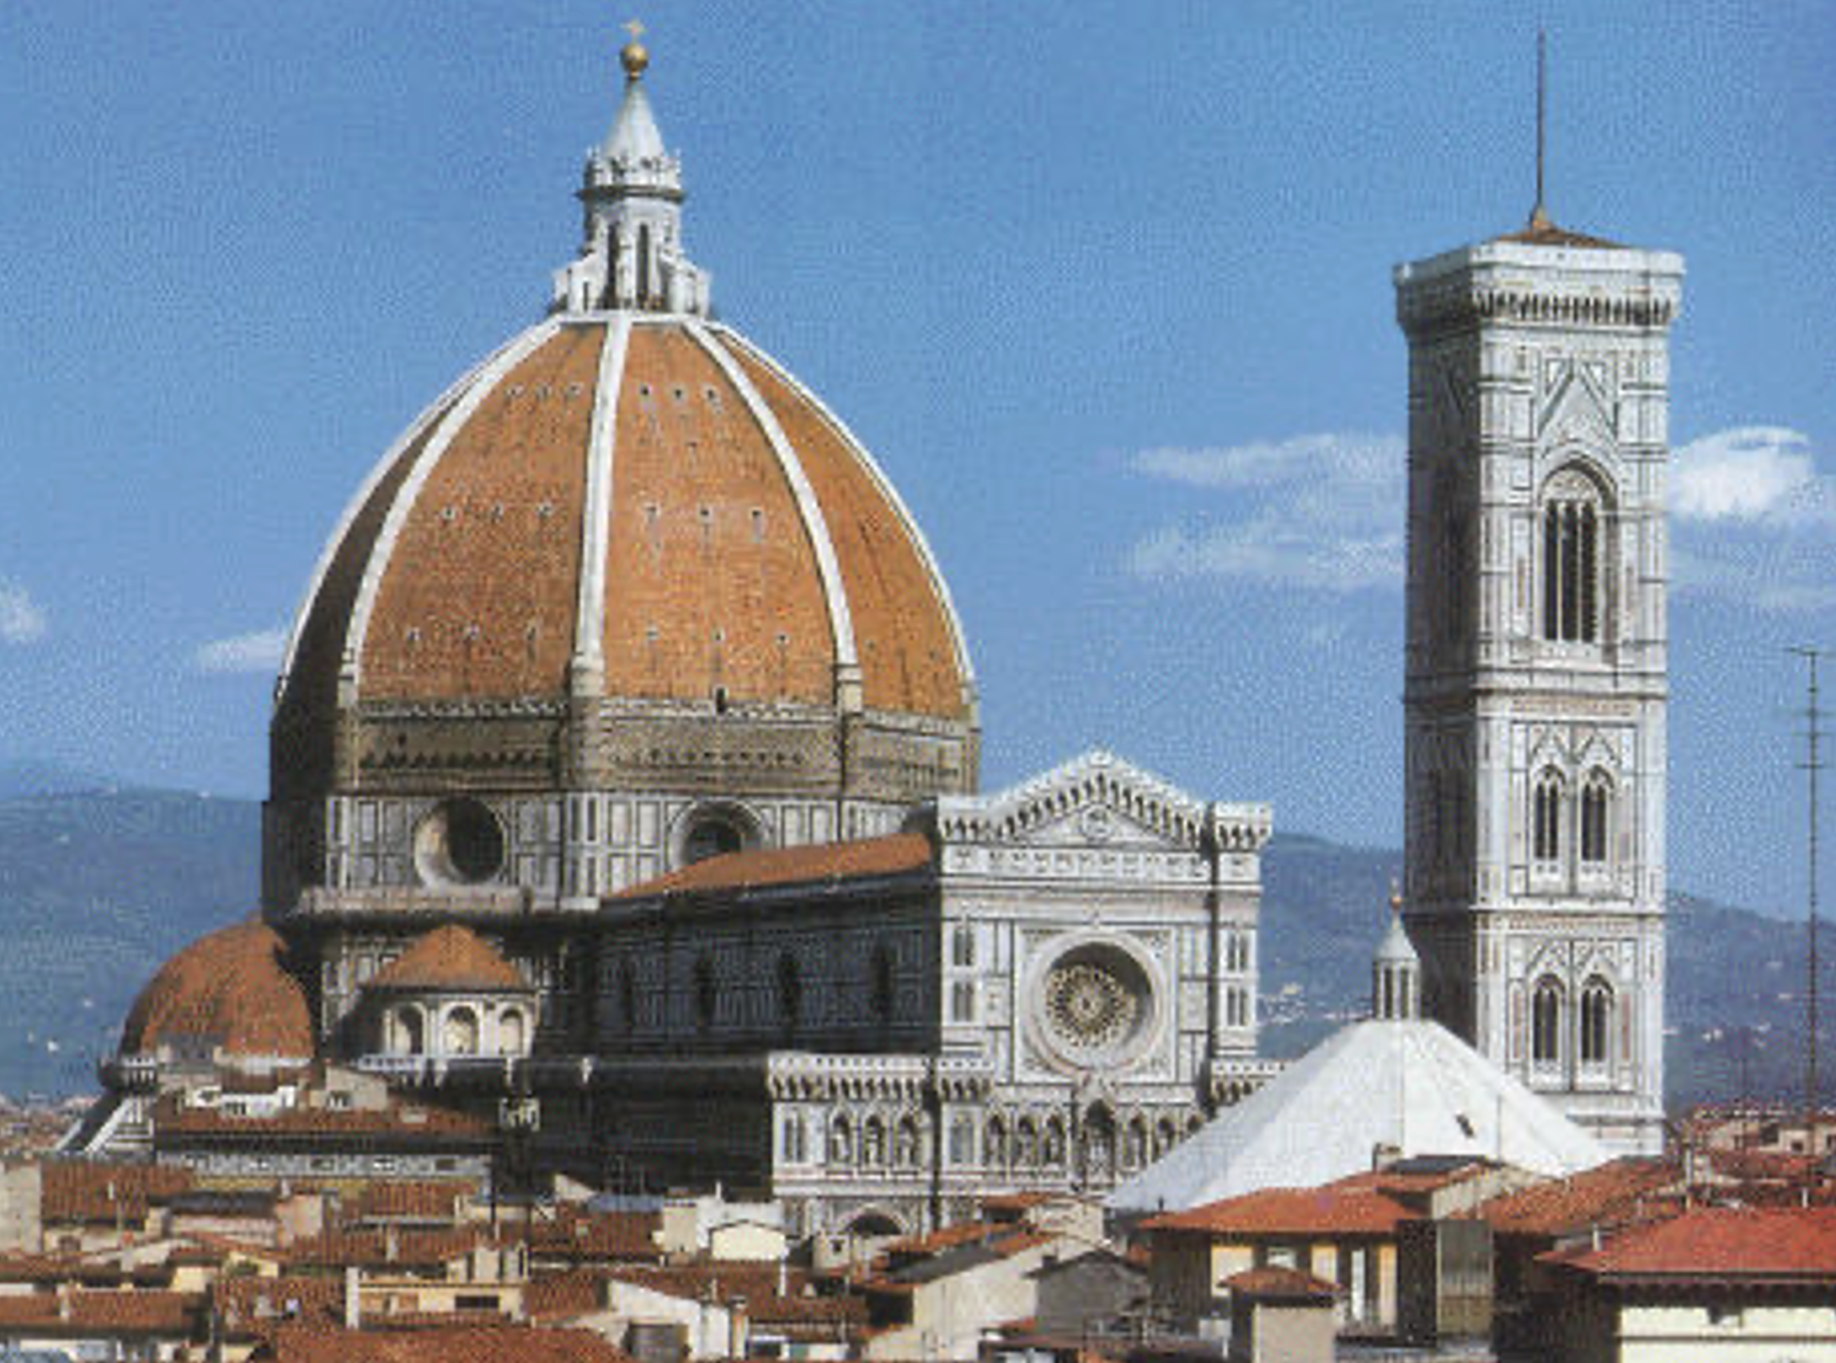
1296: Work begun on the Florence Cathedral
Basilica di Santa Maria del Fiore, 1296-1496

Slide 3
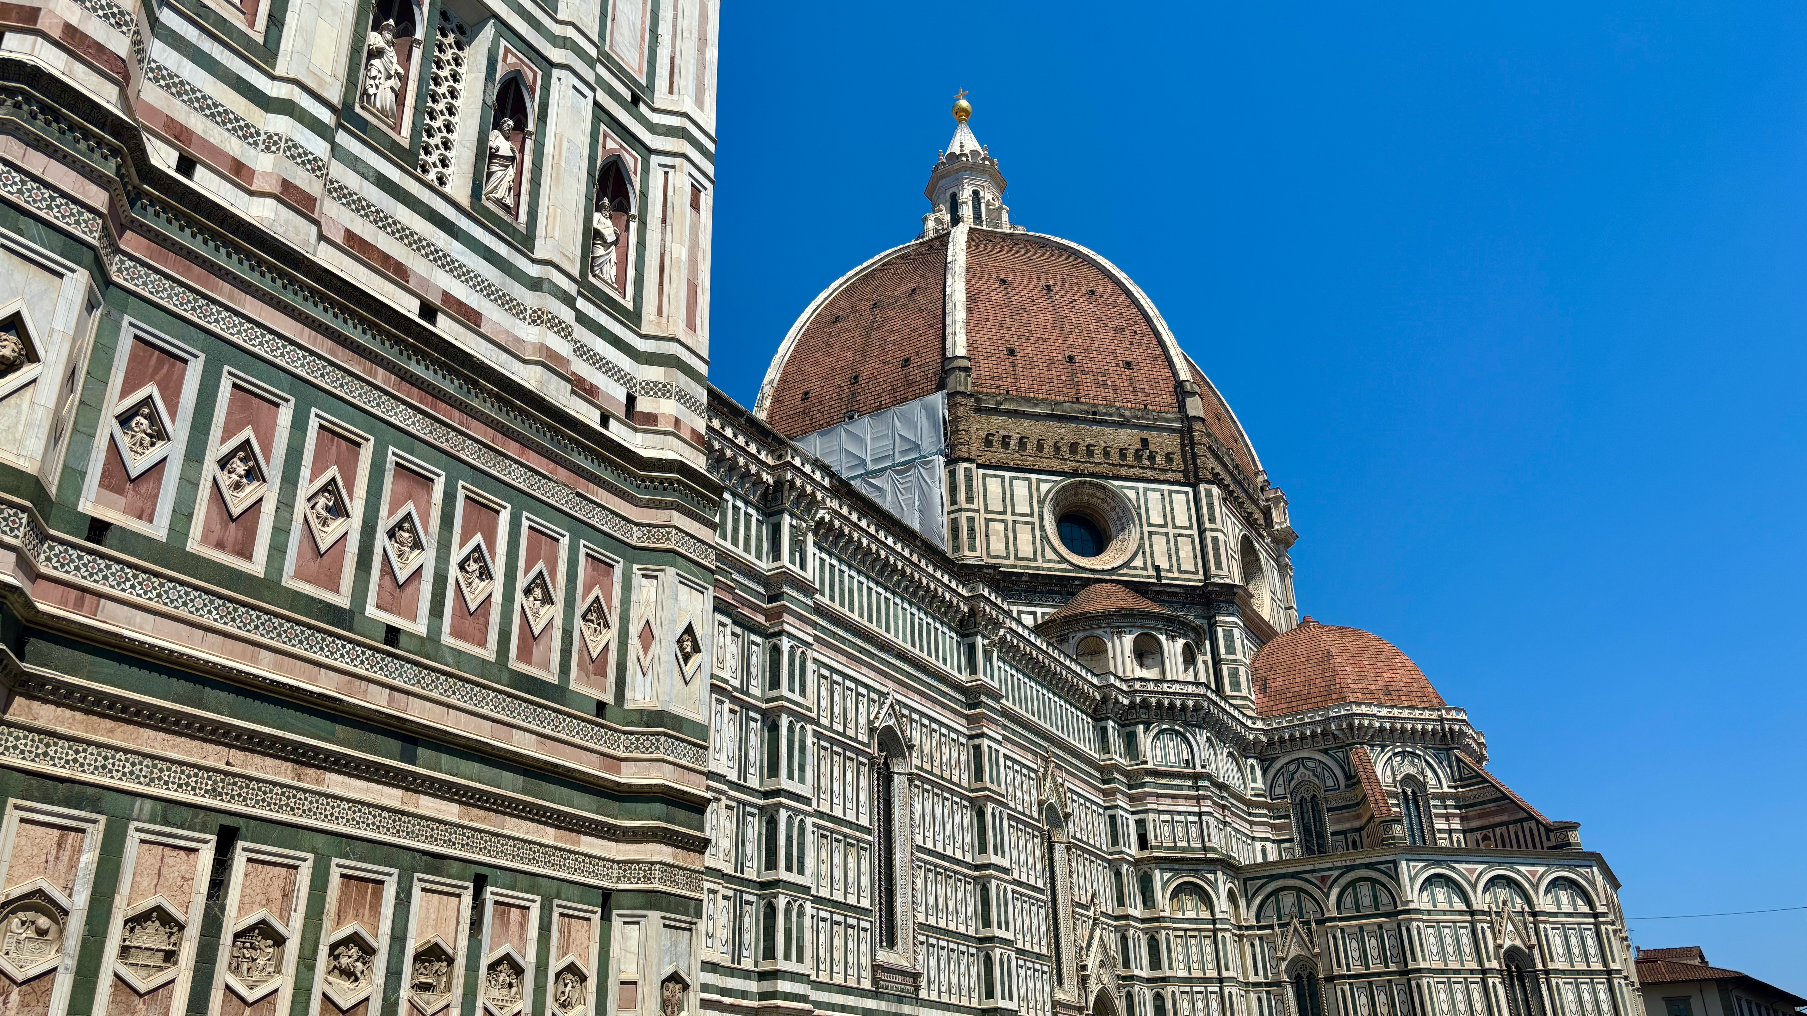

Slide 4
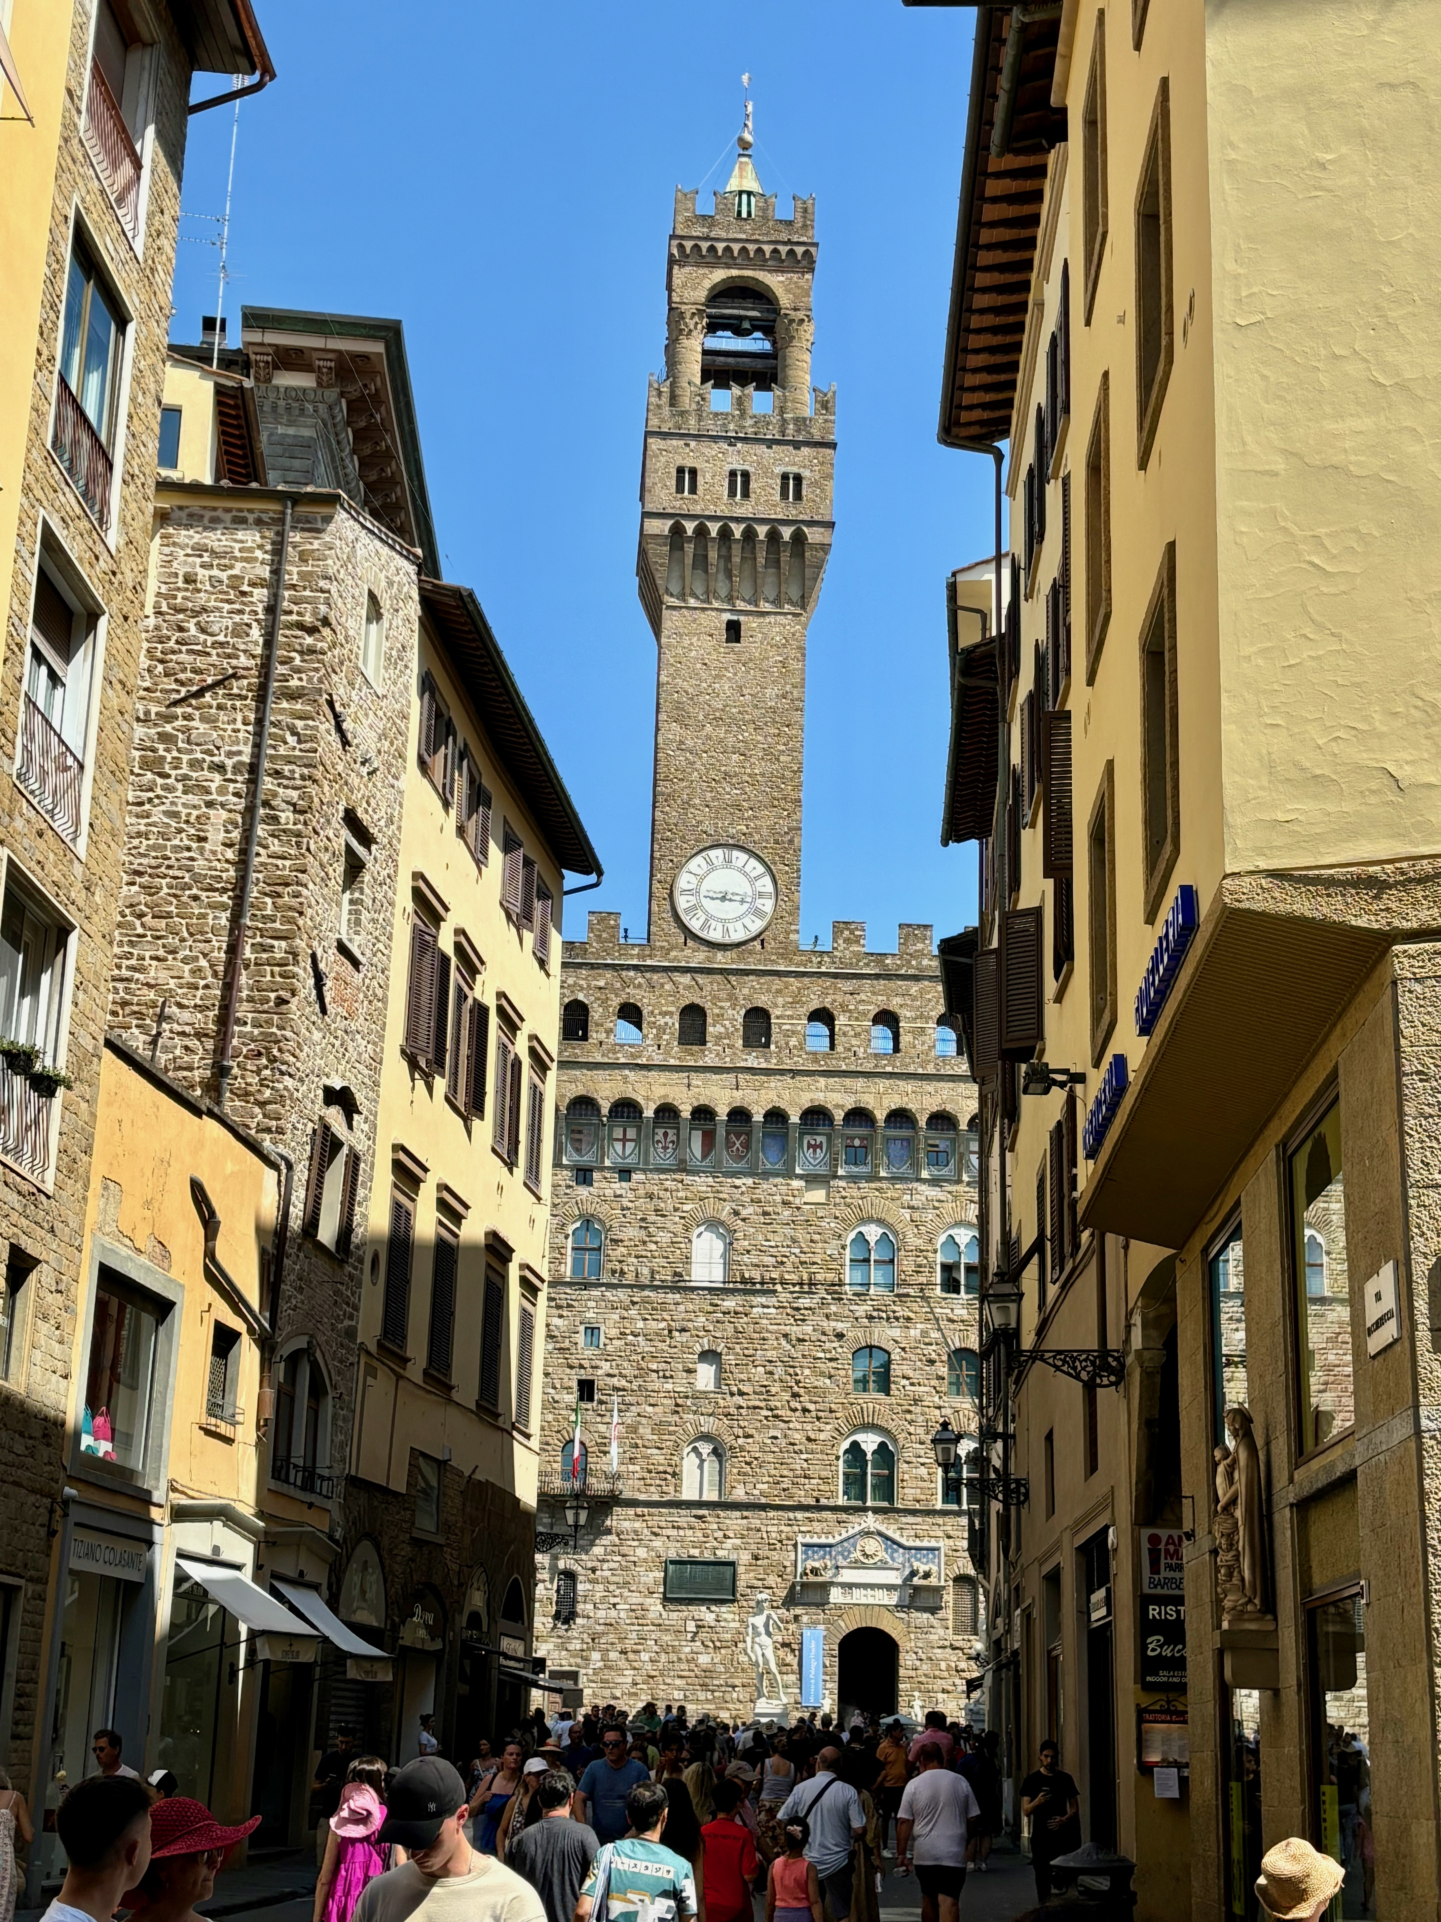
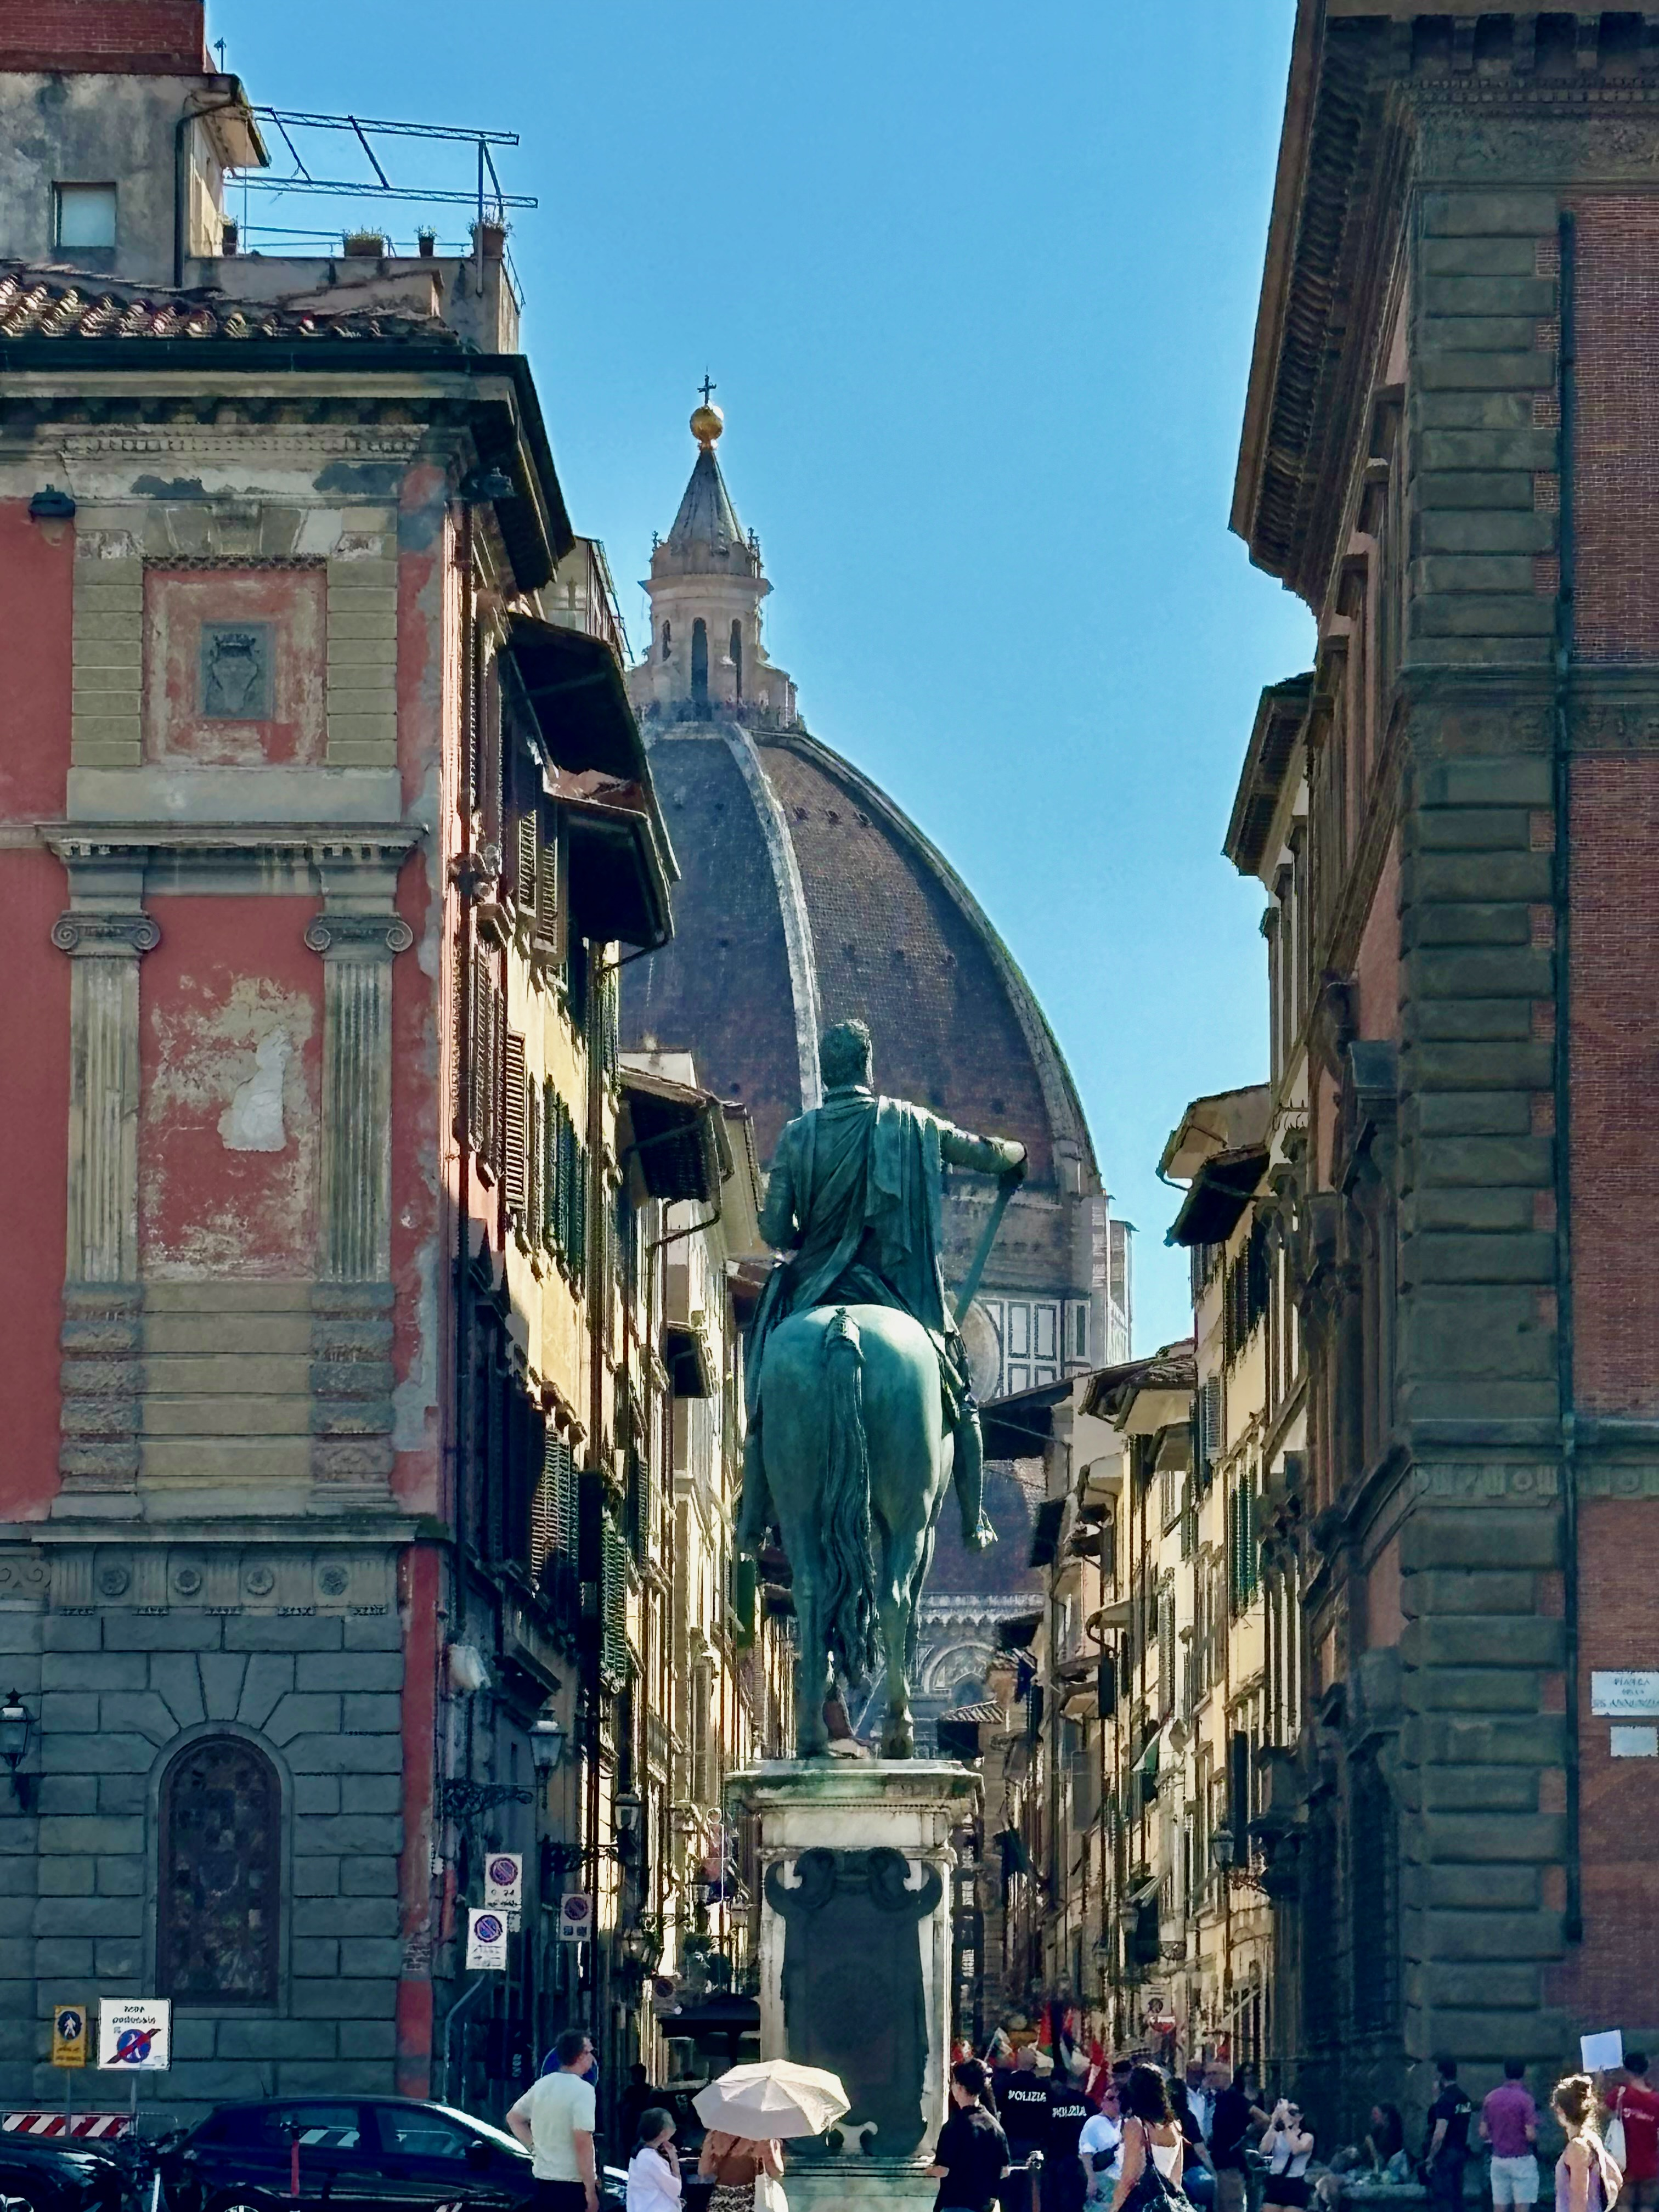

Slide 5
Diversity of the Renaissance
Art – Leonardo, Michelangelo, Raphael
Age of Discovery – Columbus discovered the ‘new world’
Religion – Martin Luther begins Reformation
Science – Copernicus hypothesized a heliocentric universe, beginning the Scientific Revolution

Slide 6
Renaissance thought
Begins with Petrarch, Boccaccio, Bruni, Alberti
Develops through Erasmus, More, Machiavelli & Montaigne
Culminates in Shakespeare, Cervantes, Bacon & Galileo

Slide 7
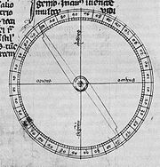
1190 First appearance of navigational compass in Europe
Pivoting compass needle in a 14th century copy of Epistola de magnete of Peter Peregrinus (1269)

Slide 8
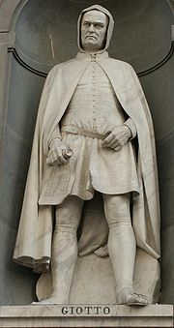
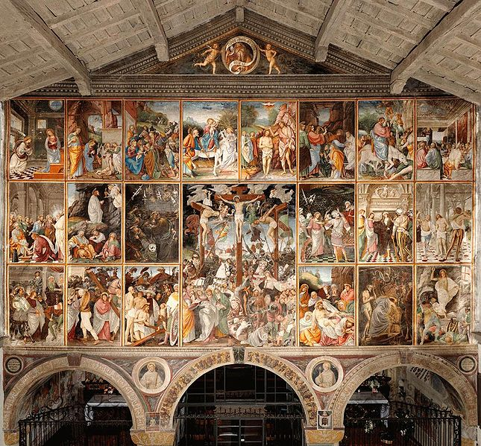
c. 1305 Giotto completes fresco cycle in the Scrovegni Chapel
Giotto di Bondone (c. 1267 – January 8, 1337), better known simply as Giotto, was an Italian painter and architect from Florence in the late Middle Ages. He is generally considered the first in a line of great artists who contributed to the Italian Renaissance.

Slide 9
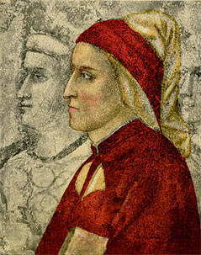
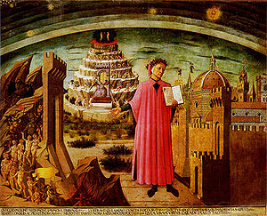
1308 -1321 Dante’s Divine Comedy
Dante shown holding a copy of the Divine Comedy, next to the entrance to Hell, the seven terraces of Mount Purgatory and the city of Florence, with the spheres of Heaven above, in Michelino's fresco.
Dante Alighieri, painted by Giotto in the chapel of the Bargello palace in Florence. This oldest portrait of Dante was painted during his lifetime before his exile from his native city.

Slide 10
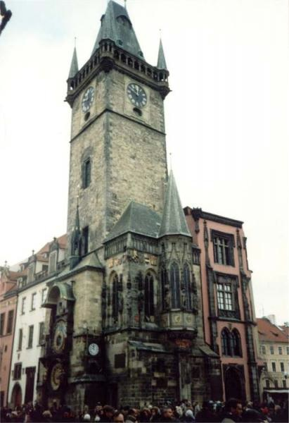
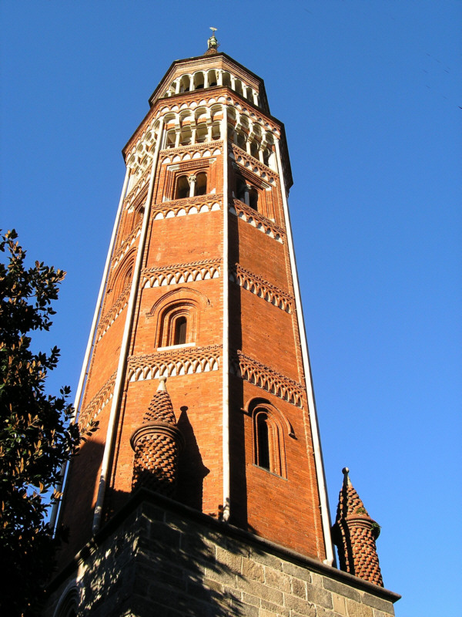
1335 First public striking clock erected in Milan
The first town to have a public clock was Milan around 1330. The clock was placed in the tower of the Church of Beata Vergine (now San Gottardo). It struck a bell at every hour up to 24, having no dial. This was noted in a manuscript by Galvano Fiamma (1283-1344), a chronicler from Milan:
“There is there a wonderful clock, because there is a very large clapper which strikes a bell 24 times according to the 24 hours of the day and night, and thus at the first hour of the night gives one sound, at the second two strokes, and so distinguishes one hour from another, which is of greatest use to men of every degree”.
Azzone Visconti wanted this clock that couldn’t be seen. It became so famous that the street close the church was called “Contrada delle Ore” (Quarter of Hours). Today the street which leads to the church is still called “via delle Ore” (hours street).

Slide 11
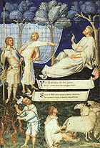
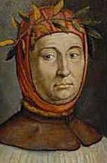
1341 Petrarch crowned poet laureate in Rome
Petrarch's Virgil (title page) (c. 1336)
Illuminated manuscript by Simone Martini, 29 x 20 cm Biblioteca Ambrosiana, Milan.
Francesco Petrarca
(July 20, 1304 – July 19, 1374)

Slide 12
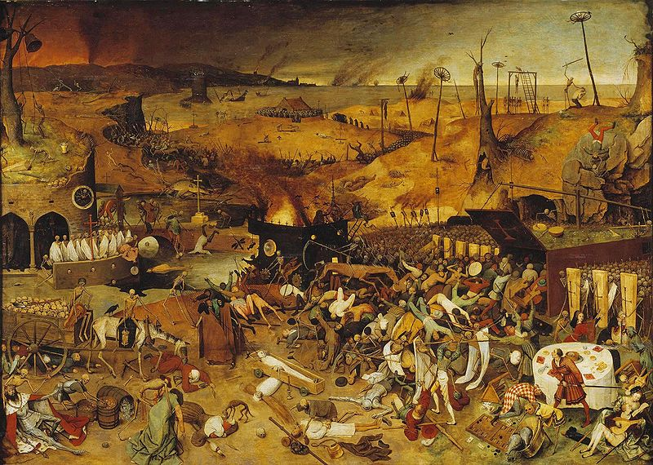
1347-51 Plague (Black Death) sweeps Europe
Pieter Bruegel's The Triumph of Death (c.1562) reflects the social upheaval and terror that followed plague, which devastated medieval Europe

Slide 13
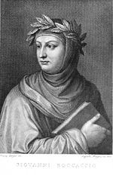
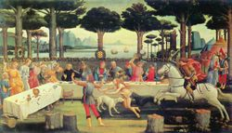
1353 Boccaccio’s Decameron
The Decameron is structured in a frame narrative, or frame tale. The Decameron played a part in the history of the novel and was finished by Giovanni Boccaccio in 1351. This work opens with a description of the Bubonic Plague (Black Death) and leads into an introduction of a group of seven young women and three young men who fled from Plague ridden Florence for a villa outside of the city walls. To pass the time, each member of the party tells one story for every one of the ten nights spent at the villa. The Decameron is a distinctive work, in that it describes in detail the physical, psychological and social effects that the Bubonic Plague had on that part of Europe. It is also interesting to note that a number of the stories contained within the Decameron would later appear in Chaucer's Canterbury Tales. However, it is unclear as to whether or not Chaucer had known of the Decameron.
Giovanni Boccaccio
(1313 – 21 December 1375)

Slide 14
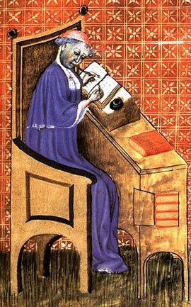
1377 Oresme’s Book on the Sky and the World
Nicole Oresme, also known as Nicolas Oresme, Nicholas Oresme, or Nicolas d'Oresme (c. 1323 - July 11, 1382) was one of the most famous and influential philosophers of the later Middle Ages. He was an economist, mathematician, physicist, astronomer, philosopher, psychologist, musicologist, theologian and Bishop of Lisieux, a competent translator, counselor of King Charles V of France, one of the principal founders and popularizers of modern sciences, and probably one of the most original thinkers of the 14th century.

Slide 15
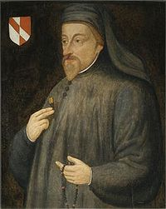
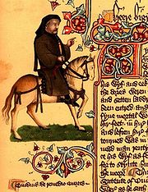
1400 Chaucer’s Canterbury Tales
Geoffrey Chaucer (c. 1343 – 25 October 1400) was an English author, poet, philosopher, bureaucrat, courtier and diplomat. Although he wrote many works, he is best remembered for his unfinished frame narrative The Canterbury Tales.
Chaucer as a pilgrim from the Ellesmere manuscript

Slide 16
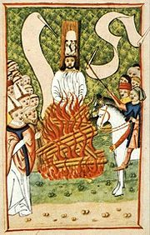
1415 Jan Hus burned at the stake
Jan Hus aka Jan Huss, John Hus, John Huss (ca. 1372 Husinec, Bohemia – 6 July 1415 Konstanz, Germany), often referred to in English as John Huss or variations thereof, was a Czech priest, philosopher, reformer, and master at Charles University in Prague.
He is famed for having been burned at the stake by civil authorities for what the Catholic Church considered to be his heretical views on ecclesiology, as the civil authorities saw heresy as a criminal offense. Hus was a key predecessor to the Protestant movement of the 16th century, and his teachings had a strong influence on the states of Europe, most immediately in the approval for the existence of a reformist Bohemian religious denomination, and, more than a century later, on Martin Luther himself.

Slide 17
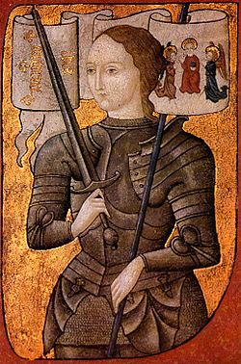
1429 Joan of Arc leads French against the English
Painting, c.1485. Artist's interpretation; the only portrait for which she is known to have sat has not survived. (Centre Historique des Archives Nationales, Paris, AE II 2490)

Slide 18
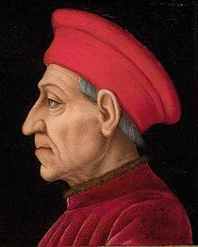
1434 Ascension to power of Cosimo de’Medici in Florence
Còsimo di Giovanni degli Mèdici (September 27, 1389 – August 1, 1464), was the first of the Medici political dynasty, de facto rulers of Florence during most of the Italian Renaissance; also known as "Cosimo 'the Elder'" ("il Vecchio") and "Cosimo Pater Patriae".

Slide 19
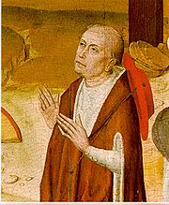
1440 Nicholas of Cusa’s On Learned Ignorance
Nicholas of Kues (1401 – August 11, 1464), also referred to as Nicolaus Cusanus and Nicholas of Cusa, was a cardinal of the Catholic Church from Germany (Holy Roman Empire), a philosopher, jurist, mathematician, and an astronomer. He is widely considered one of the great geniuses and polymaths of the 15th century. He is today recognized for significant spiritual, scientific and political contributions in European history, notable examples of which include his mystical or spiritual writings on 'learned ignorance' (and mathematical ideas expressed in related essays), as well as his participation in power struggles between Rome and the German states of the Holy Roman Empire.

Slide 20
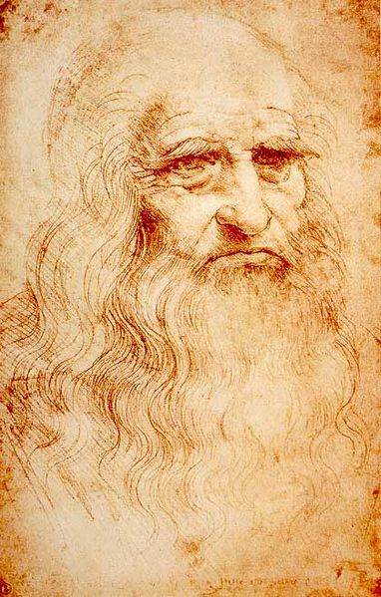
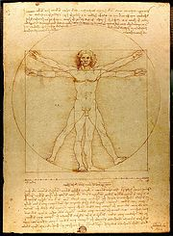
1452 Birth of Leonardo da Vinci
Leonardo di ser Piero da Vinci (April 15, 1452 – May 2, 1519), was an Italian polymath: painter, sculptor, architect, musician, scientist, mathematician, engineer, inventor, anatomist, geologist, botanist and writer. Leonardo has often been described as the archetype of the Renaissance man, a man whose unquenchable curiosity was equaled only by his powers of invention

Slide 21
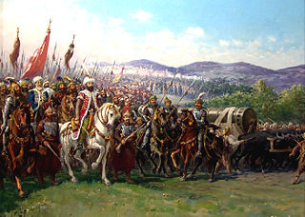
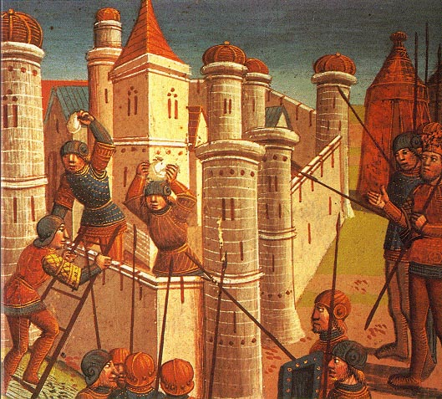
1453 Fall of Constantinople
Modern painting of Mehmed II and the Ottoman army approaching Constantinople, transporting a giant bombard
The Siege of Constantinople (painted 1499).

Slide 22
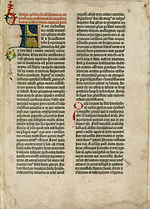
1455 Gutenburg Bible, start of printing revolution
First page of the first volume: The Epistle of St. Jerome from the University of Texas copy.

Slide 23
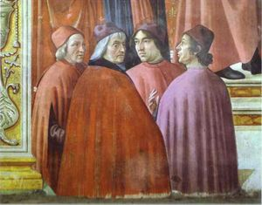
1482 Ficino’s Theologica Platonica
Marsilio Ficino (Latin name: Marsilius Ficinus; October 19, 1433 - October 1 1499) was one of the most influential humanist philosophers of the early Italian Renaissance, an astrologer, a reviver of Neoplatonism who was in touch with every major academic thinker and writer of his day, and the first translator of Plato's complete extant works into Latin. His Florentine Academy, an attempt to revive Plato's school, had enormous influence on the direction and tenor of the Italian Renaissance and the development of European philosophy.
Domenico Ghirlandaio (1486-1490). Zachariah in the Temple [detail]: Marsilio Ficino, Cristoforo Landino, Angelo Poliziano and Demetrios Chalkondyles (detail). Fresco. Santa Maria Novella, Tornabuoni Cappella, Florence, Italy.

Slide 24
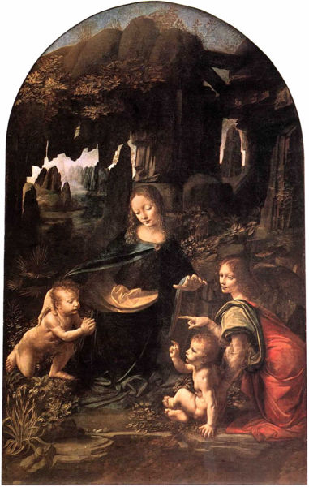
1483 Leonardo da Vinci’s Virgin on the Rocks

Slide 25
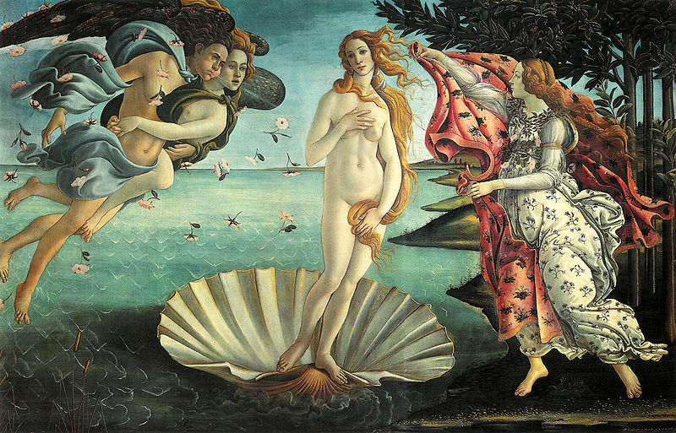
1485 Boticelli’s Birth of Venus
Alessandro di Mariano di Vanni Filipepi, better known as Sandro Botticelli or Il Botticello ("The Little Barrel"; c. 1445[1] – May 17, 1510) was an Italian painter of the Florentine school during the Early Renaissance

Slide 26
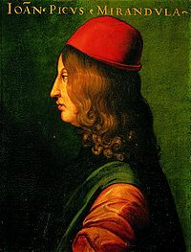
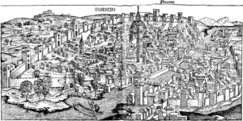
1486 Pico’s Oration on the Dignity of Man
Pico della Mirandola was an Italian Renaissance philosopher. He is famed for the events of 1486, when at the age of 23, he proposed to defend 900 theses on religion, philosophy, natural philosophy and magic against all comers, for which he wrote the famous Oration on the Dignity of Man which has been called the "Manifesto of the Renaissance”, and a key text of Renaissance humanism.
View of Florence, woodcut, Nuremberg Chronicle, 1493.
Count Giovanni Pico della Mirandola
(February 24, 1463 – November 17, 1494)

Slide 27
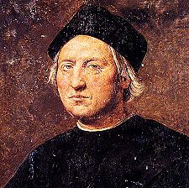
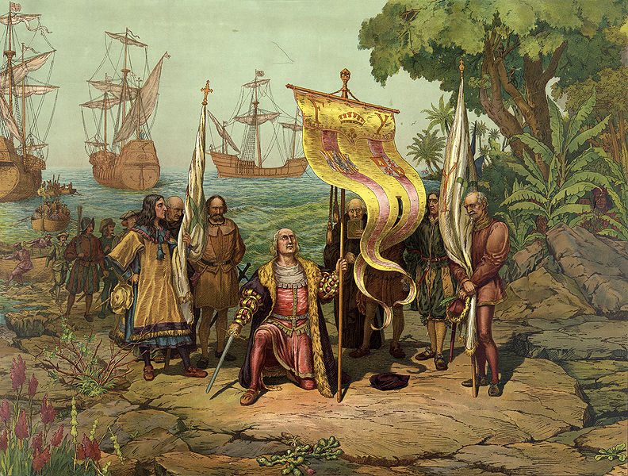
1492 Columbus reaches America
Columbus claims the New World in a chromolithograph by the Prang Education Company, 1893
Christopher Columbus
(c. 1451 – 20 May 1506)
Posthumous portrait of Christopher Columbus by Ridolfo Ghirlandaio.

Slide 28
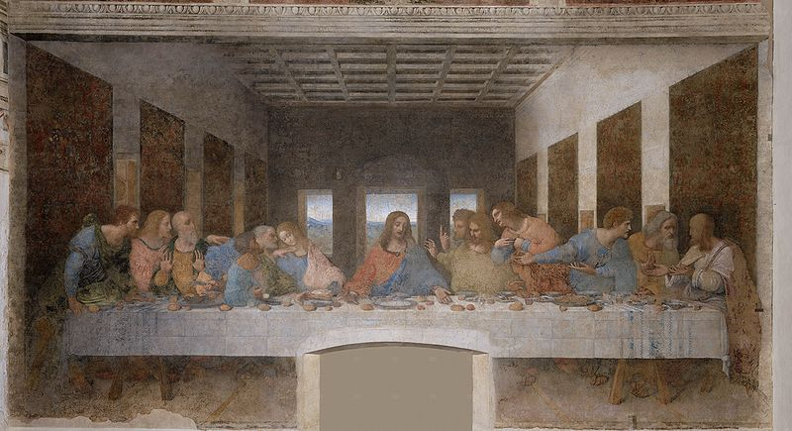
1498 Leonardo da Vinci’s Last Supper

Slide 29
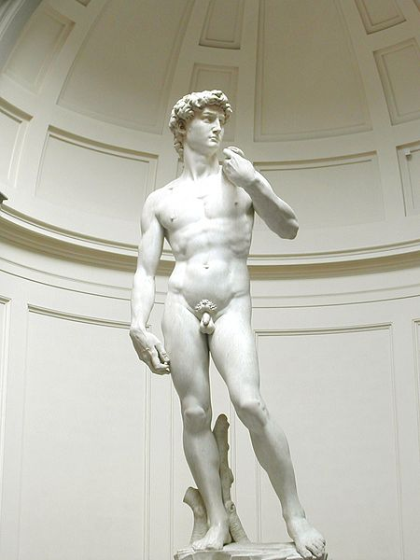
1504 Michelangelo’s David

Slide 30
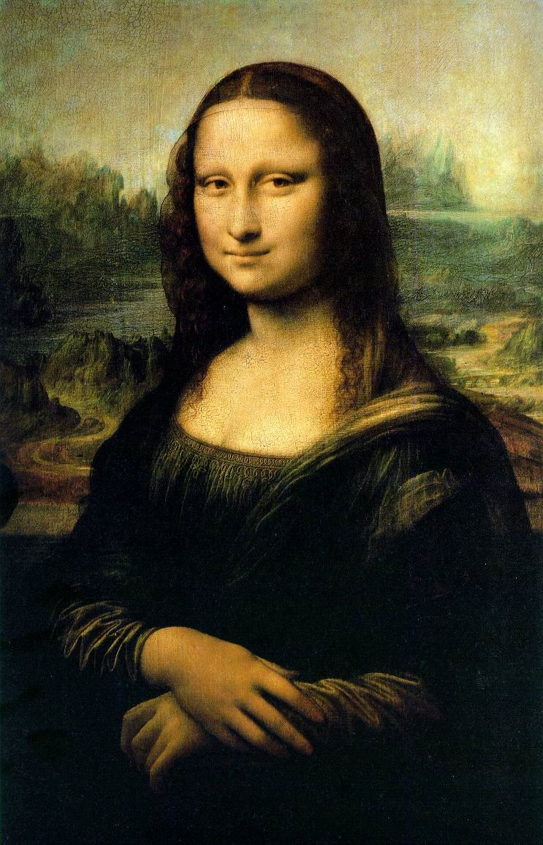
c. 1503 -1506 Leonardo da Vinci’s Mona Lisa

Slide 31
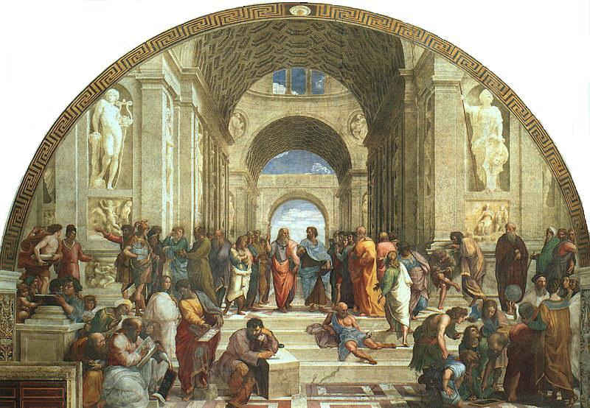
1509-1510 Raphael’s School of Athens
Raffaello Sanzio da Urbino (April 6 or March 28, 1483 – April 6, 1520), better known simply as Raphael, was an Italian painter and architect of the High Renaissance, celebrated for the perfection and grace of his paintings and drawings.

Slide 32
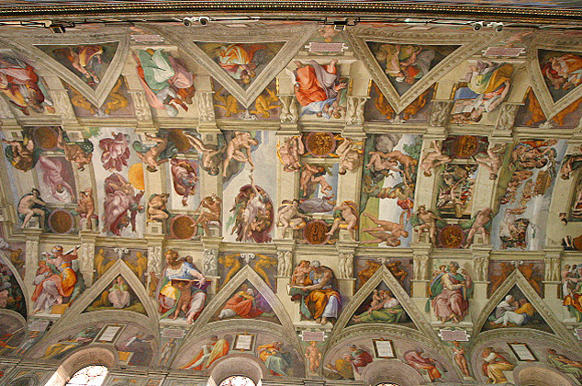
1508-12 Michelangelo’s Sistine Chapel ceiling

Slide 33
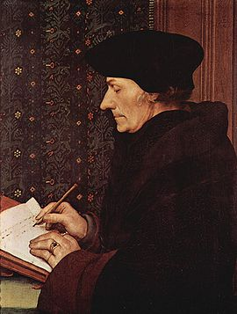
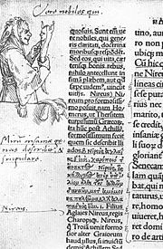
1509 Erasmus’ In Praise of Folly
Erasmus's best-known work was In Praise of Folly, a satirical attack on the traditions of the Catholic Church and popular superstitions, written in 1509, published in 1511 and dedicated to his friend, Sir Thomas More.
Marginal drawing of Folly by Hans Holbein in the first edition of Erasmus' Praise of Folly, 1515
Desiderius Erasmus Roterodamus
(October 28, 1466/1469 – July 12, 1536) was a Dutch Renaissance humanist and a Catholic priest and theologian.

Slide 34
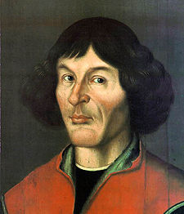
1512-14 Copernicus’ Commentariolus, first outline of heliocentric theory
The "Commentariolus" ("Little Commentary") is Nicolaus Copernicus's forty-page outline of an early version of his revolutionary heliocentric theory of the universe.[1] After further long development of his theory, Copernicus published the mature version in 1543 in his landmark work, De revolutionibus orbium coelestium (On the Revolutions of the Heavenly Spheres).
Nicolaus Copernicus (19 February 1473 – 24 May 1543)

Slide 35
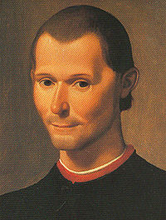
1513 Machiavelli’s The Prince
The Prince (Italian: Il Principe) is a political treatise by the Italian public servant and political theorist Niccolò Machiavelli. Originally called De Principatibus (About Principalities), it was originally written in 1513, but not published until 1532, five years after Machiavelli's death. The Prince was one of the first works of modern philosophy, in which pragmatic ends, opposed to teleological concepts, are the purpose. The treatise is not representative of the work published during his lifetime, but it is the most remembered, and the work responsible for bringing "Machiavellian" into wide usage as a pejorative term.
Niccolò di Bernardo dei Machiavelli
(3 May 1469 – 21 June 1527) was an Italian philosopher /writer, and is considered one of the main founders of modern political science.

Slide 36
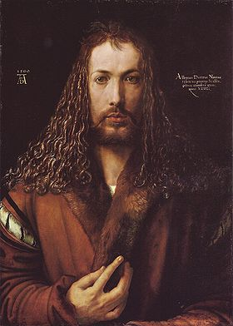
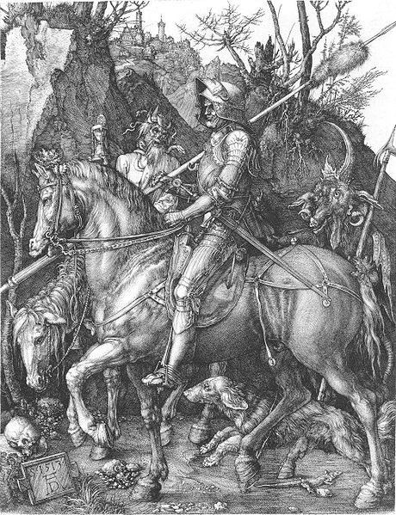
1513-14 Dürer’s Knight, Death and Devil
Albrecht Dürer (21 May 1471 – 6 April 1528) was a German painter, printmaker and theorist from Nuremberg. His prints established his reputation across Europe when he was still in his twenties, and he has been conventionally regarded as the greatest artist of the Northern Renaissance ever since.

Slide 37
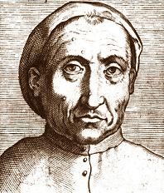
1516 Pietro Pomponazzi’s On the Immortality of the Soul
Pietro Pomponazzi (16 September 1462 – 18 May 1525) was an Italian philosopher. In On the Immortality of the Soul Pomponazzi argued specifically that Aquinas and Aristotle clash over the question of the immortality of the soul. While Pomponazzi himself does not follow Aristotle in this respect, he argues that Aristotle very clearly argues for the absolute mortality of the soul, with only limited features of immortality. He was not the first to make this claim, and appears to have been influenced by the Greek commentator on Aristotle, Alexander of Aphrodisias. He further claims that the immortality of the soul cannot be determined through reason, and thus must be left to the powers of God

Slide 38
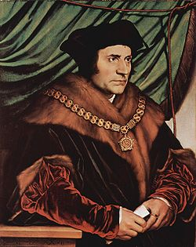
1516 Thomas More’s Utopia
Sir Thomas More (7 February 1478 – 6 July 1535), also known as Saint Thomas More, was an English lawyer, scholar, author and statesman. He is also recognised as being a saint within the Catholic Church. During his life he gained a reputation as a leading Renaissance humanist, an opponent of the Reformation of Martin Luther and wrote long treatises opposing William Tyndale and others who wished to see the Bible translated into the English language. For three years toward the end of his life he was Lord Chancellor.
More coined the word "utopia" - a name he gave to the ideal, imaginary island nation whose political system he described in Utopia, published in 1516. An important counsellor to Henry VIII of England, he was imprisoned and executed by beheading in 1535 after he had fallen out of favour with the king over his refusal to sign the Act of Supremacy 1534, which declared the king to be the Supreme Head of the Church of England, effecting a final split with the Catholic Church in Rome.

Slide 39
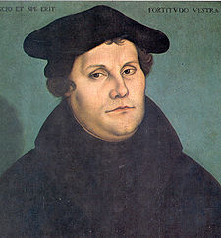

1517 Luther posts 95 theses, beginning of the Reformation
Door of the Schlosskirche (castle church) in Wittenberg to which Luther nailed his 95 Theses on the 31st of October 1517, sparking the Reformation.
Martin Luther (10 November 1483 – 18 February 1546)

Slide 40


1534 Henry VIII issues act of Supremacy
1535 Thomas More beheaded

Slide 41

1536 Calvin’s Institutes of the Christian Religion
John Calvin (10 July 1509 – 27 May 1564) was an influential French theologian and pastor during the Protestant Reformation. He was a principal figure in the development of the system of Christian theology later called Calvinism. Originally trained as a humanist lawyer, he broke from the Roman Catholic Church around 1530. After religious tensions provoked a violent uprising against Protestants in France, Calvin fled to Basel, Switzerland, where in 1536 he published the first edition of his seminal work Institutes of the Christian Religion.

Slide 42


1540 Ignatius of Loyola founds Jesuit order
Fresco of Approving of bylaw of Society of Jesus depicting Ignatius of Loyola receiving papal bull Regimini militantis Ecclesiae from Pope Paul III. The fresco was created by Johann Christoph Handke in the Church of Our Lady Of the Snow in Olomouc after 1743.

Slide 43


1541 Michelangelo’s Last Judgment
St Bartholomew displaying his flayed skin (a self-portrait by Michelangelo) in The Last Judgment

Slide 44

1543 Copernicus’ The Revolutions of Heavenly Bodies

Slide 45

Ptolemaic System

Slide 46

Epicycle in Ptolemaic system

Slide 47

1572 Tycho Brahe observes supernova
Tycho Brahe, born Tyge Ottesen Brahe (de Knudstrup) (14 December 1546 – 24 October 1601), was a Danish nobleman known for his accurate and comprehensive astronomical and planetary observations.

Slide 48

1580 Montaigne’s Essays
Michel Eyquem de Montaigne
(February 28, 1533–September 13, 1592)
was one of the most influential writers of the French Renaissance. Montaigne is known for popularizing the essay as a literary genre. He became famous for his effortless ability to merge serious intellectual speculation with casual anecdotes and autobiography — and his massive volume Essais (translated literally as "Attempts") contains, to this day, some of the most widely influential essays ever written. Montaigne had a direct influence on writers the world over, including Blaise Pascal, René Descartes, Ralph Waldo Emerson, Stefan Zweig, Friedrich Nietzsche, Jean-Jacques Rousseau, Isaac Asimov, Eric Hoffer, and perhaps William Shakespeare.

Slide 49

1584 Bruno’s On the Infinite Universe and Worlds
Giordano Bruno, born Filippo Bruno (1548 – February 17, 1600), was an Italian philosopher, mathematician and astronomer best known as a proponent of heliocentrism and the infinity of the universe. His cosmological theories went beyond the Copernican model in identifying the sun as just one of an infinite number of independently moving heavenly bodies: he is the first man to have conceptualized the universe as a continuum where the stars we see at night are of identical nature as the sun.

Slide 50

1597 Bacon’s Essays
The Essays was the first published book by the philosopher, statesman and jurist Francis Bacon. The Essays are written in a wide range of styles, from the plain and unadorned to the epigrammatic. They cover topics drawn from both public and private life, and in each case the essays cover their topics systematically from a number of different angles, weighing one argument against another.
Francis Bacon, 1st Viscount St Alban, KC (22 January 1561 – 9 April 1626), son of Nicholas Bacon by his second wife Anne (Cooke) Bacon, was an English philosopher, statesman, scientist, lawyer, jurist, and author. He served both as Attorney General and Lord Chancellor of England.

Slide 51



1600 Shakespeare’s Hamlet
William Shakespeare
(baptised 26 April 1564; died 23 April 1616)

Slide 52

1600 Giordano Bruno burned at the stake

Slide 53

1600 Giordano Bruno burned at the stake

Slide 54


1607 Cervantes’ Don Quixote
Miguel de Cervantes Saavedra
(September 29, 1547 – April 23, 1616) was a Spanish novelist, poet, and playwright. His magnum opus, Don Quixote, often considered the first modern novel, is a classic of Western literature and is regularly regarded among the best novels ever written. His work is considered among the most important in all of literature.

Slide 55


1609 Kepler’s New Astronomy
The Astronomia nova records the discovery of the first two of the three principles known today as Kepler's laws of planetary motion, which are:
1. That the planets move in elliptical orbits with the sun at one focus; and
2. That the speed of the planet changes at each moment such that the time between two positions is always proportional to the area swept out on the orbit between these positions.
Johannes Kepler
(December 27, 1571 – November 15, 1630) was a German mathematician, astronomer and astrologer, and key figure in the 17th century scientific revolution.
Title Page of Kepler's Astronomia nova (1609)

Slide 56

1609 Kepler’s New Astronomy
Orbit of Mars with epicycles from Keplers’s Astronomia nova (1609)

Slide 57


1610 Galileo’s Siderius Nuncius announces telescopic discoveries
Galileo Galilei (15 February 1564 – 8 January 1642) was an Italian physicist, mathematician, astronomer, and philosopher who played a major role in the Scientific Revolution.

Slide 58

1619 Kepler’s Harmonies of the World
Third law of planetary motion: The square of the orbital period of a planet is directly proportional to the cube of the semi-major axis of its orbit.
Kepler's laws and his analysis of the observations on which they were based—the assertion that the Earth orbited the Sun, proof that the planets' speeds varied, and use of elliptical orbits rather than circular orbits with epicycles—challenged the long-accepted geocentric models of Aristotle and Ptolemy, and generally supported the heliocentric theory of Nicolaus Copernicus (although Kepler's ellipses likewise did away with Copernicus's circular orbits and epicycles). Together with Newton's mathematical theories, they are part of the foundation of modern astronomy and physics.

Slide 59

1620 Bacon’s New Organon
The Novum Organum is a philosophical work by Francis Bacon published in 1620. The title is a reference to Aristotle's work Organon, which was his treatise on logic and syllogism. In Novum Organum, Bacon detailed a new system of logic he believed to be superior to the old ways of syllogism. In this work, we see the development of the Baconian method, consisting of procedures for isolating the form, nature or cause of a phenomenon, employing the method of agreement, method of difference, and method of concomitant variation devised by Avicenna in 1025.

Slide 60

1620 Galileo’s Assayer
In 1619, Galileo became embroiled in a controversy with Father Orazio Grassi, professor of mathematics at the Jesuit Collegio Romano. It began as a dispute over the nature of comets, but by the time Galileo had published The Assayer (Il Saggiatore) in 1623, his last salvo in the dispute, it had become a much wider argument over the very nature of Science itself. Because The Assayer contains such a wealth of Galileo's ideas on how Science should be practised, it has been referred to as his scientific manifesto.

Slide 61

1628 Galileo’s Dialogue Concerning the Two Chief World Systems
Frontispiece and title page of the Dialogue

Slide 62

1632 Galileo condemned by the Inquisition
Cristiano Banti's 1857 painting Galileo facing the Roman Inquisition

Slide 63


1637 Descartes’ Discourse on Method
René Descartes (31 March 1596 – 11 February 1650)

Slide 64


1638 Galileo’s Two New Sciences
The Discourses and Mathematical Demonstrations Relating to Two New Sciences (Discorsi e dimostrazioni matematiche, intorno a due nuove scienze, 1638) was Galileo's final book and a sort of scientific testament covering much of his work in physics over the preceding thirty years.
Unlike the Dialogue Concerning the Two Chief World Systems, it was not published with a license from the Inquisition; after the heresy trial based on the earlier book, the Roman Inquisition had banned publication of any work by Galileo, including any he might write in the future. After the failure of attempts to publish the work in France, Germany, or Poland, it was picked up by Lowys Elsevier in Leiden, The Netherlands, where the writ of the Inquisition was of little account.

Slide 65


1641 Descartes’ Meditations on First Philosophy

