Slide 1
Aristotle’s Virtue Ethics
Virtue Ethics:
Be a Good Person
Virtue ethics is a theory or morality that makes virtue the central concern. It is not a matter of the consequences of actions as the consequentialists think. Nor is it a matter moral nature of actions, as the deontological theories claim. According to virtue ethics, moral conduct is something that emanates from a person’s moral virtues, from his or her moral character, not from obedience to moral laws. Whereas the utilitarian or Kantian asks, “what should I do?”, the virtue ethicist asks, “What should I be?”

Slide 2
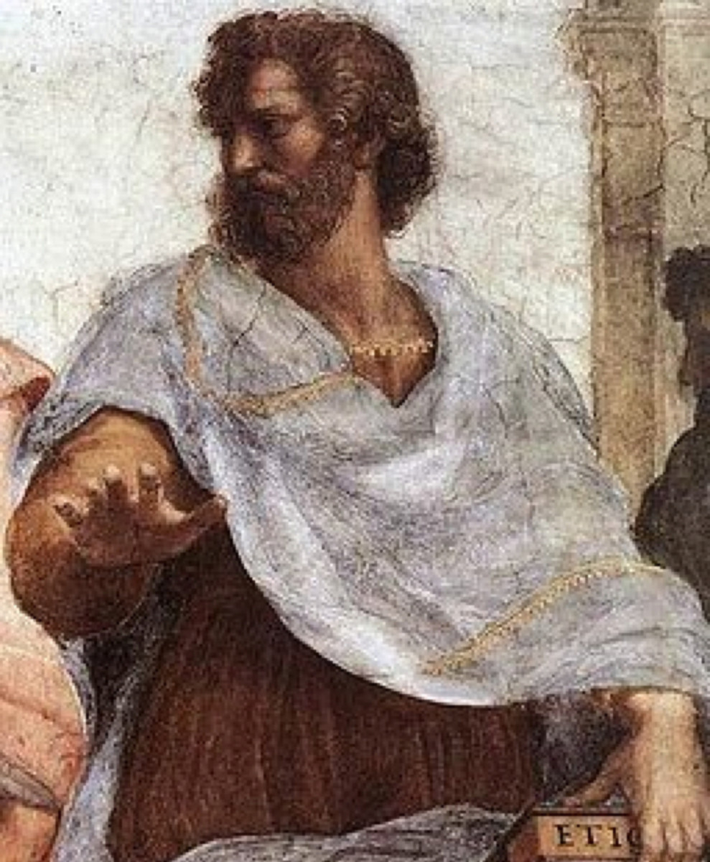
Virtue Ethics
Aristotle’s philosophy was very influential in Ethics. Aristotle thought the moral life consists not in following moral rules that stipulate right actions, but in striving to be a particular kind of person—a virtuous person whose actions stem naturally from virtuous character.
Aristotle (384–322 BC)

Slide 3
Virtue Ethics
Recall that Aristotle had a teleological view of nature. Everything is developing toward some end or purpose. Every living being has an end toward which it naturally aims. Human existence also has an end or ultimate purpose, according to Aristotle, and the highest end of human actions is to bring about this end, the best good of human existence.
Suppose, then, that (a) there is some end (τέλος) of the things we pursue in our actions which we wish for because of itself; and (b) we do not choose everything because of something else, since (c) if we do, it will go on without limit, making desire empty and futile; then clearly (d) this end (τέλος) will be the good, i.e., the best good.
Then surely knowledge of this good is also of great importance for the conduct of our lives, and if, like archers, we have a target to aim at, we are more likely to hit the right mark.
Aristotle (384–322 BC)

Slide 4
Virtue Ethics
Natural law theorists used Aristotle’s teleological view to support the view that some actions are morally right in and of themselves because they are in accord with the way nature is. Aristotle’s ethics did not go in this direction, but instead emphasized the virtuous character traits that would lead to the fulfillment of the true goal of human existence. This end or goal (τέλος), the ultimate good of human existence, Aristotle defined as:
εὐδαιμονία
Eudamonia
Happiness
Human Flourishing
Aristotle (384–322 BC)

Slide 5
Virtue Ethics
To achieve eudamonia, Aristotle thought human beings must fulfill the function that is natural and distinctive to them. Aristotle defined humans as the rational animal, and thus, the natural function of human beings is to live in accordance with reason. The life of reason entails a life of virtue because the virtues themselves are rational modes of behaving. Thus, according to Aristotle, “Happiness (eudamonia) is an activity of the soul in accordance with complete or perfect virtue.”
What, then, is perfect virtue?
Aristotle (384–322 BC)

Slide 6
Virtue Ethics
A virtue is a stable disposition to act and feel according to some ideal or model of excellence. It is a deeply embedded character trait that can affect actions in countless situations.
Aristotle distinguished between intellectual virtues and moral virtues. The intellectual virtues include wisdom, prudence, rationality. The moral virtues include fairness, benevolence, honesty, loyalty, conscientiousness, and courage.
Aristotle thought the intellectual virtues can be taught, but the moral virtues require practice, and thus, are the result of good habits.
Aristotle (384–322 BC)

Slide 7
Virtue Ethics
Aristotle’s notion of a moral virtue is what he calls the “Golden Mean,” a balance between two behavioral extremes.
Deficit Golden Mean Excess
Cowardice Courage Rashness
Stinginess Generosity Extravagance
Slothfulness Ambition Greed
Humility Modesty Pride
Secrecy Honesty Loquacity
Moroseness Good Humor Absurdity
Quarrelsomeness Friendship Flattery
Self-indulgence Temperance Insensibility
Apathy Composure Irritability
Indecisiveness Self-Control Impulsiveness
Aristotle (384–322 BC)

Slide 8
Virtue Ethics
Modern virtue ethics is deeply influenced by Aristotle’s thought, though some virtue ethicists don’t accept his teleological view of human nature and some question his concept of virtue as a mean between extremes. Like Aristotle, contemporary thinkers put the emphasis on quality of character and virtues, rather than on particular principles or rules of right action. Virtue ethicists, for example, are less likely to ask whether lying is wrong in a particular situation than whether an action or person is honest or dishonest. Virtue ethicists agree with Aristotle in arguing that a pure duty-based morality of rule adherence represents a barren, one-dimensional conception of the moral life.

Slide 9
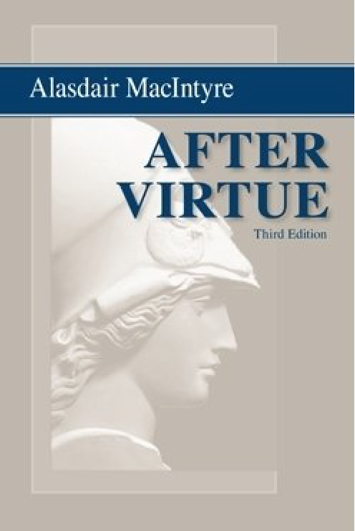
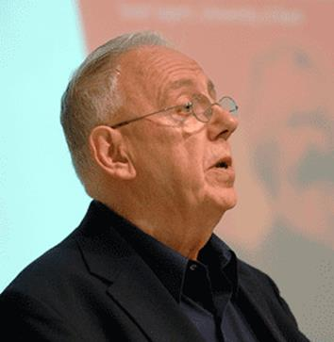
Virtue Ethics
Contemporary virtue ethics was greatly influenced by the book After Virtue (1981), widely recognized as one of the most important works of moral and political philosophy of the 20th century.
Alisdair MacIntyre (1929- )

Slide 10
Virtue Ethics
Modern virtue ethicists agree with Aristotle on two main points:
1) The cultivation of virtues is not merely a moral requirement—it is a way (some would say the only way) to ensure human flourishing and the good life.
.

Slide 11
Virtue Ethics
2) Ethics must take into account motives, feelings, intentions, and moral wisdom—factors that duty-based morality neglects.
According to Kant, the only thing that matters in determining the moral worth of actions is whether one does it from a recognition that it is one’s duty to do it. We don’t need to consider our motives and feelings. In virtue ethics, acting from such motivations as friendship, loyalty, kindness, love, or sympathy is a crucial part of acting from a virtuous character.

Slide 12
Virtue Ethics
Virtue in Action
If moral rules are secondary in virtue ethics, how does a virtue ethicist make moral decisions? In considering whether or not to tell a lie, a virtue ethicist thinks, not about the consequences of the action, nor the moral rightness of the action, but rather the impact of the action upon her character. If honesty is a virtue, then she will do her best to act honestly and avoid lying.
Virtue ethicists often look to role models, people who embody the virtues and have inspired others with their virtuous conduct. Through practice in following the role model, and developing good habits, the virtuous person develops a character that spontaneously does what is good.

Slide 13
Virtue Ethics
Evaluating Virtue Ethics
Some philosophers think that virtue ethics seems to explain important aspects of the moral life. It seems to offer a more plausible explanation of the role of motivation in moral actions than duty-based ethics. Some philosophers also defend virtue ethics in pointing out that the aims of being a good person and living a good life of happiness or human flourishing are obviously central to the moral life and should be part of any adequate theory of morality.

