Slide 1
Hellenistic and Roman Philosophy
Winged Victory of Samothrace
Lartos marble (ship) and Parian marble (figure),
c. 190 B.C.E. 3.28 m high, Hellenistic Period
(Musée du Louvre, Paris)
The Winged Victory of Samothrace, or the Niké of Samothrace, is a votive monument originally discovered on the island of Samothrace, north of the Aegean Sea. It is a masterpiece of Greek sculpture from the Hellenistic era, dating from the beginning of the 2nd century BC (190 BC). It is composed of a statue representing the goddess Niké (Victory), whose head and arms are missing and its base is in the shape of a ship's bow.
Photo: Tim Freeman, 2015.

Slide 2
Alexander the Great

Slide 4
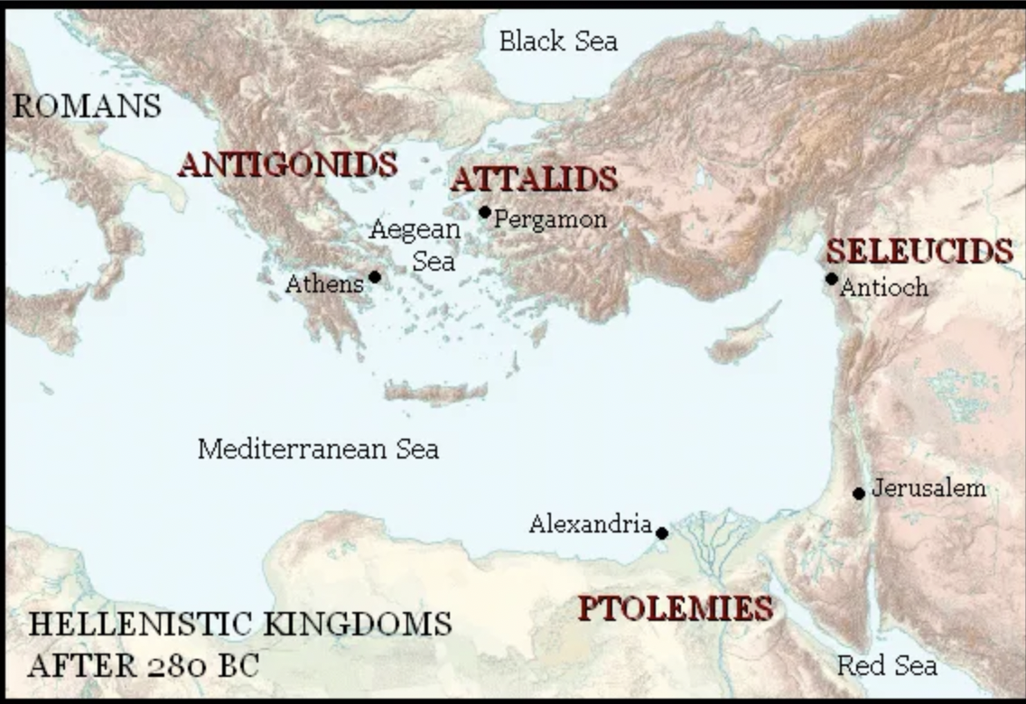
The Hellenistic World
Marble Head of a Ptolemaic Queen
Hellenistic Period, ca. 270–250 BCE.
The Metropolitan Museum, New York

Slide 5
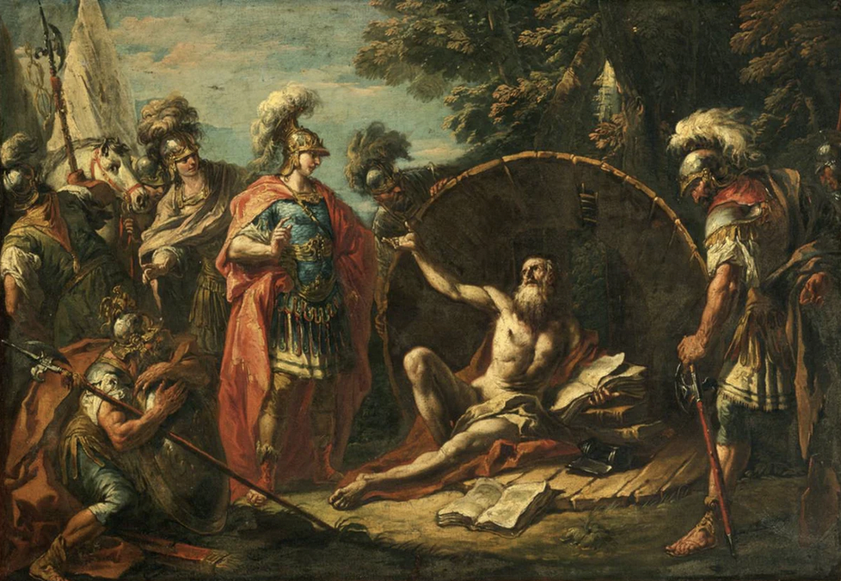
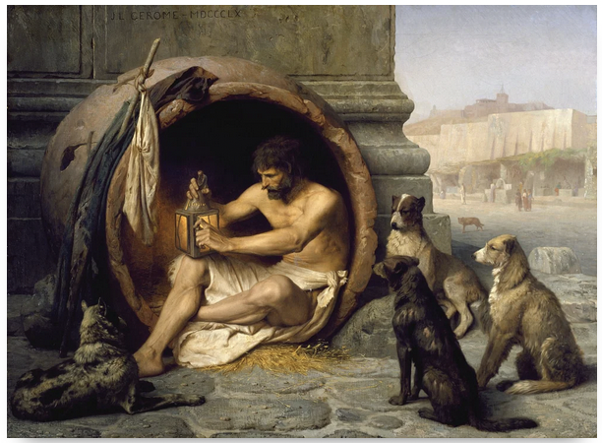
The Cynics
Diogenes of Sinope
Diogenes sitting in his tub
Jean-Léon Gérôme (1860 CE)
“Truly, if I were not Alexander,
I would wish to be Diogenes.”
Alexander the Great
Alexander and Diogenes, Gaspare Diziani, 1740s.

Slide 6
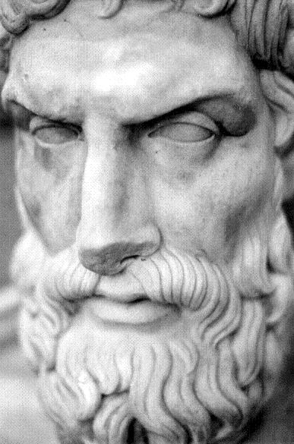
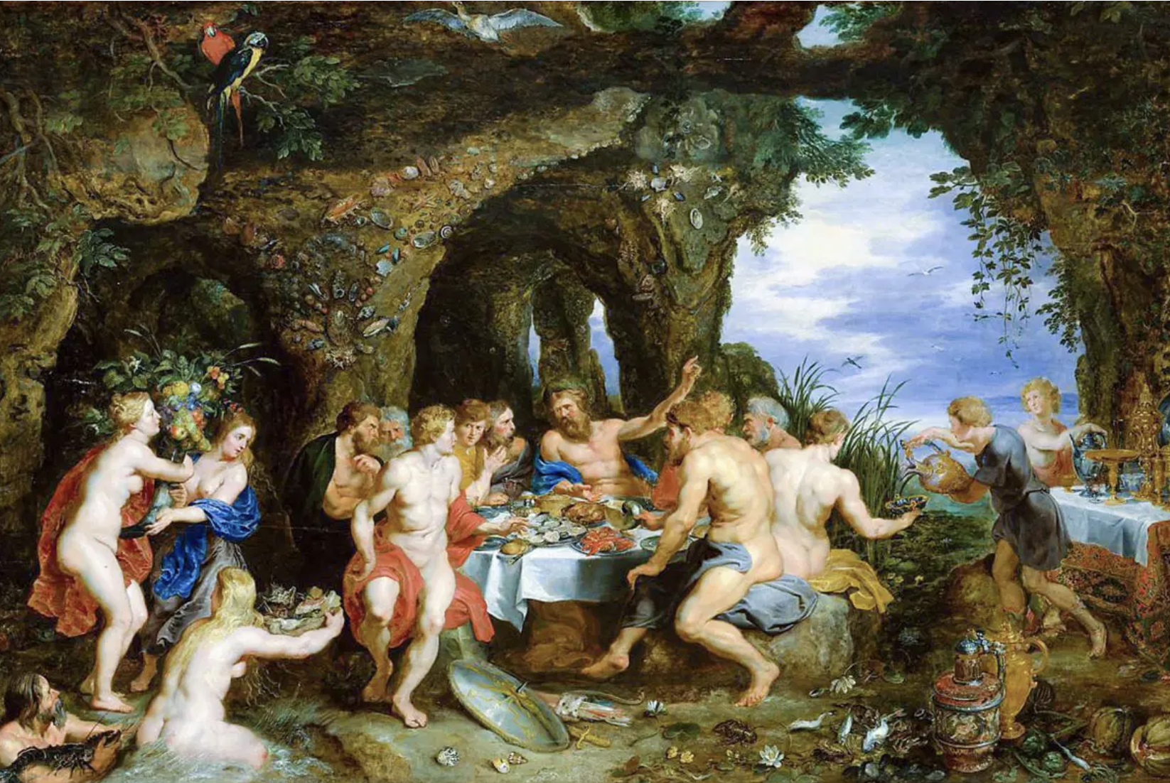
The Epicureans
“Not what we have
But what we enjoy, constitutes our abundance.”― Epicurus
Epicurus (341–270 BC)
The Feast of Acheloüs, Peter Paul Rubens 1615,
Metropolitan Museum of Art, New York.

Slide 7
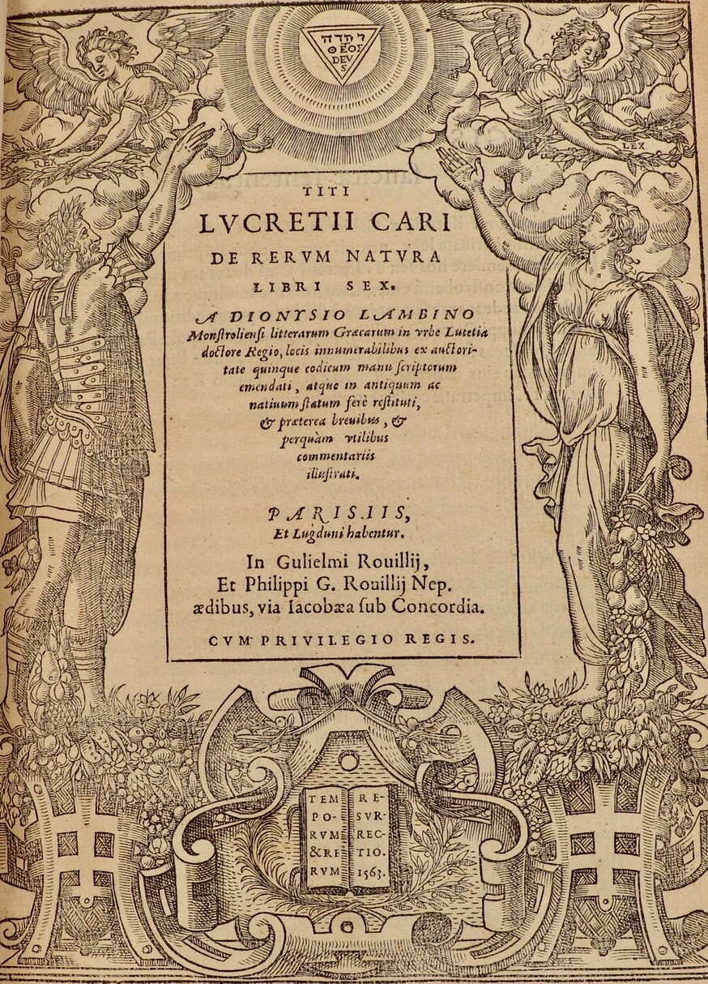
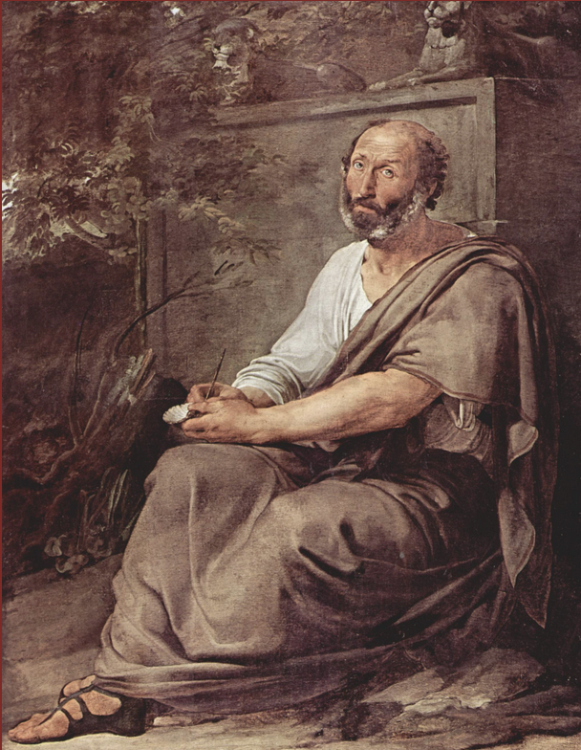
The Epicureans
“Man's greatest wealth is to live on a little with contented mind; for little is never lacking.”
― Lucretius
Lucretius (mid-90s to mid-50s BCE)
The Nature of Things (De Rerum Natura)

Slide 8
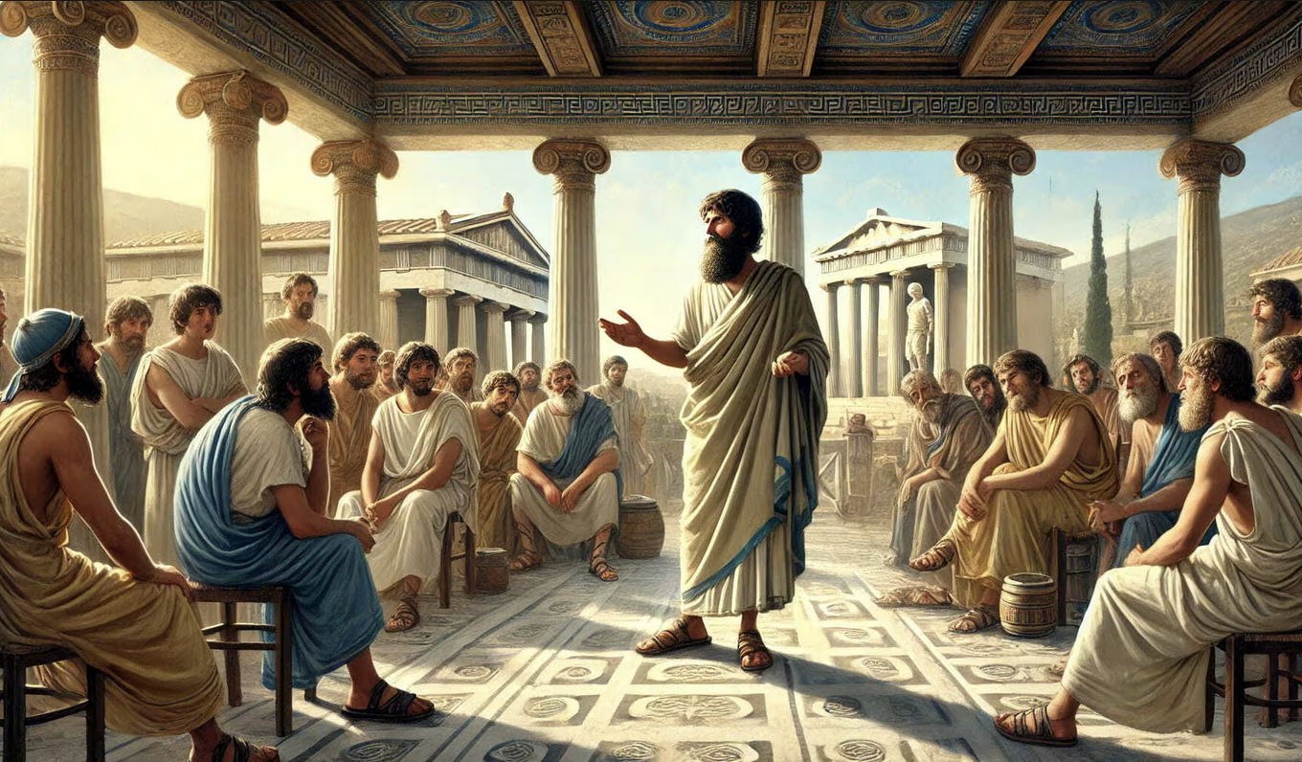
The Stoics
“Man conquers the world by conquering himself.” ― Zeno of Citium
Zeno of Citium,
c. 334 – c. 262 BC.

Slide 9
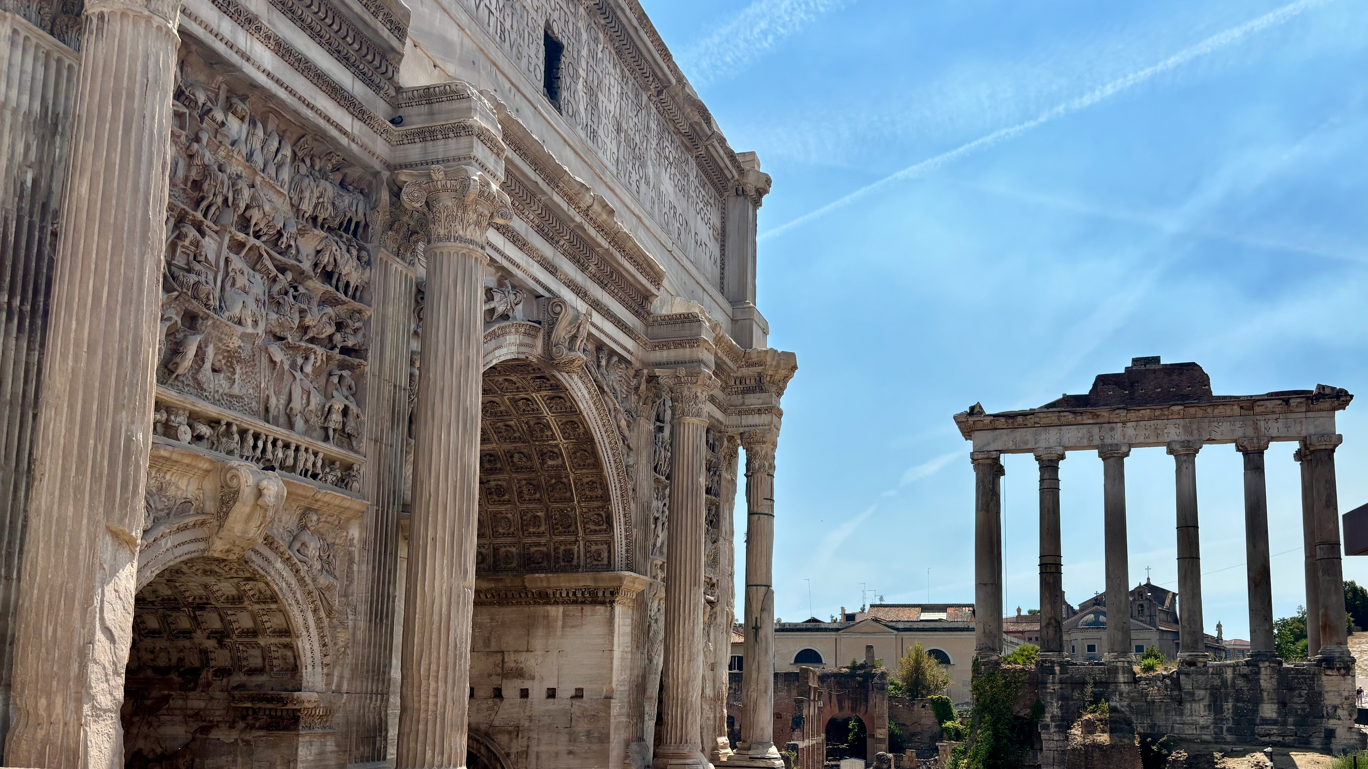
The Stoics
“It's not what happens to you, but how you react to it that matters.”― Epictetus
Epictetus (55–135 CE)

Slide 10
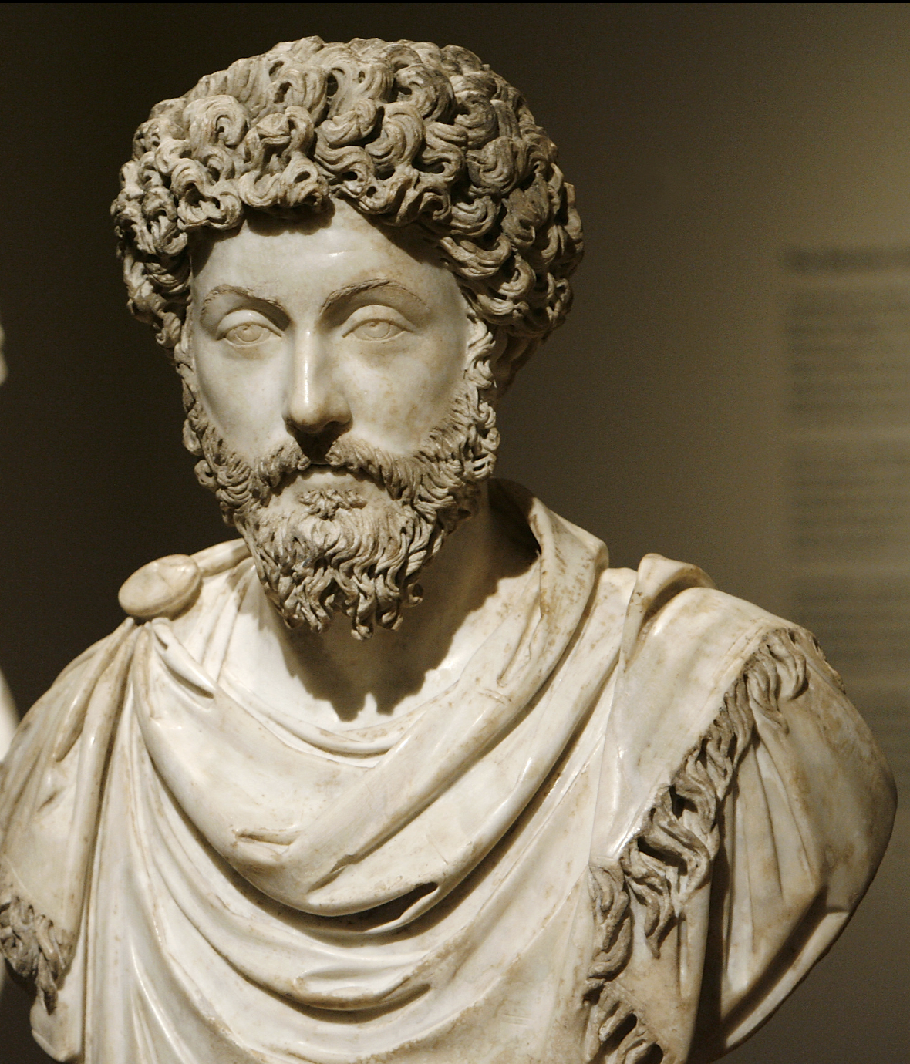
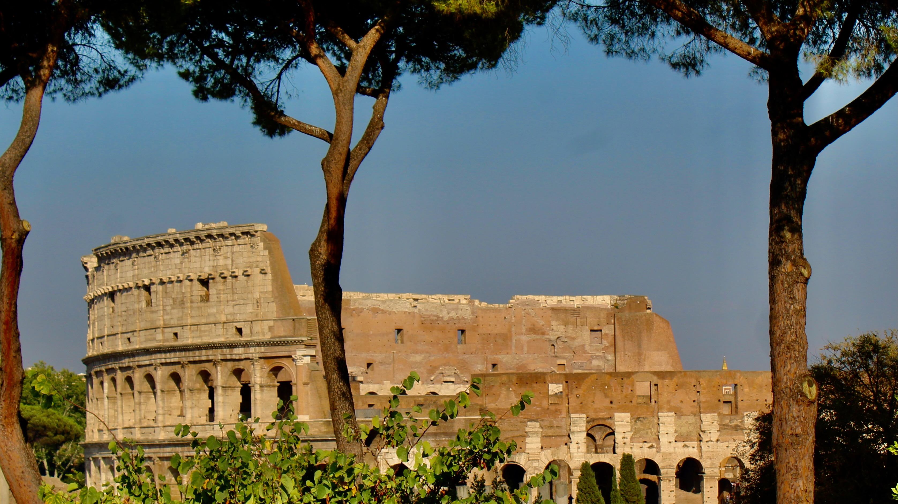
The Stoics
“Our life is what our thoughts make it.”― Marcus Aurelius, Meditations
Marcus Aurelius, c. 170 to 180 AD.

Slide 11
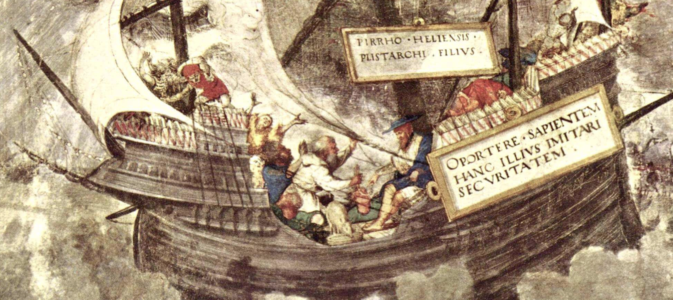
The Skeptics
“Skepticism is a faculty and a method that is used to examine, that compares, in every possible way, the apparent, or sensitive, and those that notice by the intonement; by the means of which we reach (because of the equal weight that is in things or in opposite reasons) first to the epicoche, that is to say, to the suspension of the assent, the tranquility of the soul.”
Pyrrho of Elis,
360 - 270 B.C.

Slide 12
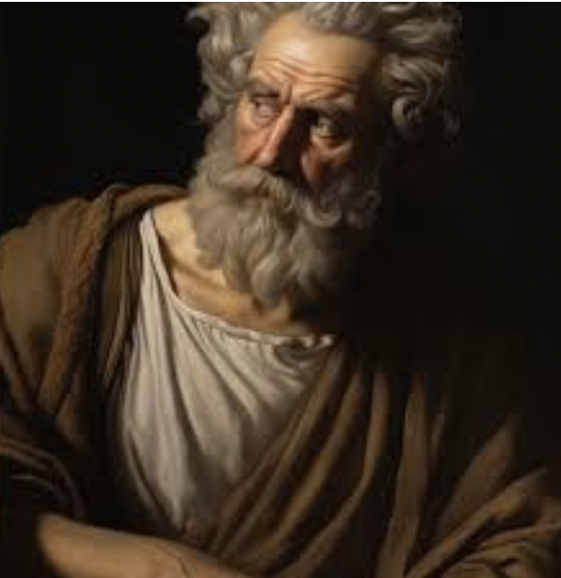
The Skeptics
“Skepticism relieved two terrible diseases that afflicted mankind: anxiety and dogmatism.”
― Sextus Empiricus
Sextus Empiricus (ca. 160-210 CE).

