Slide 1
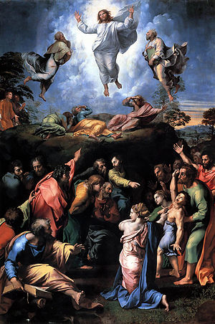
Raphael. Transfiguration. 1516-1520.
Type oil on wood, 405 cm × 278 cm (159 in × 109 in).
Pinacoteca Vaticana, Vatican City

Slide 2
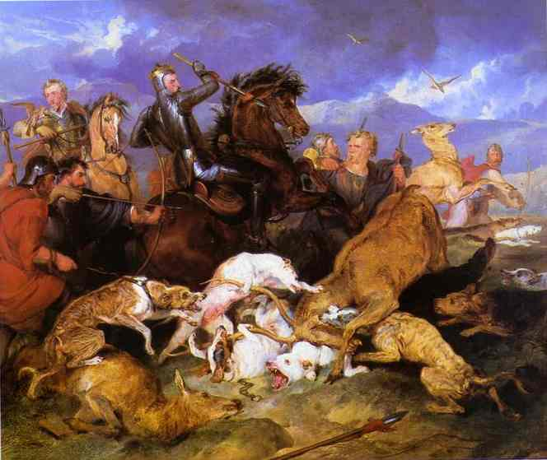
Sir Edwin Landseer. The Hunting of Chevy Chase. 1825-1826.
Oil on canvas. Birmingham City Museum and Art Gallery, Birmingham, UK.

Slide 3
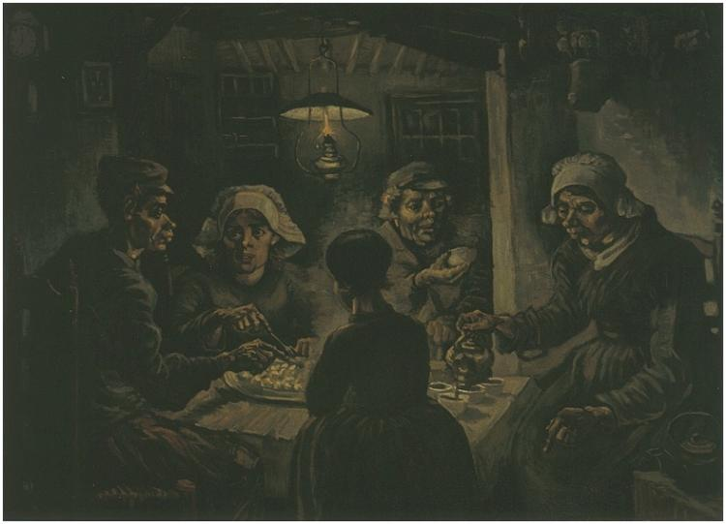
Vincent Van Gogh. The Potato Eaters. 1885.
Oil on canvas, 82 x 114 cm.
Vincent van Gogh Museum, Amsterdam

Slide 4
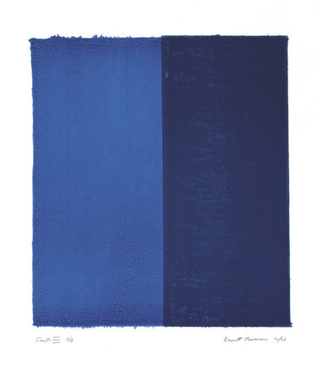
Barnett Newman. Canto VIII, c.1963

Slide 5
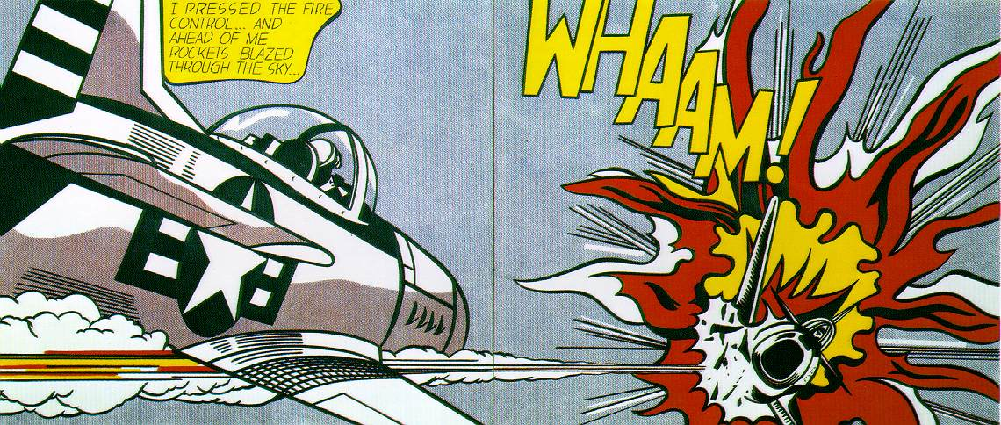
Roy Lichtenstein. Whaam! 1963.
Magna on canvas, 172 x 269 cm (68 x 106 in.) (two canvasses).
Tate Gallery, London

Slide 6
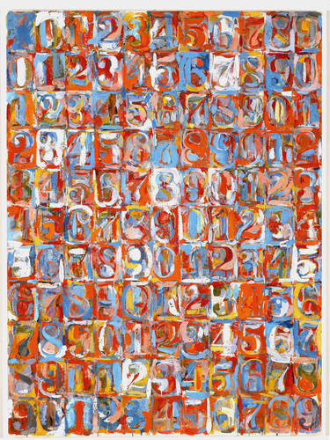
Jasper Johns.
Numbers in Color. 1958–59.
Encaustic and newspaper on canvas. 66 1/2 x49 1/2 in. ( 168.9 x 125.7 cm). Gift of Seymour H. Knox, Jr., 1959. Albright-Knox Art Gallery, Buffalo, N.Y.

Slide 7
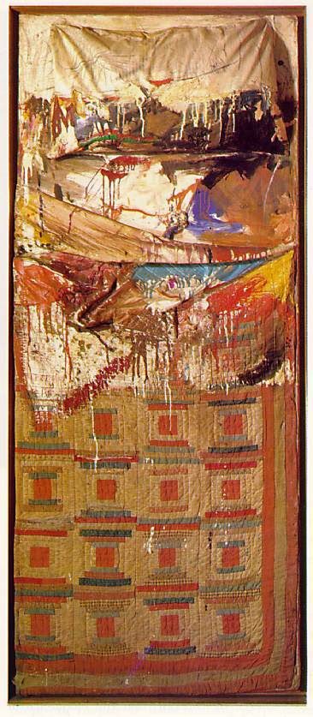
Robert Rauschenberg. Bed. 1955
Combine painting, 6'2" x 31 1/2" x 6 1/2”.
Mr and Mrs Leo Castelli, New York

Slide 8
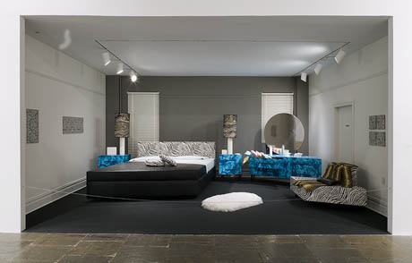
Claes Oldenburg’s Bedroom Ensemble (1963/1995).
Whitney Museum, New York

Slide 9
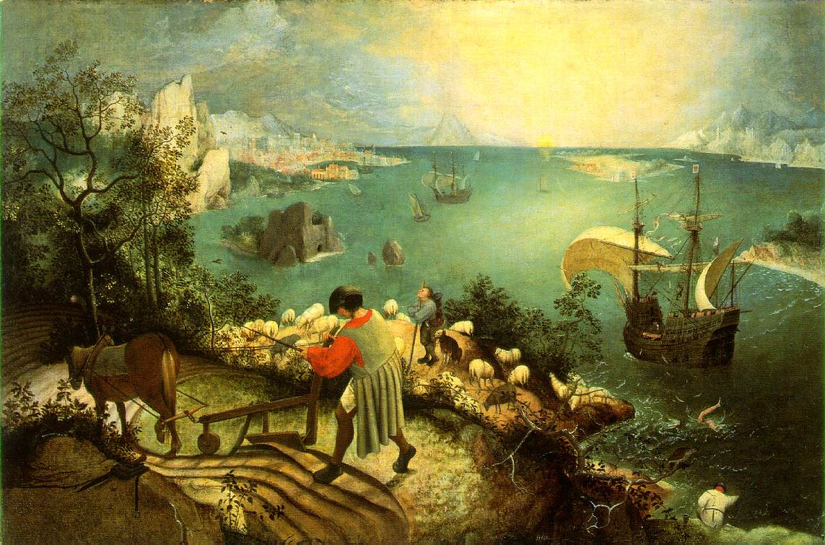
Pieter Bruegel,the Elder. Landscape with the Fall of Icarus. c.1558.
The painting is oil on canvas that is mounted on wood, 73.5x112cm.

Slide 10
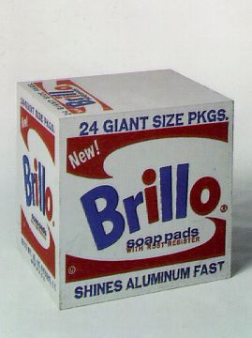
Andy Warhol.
Brillo Soap Pads Box. 1964
silkscreen ink on synthetic, polymer paint on wood,
17 x 17 x 14 in.
The Andy Warhol Museum, Pittsburgh Founding Collection.

Slide 11
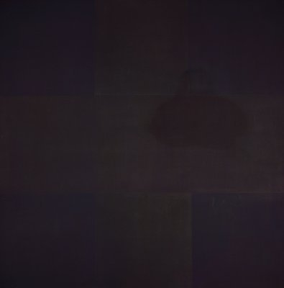
Ad Reinhardt. Black Box.

Slide 12
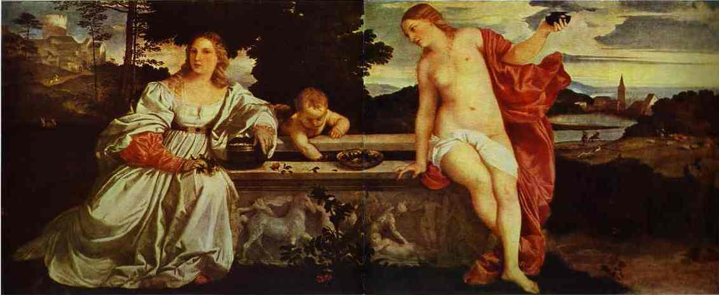
Titian. Sacred and Profane Love. 1514.
Oil on canvas. Museo Galleria Borghese, Rome, Italy.

