Slide 1
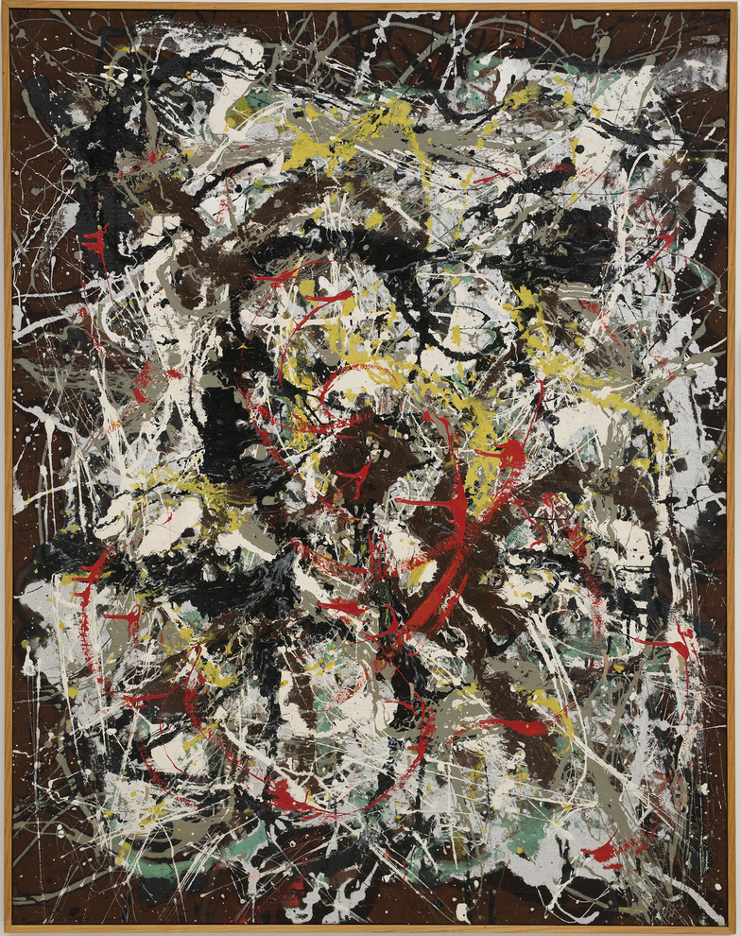
“The modern artist is living in a mechanical age and we have … mechanical means of representing objects in nature such as the camera and the photograph. The modern artist, it seems to me, is expressing an inner world—in other words—expressing the energy, the motion, and other inner forces… the modern artist is working with space and time, and expressing his feelings rather than illustrating…”
Jackson Pollock
Abstract Expressionism
Number 4, Jackson Pollock, Oil, enameled paint and aluminum paint on canvas, 1952, The Carnegie Museum of Art, Pittsburg, PA

Slide 2
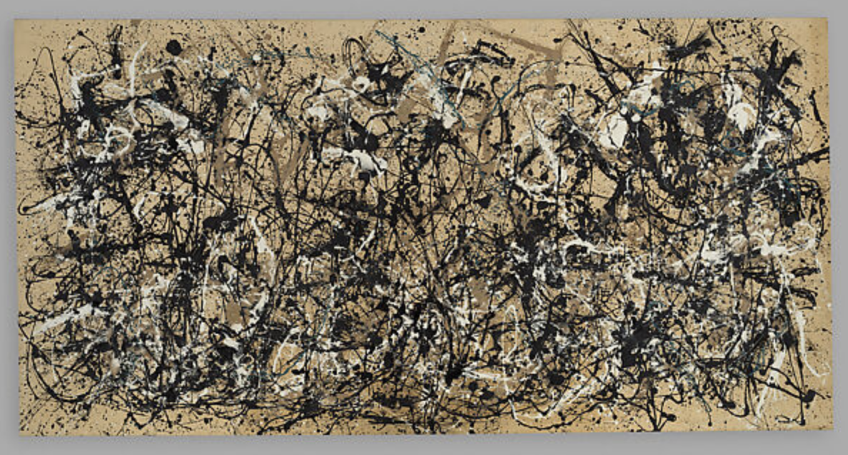
Autumn Rhythm (Number 30), Jackson Pollock, Enamel on canvas, 1950, The Metropolitan Museum of Art.

Slide 3
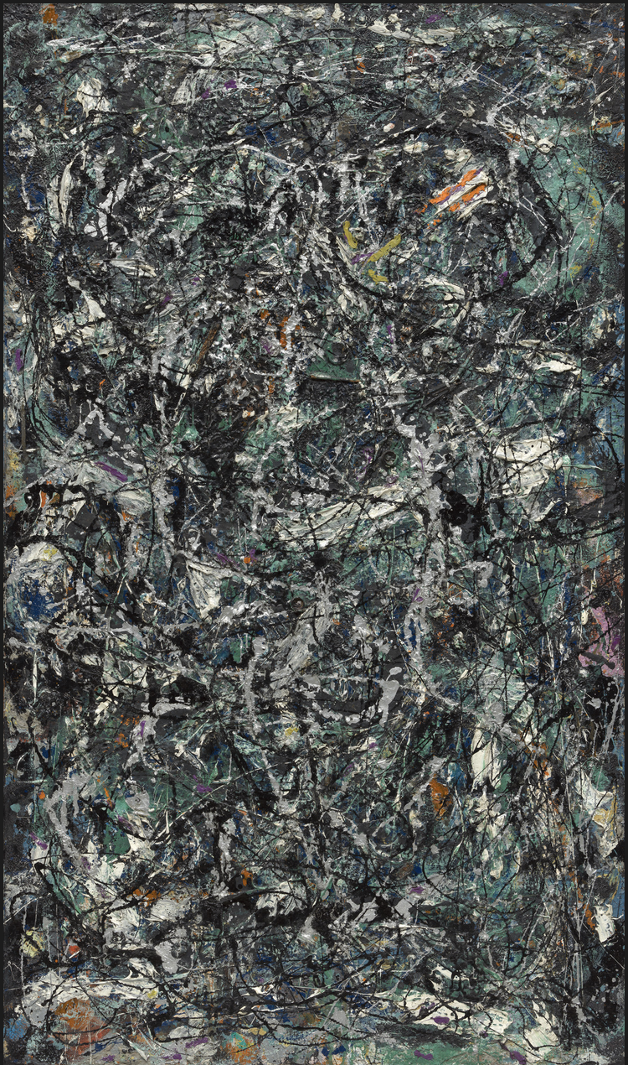
Full Fathom Five, Jackson Pollock, Oil on canvas with nails, tacks, buttons, key, coins, cigarettes, matches, etc., 1947, The Museum of Modern Art

Slide 4
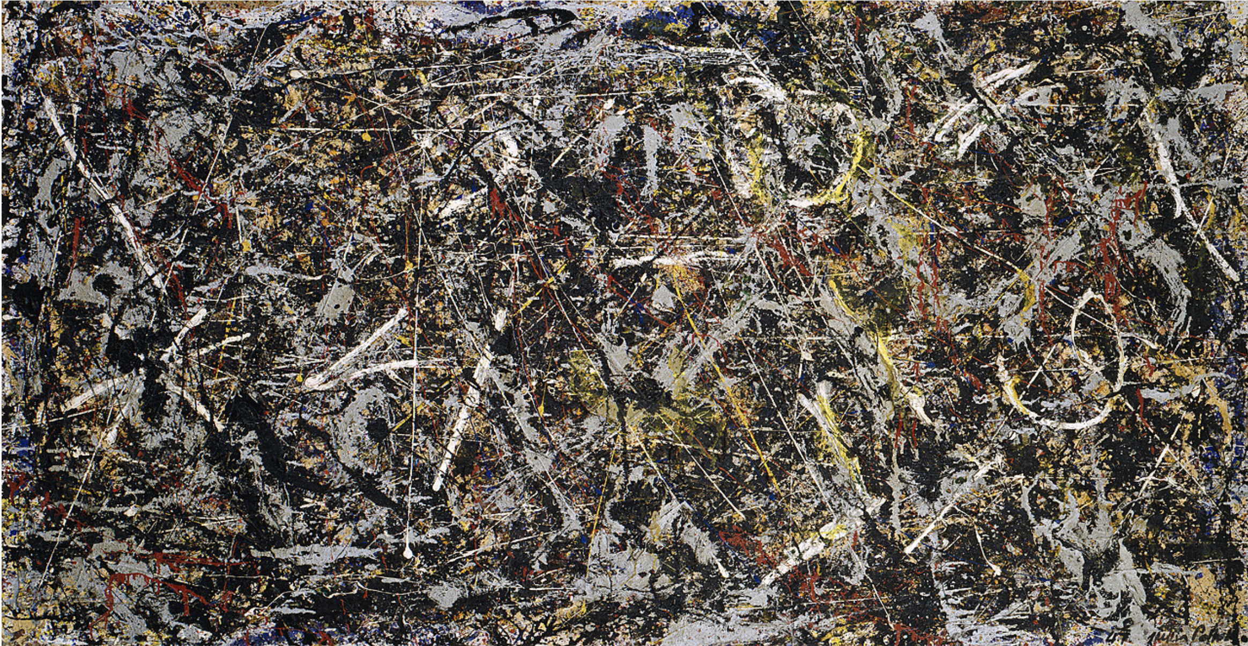
Alchemy, Jackson Pollock, Oil, aluminum, alkyd enamel paint with sand, pebbles, fibers, and wood on commercially printed fabric, 45 1/8 x 87 1/8 inches, 1947,
The Solomon R. Guggenheim Foundation, Peggy Guggenheim Collection.

Slide 5
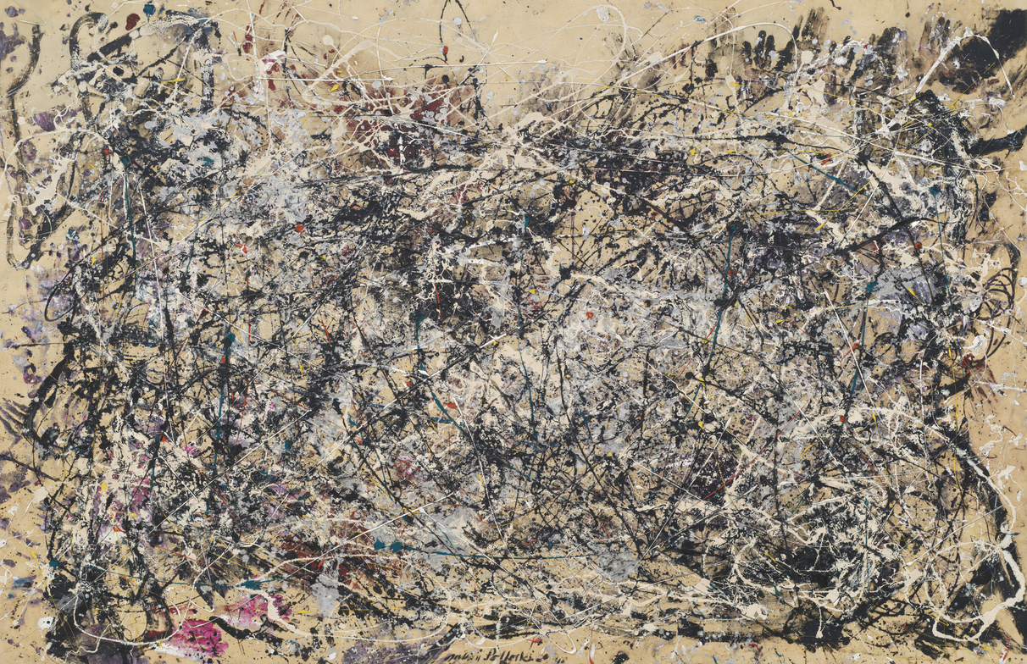
Number 1A, Jackson Pollock, Oil and enamel paint on canvas, 1948, The Museum of Modern Art

Slide 6
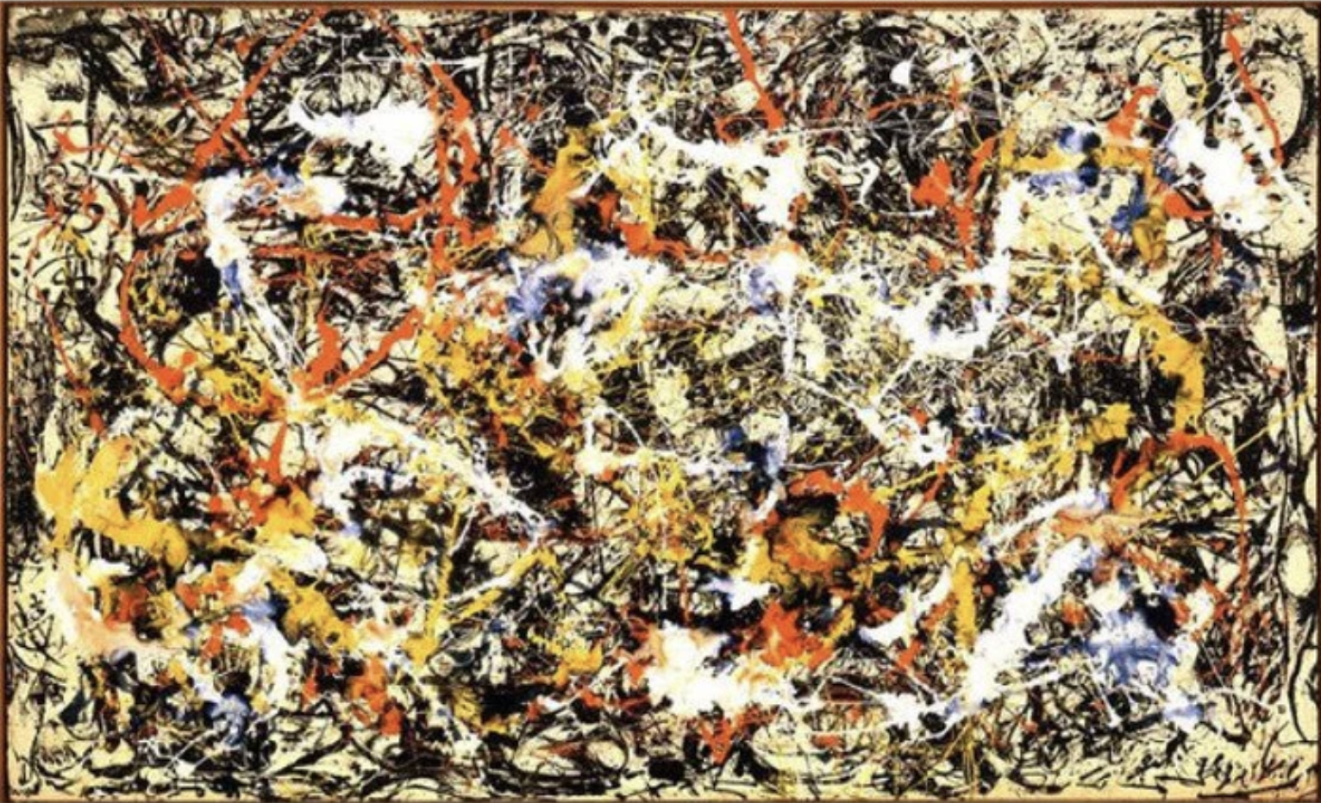
Convergence, Jackson Pollock, Oil on canvas, 1952, 93 1/2 x 155 inches, Collection Albright-Knox Art Gallery, Buffalo, New York.

Slide 7
Guignon, Charles B. 1998. “Existentialism” doi:10.4324/9780415249126-N020-1. Routledge Encyclopedia of Philosophy, Taylor and Francis, https://www.rep.routledge.com/articles/thematic/existentialism/v-1.
Merleau-Ponty, Maurice. 1993. “Cézanne’s Doubt” in The Merleau-Ponty Aesthetics Reader: Philosophy and Painting. Edited by Michael B. Smith. Evanston, Illinois: Northwestern University Press. [1945]
Merleau-Ponty, Maurice. 1994. “Eye and Mind” in Art and Its Significance, 3rd ed. Edited by Stephen David Ross. Albany: State University of New York Press. [1961]
Bibliography

