Slide 1
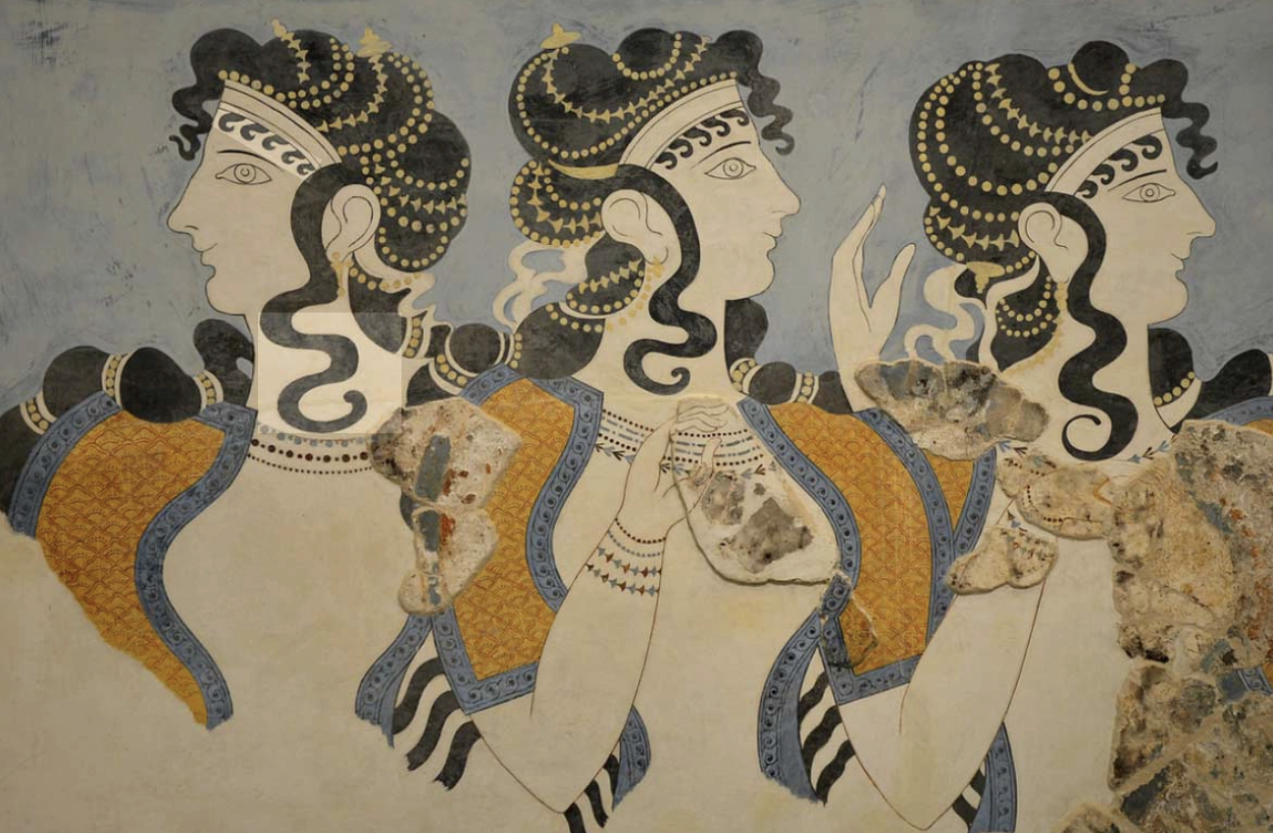
Nine Principles for a Matriarchal Aesthetic
Heide Göttner-Abendroth

Slide 2
1] Art as magic: Art is a form of magic that can change psychic and social reality through the use of symbols, unlike traditional art which is seen as fictional.
“Matriarchal art is located beyond the fictional, both in the past and in the present. Beyond the fictional art becomes magic. Magic intrudes into reality by means of symbols and has the effect of changing reality. Ancient matriarchal art tried to influence nature and to change it by using magic (ancient magic): modern matriarchal art attempts to change psychic and social reality using magic (modern magic)” (1994: 566).

Slide 3
2] Mythological framework: It operates within the predetermined framework of matriarchal mythology, representing "diversity in unity".
“Matriarchal art has an enduring and predetermined framework: the structure of matriarchal mythology. This structure is universal as it is the basic pattern of all mythologies and all the later religions which developed from them. It is one of the fundamental objective categories of the human imagination. [. . .] Each matriarchal society gave to the structure of it matriarchal mythology (religion, rituals, ways of living) a different reality. The result is that its concrete forms are as varied as the regional, individual and social conditions of those who created them. Matriarchal art which derives from the structure of matriarchal mythology is therefore diversity in unity, in which the unity is not dogmatic, the diversity not subjective” (1994: 566-567).

Slide 4
3] Collective participation: It transcends traditional communication, with all participants acting as both authors and spectators.
“Matriarchal art transcends the traditional mode of communication which consists of: author-text (art product)-reader. Matriarchal art is not ‘text’, it is not limited to manufacturing art products. On the contrary, it is a process which gives a pre-existing inner structure, found in the ritual dance, external expression. It is a process in which all participate collectively to create this external expression. It is a process in which all participate collectively to create this external expression; all are simultaneously authors and spectators” (1994: 567).

Slide 5
4] Total commitment: It requires the total commitment of all participants, uniting thinking, feeling, and doing into a concrete mythological image.
“Matriarchal art demands the total commitment of all participants. As it does not recognize any divisions between author and audience in which the author creates the symbolic action and the audience (at the most) either identifies with it emotionally or contemplates it on a theoretical level (a patriarchal role division): in matriarchal art there is no division between emotion and thought. All participants operate simultaneously on the levels of emotional identification, theoretical reflection and symbolic action. [. . .] Matriarchal art welds together feeling, thinking and doing in the form of the concrete mythological image and it is this totality which releases true ecstasy in the participants” (1994: 567).

Slide 6
5] Inevaluability by outsiders: It cannot be evaluated or interpreted by outsiders and is not a commodity to be bought or sold.
“Matriarchal art does not correspond to an extended model of communication with the elements: author-text-dealer-agent-audience. The dealer (art market) and agent (critic, interpreter, translator from one medium into another, archivist, art historian, etc.) are redundant. As it is a process which takes place between the participants matriarchal art cannot be evaluated and interpreted by outsiders nor sold as a commodity on the art market and later stored away in a dusty archive or exhibited in a museum. For matriarchal art cannot be objectified; that is, turned into an object. It is a dynamic process characterized by ecstasy and with a positive impact on reality (magic)” (1994: 567-568).

Slide 7
6] Inseparability from life: It cannot be separated from social reality, as it is a complex process of social interaction.
“Matriarchal art cannot be subdivided into genres because it cannot be objectified. The ritual dance ceremony embraces music, song, poetry, movement, decoration, symbol, comedy and tragedy, all for the purpose of invoking, imploring, praising the goddess. The division between art and non-art is also redundant. One the one hand, matriarchal art breaks down the barrier between art and theory. In its ancient form, matriarchal art merges with mythology and astronomy; in its modern form with philosophy, the humanities, and with the natural world and social sciences” (1994: 568).

Slide 8
7] Resistance to commodification: It is not something to be commodified or stored away in a museum.
“As matriarchal art derives from the structure of matriarchal mythology which is a completely different value system—and not merely a reversed or contradictory one—from that of patriarchy, it too shares this different system of values. The erotic is the dominant force and not work, discipline, renunciation. The continuation of life as a cycle of re-births is it primary principle, and not war or heroic death for abstract, inhuman ideals. A sense of community, motherliness and sisterly love are the basic rules of the matriarchal society and not paternal authority, dominance of the husband, private and group egoism” (1994: 568).

Slide 9
8] Non-objectifiable nature: It is not an object that can be objectively evaluated; it is a dynamic process.
“The social changes which matriarchal art brings about override the divisions in the aesthetic sphere. In patriarchal societies aesthetics is divided into a formalist, elitist, socially effective art on the one hand, and a popular, widespread but socially vilified and outcast art on the other. Overcoming this division would return art to its original public role, allowing it to emerge as the most important social activity and bringing about the aestheticisation of the whole society. This was the reality of ancient matriarchal art; modern matriarchal art attempts to achieve it once again” (1994: 568).

Slide 10
9] Genre transcendence: It breaks down the barriers between genres because it cannot be objectified.
“Matriarchal art is not ‘art’. For ‘art’ is necessarily defined in terms of the fictional; the principle of fictionality is the primary principle of every patriarchal theory of art (aesthetics). ‘Art’ is a concept and in its form as object has only existed since the aesthetic sphere was divided. ‘Art’ is therefore always artificial or denatured art. Matriarchal art is independent of the fictional and is therefore not ‘art’ in the patriarchal sense of the word. Nor does it require any technical know-how. It is rather the ability to shape life and so change it; it is itself energy, life, a drive toward the aestheticisation of society. It can never be divorced from complex social action because is is itself the center of that action” (1994: 569).

