Slide 1

“The postmodern would be that which, in the modern, puts forward the unpresentable in presentation itself; that which denies itself the solace of good forms, the consensus of taste which would make it possible to share collectively the nostalgia for the unattainable; that which searches for new presentations, not in order to enjoy them but in order to impart a stronger sense of the unpresentable. A postmodern artist or writer is in the position of a philosopher: the text he writes, the work he produces are not in principle governed by preestablished rules, and they cannot be judged according to a determining judgment, by applying familiar categories to the text or to the work. Those rules and categories are what the work of art itself is looking for. The artist and the writer, then, are working without rules in order to formulate the rules of what will have been done” (Lyotard 1994, 563-64).
Postmodernism
French philosopher Jean-François Lyotard famously described Postmodernism as the “incredulity towards metanarratives.”
Derrida Queries De Man
Oil on canvas, Mark Tansey, 1990
Collection of Mike and Penny Winton

Slide 2
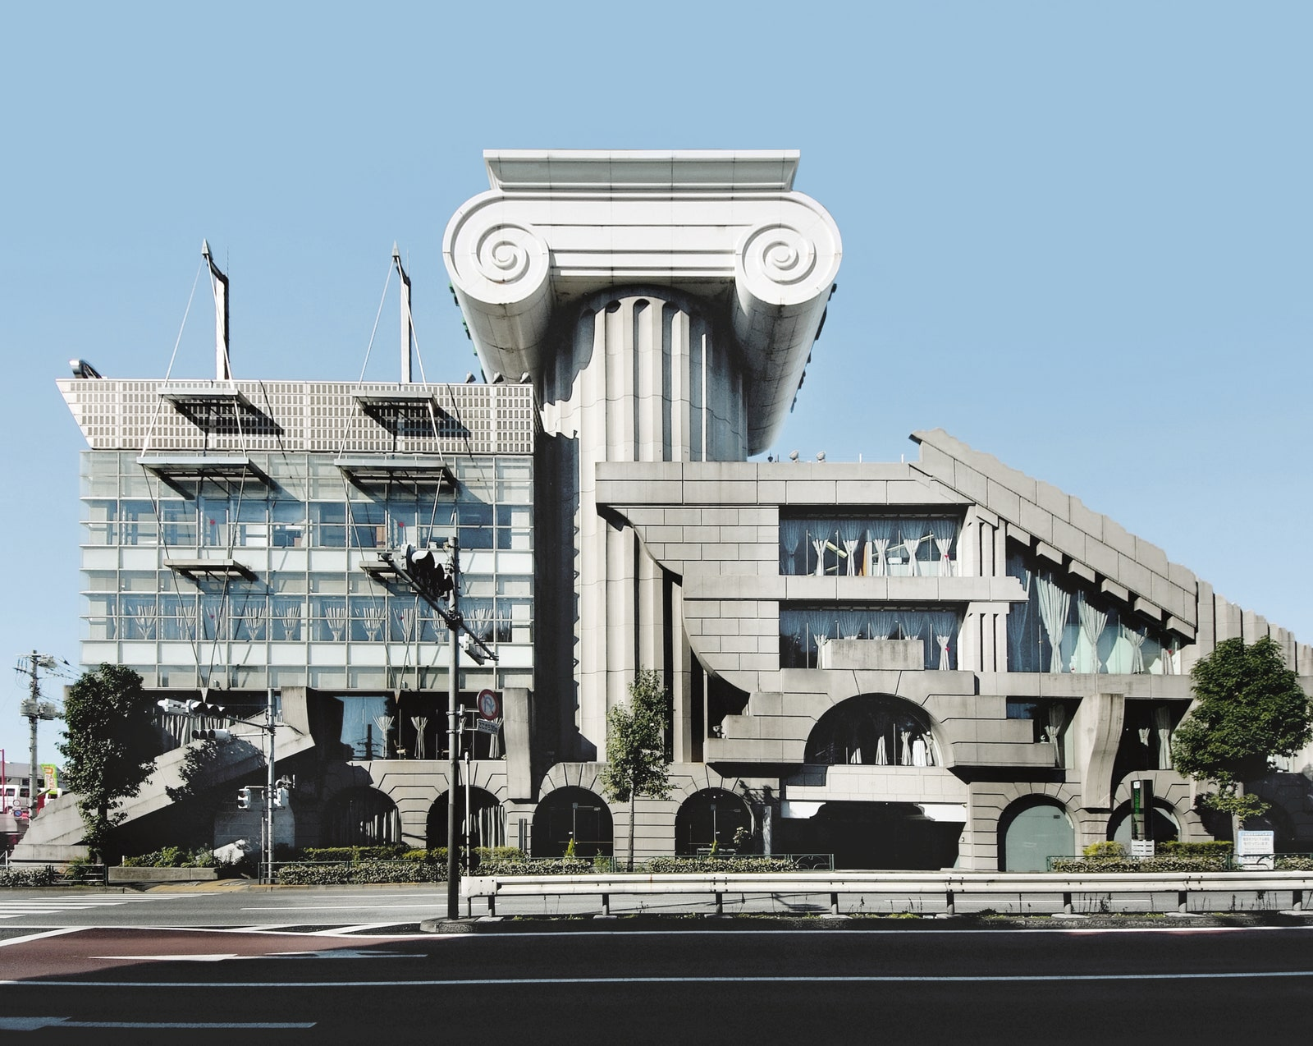
Cultural theorist and architectural historian Charles Jenks was instrumental in popularizing the term ‘postmodern’ in reference to architecture.
Postmodernism
In his essay ”What is Post-Modernism?” Jenks notes the confusion surrounding the term: “The growth of Post-Modernism has followed a sinuous, even tortuous, path. Twisting to the left and then to the right, branching down the middle, it resembles the natural form of a spreading root, or a meandering river that divides, changes course, doubles back on itself and takes off in a new direction. Its meaning is still in dispute not only because of this change but also because it signifies two quite different traditions to writers, philosophers and artists. Seen as progressive in some quarters, it is damned as reactionary and nostalgic in others: supported for its social and technical realism, it is also accused of escapism. Even, at times, when it is being condemned to its schizophrenia this ‘failing’ is turned, by its defenders, into a virtue” (Jenks 1986, 1).
M2 Building by Kengo Kuma, 1991
Tokyo, Japan

Slide 3
Main Features of Philosophical Postmodernism
1) a critique of the traditional notion of truth
that this kind of truth is at all attainable
at least the idea of the naked truth
a truth that reveals to us how things are in themselves
postmodernism really begins with a radicalization of Kant’s
recognition that we cannot have unmediated access to things themselves, to brute facts
language is thus not constrained by an extra-linguistic world
language is thus a ‘play of signs’
in which we creatively construct a world we mistakenly believe to be a world of brute reality
Nietzsche’s perspectivism in which the world that concerns us is a fiction
a product of the Apollonian drive to find order within chaos
Derrida’s critique of the ‘metaphysics of presence’ and ‘myth of logocentrism’
which is a critique of the idea that reality itself, real objects, real meaning, can be directly present to us

Slide 4
Main Features of Philosophical Postmodernism
2) Postmodernism is also critical also of the idea of “human nature” as something that is shared by all human beings and which affords them the capacity to be rational
human nature is not something given but the product of historical and cultural developments
the individual is historically and socially constituted
rationality is thus not a natural endowment, but a historically and culturally constructed achievement
appeals to reason and rationality are not then appeals to some neutral, widely shared common ground, but is rather the product of the common human desire to control others
‘reason’ is but an instrument in the battle for power

Slide 5
Main Features of Philosophical Postmodernism
3) For the postmodernist, then, there are no foundational truths, no sets of privileged, rationally unassailable propositions, on which our insights and understandings are based.
Nieztsche’s ‘death of God’ is thus the beginning of postmodernism.
Our understandings, or ‘truths’ in the more modest sense of Nietzsche’s perspectivism, are the products of a historical process, a process which is often hidden and not acknowledged or seen by the knower.
There is thus no neutral common ground or standpoint from which an objective evaluation of competing views can be undertaken.
We do not have an unbiased insight into the nature of things.
This is what Lyotard meant by the “incredulity toward metanarratives.”

Slide 6
Motivations for Philosophical Postmodernism
An almost sentimental yearning for community
an emphasis on community versus radical individualism of modernity
hostility to Enlightenment notion of individual autonomy
this yearning for community begins with Hegel, who mourns the fragmentation of the community
Hegel thus begins the critique of the Enlightenment
The Hegelian line of thought leads one to recognize the historicity of the knowing subject,
the perspectivism of the knower as Nietzsche emphasized

Slide 7
Motivations for Philosophical Postmodernism
2) emphasis on the philosopher as artist
Thus Nietzsche is the first full-blown philosophical postmodernist. In the early essay “On Truth and Lie in an Extra-moral Sense” there is the well known passage in which truth is described as nothing more than metaphors:
What then is truth? A movable host of metaphors, metonymies, and anthropomorphisms: in short, a sum of human relations which have been poetically and rhetorically enhanced, transferred, and embellished, and which, after long usage, seem to a people to be fixed, canonical, and binding. Truths are illusions which we have forgotten are illusions; metaphors that have become worn out and have been drained of sensuous force, coins which have lost their embossing and are now considered as metal and no longer as coins. (Nietzsche ” 84)
Nietzsche thus rejects absolute notions of reason, knowledge, and morality
these are only man-made “idols”
“there are thus no absolute facts, no truth, objective values, rationality, and knowledge” what we regard as such is relative to our interests, to our perspectives.

Slide 8
Postmodernism and Philosophy of Art
The conflict between modernism and postmodernism underlies many of the more hotly contested issues in contemporary philosophy of art.
Theory of interpretation:
modernism: for any work of art there is and must be a single true interpretation.
postmodernism: there is no one true interpretation.
Evaluation of works of art:
modernism: a work of art can be genuinely good and it can have intrinsic formal properties that make it so (refers to Bell’s theory of significant form)
postmodernism: artistic merit is a function of historical and cultural circumstance; what makes a work of art ‘good’ or ‘beautiful’ is not a set of intrinsic features of the work, but historically derived values and conventions of a particular culture.

Slide 9
Postmodernism and Philosophy of Art
Ontology of art:
modernism: art exists independently of cultures and times; art transcends history; clear boundaries between art and life, between art and non-art
another way to put this: modernism holds that there is an essence to art, an essence that enables one to answer the Socratic question with regard to art—to have a definition of that essence that would enable one to clearly distinguish what is art from what is not, and, furthermore, what is good or ‘fine’ art as opposed to popular art
postmodernism: no intrinsic features that distinguish art from non-art
the Socratic question cannot be posed to art—there is no essence to art, thus no way other than the historical conventions of a particular artworld for distinguishing between art and non-art, ‘fine’ and popular art

Slide 10
Postmodernism and Philosophy of Art
The role or function of art:
modernism: some modernists view art as a self-contained autonomous phenomenon [the heirs of Kant’s notion of the aesthetic as an independent autonomous realm] and thus is not to be appreciated in terms of its instructive functions [does not have cognitive value]; in other words, what we can learn from art is incidental to its functions as art. Some modernists argue that art may have a cognitive function, and thus cognitive content is integral to its value as art—but its powers of instruction are limited.
postmodernism:
human cognition (or knowledge) is shaped by art, by human cultural products in general, and thus it is impossible to reach beyond the dominant narratives, texts, discourses, or ‘vocabularies’ to some supposed independent reality against which we can judge the truth or adequacy of knowledge.
The perennial problems of the philosophy of art—the identification of art, the interpretation and evaluation of art, whether or not art has cognitive content, problems about the perception of works of art, and the ways in which works of art exist—all are shaped by this divide between modernism and postmodernism.

Slide 11

Postmodern Art
What is the connection between postmodern philosophy and postmodern art?
Modernism in art: works of art are individual, unique, objects of beauty created by imaginative endeavors of highly talented individuals.
the idea of genius prevails in modern art: some natural brilliance that enables those with outstanding talent to create original works of art.
High Modernism: the essence of the visual and musical arts resides in their formal properties [Bell’s theory of significant form]
postmodernist art begins with an assault on the modernist boundaries of art
a refusal to see art as purely formal and as distinct from life
willingness to appropriate ready-made objects
Dadaism as the first postmodernist art movement
Fountain
Ready-made, Marcel Duchamp, 1917
Tate Museum of Art, London

Slide 12
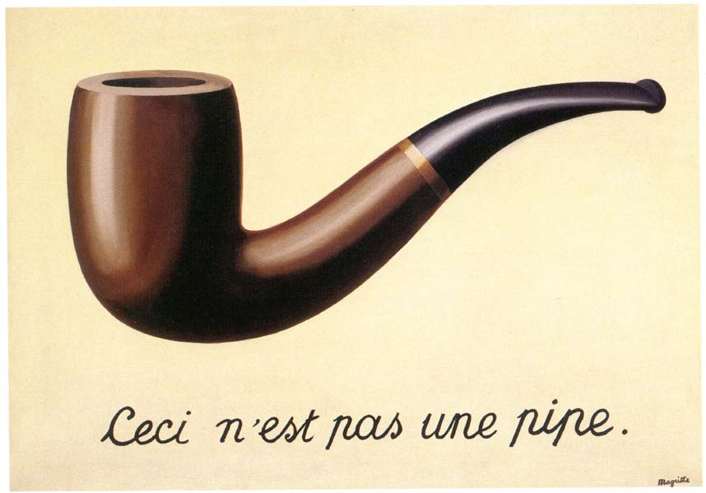
Postmodern Art
French postmodern philosopher Michel Foucault
finds the surrealist painting of René Magritte as indicators of 20th century thought.
According to Foucault two principles have ruled Western painting from the 15th to 19th centuries.
1) words and images have usually been kept distinct, and when they have been both present words were subordinated to images in artistic importance
2) whenever a painted image resembled an object in the world, the image usually served to direct the viewer’s attention outside the painting to the objects represented.
Foucault argues that Magritte’s The Treason of Pictures subverts these assumptions.
The Treason of Pictures
René Magritte, 1929

Slide 13

Untitled
Jean-Michel Basquiat, 1982

Slide 14
Jenks, Charles. 1986. “What is Post-Modernism?” New York: St. Martin's Press. Lyotard, Jean-François. 1994. “What is Postmodernism?” in Art and Its Significance, 3rd ed. Edited by Stephen David Ross. Albany: State University of New York Press. [1984] Nietzsche, Friedrich. 1954. “On Truth and Lie in the Extra-Moral Sense” in The Portable Nietzsche, edited and translated by Walter Kaufmann. New York: Viking Press. [1873]
Bibliography

