Slide 1
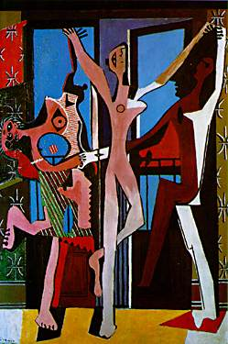
Pablo Picasso, The Three Dancers. 1925.
Oil on canvas, 215 x 142 cm.
Tate Gallery, London

Slide 2
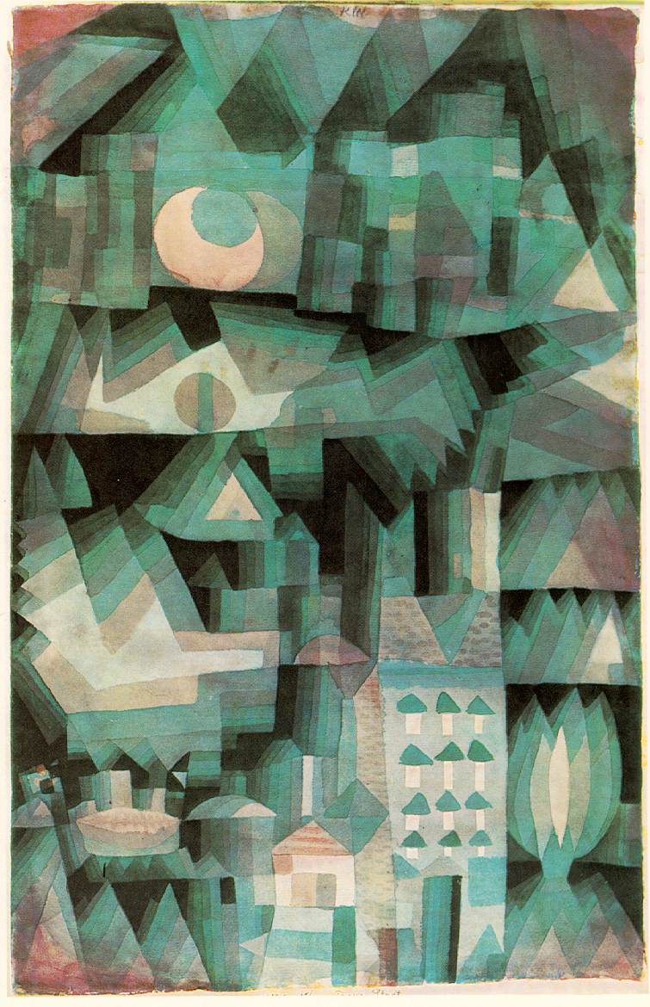
Paul Klee. Dream City. 1921.
Watercolor and oil, 18 7/8 x 12 1/4 in.
Private collection

Slide 3
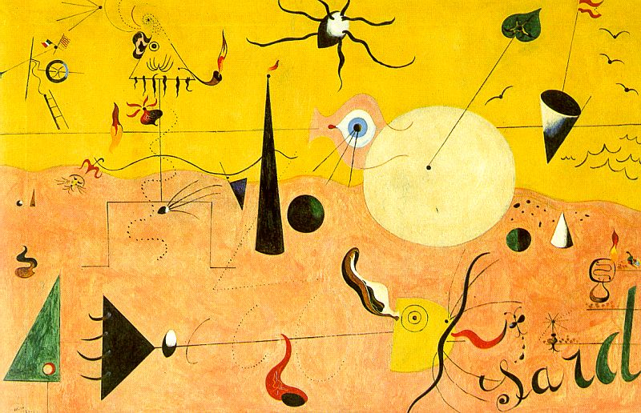
Joan Miro. Catalan Landscape: The Hunter. 1923-24.
oil on canvas

Slide 4
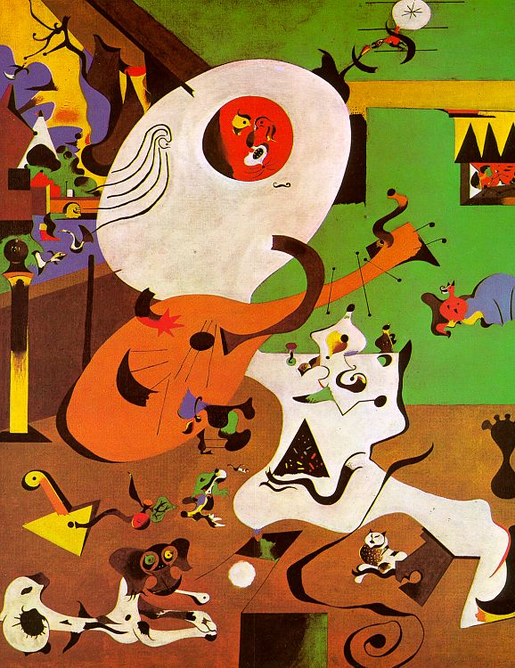
Joan Miro. Dutch Interior I. 1928.
oil on canvas.

Slide 5
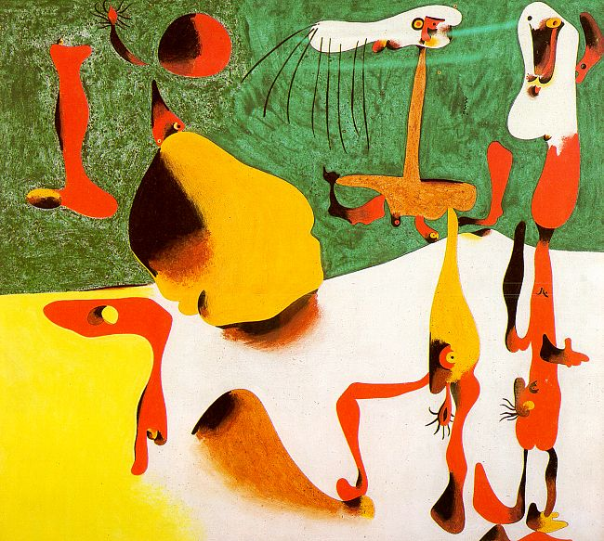
Joan Miro. Personages in the Presence of a Metamorphosis. 1936.
egg tempera on masonite, New Orleans Museum of Modern Art.

Slide 6
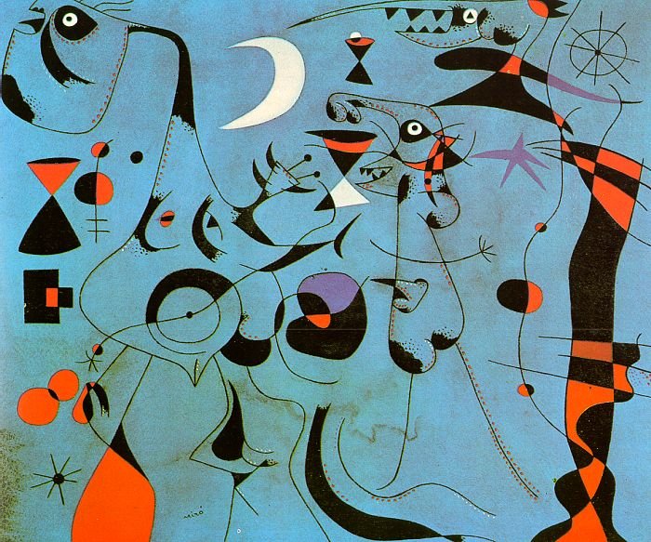
Joan Miro. Personages in the Night Guided by the Phosphorescent Tracks of Snails, 1940.
gouache & turpentine paint on paper, private collection.

Slide 7
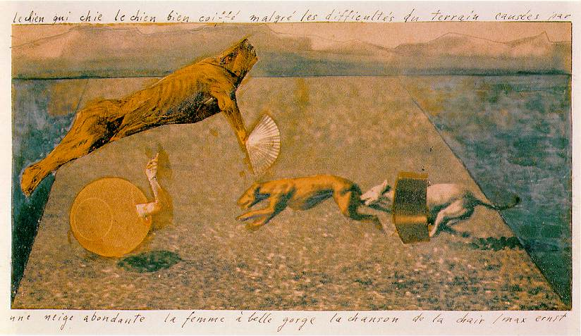
Max Ernst. The Song of the Flesh. 1920.
Collage with fragments of photographs, gouache and pencil on card. 12 x 21 cm.
Musee National d'Arte Moderne, Centre Georges Pompidou, Paris

Slide 8
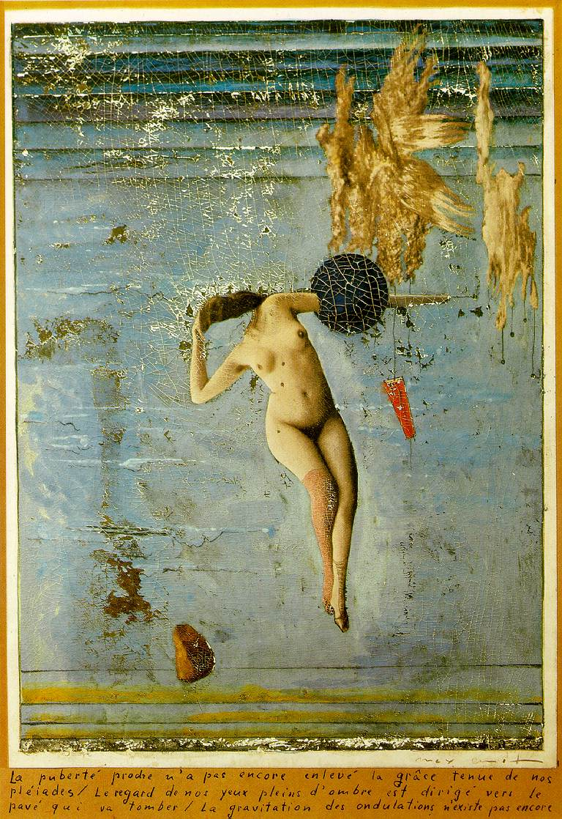
Max Ernst.
Approaching Puberty or The Pleiads. 1921.
Gouache and oil on paper, all on cardboard. 24.5 x 16.5 cm.
Rene Rasmussen Collection, Paris

Slide 9
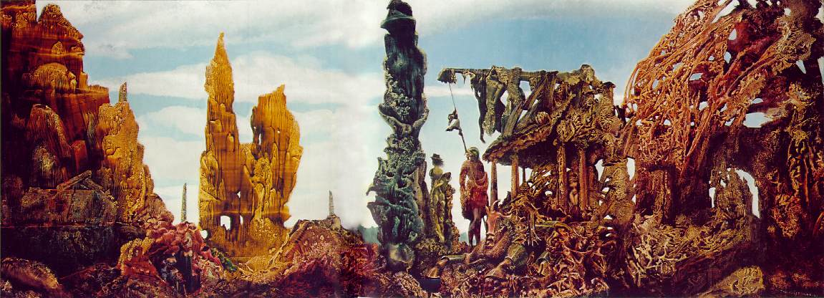
Max Ernst. Europe After the Rain. 1940-42.
Oil on canvas, 54.8 x 147.8 cm.
Wadsworth Atheneum, Hartford, CT

Slide 10
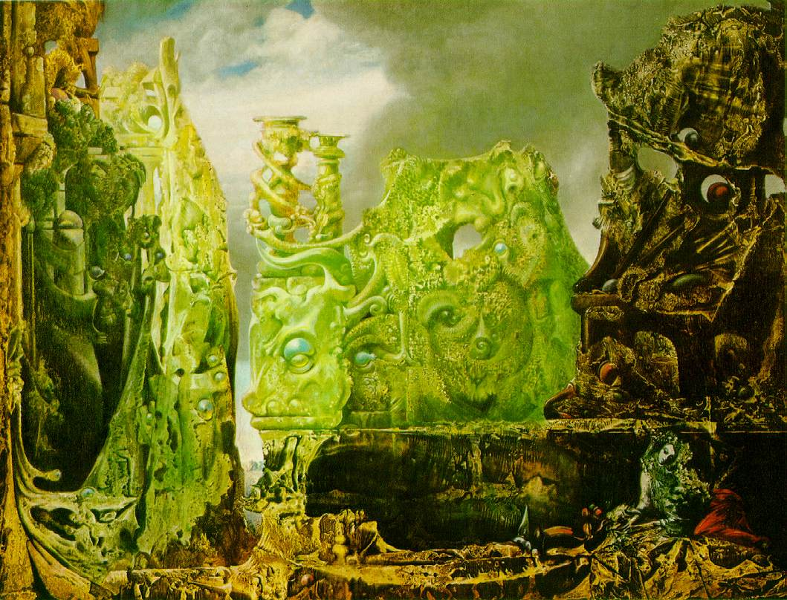
Max Ernst. The Eye of Silence. 1943/44.
Oil on canvas, 108 x 141 cm.
Washington University Art Gallery, Saint Louis, MO

Slide 11
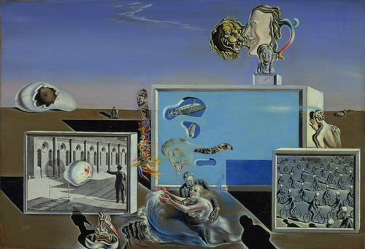
Salvador Dalí. Illumined Pleasures. 1929.
Oil and collage on composition board, 9 3/8 x 13 3/4" (23.8 x 34.7 cm).
The Sidney and Harriet Janis Collection.
The Museum of Modern Art, New York

Slide 12
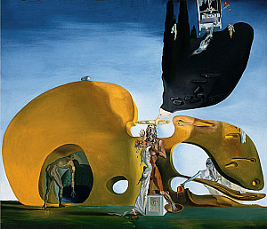
Salvador Dali. Birth of Liquid Desires. 1931–32.
Oil and collage on canvas, 37 7/8 x 44 1/4 inches (96.1 x 112.3 cm).
The Solomon R. Guggenheim Foundation, Peggy Guggenheim Collection, Venice

Slide 13
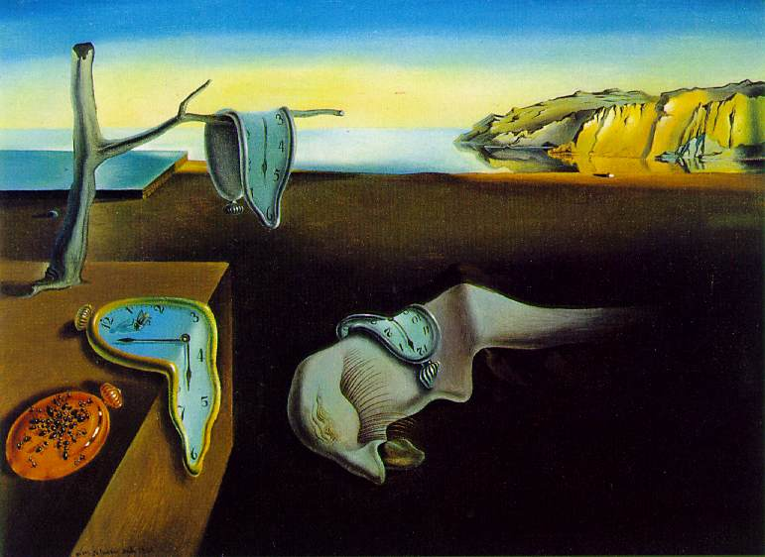
Salvador Dalí. The Persistence of Memory. 1931.
Oil on canvas, 24 cm × 33 cm (9.5 in × 13 in).
Museum of Modern Art, New York City

Slide 14
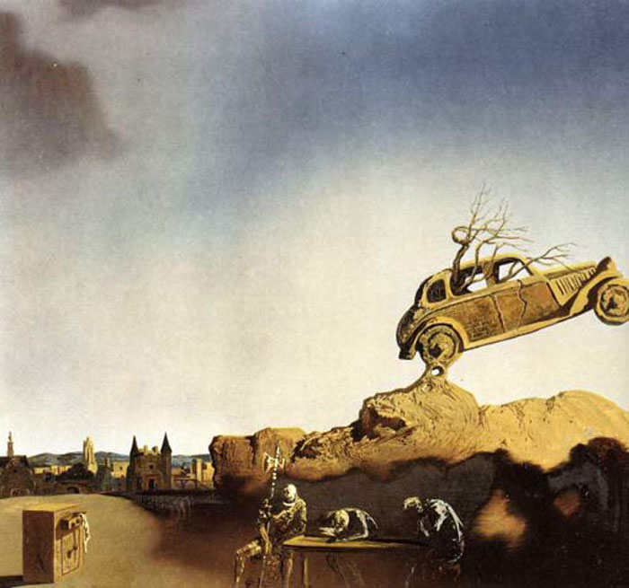
Salvador Dali. Apparition of the Town of Delft. 1936.
Oil on canvas

Slide 15
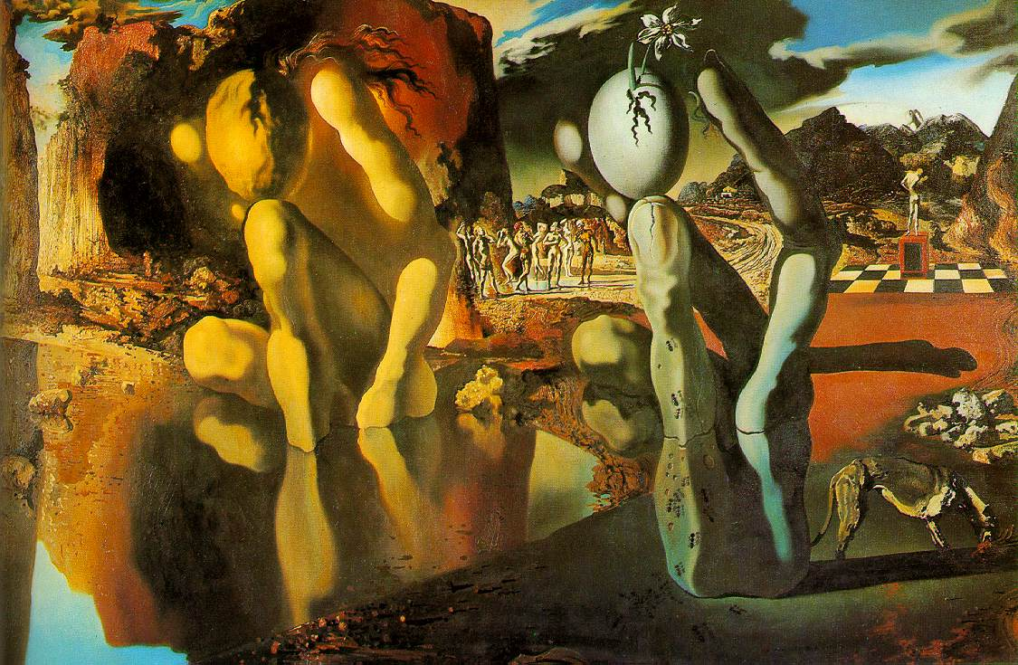
Salvador Dalí. Metamorphosis of Narcissus. 1937.
Oil on canvas, 51.1 cm × 78.1 cm (20.12 in × 30¾ in).
Tate Modern, London

