Slide 1
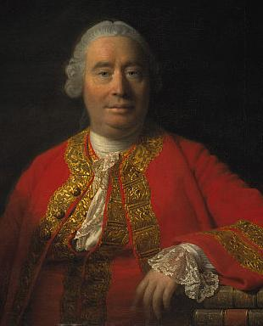
David Hume’s
Philosophy of Religion
David Hume
(1711-1776)

Slide 2
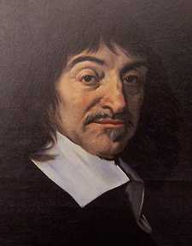
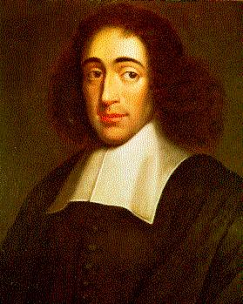
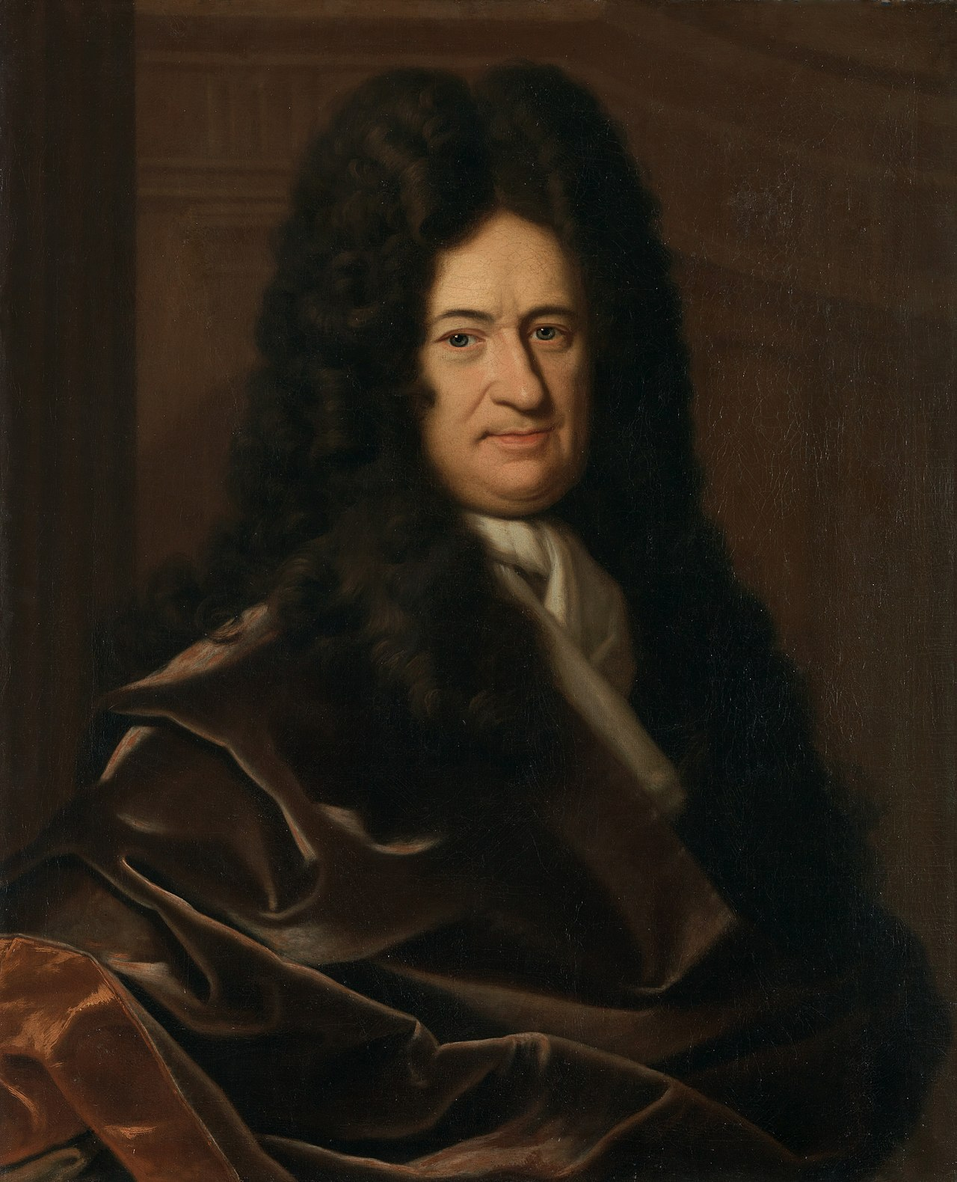
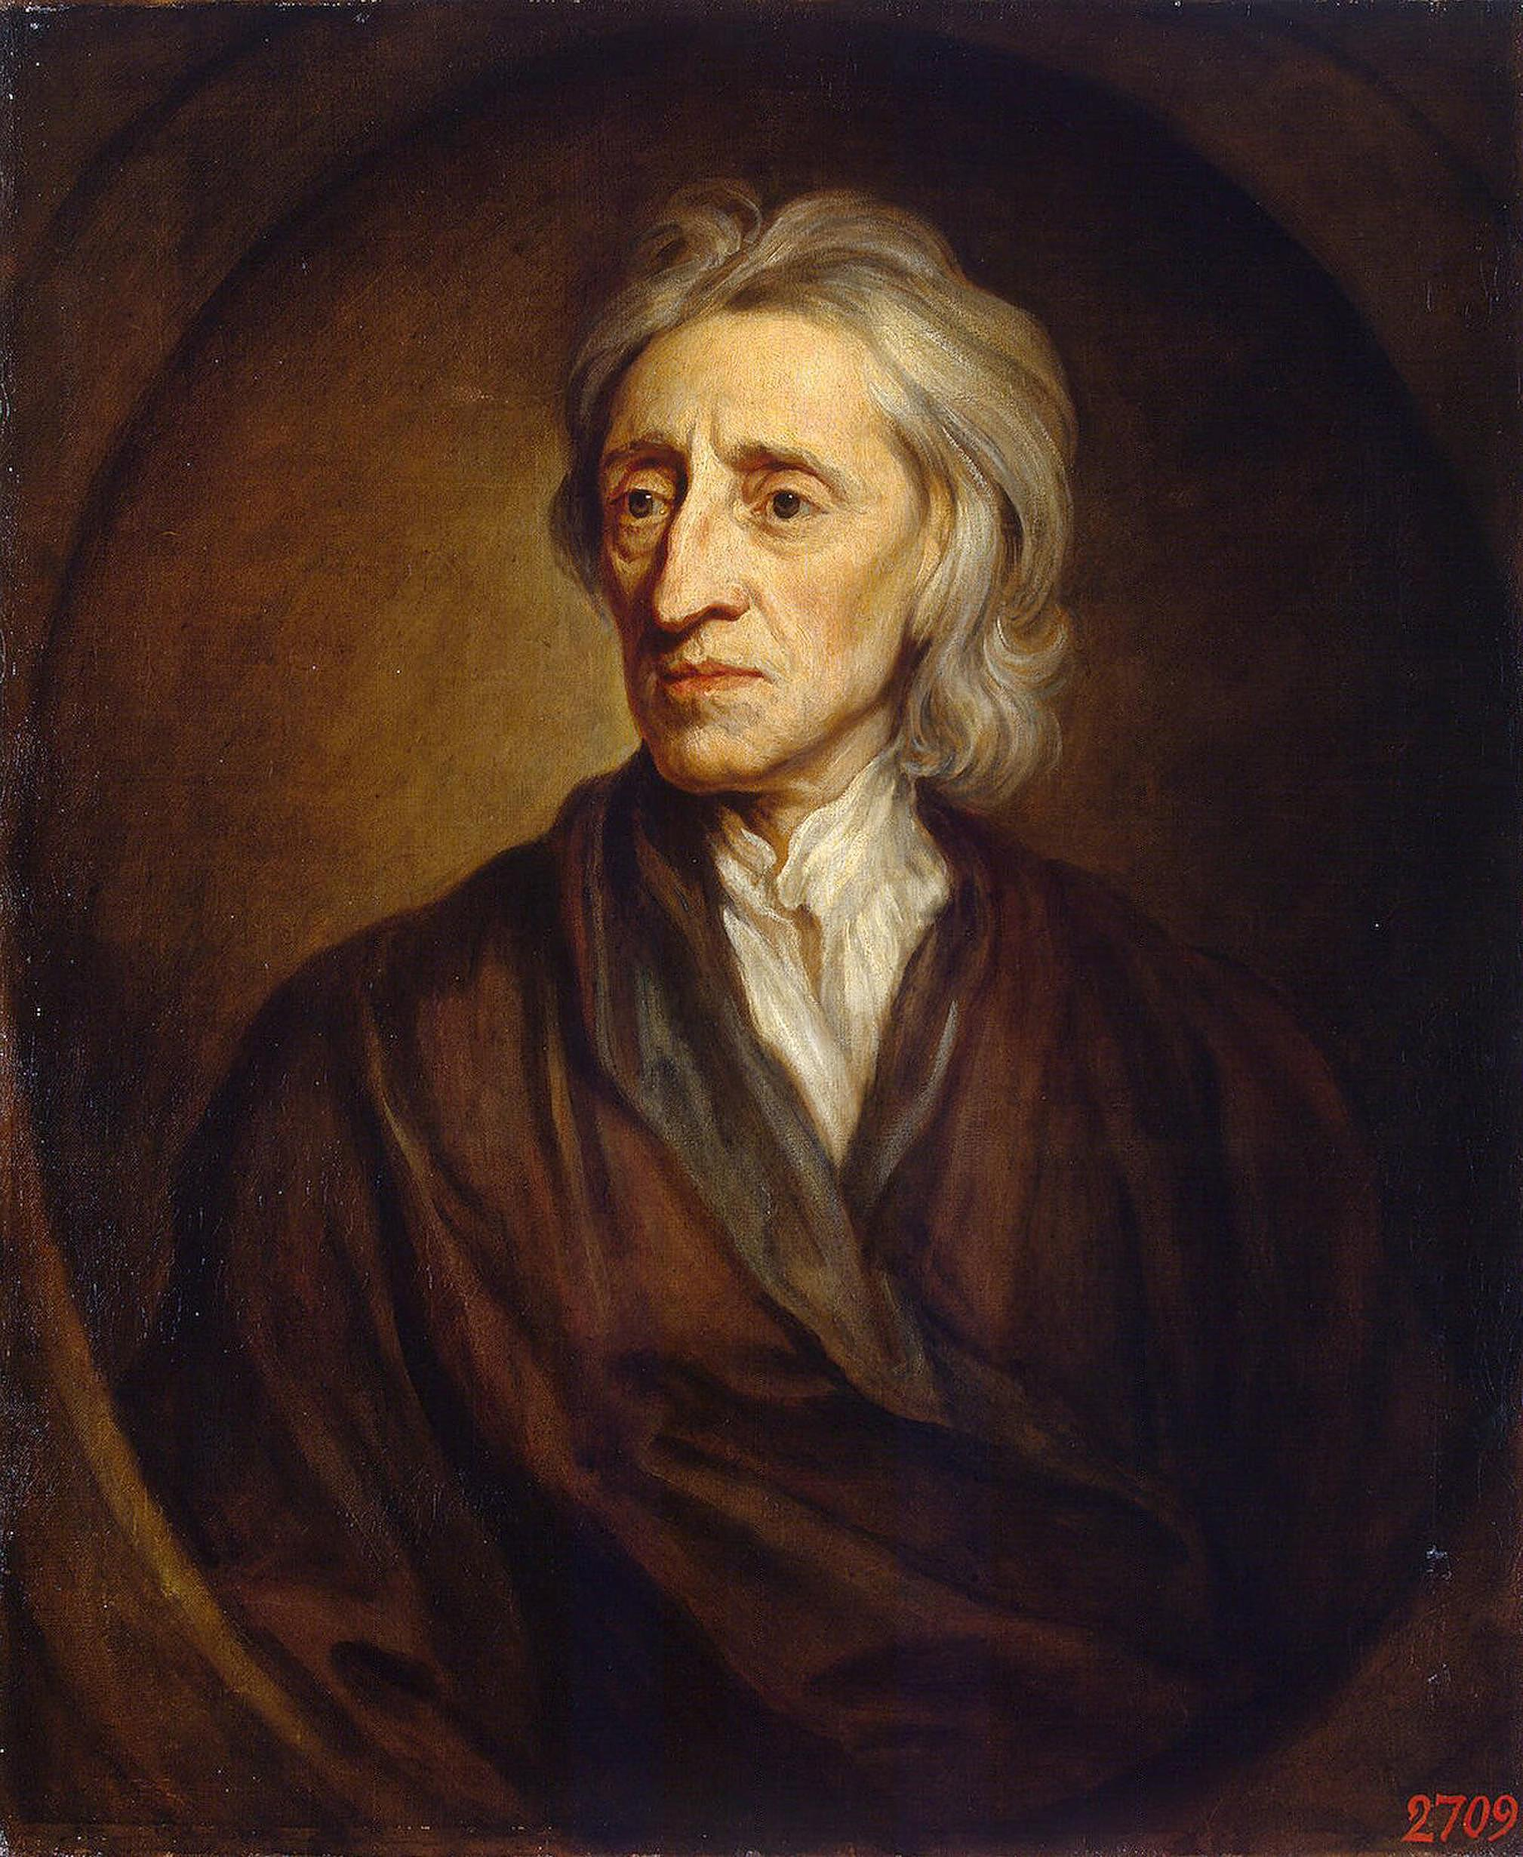
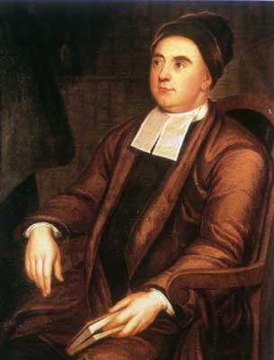
Modern Philosophy
Rationalism
Knowledge comes from Pure Reason
Empiricism
Knowledge comes from the Senses
René
Descartes (1596–1650)
France
Baruch
Spinoza
(1632–1677)
The Netherlands
Gottfried Leibniz (1646–1716)
Germany
John
Locke
(1632-1704)
England
George
Berkeley
(1685-1753)
Ireland
David
Hume
(1711-1776)
Scotland

Slide 3
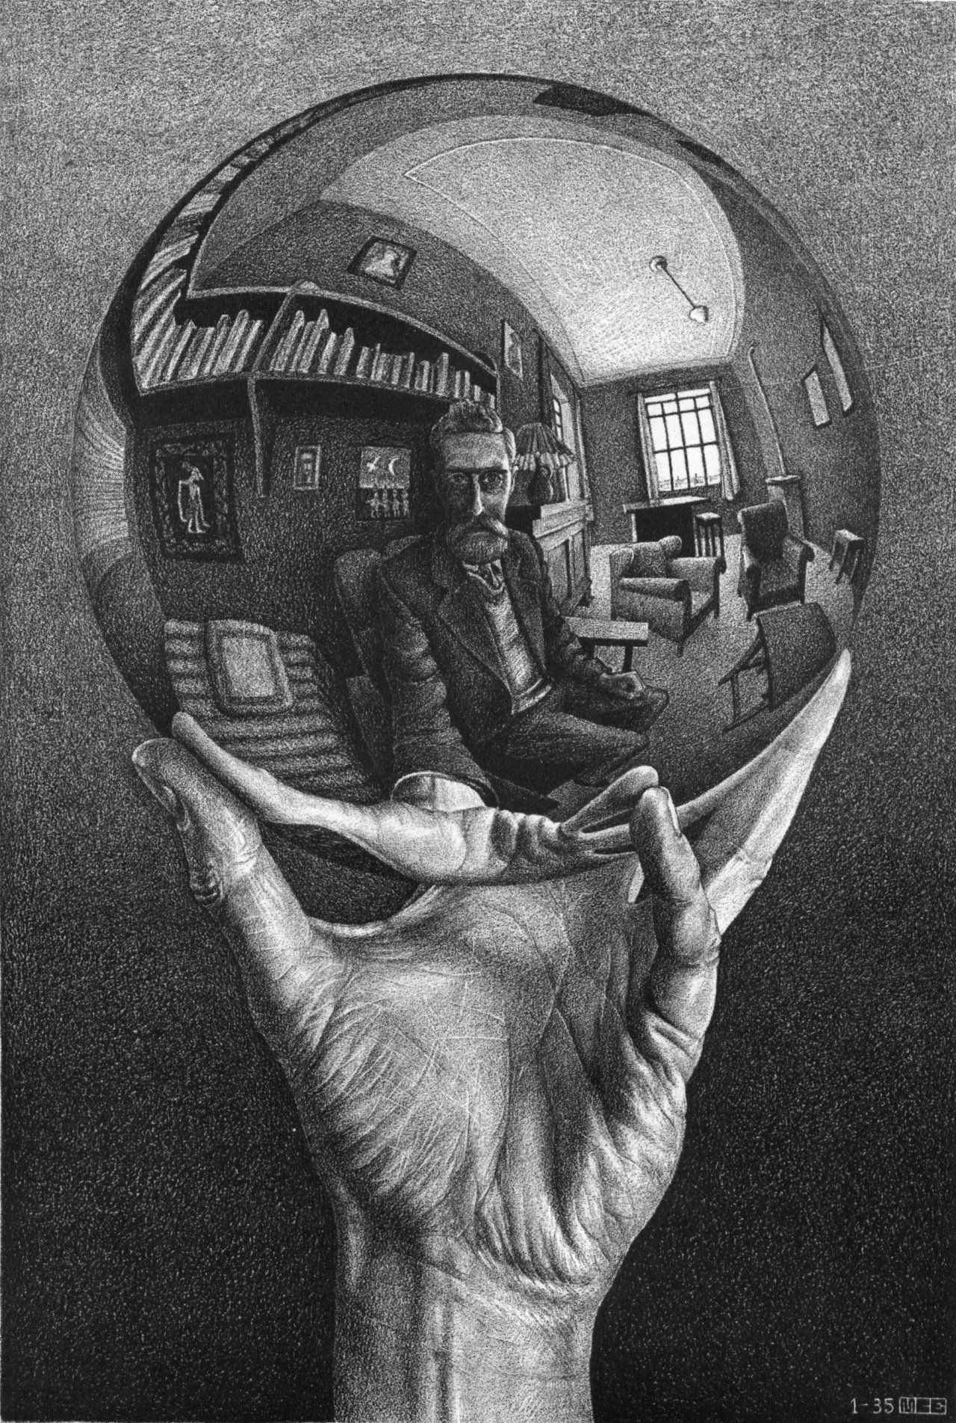
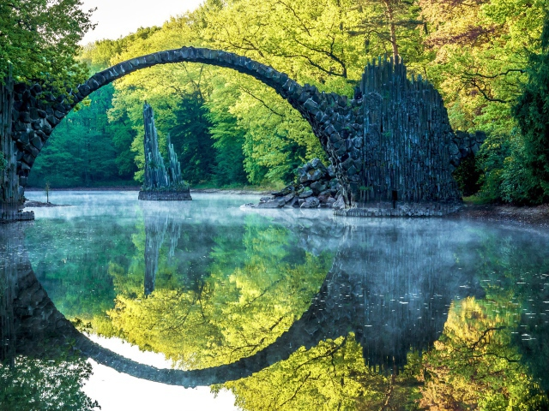
Mind as a Mirror of Nature
Mind
Thinking Substance
Ideas in Mind Reflect Reality
Nature/Reality as it is in-itself
Extended Substance

Slide 4
Hume’s Fork
All knowledge statements are of two kinds:
Relations of Ideas
True by definition
Certain truths
A priori truths
(No sense evidence needed)
All bachelors are unmarried men.
Matters of Fact
Not true by definition
Contingent (probable) truths
A posteriori truths
(require sense evidence)
All Swans are white

Slide 5
Hume’s Analysis of Causality
All cause and effect statements are matter of fact statements thus require sense evidence
What four things would you need sense evidence for in order to prove that event A was the cause of event B?

Slide 6
Hume’s Analysis of Causality
All cause and effect statements are matter of fact statements thus require sense evidence
What four things would you need sense evidence for in order to prove that event A was the cause of event B?
1. Temporal Priority (A happens then B happens)

Slide 7
Hume’s Analysis of Causality
All cause and effect statements are matter of fact statements thus require sense evidence
What four things would you need sense evidence for in order to prove that event A was the cause of event B?
1. Temporal Priority (A happens then B happens)
2. Spatial contiguity (There is a spatial connection between event A and event B)

Slide 8
Hume’s Analysis of Causality
All cause and effect statements are matter of fact statements thus require sense evidence
What four things would you need sense evidence for in order to prove that event A was the cause of event B?
1. Temporal Priority (A happens then B happens)
2. Spatial contiguity (There is a spatial connection between event A and event B)
3. Constant Conjunction (would have to see it many times)

Slide 9
Hume’s Analysis of Causality
All cause and effect statements are matter of fact statements thus require sense evidence
What four things would you need sense evidence for in order to prove that event A was the cause of event B?
1. Temporal Priority (A happens then B happens)
2. Spatial contiguity (There is a spatial connection between event A and event B)
3. Constant Conjunction (would have to see it many times)
4. Necessary connection (the next time that A happens, B will happen)

Slide 10
Dialogues Concerning Natural Religion
Philo’s Response to the Teleological Argument
My main reservation about what Cleanthes has said, Philo remarked, is not so much that he bases all religious arguments on experience as that his arguments seem not to be the most certain and unbreakable even of that inferior experience-based kind. That a stone will fall, that fire will burn, that the earth has solidity, we have observed thousands of times; and when any new instance of this sort is presented we don’t hesitate to draw the usual conclusion—this stone will fall, this fire will burn, the earth that I am about to put my right foot on is solid. The exact similarity of the cases gives us a perfect assurance of a similar outcome; and we never want or look for stronger evidence than that. But the evidence is less strong when the cases are less than perfectly alike; any reduction in similarity, however tiny, brings a corresponding reduction in the strength of the evidence; and as we move down that scale we may eventually reach a very weak analogy, leading to a conclusion that is confessedly liable to error and uncertainty. After having observed the circulation of the blood in human creatures, we have no doubt that it circulates in Titius and Maevius. But from its circulation in frogs and fishes it is only a presumption—though a strong one, from analogy—that blood circulates in men and other animals. The analogical reasoning is even weaker when we infer the circulation of the sap in plants from our experience that the blood circulates in animals; and those who hastily followed that imperfect analogy between plants and animals have been found by more accurate experiments to have been mistaken.
If we see a house, Cleanthes, we conclude with the greatest certainty that it had an architect or builder; because this is precisely the kind of effect that we have experienced as coming from that kind of cause. But surely you won’t say that the universe is so like a house that we can with the same certainty infer a similar cause, or that the analogy is here entire and perfect. The unlikeness in this case is so striking that the most you can offer ·on the basis of it · is a guess, a conjecture, a presumption about a similar cause; and I leave it to you to consider how that offering will be received in the world!

Slide 11
Dialogues Concerning Natural Religion
Philo’s Response to the Teleological Argument
This cautious proceeding of the astronomers implicitly condemns your argument, Cleanthes; or, rather, it points to the fact that the subject on which you are engaged exceeds all human reason and enquiry. Can you claim to show any such similarity between the structure of a house and the generation of a universe? Have you ever seen nature in a situation that resembles the first arrangement of the elements at the beginning of the universe? Have worlds ever been formed under your eye; and have you had leisure to observe the whole progress of world-making, from the first appearance of order to its final consummation? If you have, then cite your experience, and deliver your theory.

